Slide 1
Phonics and early reading ks1
welcome

Slide 2
A love of reading is the biggest indicator of future academic success.
OECD (The Organisation for Economic Co-operation and Development)
Notes:
Slide purpose:
To share the link that research has established between loving reading and being successful academically
Suggested script:
Let's start our session with a quote from the Organisation for Economic Co-operation and Development ...
Read the quote.
This quote reminds us of the importance not just of teaching children to read, but also of teaching them to love reading.
Today, we're going to talk about phonics, but we always see phonics as the route into reading and a love of reading as the ultimate goal of phonics teaching.

Slide 3
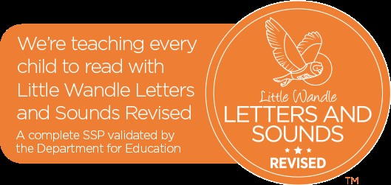
Little Wandle Letters and Sounds Revised
This starts in nursery and is taught to the children right up to the end of Y2.
Some KS2 children will access this program to support them with any gaps in their learning. This will be an intervention to plug gaps and to allow the child to fully access the National Curriculum.

Slide 4
Phonics is:
making connections between the sounds of our spoken words and the letters that are used to write them down.
Notes:
Slide purpose:
To provide a simple definition of phonics
Suggested script:
So what is phonics?
Read the slide.
It sounds complicated but it really isn’t!
Let's learn some important words that will help you understand phonics ...

Slide 5
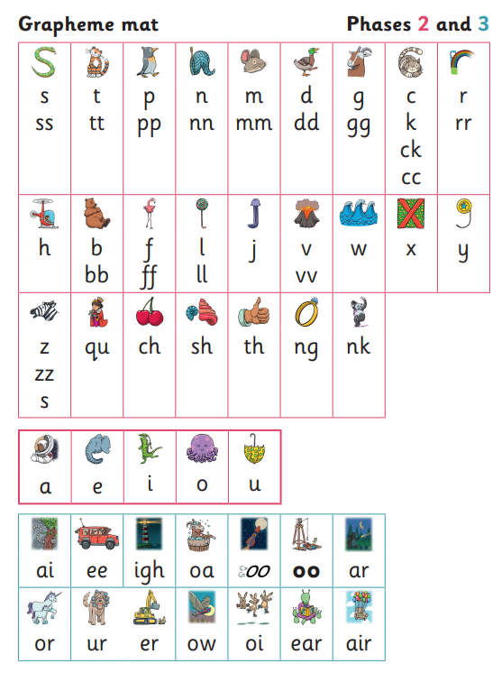
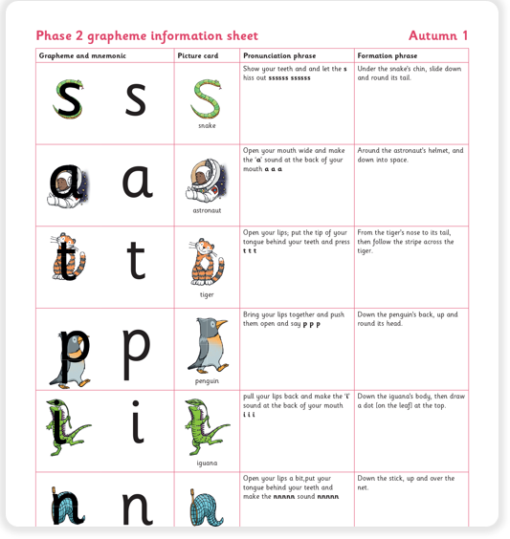
Reception
Phase 2, 3 and 4.
Letters and Sounds | A complete Phonics resource to support children (littlewandlelettersandsounds.org.uk)

Slide 6
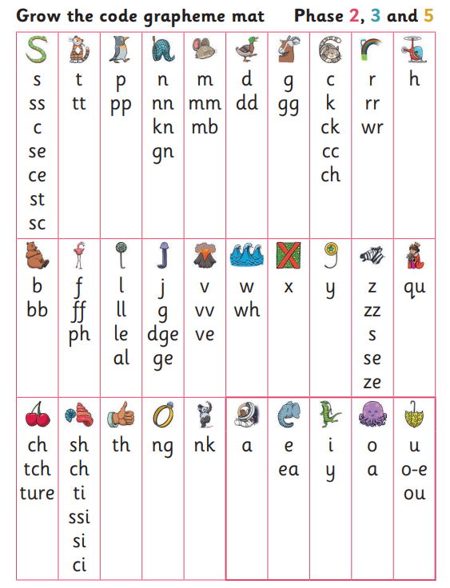
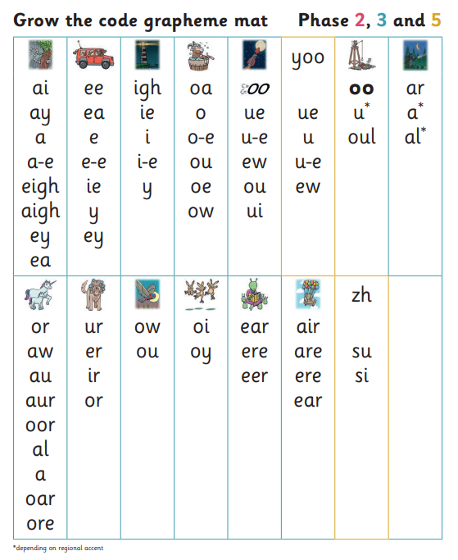
Year 1
Phase 5.
For parents – Letters and Sounds (littlewandlelettersandsounds.org.uk)

Slide 7
Children are taught to decode and blend to be able to read the word.
cat
. . .
runner
. . _ _
For parents | Letters and Sounds (littlewandlelettersandsounds.org.uk)

Slide 8
Year 2
Support for children who did not pass the phonic check in Y1.
Additional support with Rapid Catch Up to plug gaps in learning.
Support to develop fluency at a rate of 90 wpm or greater.

Slide 9
Reading in School
Decoding Prosody Comprehension

Slide 10

Reading at home

Slide 11

Books going home
Notes:
Slide purpose:
To introduce the process and format for reading at home
Suggested script:
As well as the ‘learning to read’ book that your child will bring home they will also bring home a book for sharing with you.
This shared book is SO important. This is how we are going to give them the WILL to read.
Please read with your child as often as you can – at least once a day if possible.

Slide 12
Listening to your child read their phonics book
Your child should be able to read their book without your help.
They might sound out words and blend them before they read them fluently.
If they can’t read a word, read it to them.
Talk about the book and celebrate their success.
Notes:
Slide purpose:
To give guidance on reading the decodable book at home
Notes
Read the slide.

Slide 13
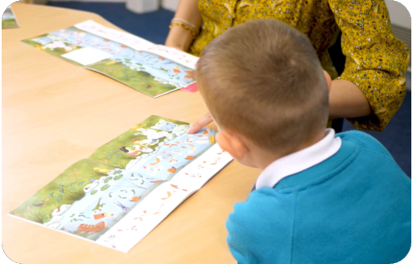
Reading a wordless books
Wordless books are invaluable as they teach reading behaviours and early reading skills to children who are not blending – yet!
Talk about the pictures.
Point to the images in the circles and find them on the page.
Encourage your child to make links from the book to their experiences.
Reading Wordless Books to Your Child - YouTube
Notes:
Slide purpose:
To give guidance on reading wordless books at home
Notes:
Read the slide.

Slide 14

Read to your child
The shared book is for YOU to read:
Make the story sound as exciting as you can by changing your voice.
Talk with your child as much as you can:
  Introduce new and exciting language.
  Encourage your child to use new vocabulary.
  Make up sentences together.
  Find different words to use.
  Describe things you see.
Notes:
Slide purpose:
To give guidance on reading the shared book at home
Notes:
Read the slide.

Slide 15

The most important thing you can do is read with your child
Reading a book and chatting had a positive impact a year later on children’s ability to…
understand words and sentences
use a wide range of vocabulary
develop listening comprehension skills.
The amount of books children were exposed to by age 6 was a positive predictor of their reading ability two years later.
Parental involvement in the development of children’s reading skills: A five-year longitudinal study (2002) Senechal, M. and Lefvre, J
Notes:
Slide purpose:
To summarise key takeaways
Suggested script:
Celebrate your child’s success at school.
Make time for reading at home!

Slide 16
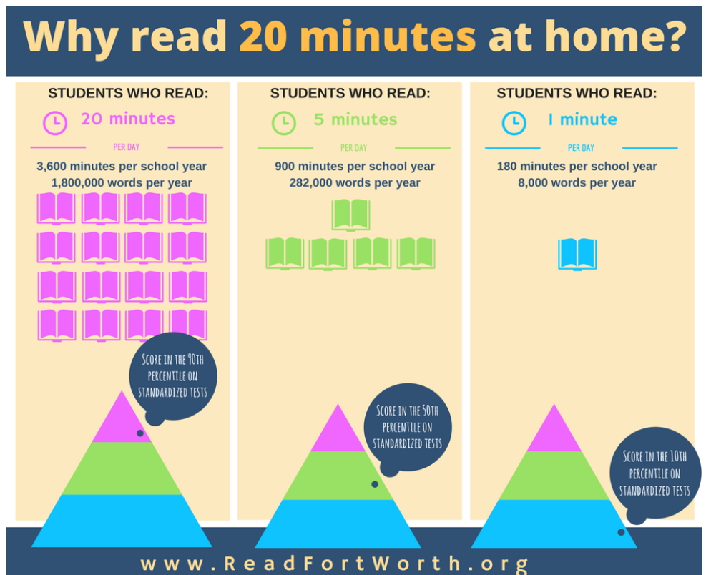

Slide 17


Slide 18
One of the greatest gifts adults can give is to read to children
Carl Sagan
Notes:
Slide purpose:
Key takeaways/final message
Notes:
Read the quote.

