Slide 1

PSHE and RSE at
Abingdon Primary School

Slide 2



Our Bespoke Drivers
Role Models of all Protected Characteristics
Accessing our local area and all it offers
The Power of Word

Slide 3
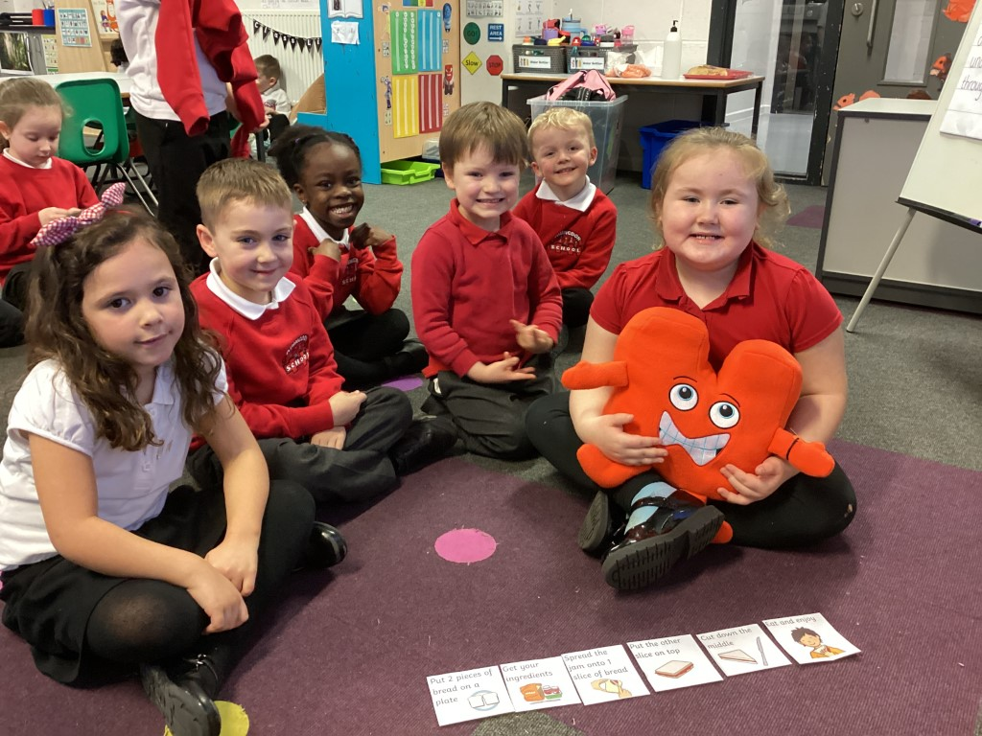
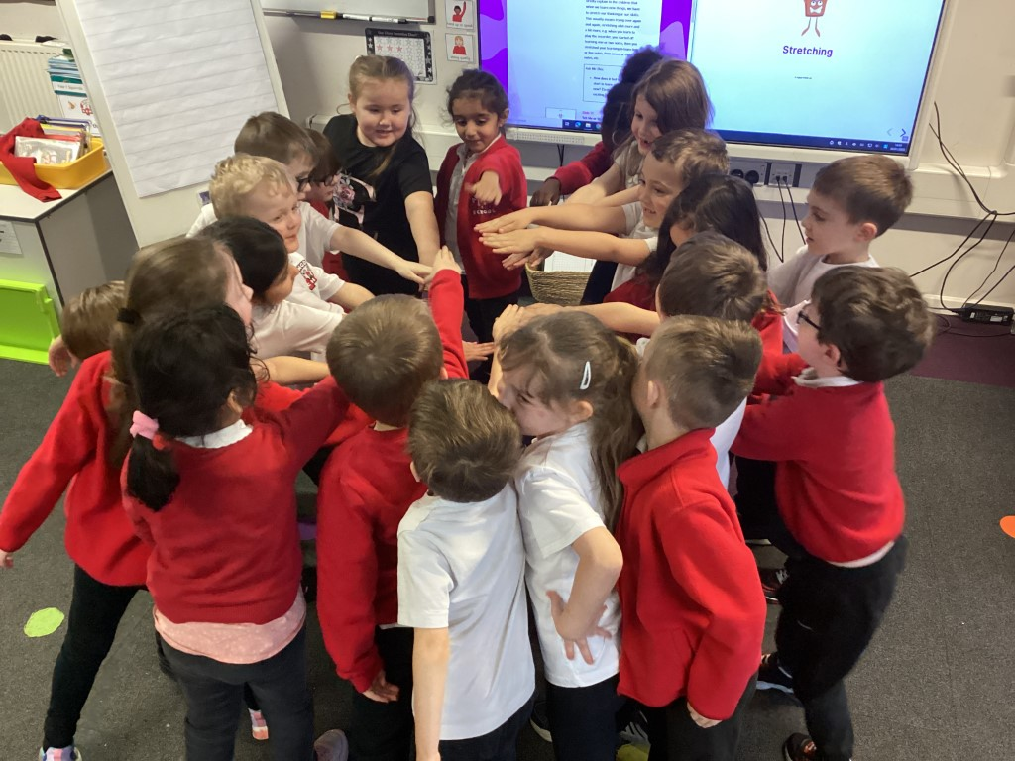
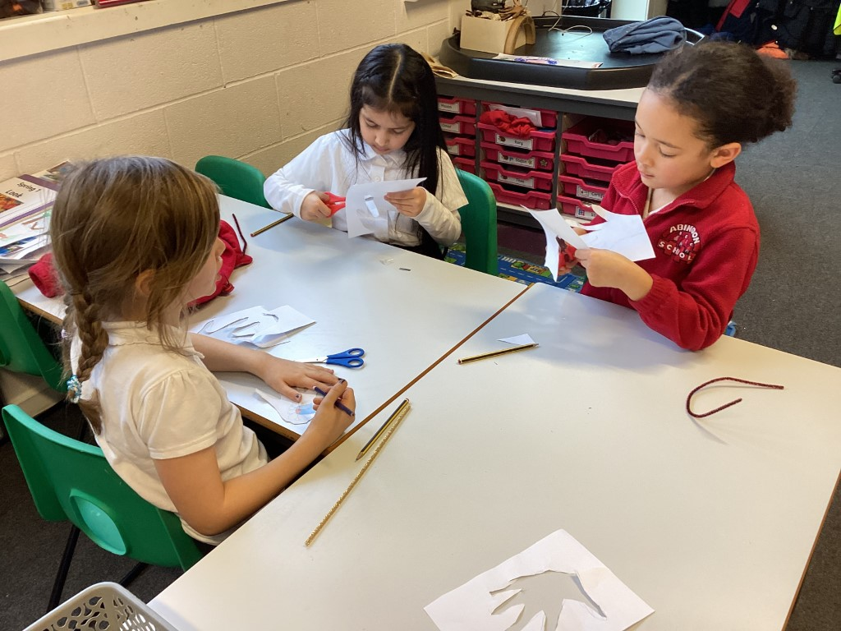
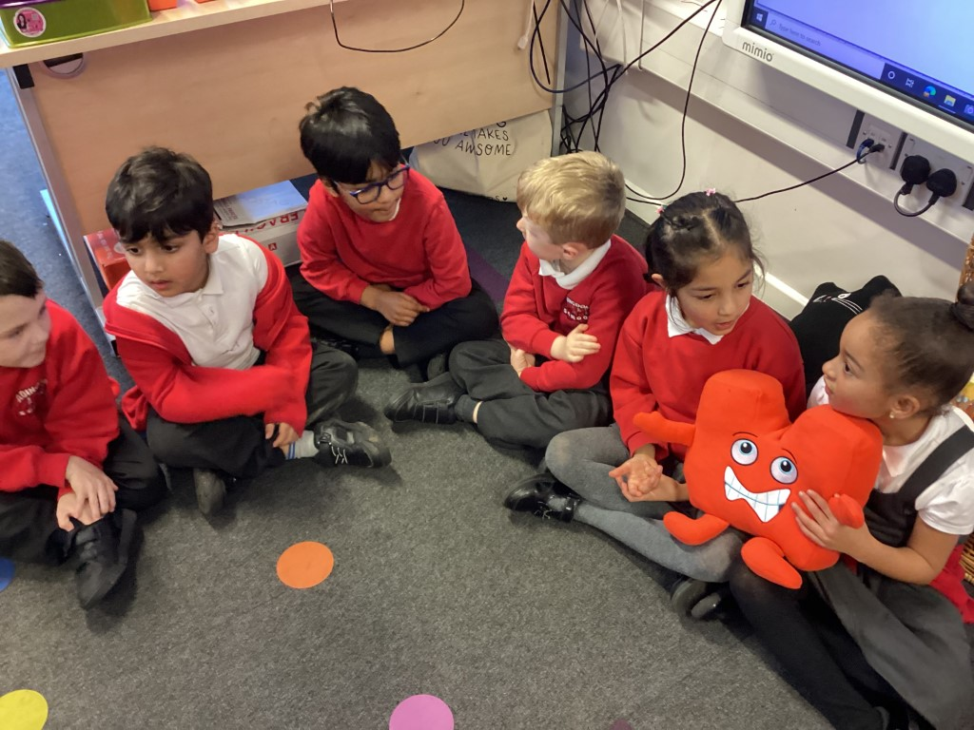
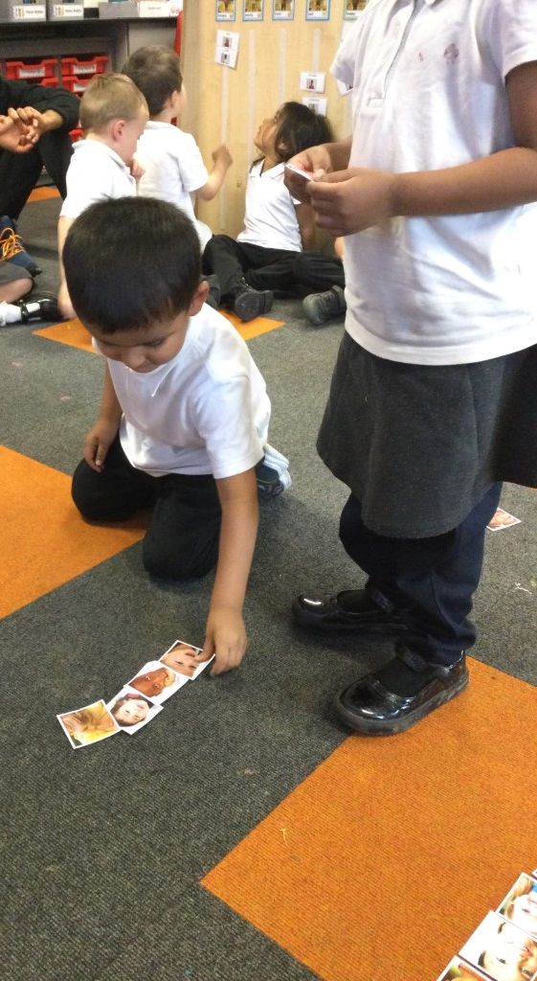
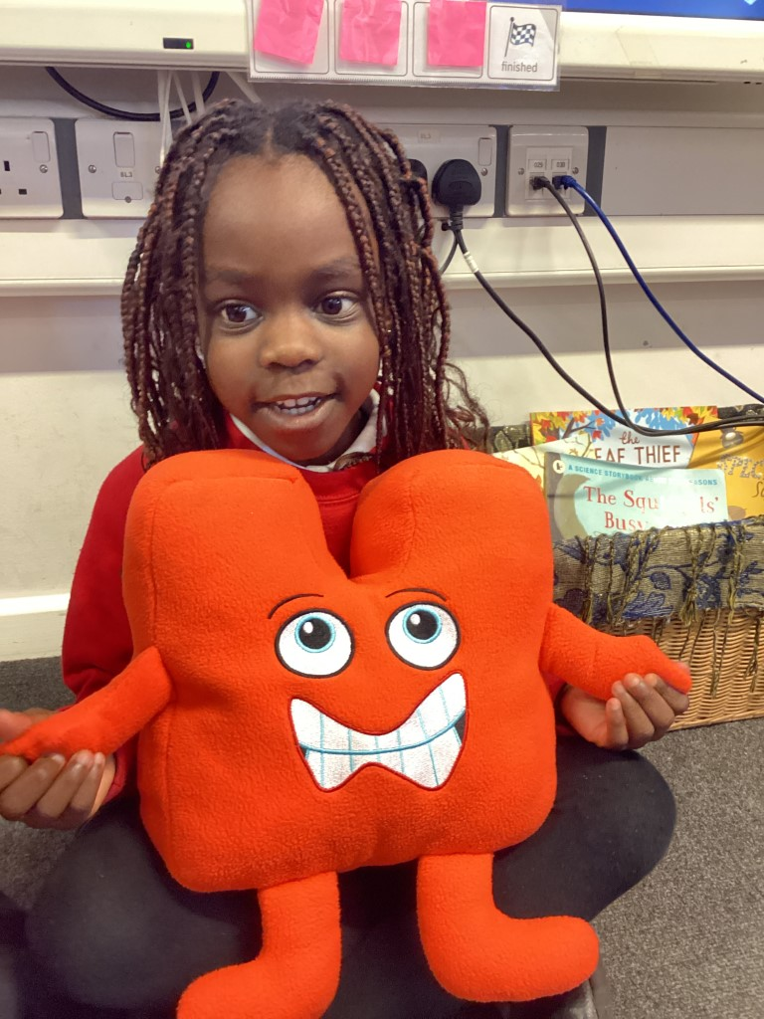
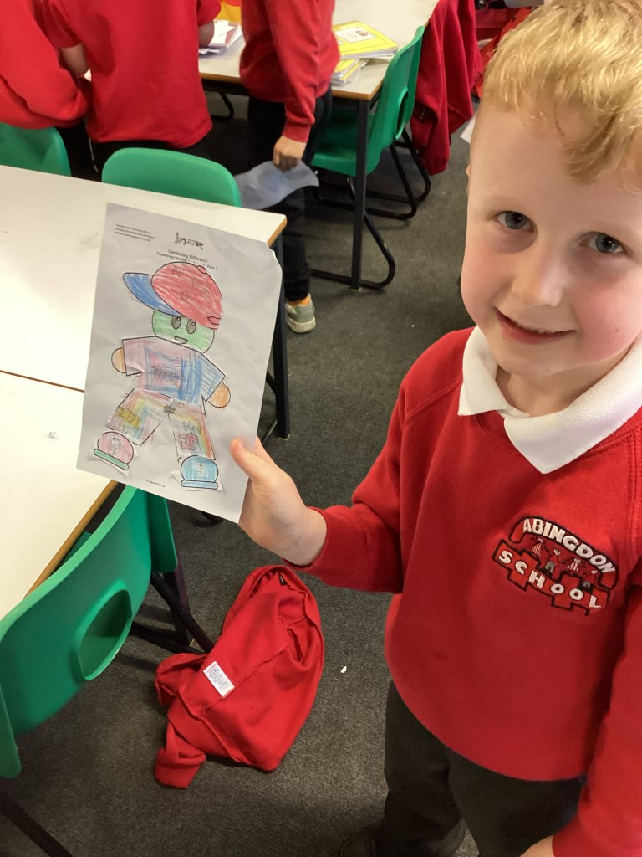
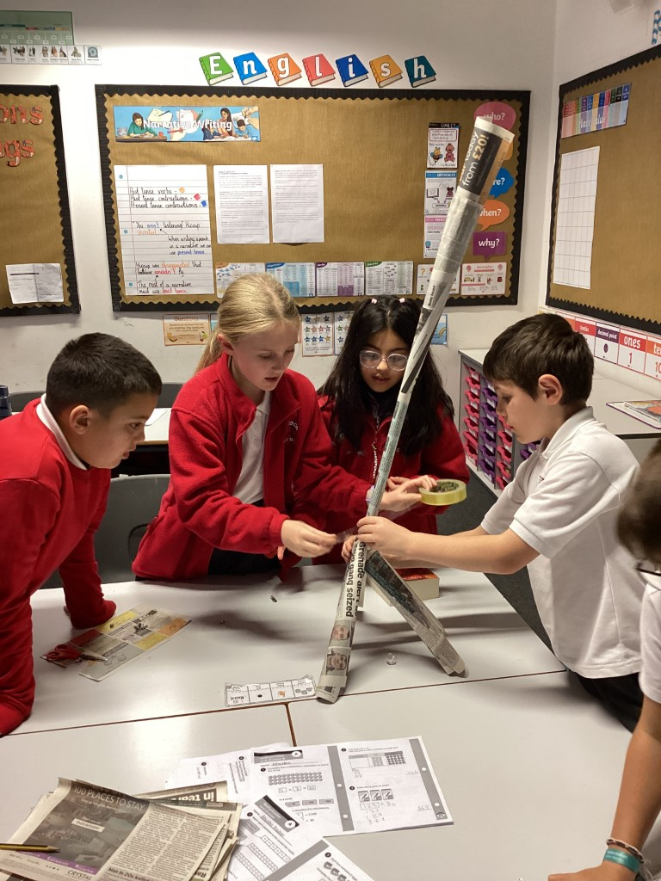
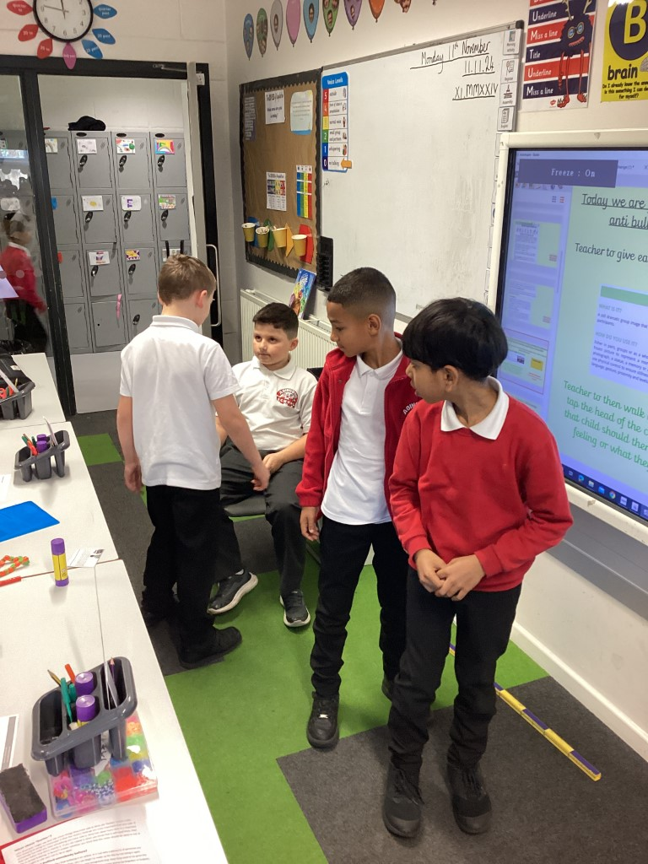
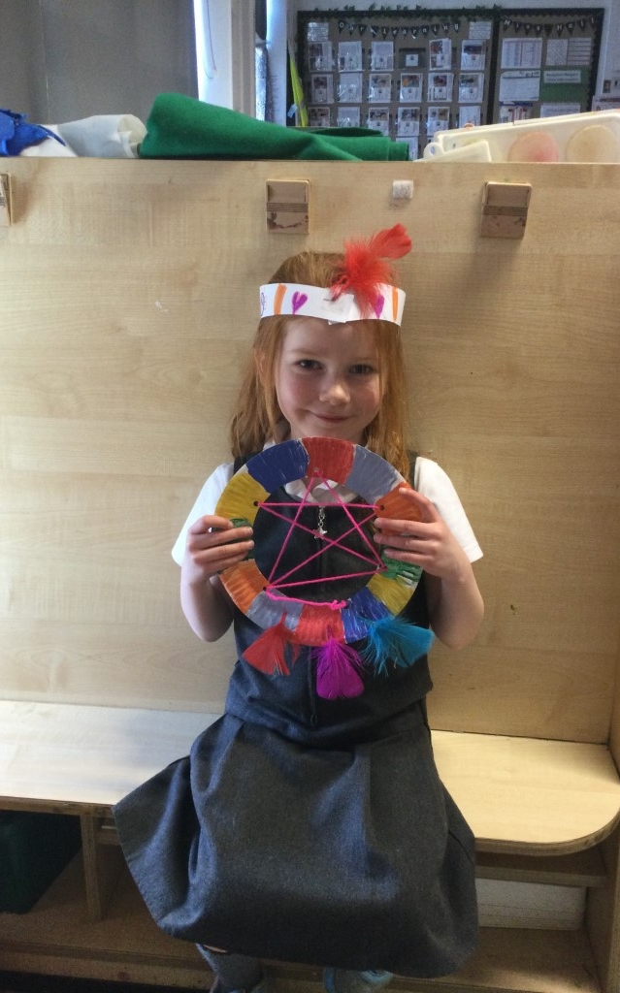
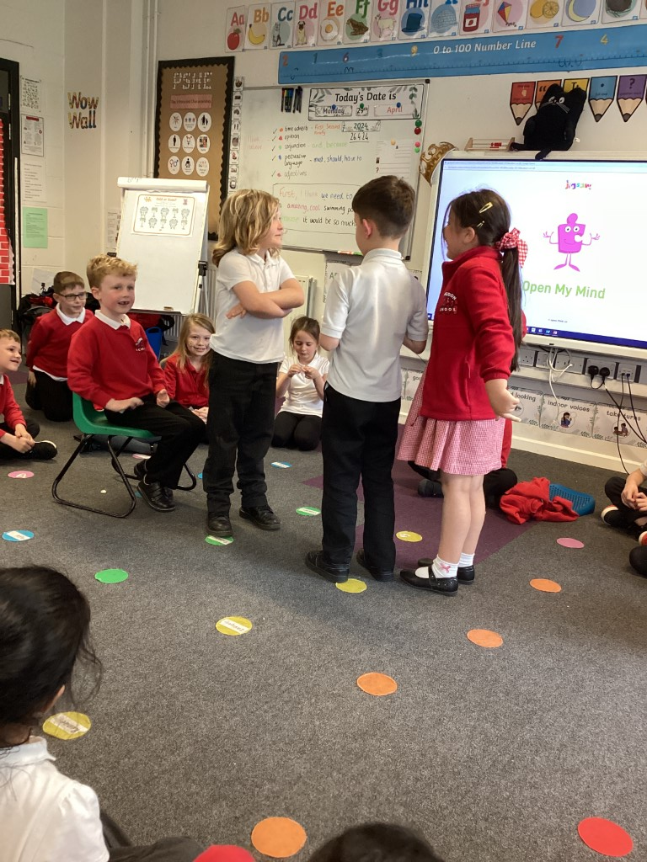
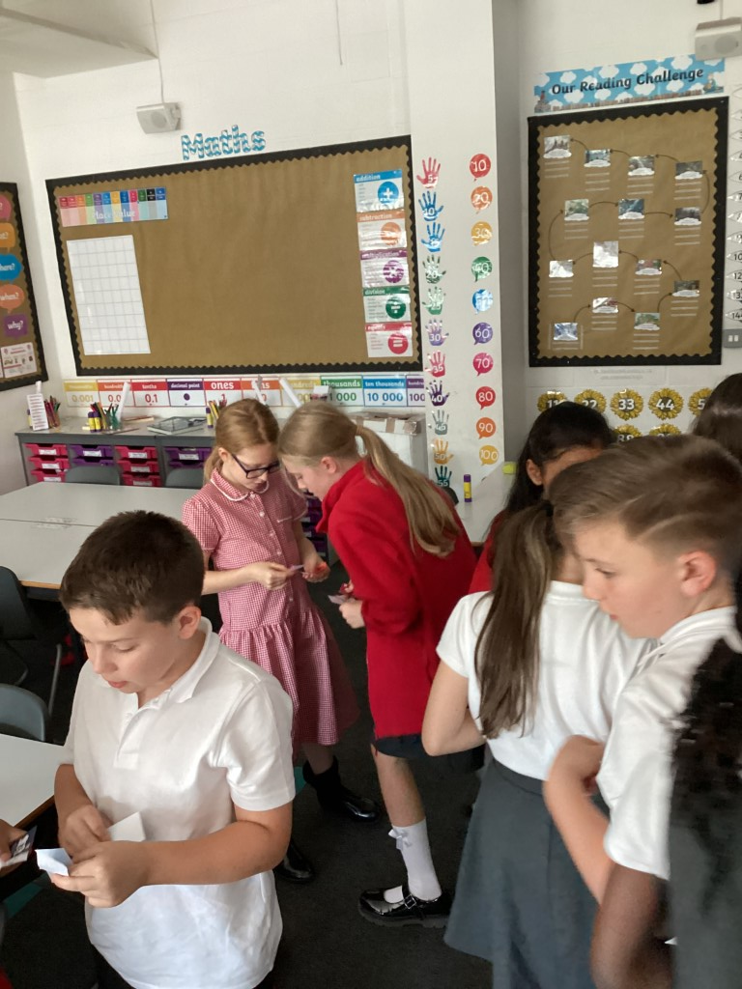
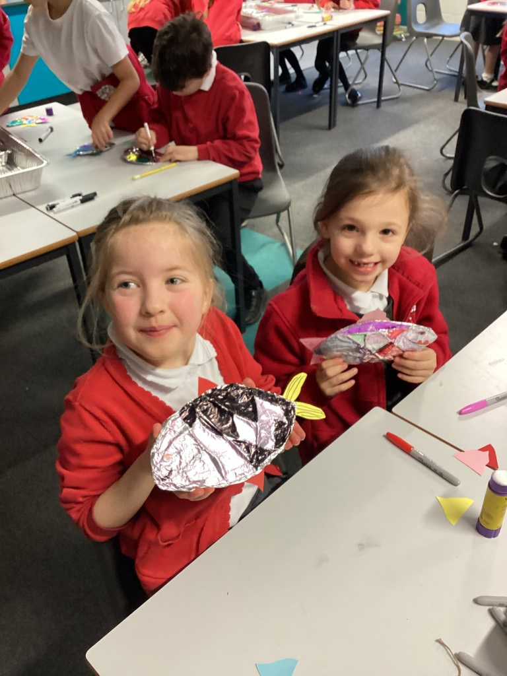
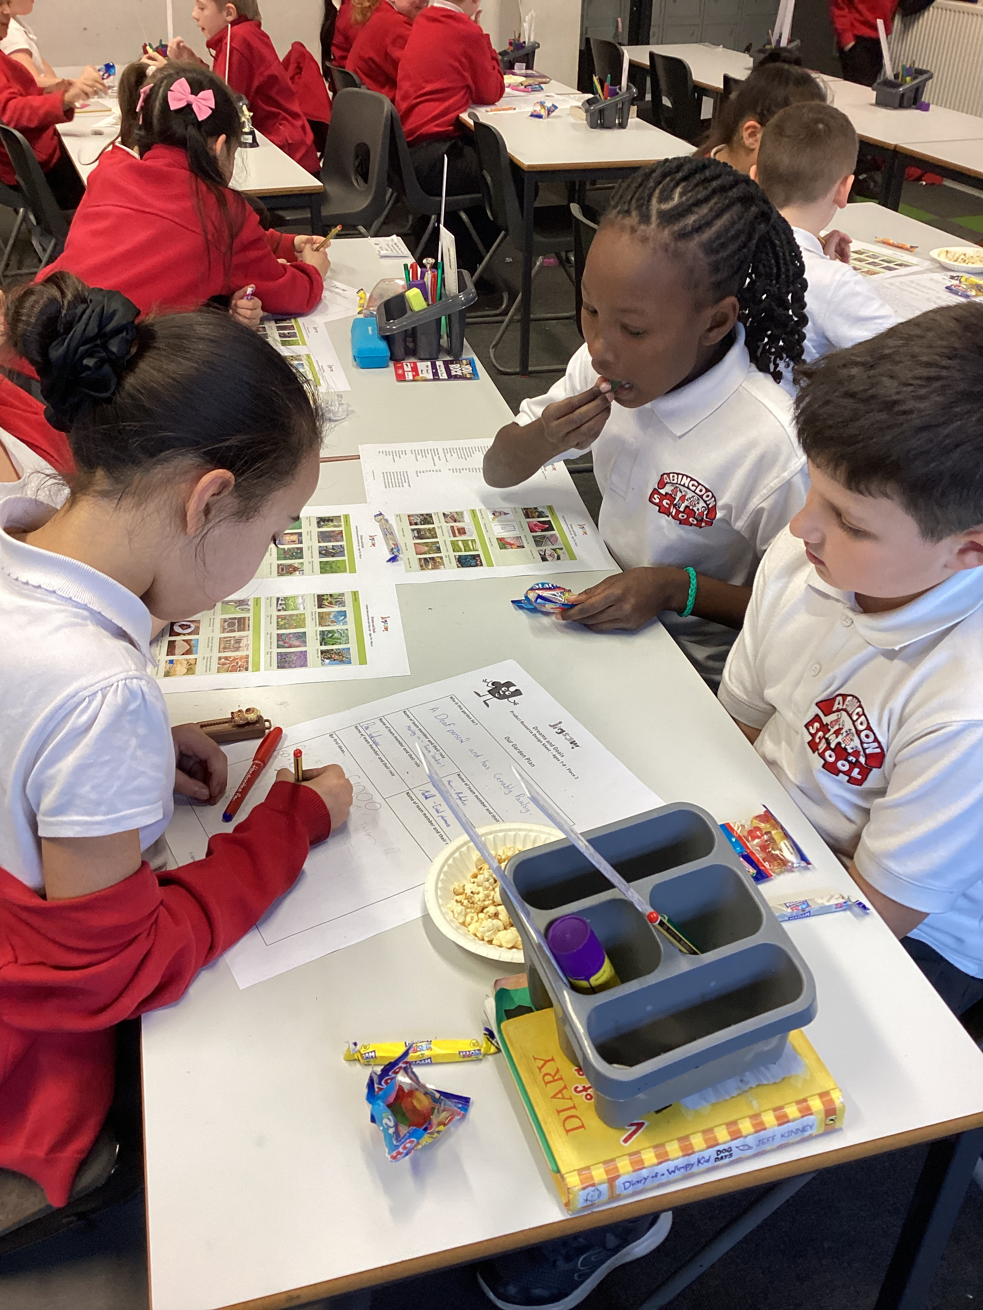
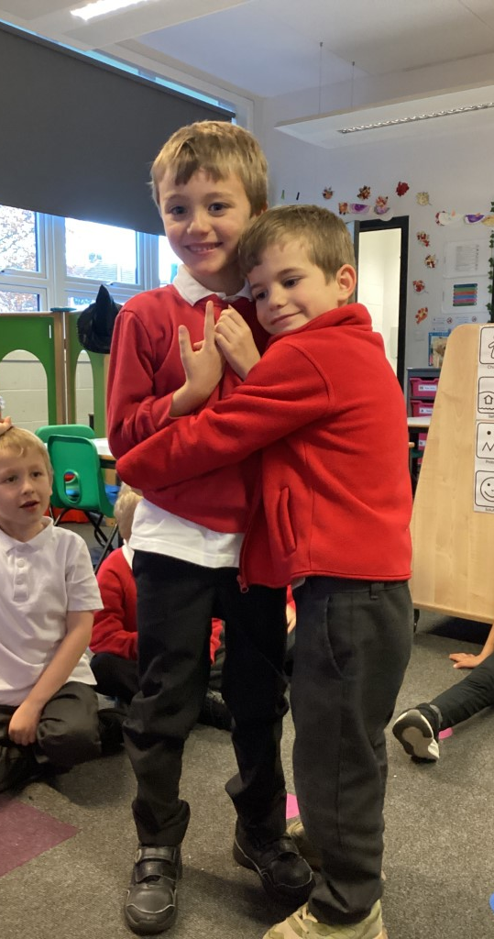
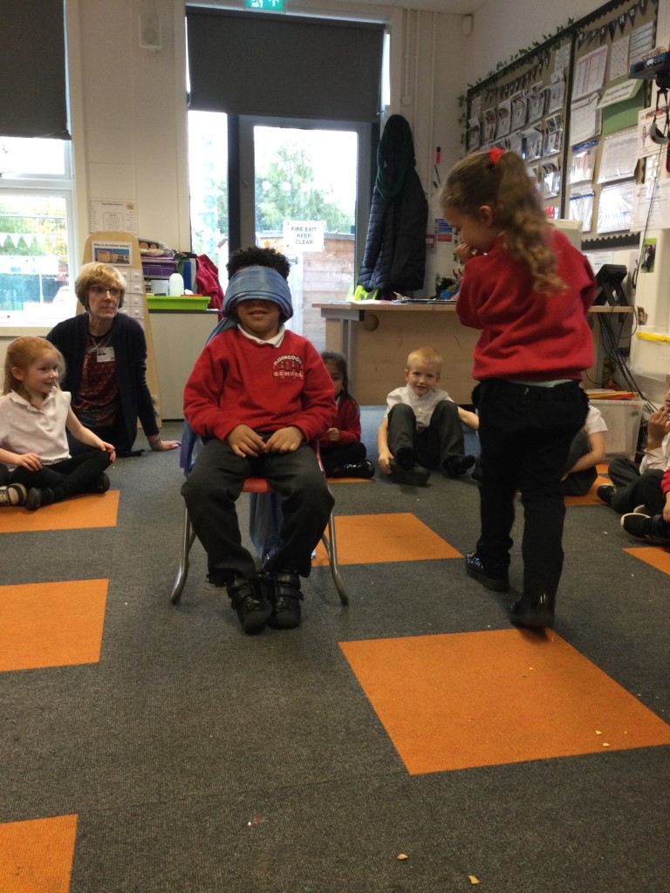
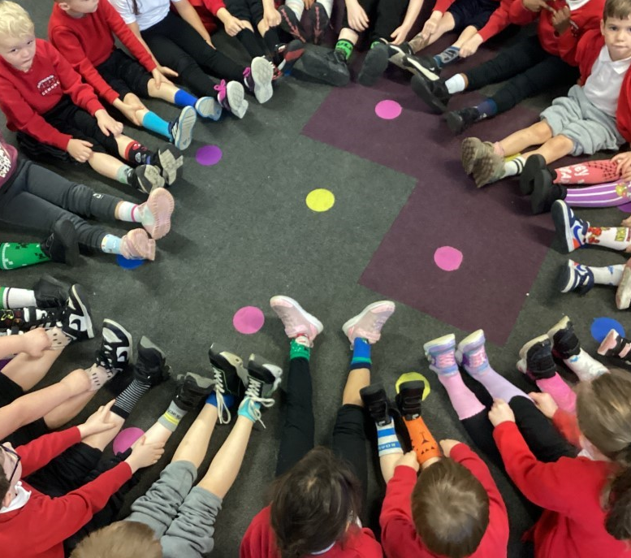
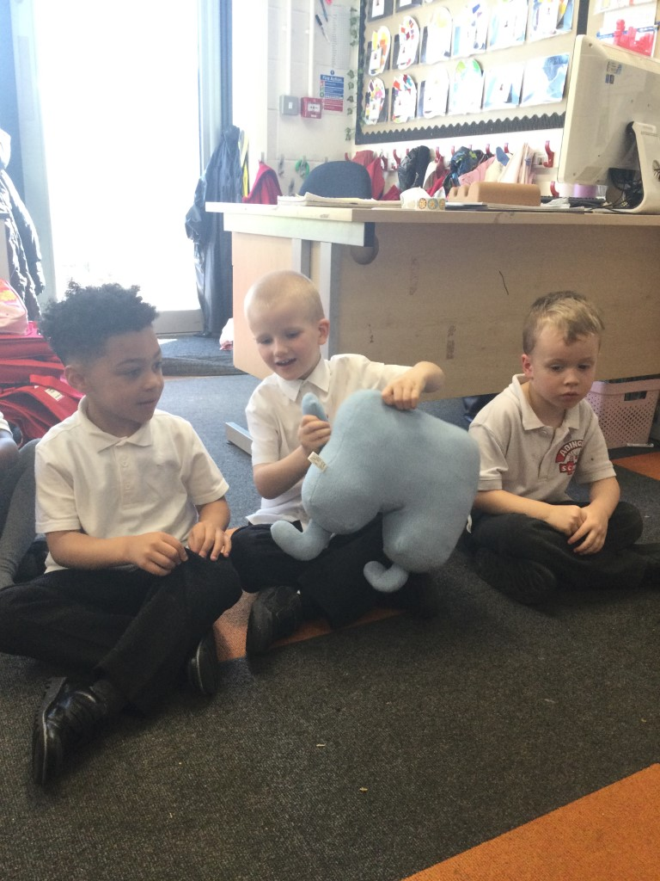
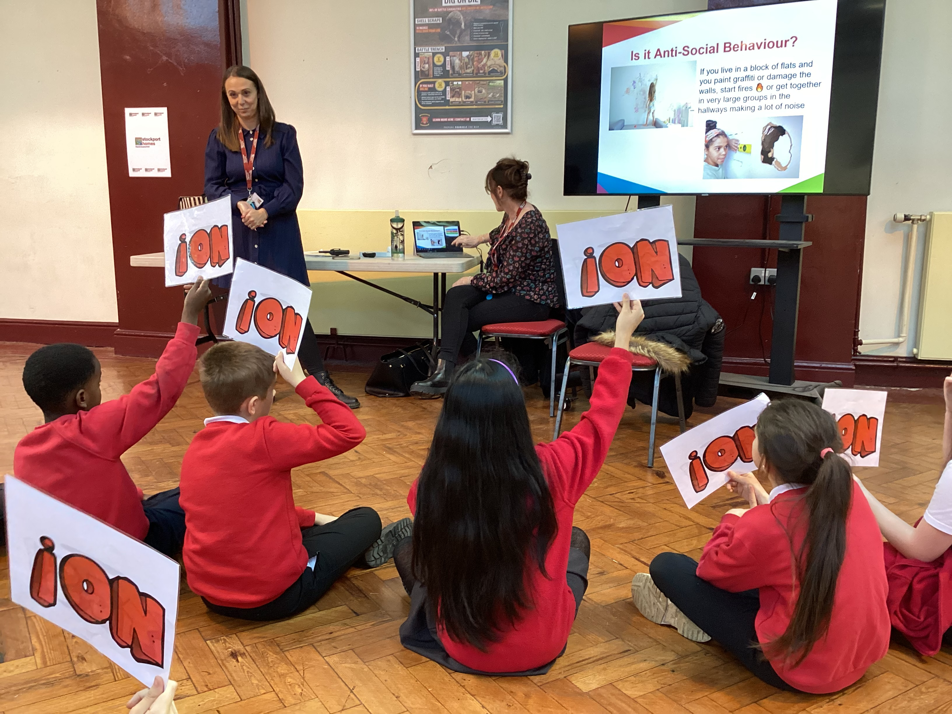
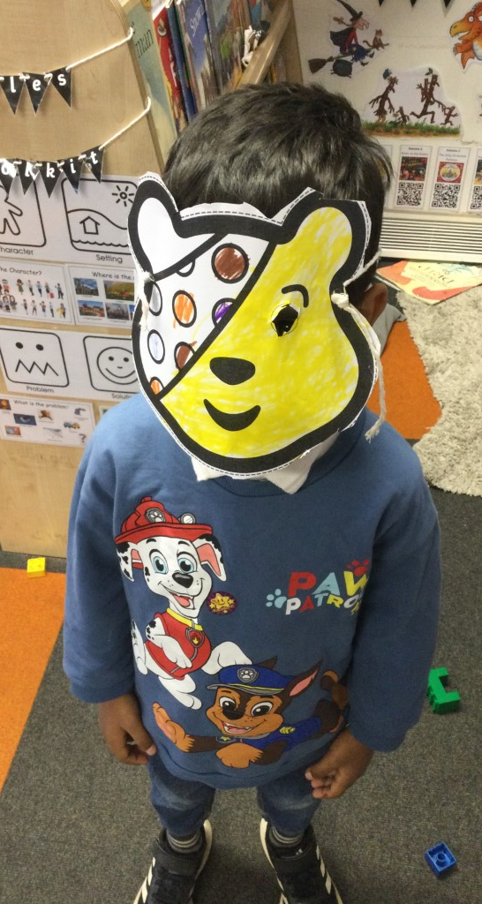
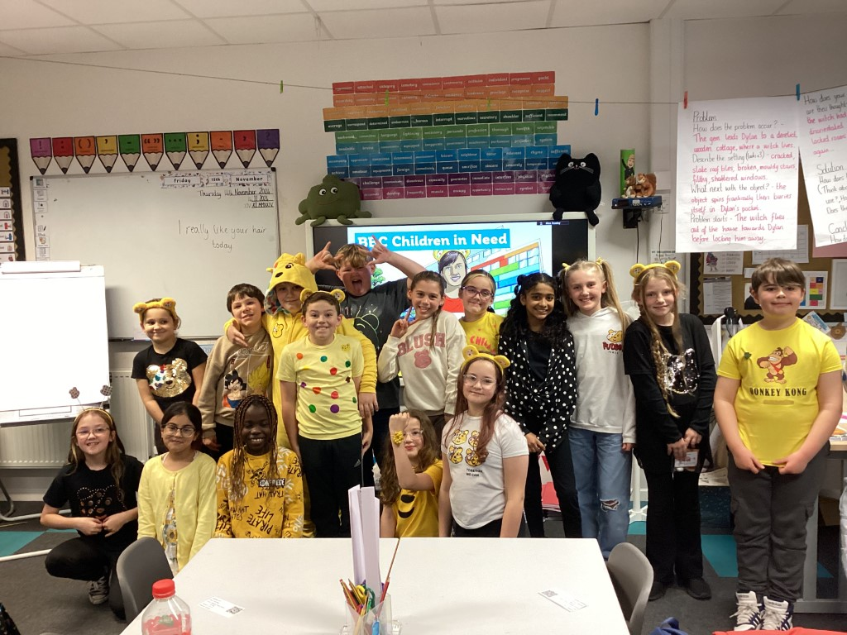
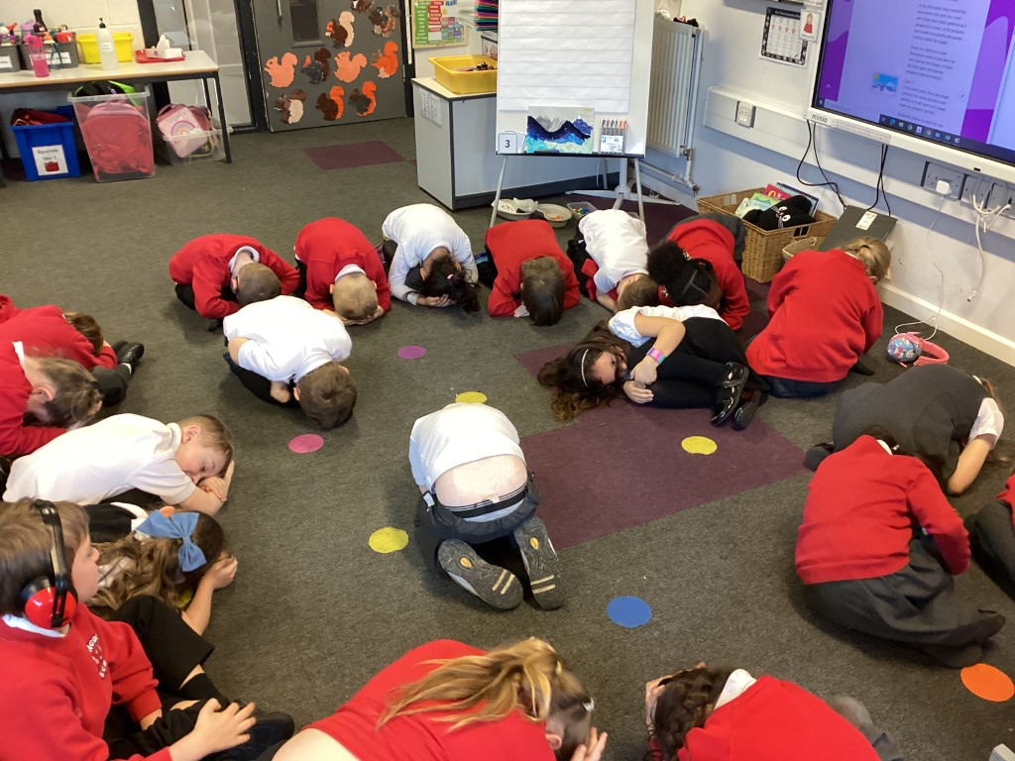
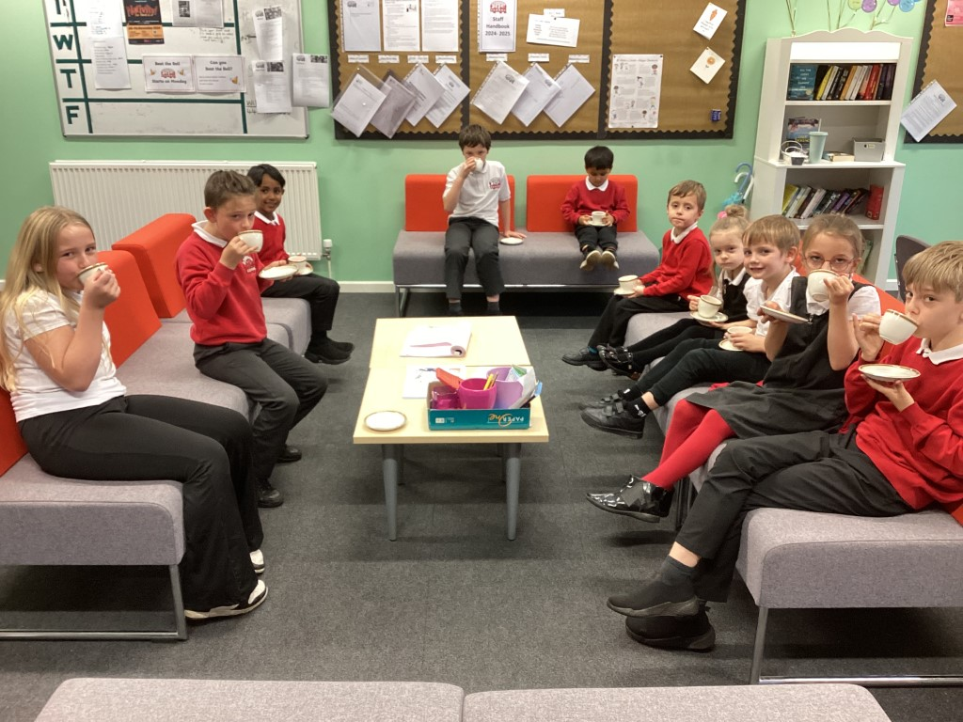
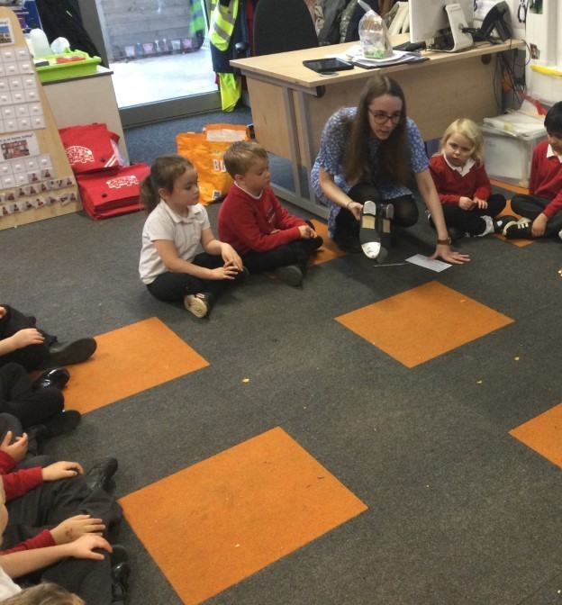

Slide 4

Our Vision for PSHE – Why is PSHE important at Abingdon?
At Abingdon Primary School, Personal, Social, Health and Economic education (PSHE), encompasses all areas of our curriculum and is at the heart of everything we do. PSHE is a school curriculum subject in England that helps children and young people stay safe, healthy and empowered. It prepares pupils for success in their education or career, and for life in modern Britain.
At Abingdon, PSHE is a golden thread that runs through every aspect of school life, underpinning all other learning. We promote our pupils’ personal development by providing them with essential life skills and knowledge. Our aim is to enable our pupils to become our 3 R’s - respectful, resilient and responsible members of the community who are healthy, confident and equipped with the relevant skills to become successful. We also recognise the importance of our children’s wellbeing and the knock-on effects this can have on their academic achievement and use our PSHE curriculum to facilitate the promotion of this throughout school.

Slide 5
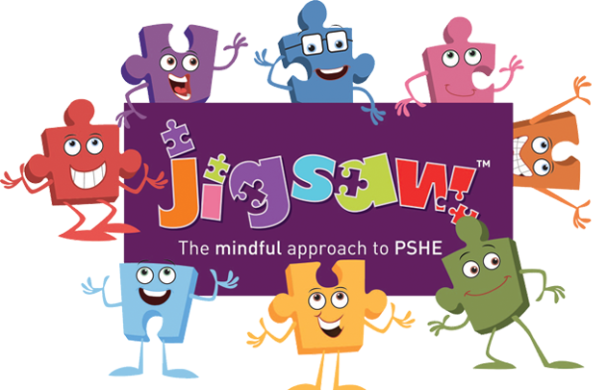
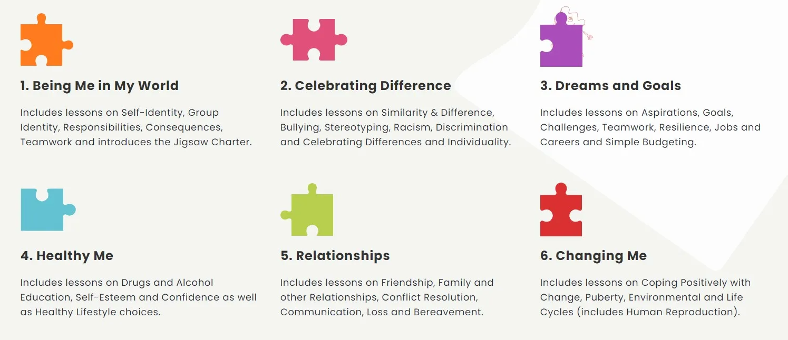
How is Learning Across Our School is Sequenced?
Jigsaw, the mindful approach to PSHE, is a progressive and spiral scheme of learning. In planning the lessons, Jigsaw PSHE ensures that learning from previous years is revisited and extended, adding new concepts, knowledge and skills, year on year as appropriate. It is taught through 6 key concepts which are designed to progress in sequences throughout the academic year. These are: Being Me in My World, Celebrating Difference, Dreams and Goals, Healthy Me, Relationships, Changing Me.
Each Piece (lesson) has two Learning Intentions: one is based on specific PSHE learning (covering the national framework for PSHE Education and the statutory Relationships and Health Education guidance, but enhanced to address children’s needs today); and one is based on emotional literacy and social skills development to enhance children’s emotional and mental health. Lesson objectives are structured and sequenced so that final outcomes are secure and meaningful. Children do not learn objectives in isolation but continue to embed these through carefully planned application of skills throughout the year.

Slide 6
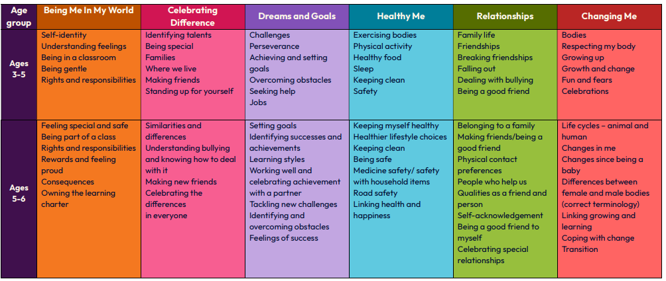
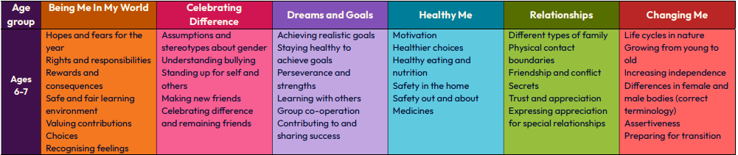
EYFS and KS1 Content Overview

Slide 7
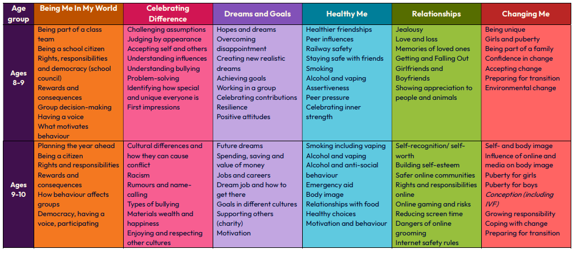
KS2 Content Overview

Slide 8
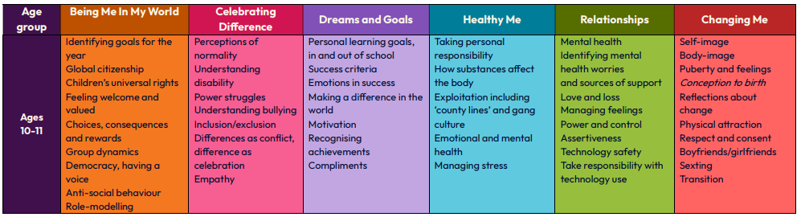
KS2 Content Overview

Slide 9
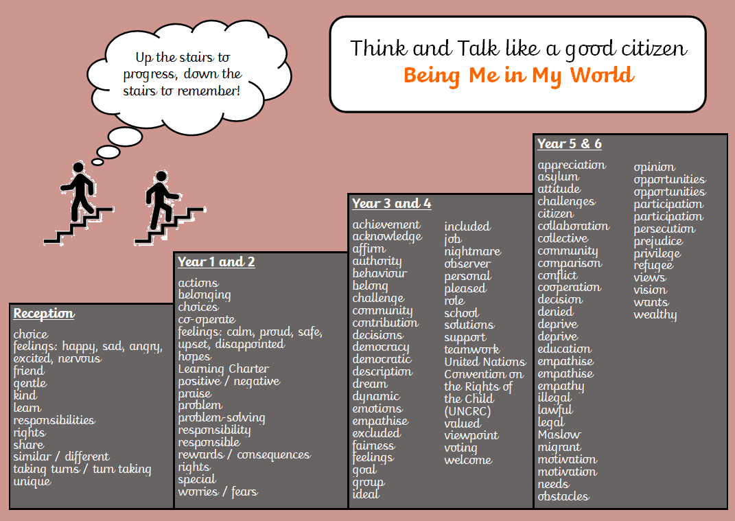

Vocabulary Progression – Being Me in My World
This links to The Power of Word – understanding the power that vocabulary can have.

Slide 10
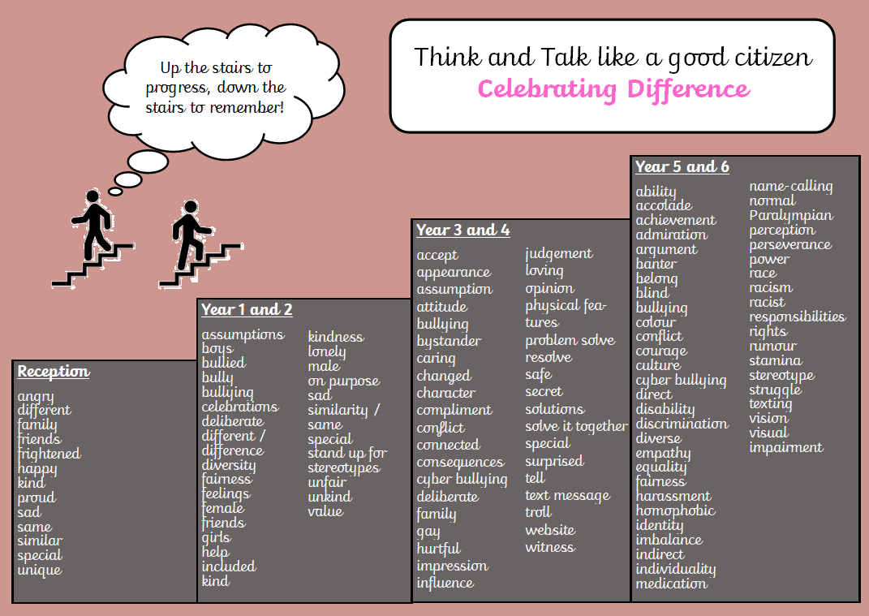

Vocabulary Progression – Celebrating Difference
This links to The Power of Word – understanding the power that vocabulary can have.

Slide 11
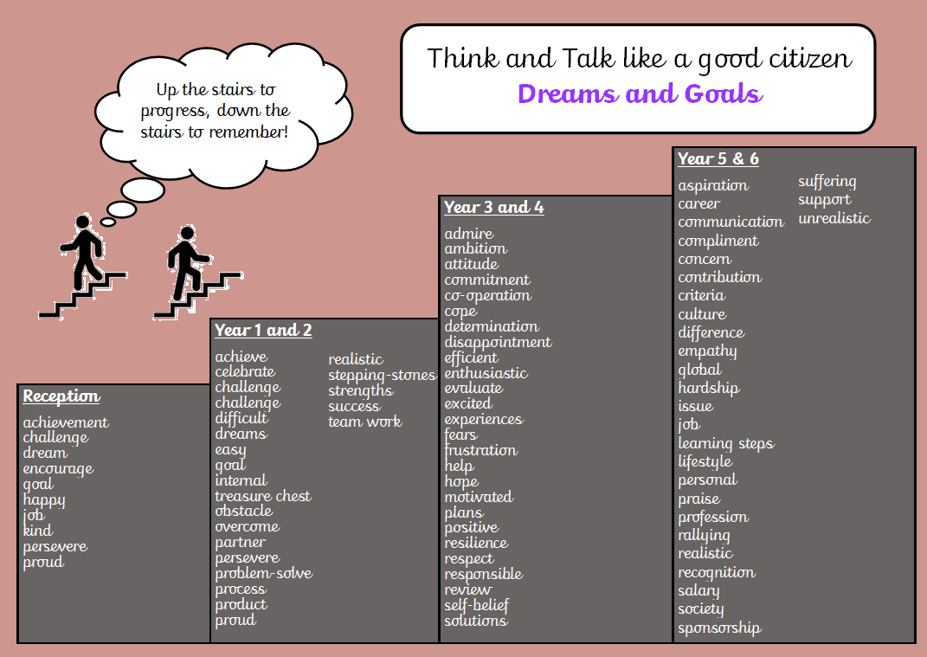

Vocabulary Progression – Dreams and Goals
This links to The Power of Word – understanding the power that vocabulary can have.

Slide 12
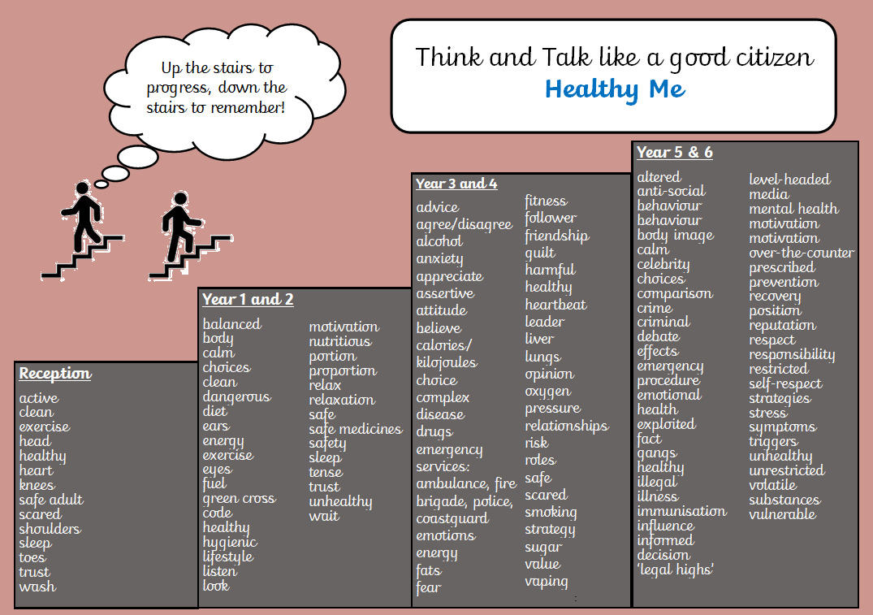

Vocabulary Progression – Healthy Me
This links to The Power of Word – understanding the power that vocabulary can have.

Slide 13
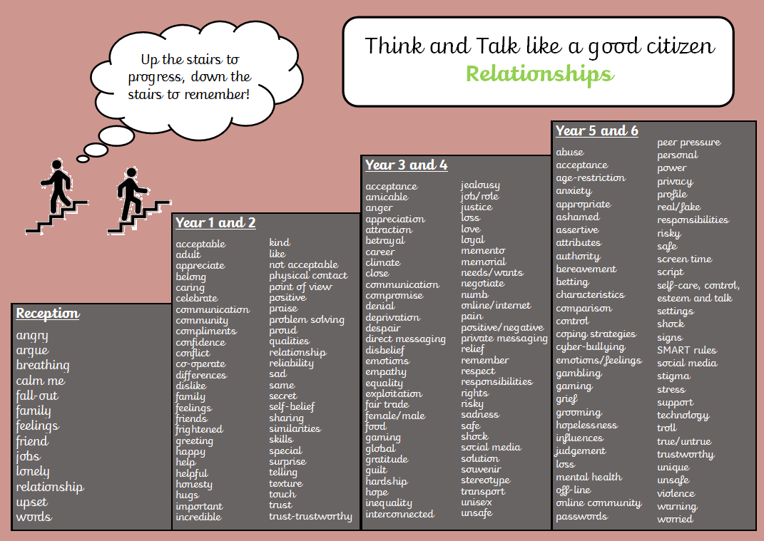

Vocabulary Progression - Relationships
This links to The Power of Word – understanding the power that vocabulary can have.

Slide 14
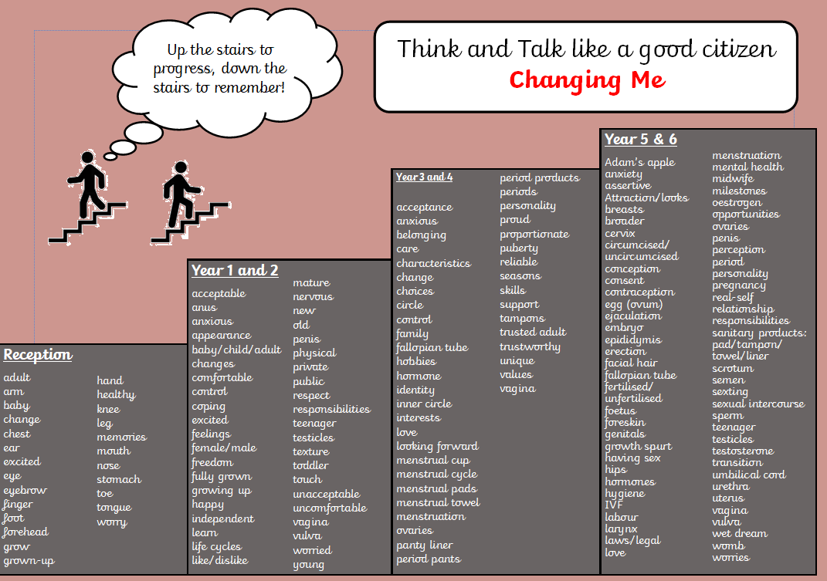

Vocabulary Progression – Changing Me
This links to The Power of Word – understanding the power that vocabulary can have.

Slide 15
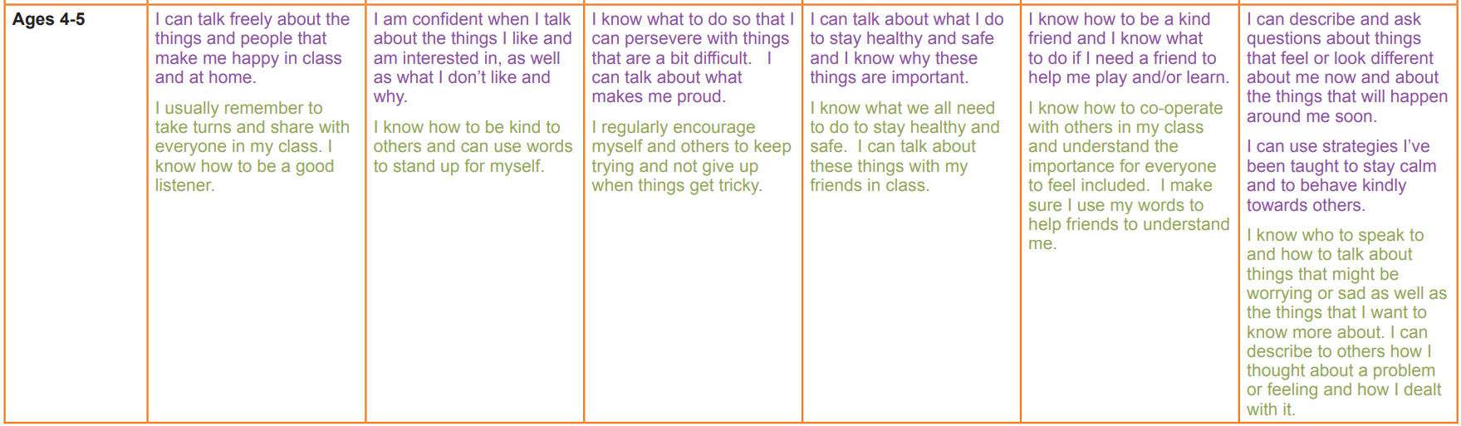
How are knowledge and skills built on through school?
Progression grids are in place to track the progress of each element of the PSHE curriculum.

Slide 16
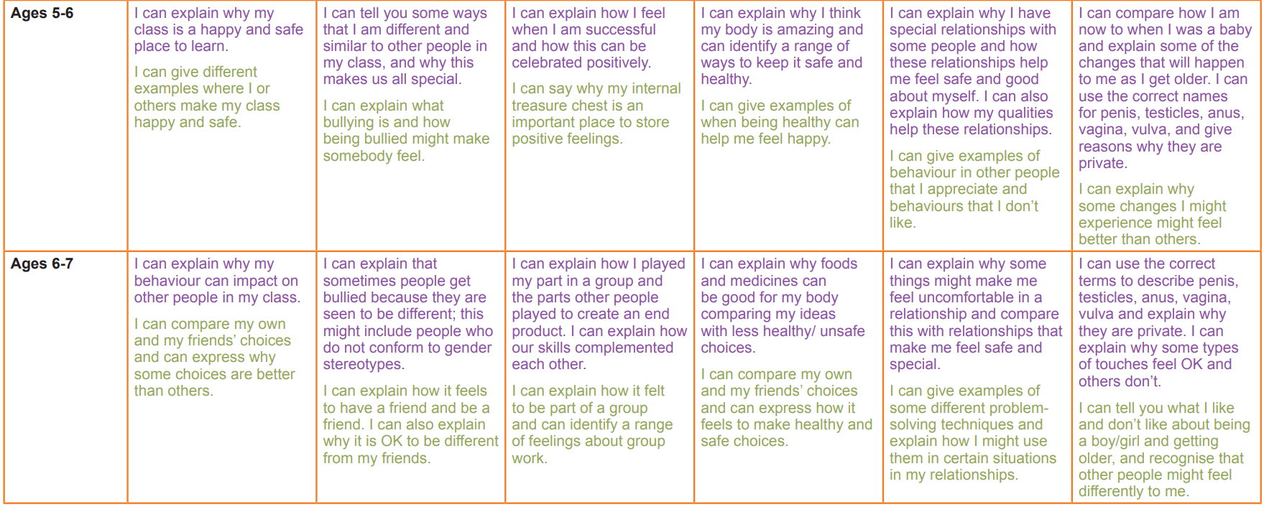
How are knowledge and skills built on through school?
Progression grids are in place to track the progress of each element of the PSHE curriculum.

Slide 17
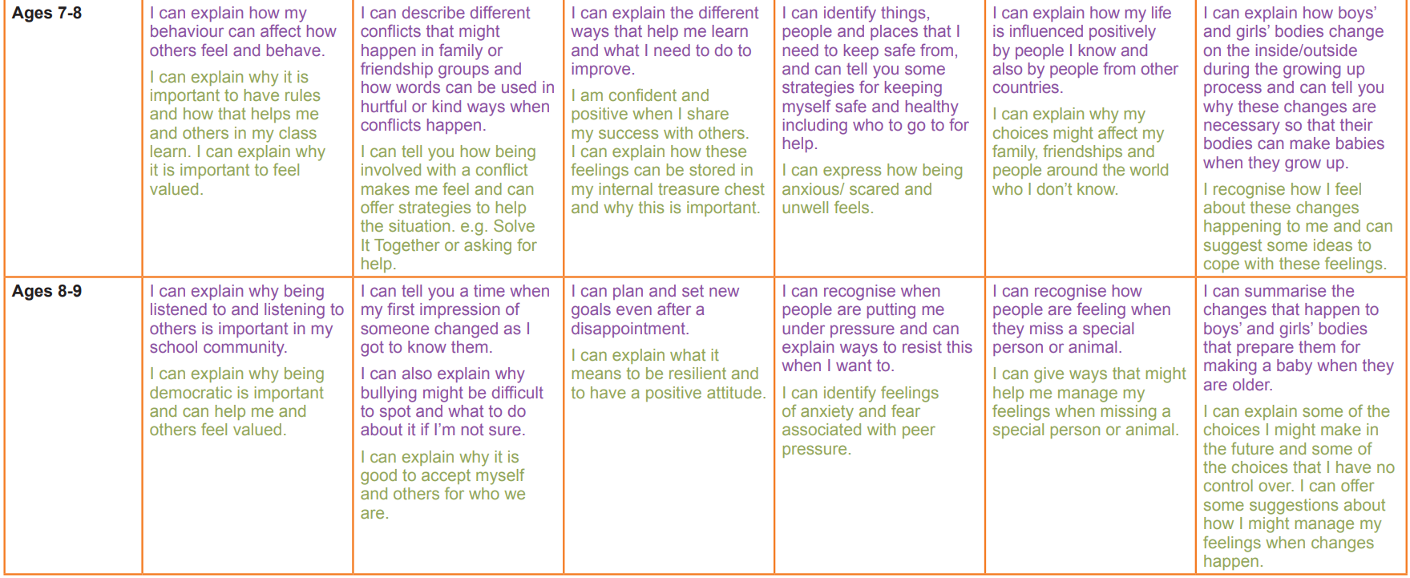
How are knowledge and skills built on through school?
Progression grids are in place to track the progress of each element of the PSHE curriculum.

Slide 18
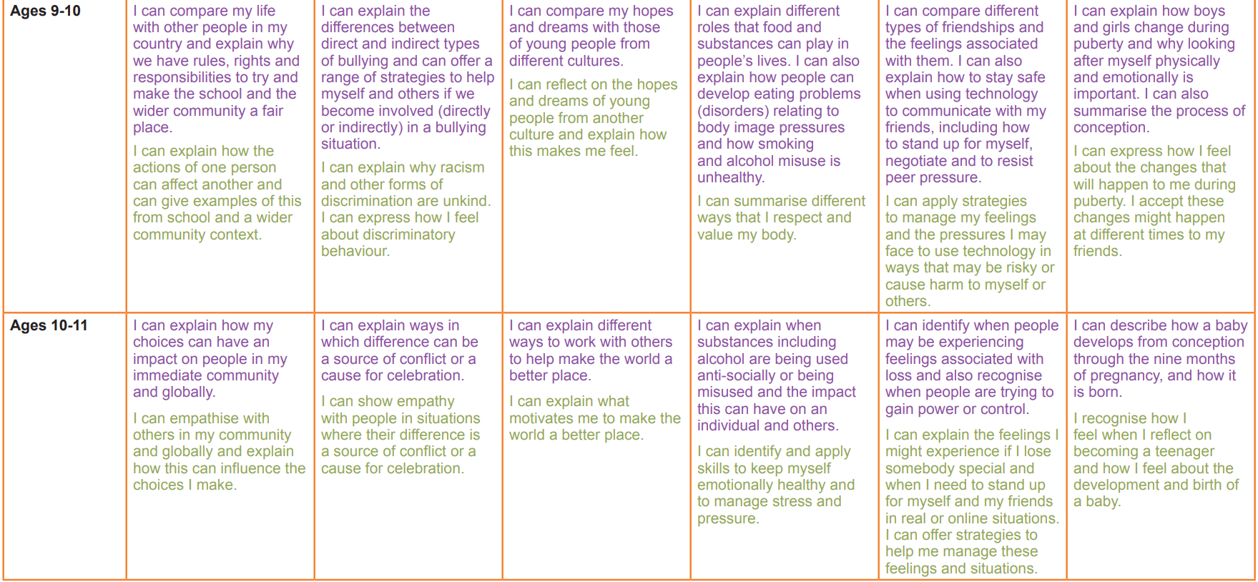
How are knowledge and skills built on through school?
Progression grids are in place to track the progress of each element of the PSHE curriculum.

Slide 19
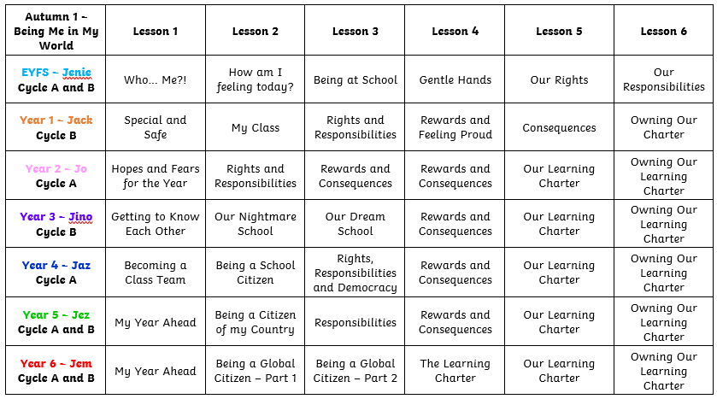
Medium Term Plans – Autumn 1

Slide 20
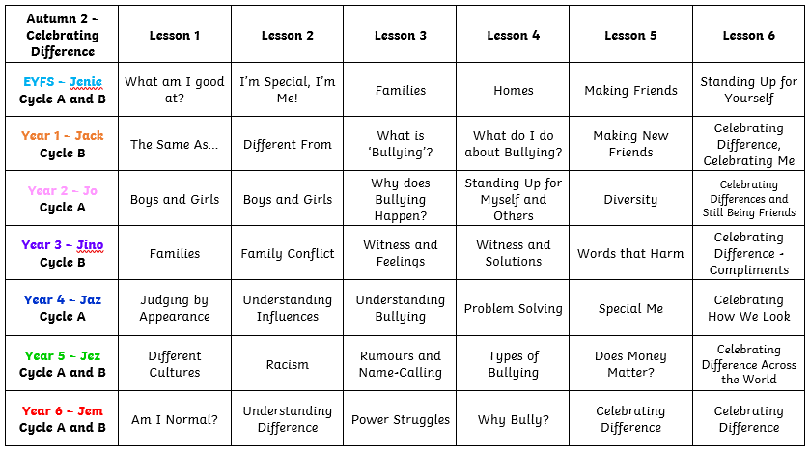
Medium Term Plans – Autumn 2

Slide 21
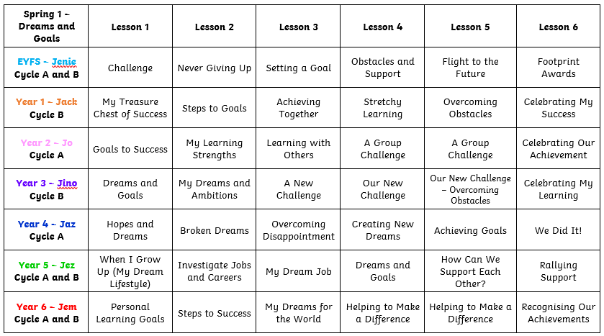
Medium Term Plans – Spring 1

Slide 22
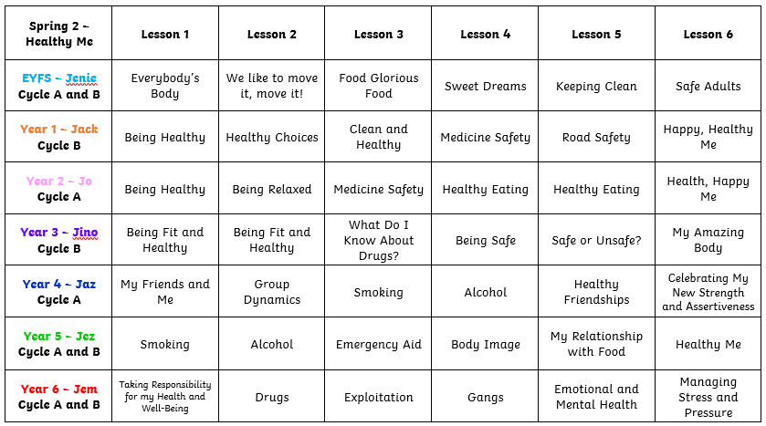
Medium Term Plans – Spring 2

Slide 23
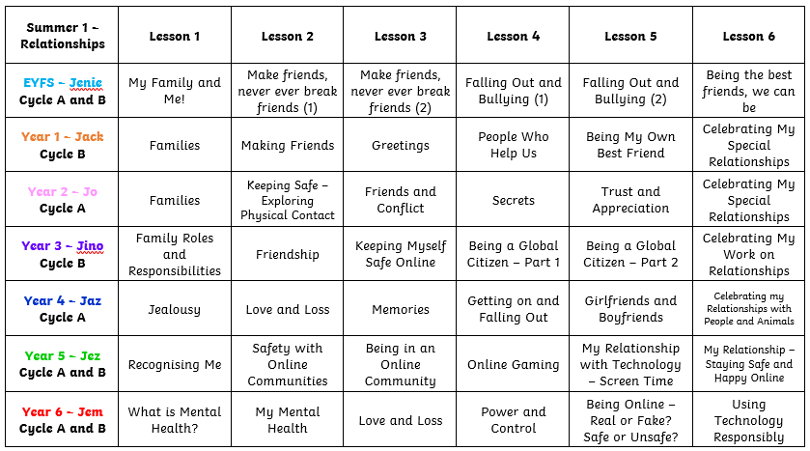
Medium Term Plans – Summer 1

Slide 24
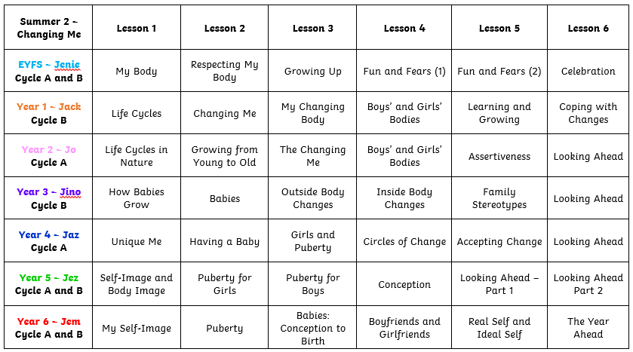
Medium Term Plans – Summer 2

Slide 25
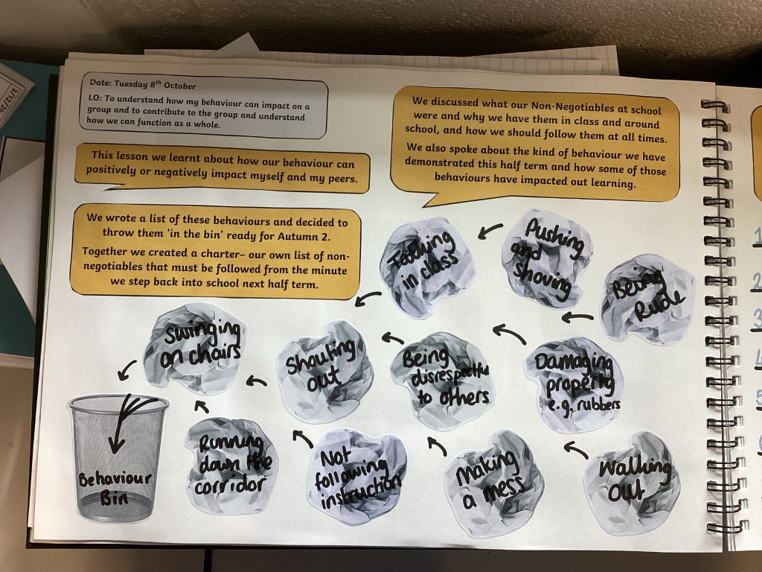

Prior Learning
To ensure a depth and accuracy of learning which builds upon prior learning, all classes undertake weekly Jigsaw PSHE lessons which follow a fully planned and spiralling/progressive PSHE scheme. Prior learning is also shown in the progression grids and the class floor books from the current and previous years. Discussions are had at the start of each lessons using the Piece numbers highlighted on the slides and the title slide which identifies which topic we are on. Unit recaps are also carried out at the start and end of each unit to ensure any gaps or misconceptions are addressed, corrected and accurate learning can be built upon.
LO’s highlighted on every page to allow accurate recap.
Visuals to show what was learnt in the lesson as well as write ups, help all pupils access the recap of prior learning, even in EYFS.

Slide 26
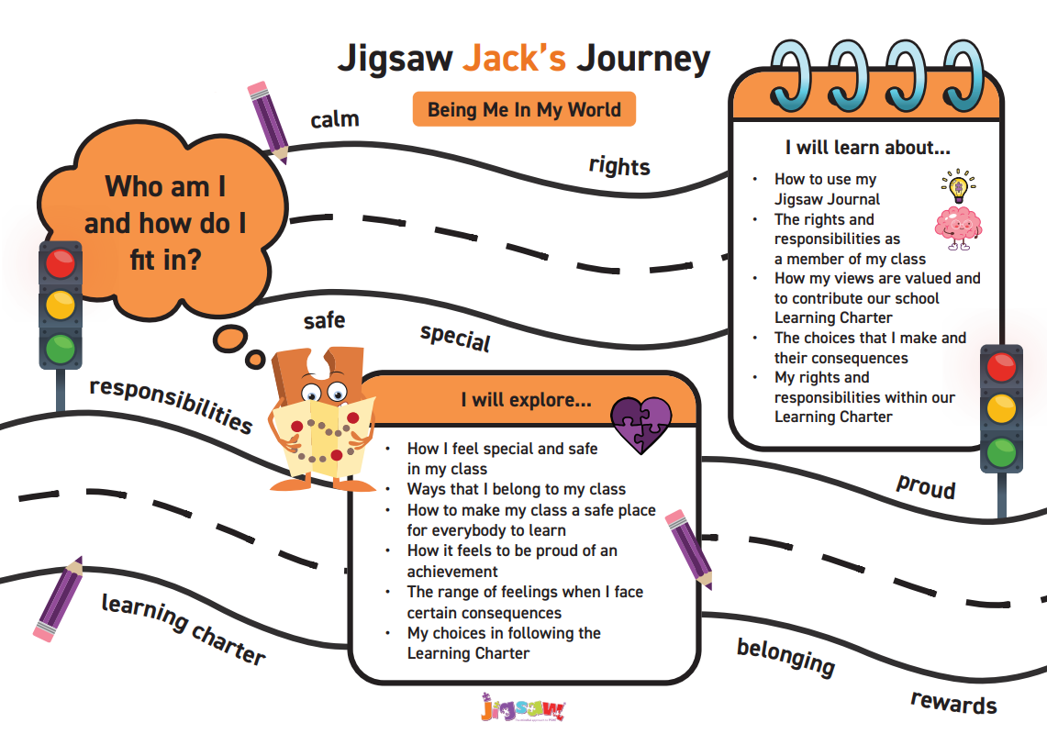
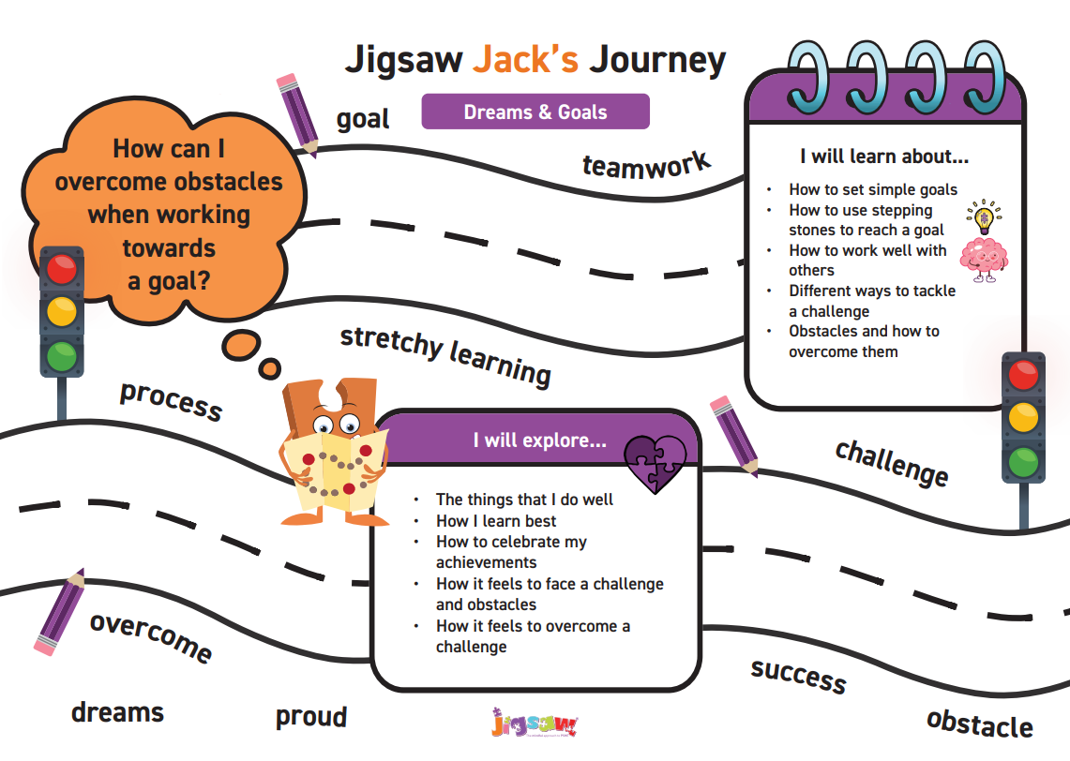
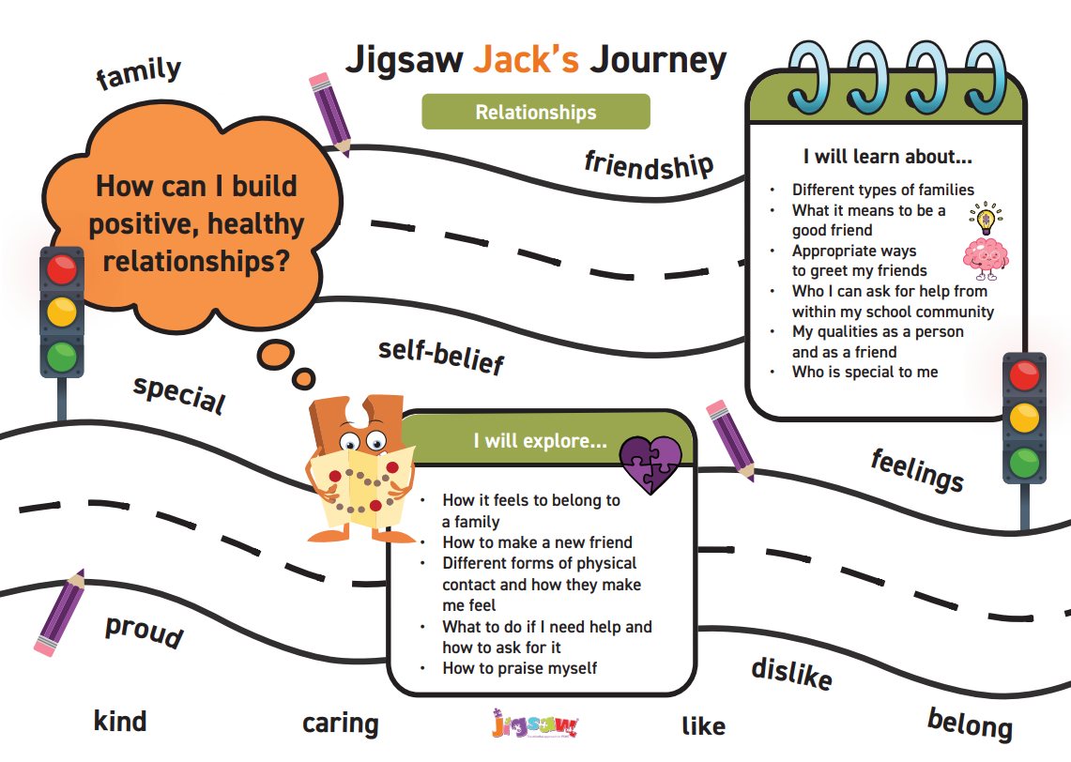



Knowledge Organisers
Knowledge Organisers (KO’s are available for teachers to use in each lesson, however, unlike other foundation subjects, PSHE is recorded in one class floor book, so children do not use the KO’s in the same way as they may in History or Science for example. Additionally, due to the complex needs in our individual classes, KO’s are not used in the same way in each class or by each year group. Teachers use their knowledge of their children and their teacher judgement to determine how these KO’s are used in each classroom during PSHE. Some teachers use them in their floor books, some teachers may refer to them when adapting planning and ensuring all content is covered and others may use the vocabulary but not the document itself. Here is an example of some we have access to through Jigsaw PSHE…

Slide 27





Whole School PSHE Events
At Abingdon, we aim to enhance and enrich the lives of children by enabling them to have access to a variety a fantastic learning opportunities within and beyond the curriculum. We believe PSHE Education, British Values and the SMSC (spiritual, moral, social and cultural) development has a crucial role in preparing pupils for the world outside, helping them to develop the skills and attributes they need to thrive and achieve their full potential. Our enhancement calendar enables us to include a variety of events, talks, assemblies, and discussions into our curriculum and ensures children gain a holistic view of the world around them.

Slide 28











Abingdon Enhancement Calendar
International Poetry Day – English Cross-Curricular Link
Harvest
Cerebral Palsy Day
Remembrance Day – History Cross-Curricular Link
World Mental Health Day
Anti-Bullying Week – Odd Socks Day
Diwali
Road-Safety Week
Children in Need

Slide 29






Key Learning - Posters
Below is an example of the PSHE key learning posters which have been made for each Unit. The posters highlight to the children (using ‘key’ images), what we want them to know by the end of each Jigsaw Piece.

Slide 30




Assessment
Assessing children's learning is vital to inform their next steps. A full assessment process is embedded in the Jigsaw program including a set of attainment descriptors for every year group and assessment activities to involve children in the process. We use a number of formative assessment strategies in PSHE like questioning, quizzes, speaking and listening opportunities, weekly recaps etc. as well as assessing against the attainment descriptors (broken down on the key learning posters) at the end of each unit.

Slide 31






Challenge and Adaptations
The PSHE Education Planning Framework for Pupils with SEND is supported by Jigsaw. Like us here at Abingdon, Jigsaw believe that PSHE should be accessible for all.
The Planning Framework (for SEND) is organised into six sections:
Self-Awareness (Me, who I am, my likes, dislikes, strengths and interests)
Self-care, support and safety (Looking after me and keeping safe; aspects of RSE and SE.)
Managing Feelings (Understanding feelings, and that how I feel and how others feel affects choices and behaviour; aspects of RSE and SE)
Changing and Growing (How I and others are changing; new opportunities and responsibilities; aspects of RSE and SE)
Healthy Lifestyles (Being and keeping healthy, physically and mentally)
The World I Live In (Living confidently in the wider world)

Slide 32




Challenge and Adaptations
Each of the six sections is subdivided into topic areas.
There is overlap between the topic areas and sections due to the importance of embedding this knowledge wherever possible. For example, mental health and online safety are explicitly covered in some topic areas but are also integrated throughout all six sections where appropriate.
Opportunities are presented for pupils (where appropriate/possible) to:
Experience taking and sharing responsibility.
Feel positive about themselves and others.
Reflect on their perceptions and experiences.
Develop the understanding, language, communication skills and strategies required to exercise personal autonomy wherever possible.
Carry out or take part in daily personal living routines.
Make real decisions (with support if needed, so they can act upon them).
Take part in group activities and make contributions.
Develop and maintain positive relationships and interactions with others.
Recognise and celebrate their achievements and successes.

Slide 33


Challenge and Adaptations
Grids for each section identify outcomes of learning for each topic in progressive stages, starting with the Stage 1, ‘Encountering’, through to the Stage 6, ‘Enhancement’.
Each column builds on the one before, assumes that the pupil has met the previous column’s outcomes, and in some cases introduces new or additional learning in successive columns. Between each row are suggestions of which Jigsaw lessons cover the SEND framework.
See the full document here

Slide 34






Challenge and Adaptations
We use the ‘Five-a-day’ principle alongside our own current focuses for adaptations:
“Nest/Pair/Share”
Pre-teaching of vocabulary and any key concepts
Visual resources and dual coding across the whole school
Chunking learning
Modelling and misconceptions

Slide 35

Provision Pyramids
At Abingdon, we are fully committed to delivering a PSHE curriculum that helps foster a happy child in modern Britain, We endeavour to give children the tools to develop into enthusiastic, confident and skilled individuals both at home and at school.
Our key to success is a consistent approach across the whole school towards: British Values, The 9 Protected Characteristics, Personal Development (through our Enhancement Calendar) and the recording and presentation of floor books, to document learning and experiences of our children.

Slide 36
What do our children say about our curriculum?

