Slide 1

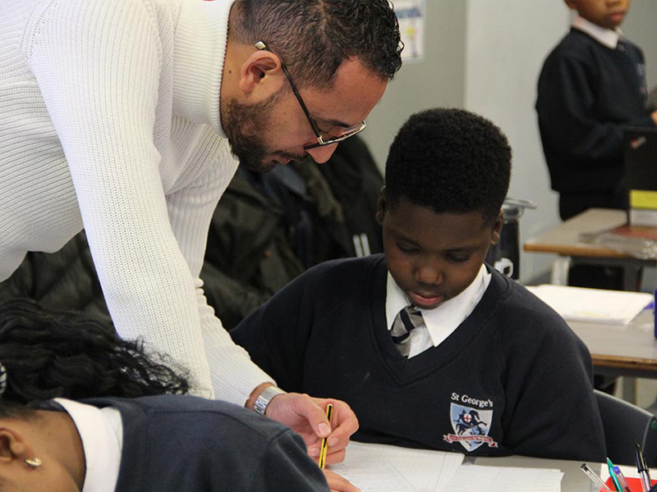
Welcome
St George’s PTA AGM
23rd Nov 21 2pm
Our purpose is:
  to raise funds to supports school projects, equipment and non –curricular activities that enrich the life of the school
  contribute to a friendly and fun school community by organising events like coffee mornings.

Slide 2
Minutes from previous AGM

Slide 3
Elections
3 roles on the PTA needed to be elected: Chair, Secretary and Treasurer. Do you agree the following?
Chair: Zakia
Secretary: Katriona
Treasurer: Kemi
2 Additional appointments:
Comms and Media: Sueann
Donations officer: Irina

Slide 4
The PTA Committee
Headteacher
Mr Andrew Rojas
Chair
Ms Zakia Mohamadi
Secretary
Ms Katriona Beales
Media Relations
Ms Sueann Carter
Treasurer
Ms Olukemi Oketope
Donation Co-ordinator
Ms Irina Petrea
Ms CJ
Ms Princess busayosul
Ms Mamzy
And others! Maybe you?
Committee members

Slide 5
Chair’s Report
Oct 20-Oct 21
Despite the restrictions of the pandemic we had some real successes:
Successful crowd funder to buy laptops. We smashed our target in 24 hours! Resulted in a positive news story in South London Press.
Christmas presents for all children.
Thank you to all supporters, parents, staff and governors.

Slide 6
Financial Statement
Date | Income | Outgoing (paid to school)
BANK ACCOUNT Opening balance 1st Oct 20 £250
28th Oct 20 |  | £4,455.63 (from Peckham Settlement charity – received financial year 19-20)
14th Dec 20 | £200 (received from the British Toy Association)
19th Jan 21 | £151.53 (proceeds from ice cream sales after school)
2nd Feb 21 |  | £300 (paid to school to go towards stationary expenses for children during lockdown)
ADDITIONAL Transactions
May 2021 | £5,952.46 (Crowd-fund total income minus commission to the platform – via Mr Rojas bank account) * | £5,952.46
31st OCT 2021 | TOTAL income = £6,303.99 | TOTAL outgoing money to the school = £10,708.09 | BALANCE as of 31st Oct 21 £301.53
This money enabled the school to buy:
7th August 2020 £4,455.63 Brought Laptops, Tablets, and a caddy
27th January 2021 £300 Brought books
17th May 2021 £5,952.46 Brought Laptops

