Slide 1
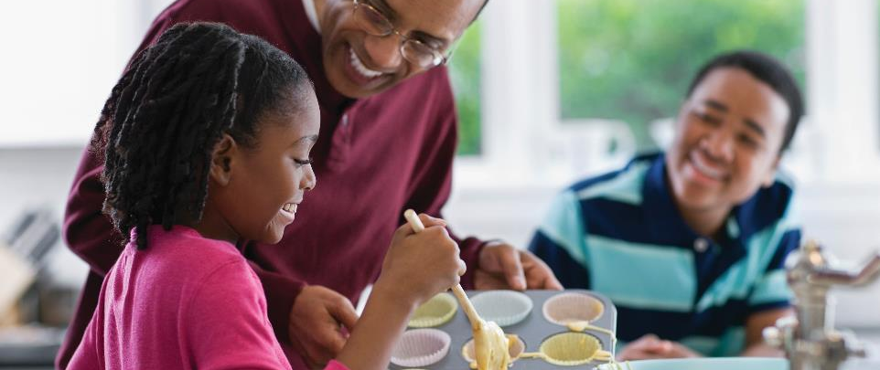
Help Your Child Love Maths!

Slide 2

How do you feel about maths?

Slide 3

Discussion
How do you feel about maths?

Slide 4
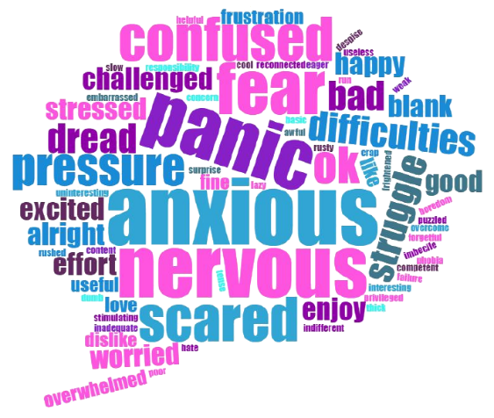
How do you feel about maths?

Slide 5
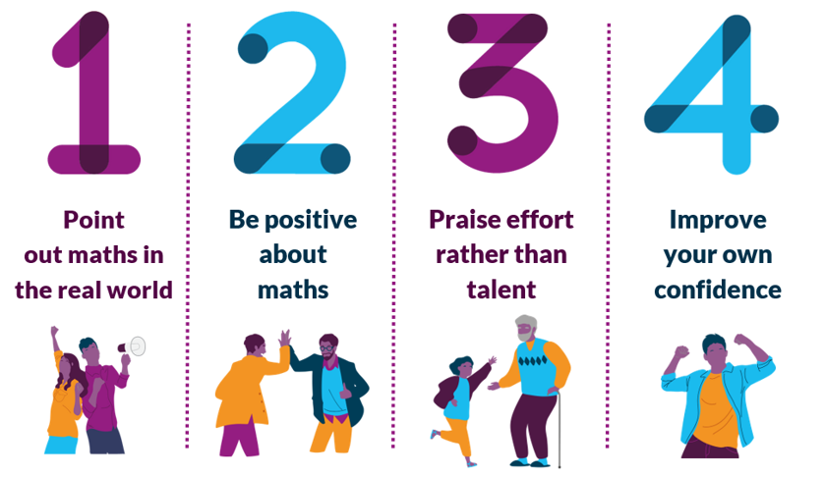
National Numeracy’s top tips for families

Slide 6

National Numeracy’s top tips for families

Slide 7
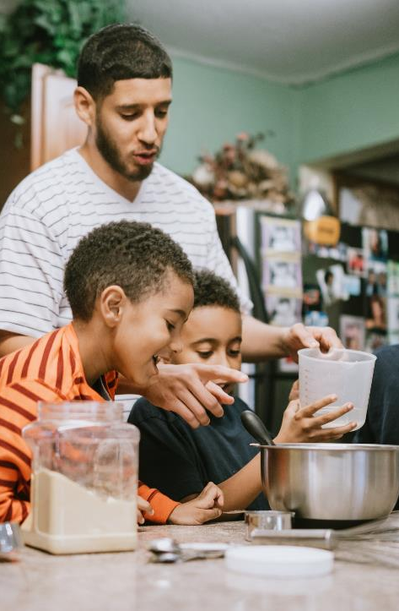
Point out the maths in everyday life

Slide 8
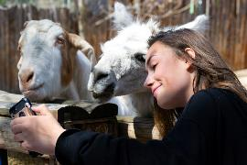


Maths in everyday life
Where do we see maths and numbers in everyday life?
“Students’ motivation to learn maths is higher among students whose parents discuss how mathematics can be applied to everyday life,” (The Programme for International Student Assessment 2013).

Slide 9
Discussion
Where do we see maths and numbers in everyday life?

Slide 10
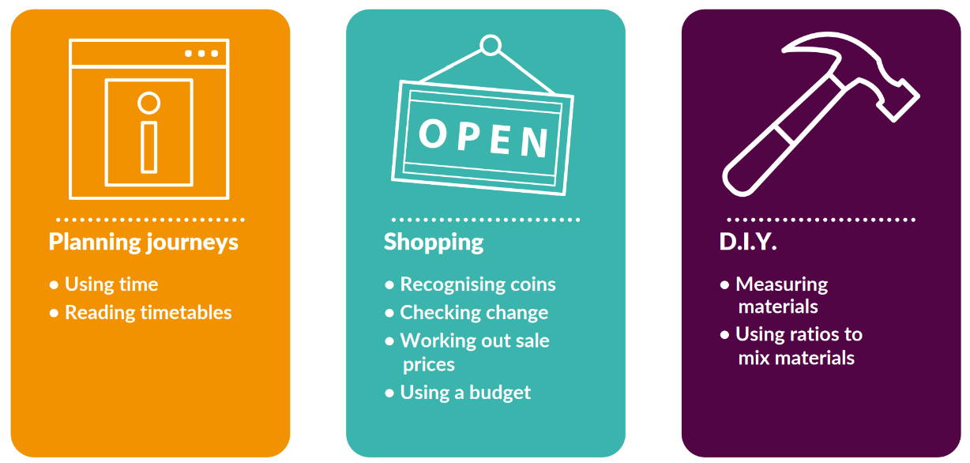
Maths in everyday life

Slide 11
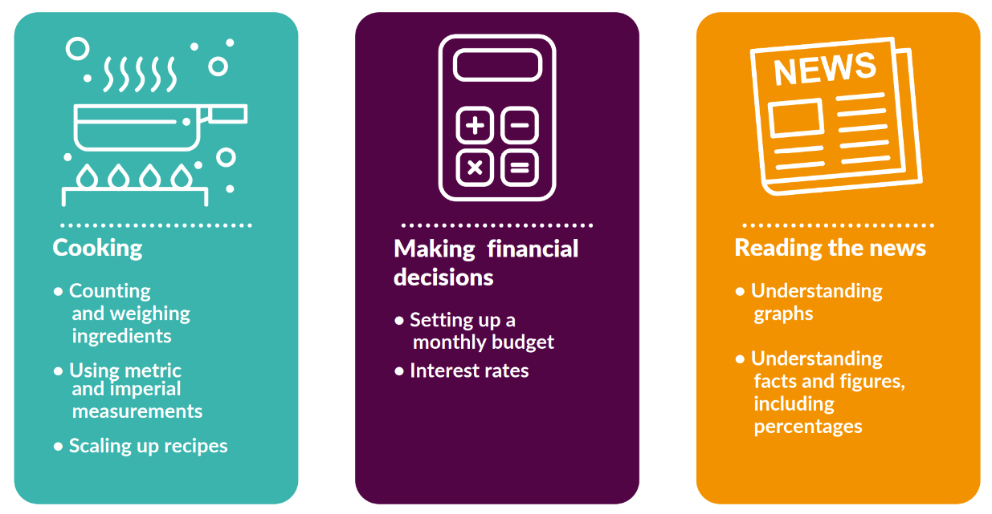
Maths in everyday life

Slide 12

Be positive about maths

Slide 13
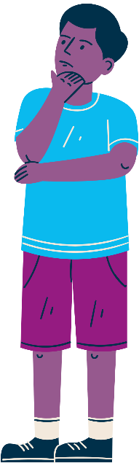
Be positive about maths
Here are some things people sometimes say to children about maths.
Have you heard these things being said?
What could be said instead to encourage positive attitudes in children?

Slide 14


Be positive about maths
“I was never any good at maths at school and it did me no harm.”

Slide 15


Be positive about maths
“You won’t need to worry about maths once you’ve finished school.”

Slide 16


Be positive about maths
“It’s ok. You can’t be good at everything. You’re better at literacy. Your brother is more of a maths-y person.”

Slide 17


Be positive about maths
“Well done for getting that right. You’re so clever.”

Slide 18

Praise effort, rather than talent

Slide 19
Praise effort, rather than talent
Praising talent:
Well done. You’re so clever.
You’re naturally really good at this.
It’s amazing that maths is so easy for you.
Praising effort:
Well done for working so hard at that.
You’ve learned so much, well done.
It’s great that you kept going with that even when it was tricky.

Slide 20
Growth Mindset
Fixed Mindset
Talent is innate
Some people just can’t do certain things
There is no point in trying to improve if you aren’t born with the ability
Growth Mindset
Ability is not fixed
You can learn and improve at anything is you put enough time and effort into it
If you put your mind to it, you will be able to improve: ability isn’t something you’re born with

Slide 21
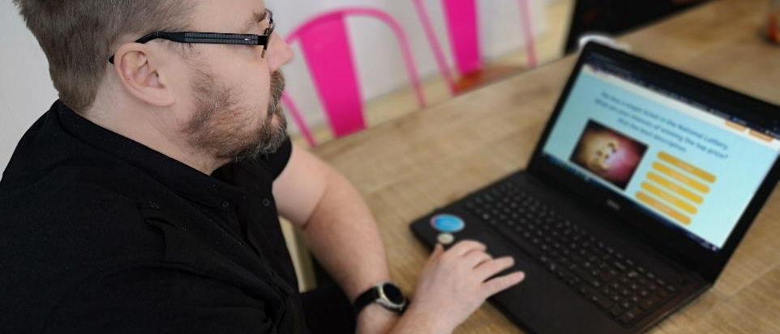
Boost your own confidence

Slide 22

Boost your own confidence

Slide 23
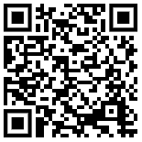

National Numeracy Challenge
www.nationalnumeracy.org.uk/challenge/sfpaq

