Slide 1
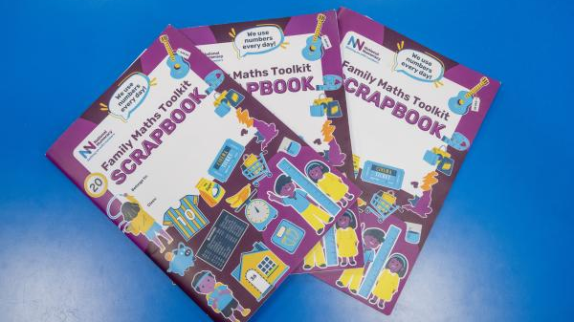
Introducing our Family Maths Scrapbooks
Enjoying maths together at home
This year, children in Years 2–6 will be taking part in the National Numeracy Schools & Families Programme.

Slide 2
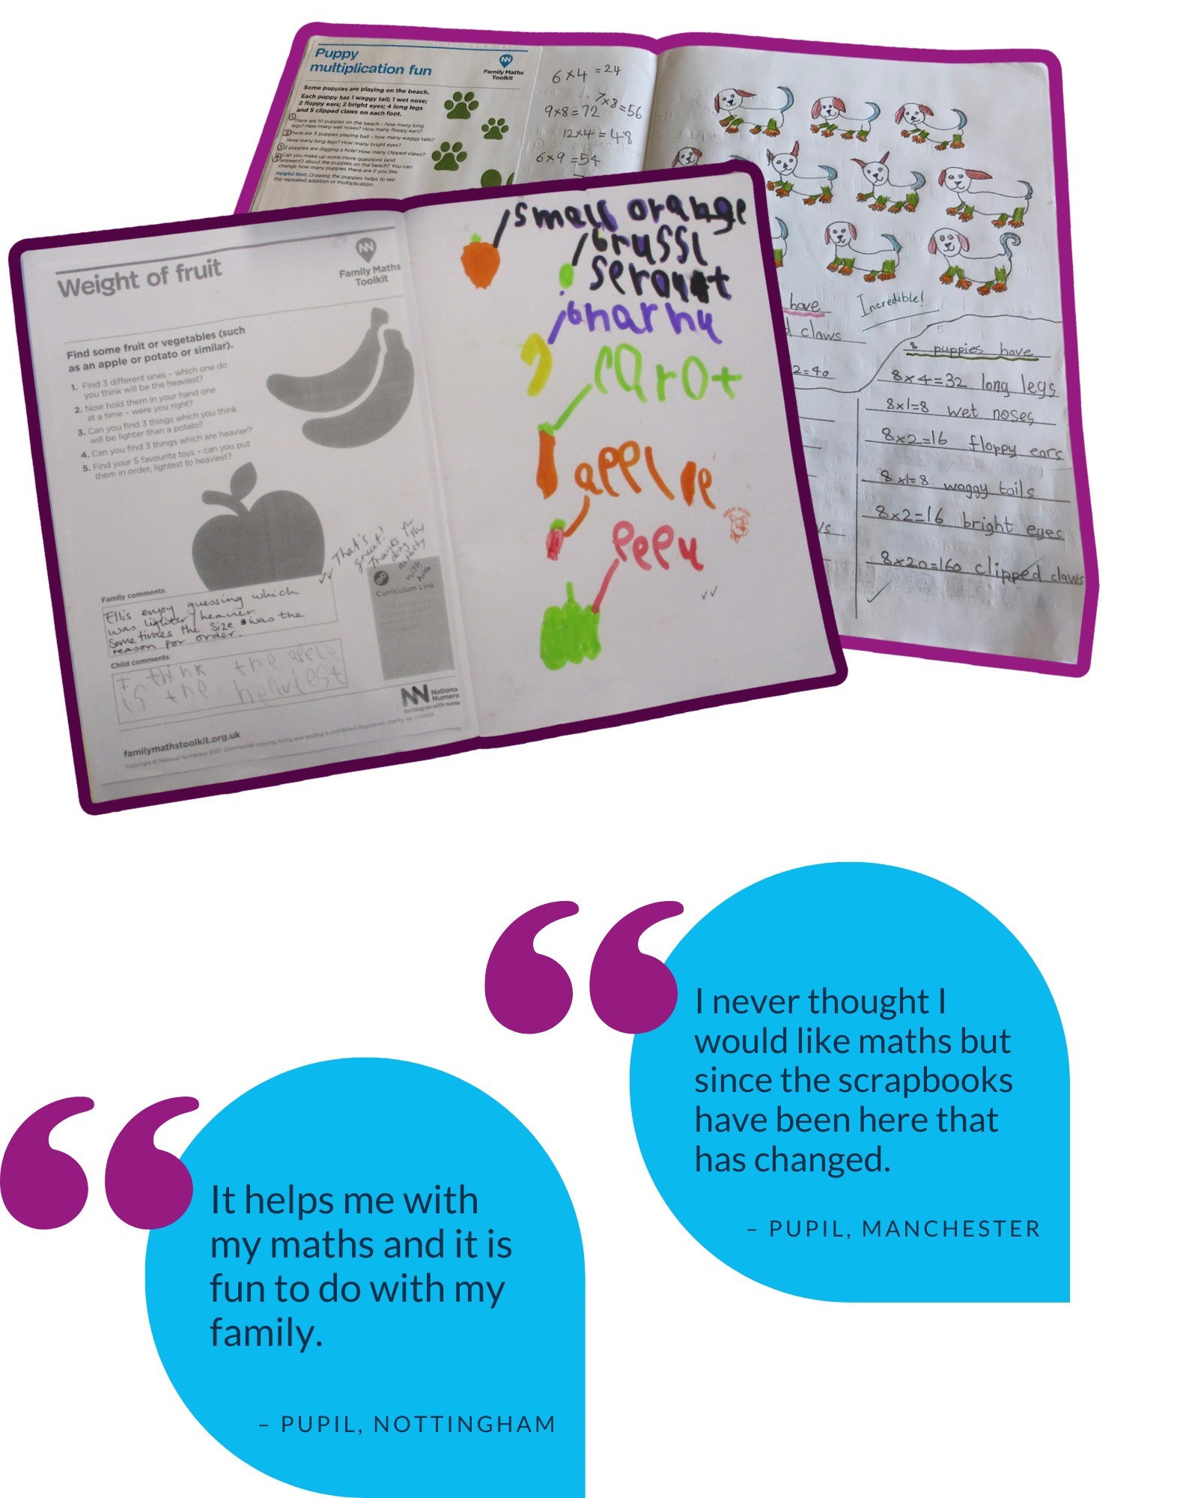
Family Maths Scrapbooks
The programme aims to:
build children's confidence with numbers
develop positive attitudes towards maths
help children recognise how useful maths is outside the classroom
support families to feel confident talking about and enjoying maths together
Notes:
“The purpose isn't to send home more traditional maths homework. We want children to see that maths is all around us and give families opportunities to enjoy exploring maths together.”

Slide 3
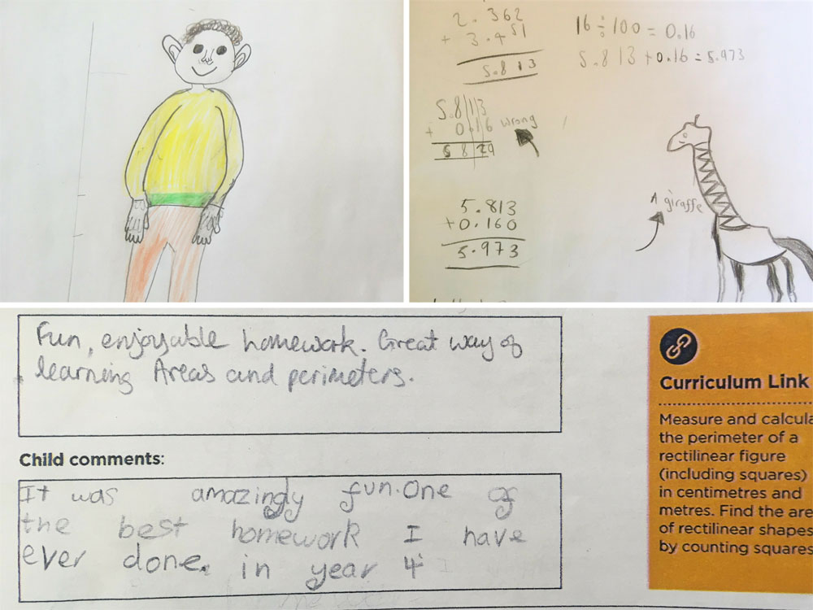
What is a Maths Scrapbook?
How does it work?
Your child will bring home their Family Maths Scrapbook each fortnight with a new activity.
The activity is designed to be explored together as a family but will link to learning they’ve recently done at school.
Children can record their thinking in any way that works for them.
The activities support children's curriculum learning, but often use real-life situations, problem solving and reasoning.
The scrapbook deliberately has blank pages so children and families can choose how they record their ideas. Activities can involve writing, pictures, calculations, photographs or diagrams.
There isn't always one right answer!
Many of the activities are open-ended, allowing families to talk, explore and take their thinking in different directions.

Slide 4
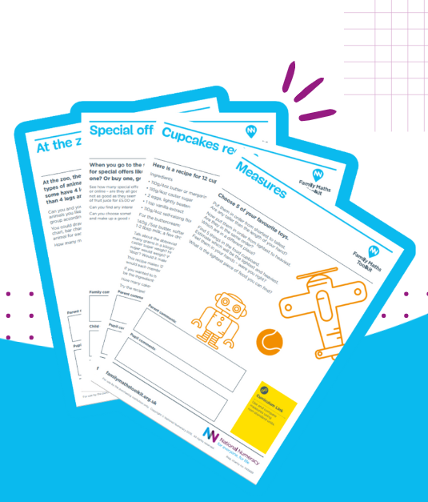
Talk • Explore • Have a go • Enjoy!
You might:
Play a maths game together
Investigate a problem
Spot maths in everyday life
Talk about different ways to solve something
Draw, write or calculate
Add photographs of what you did
The National Numeracy activities are designed so families do not need specialist mathematical knowledge or equipment to take part. The emphasis is on discussion, confidence and exploring maths together.
Notes:
“Please don't worry about teaching your child a particular method or getting everything right. Ask questions, have a go together and let your child explain their thinking. The conversation is really valuable.”

Slide 5
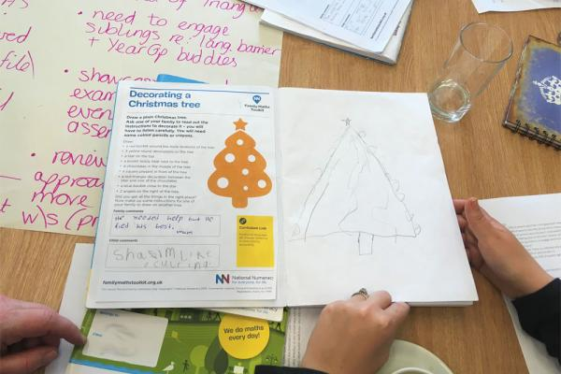
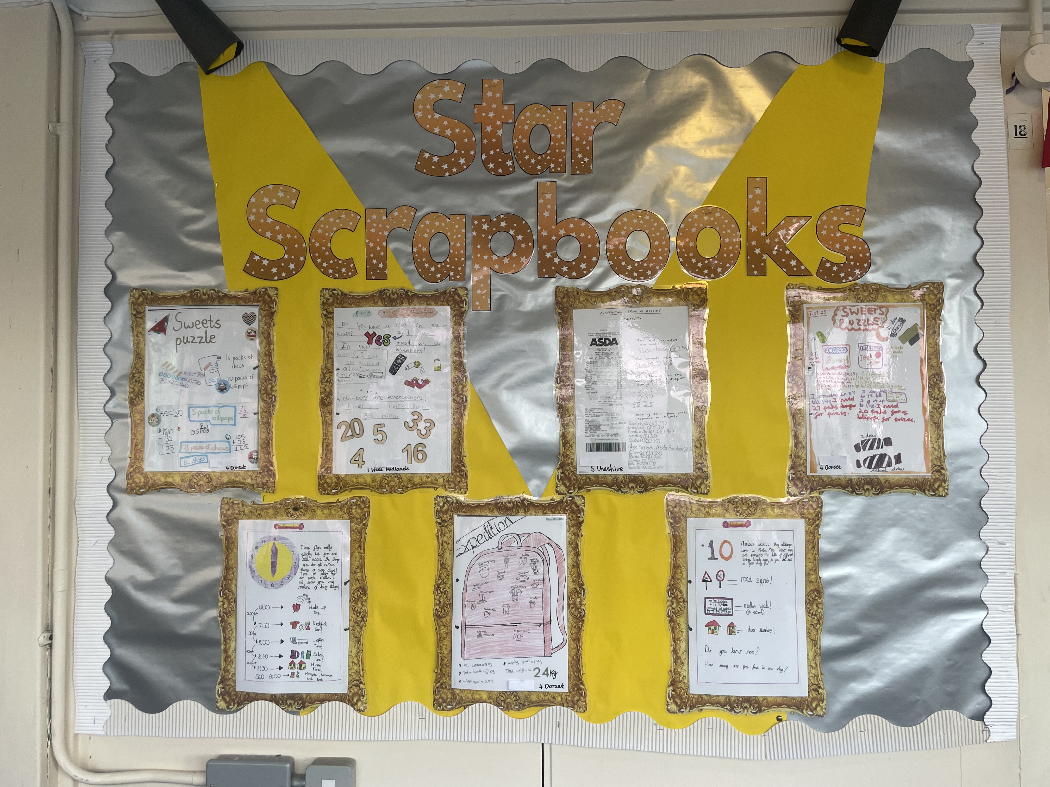
Make maths a positive experience!
The Schools & Families Programme is specifically designed to increase children's confidence and positive feelings about maths, alongside increasing parents' and carers' confidence in supporting their children.
Have a look!
We have some Maths Scrapbooks from last year for you to look through today.
Your child’s first activity, and scrapbook, will be sent home on Monday 12th October 2026.

