Slide 1


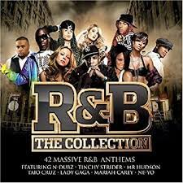

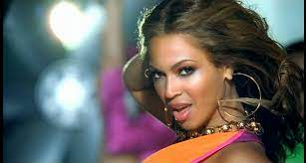
Music Monday
Do Now
Name the music genre from last week…

Slide 2

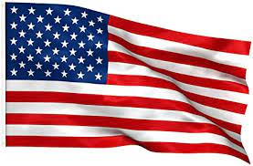
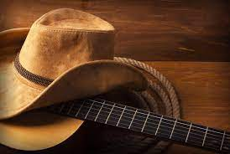
Music Monday
Country
Originating: Around 1920s
Country is a genre of popular music that originated with blues, church music such as Southern gospel and spirituals, old-time, and American folk music forms including Appalachian, Cajun, Creole, and the cowboy Western music styles of New Mexico, Red Dirt, Tejano, and Texas country.

Slide 3
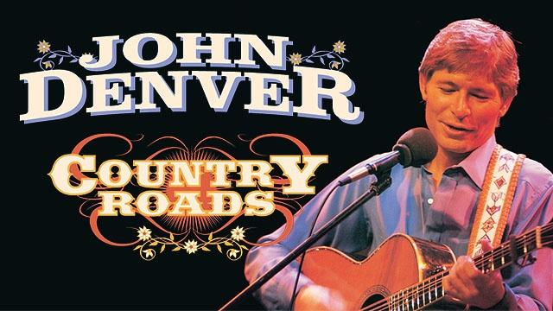

Music Monday
Country
John Denver – Take me home, country roads
Listen carefully

Slide 4
Music Monday
Country
John Denver – Take me home, country roads
TTYP
What instruments can you hear?
Does it sound like any other genre we have listened to?

Slide 5
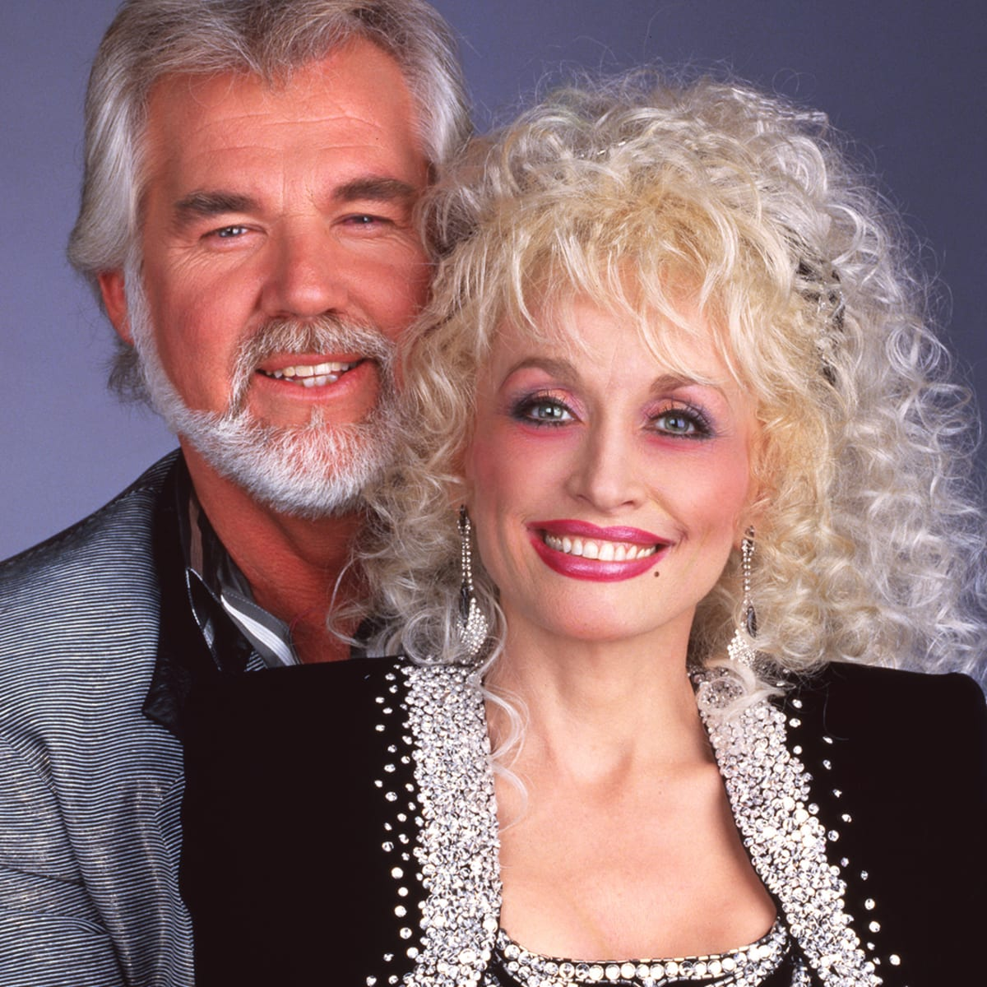
Music Monday
Country
Kenny Rogers & Dolly Parton – Islands In The Stream
Listen carefully

Slide 6
Music Monday
Country
Kenny Rogers & Dolly Parton – Islands In The Stream
Are there any similarities/ differences between the two Country songs we have heard today?
Can you use because in your answer?

Slide 7

Greater Depth
Music Monday
Discuss any other genres we have covered that originate from America.

