Slide 1


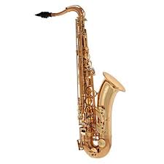

Music Monday
Do Now
Which instrument family does this instrument belong to?
Saxophone
Wind family

Slide 2


Music Monday
Rock n Roll
Rock and roll is a genre of popular music that evolved in the United States during the late 1940s and early 1950s. It originated from black American music such as gospel, jump blues, jazz, boogie woogie, rhythm and blues, as well as country music.

Slide 3
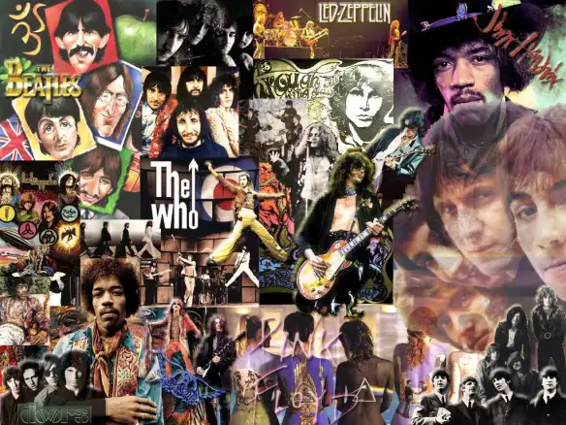
Music Monday
Rock n Roll – Popular Artists
The Beatles
Chuck Berry
Elvis
The Rolling stones
Bob Dylan
The Who
Pink Floyd
Led Zepplin

Slide 4
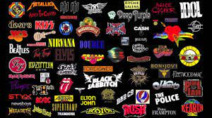
Music Monday
Rock n Roll
Here is a rock n Roll mashup of lots of famous Rock n Roll artists and songs! ENJOY…..
https://www.youtube.com/watch?v=UMcaVUJ_abc

Slide 5
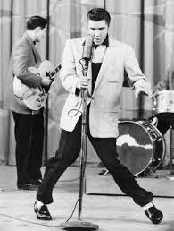

Music Monday
Rock n Roll
Elvis Presley– Hound dog
Listen carefully

Slide 6
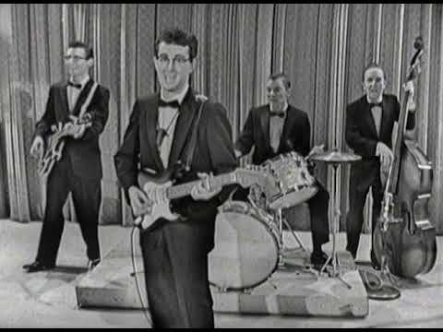
Music Monday
Rock n Roll
Buddy Holly and the Crickets– That’ll be the day
TTYP
How would you describe this genre of music to a friend

Slide 7

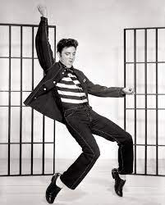
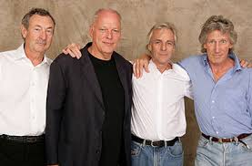
Greater Depth
Music Monday
Which Rock n Roll artist is more modern?
How do you know? How can you tell?
Pink Floyd
Elvis Presley

