Slide 1


LIFE/work balance
We have started a #LIFEworkbalance campaign and we need your help to complete our LIFE/work balance survey.
We hope to publish the results soon, so please give 15 minutes of your time to help us get a true picture of school life.
Want to be a part of this campaign? Take the survey on our website and share it with your colleagues!
© Classroom Secrets Limited 2019

Slide 2

Year 4 – Summer Block 2 – Measurement: Money – Ordering Money
About This Resource:
This PowerPoint has been designed to support your teaching of this small step. It includes a starter activity and an example of each question from the Varied Fluency and Reasoning and Problem Solving resources also provided in this pack. You can choose to work through all examples provided or a selection of them depending on the needs of your class.
National Curriculum Objectives:
Mathematics Year 4: (4M1) Estimate, compare and calculate different measures, including money in pounds and pence
More Year 4 Money resources.
Did you like this resource? Don’t forget to review it on our website.
© Classroom Secrets Limited 2019

Slide 3
Year 4 – Summer Block 2 – Measurement: Money
Step 2: Ordering Money
© Classroom Secrets Limited 2019

Slide 4
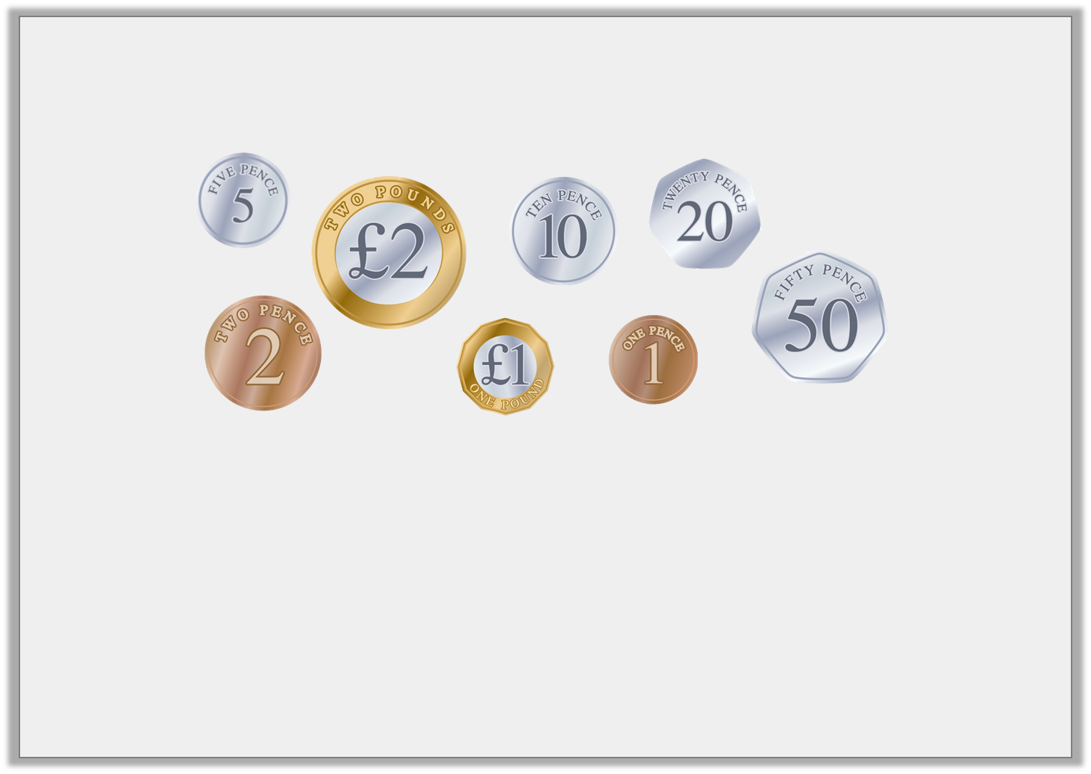
Introduction
Order these coins from lowest to highest value.
How many 10p coins are in £1?
How many 50p coins are in £1?
How many 20p coins are in £1?
How many 5p coins are in £1?
© Classroom Secrets Limited 2019

Slide 5
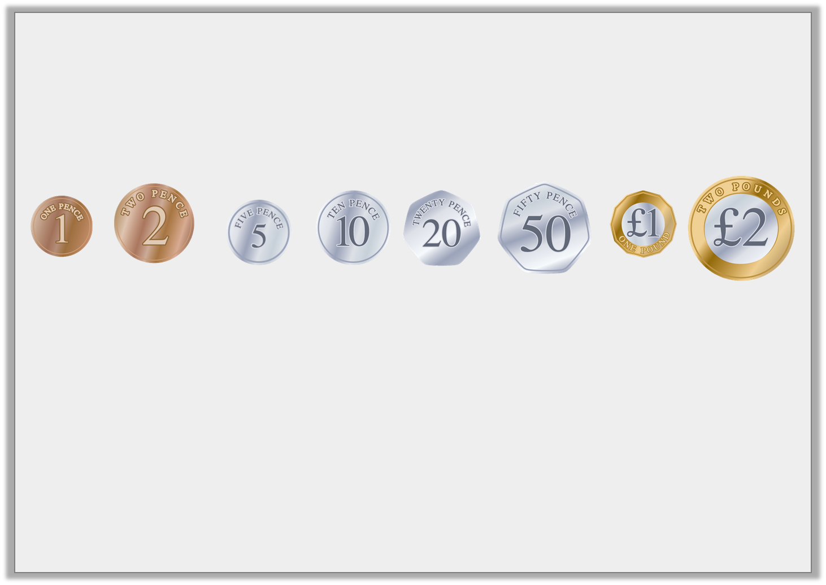
Introduction
Order these coins from lowest to highest value.
How many 10p coins are in £1? 10
How many 50p coins are in £1? 2
How many 20p coins are in £1? 5
How many 5p coins are in £1? 20
© Classroom Secrets Limited 2019

Slide 6
Varied Fluency 1
Order these amounts from smallest to largest.
6,932p |  | 2,135p
4,863p |  | 3,921p
© Classroom Secrets Limited 2019

Slide 7
Varied Fluency 1
Order these amounts from smallest to largest.
2,135p, 3,921p, 4,863p, 6,932p
6,932p |  | 2,135p
4,863p |  | 3,921p
© Classroom Secrets Limited 2019

Slide 8
Varied Fluency 2
Circle the amount that would complete this sequence
£13.45 |  | £14.54 |  | £17.22
£16.99
£17.20
£18.01
© Classroom Secrets Limited 2019

Slide 9
Varied Fluency 2
Circle the amount that would complete this sequence
£13.45 |  | £14.54 |  | £17.22
£16.99
£17.20
£18.01
© Classroom Secrets Limited 2019

Slide 10
Varied Fluency 3
Use >, < and = to compare these amounts.
2,456p |  | 1,452p
£18.97 |  | 1,679p
3,543p |  | £32.67
£45.10 |  | 4,510p
© Classroom Secrets Limited 2019

Slide 11
Varied Fluency 3
Use >, < and = to compare these amounts.
2,456p | > | 1,452p
£18.97 | > | 1,679p
3,543p | > | £32.67
£45.10 | = | 4,510p
© Classroom Secrets Limited 2019

Slide 12
Varied Fluency 4
True or false? The statement below is correct.
1,526 | < | £12.56
© Classroom Secrets Limited 2019

Slide 13
Varied Fluency 4
True or false? The statement below is correct.
False, 1,526p is the same as £15.26 and £15.26 is greater than £12.56.
1,526 | < | £12.56
© Classroom Secrets Limited 2019

Slide 14

Problem Solving 1
Holly has been saving 50p coins.
She has more than £36.50 but less than £39.00.
How much could Holly have?
© Classroom Secrets Limited 2019

Slide 15
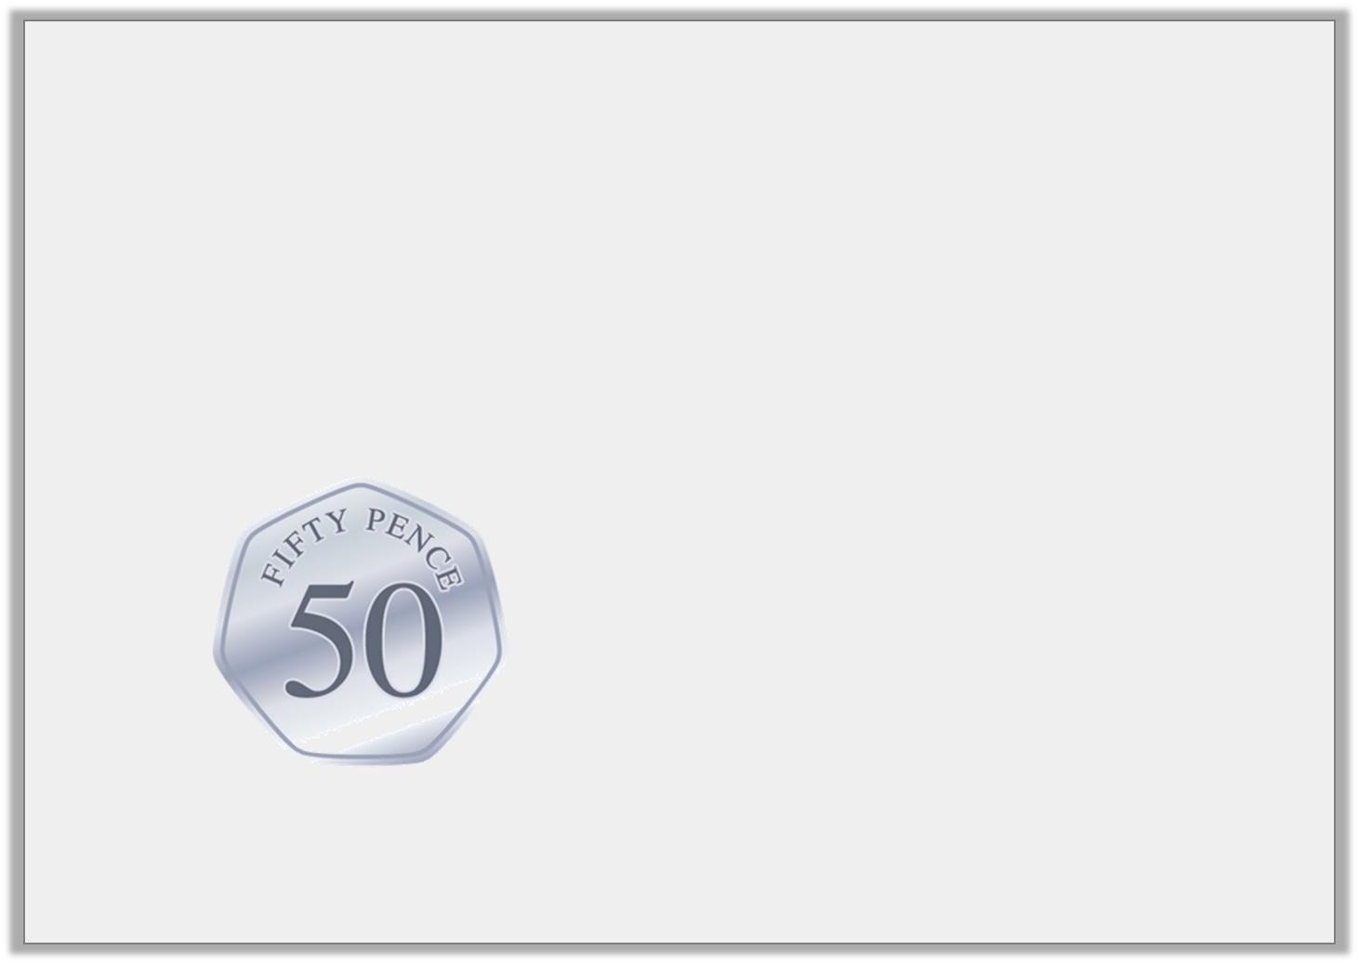
Problem Solving 1
Holly has been saving 50p coins.
She has more than £36.50 but less than £39.00.
How much could Holly have?
£37.00, £37.50, £38.00 or £38.50
© Classroom Secrets Limited 2019

Slide 16
Problem Solving 2
How many ways can you make this statement true? Use the digit cards below.
6
3
5
1
£5.61 >
3
© Classroom Secrets Limited 2019

Slide 17
Problem Solving 2
How many ways can you make this statement true? Use the digit cards below.
12: £3.13, £3.15, £3.16, £3.31, £3.35, £3.36, £3.51, £3.53, £3.56, £3.61, £3.63, £3.65
6
3
5
1
£5.61 >
3
© Classroom Secrets Limited 2019

Slide 18

Reasoning 1
Who has the most money? Explain why.
I have two 50p coins.
I have six 20p coins.
Lee
Milo
© Classroom Secrets Limited 2019

Slide 19
Reasoning 1
Who has the most money? Explain why.
Milo has the most because…
I have two 50p coins.
I have six 20p coins.
Lee
Milo
© Classroom Secrets Limited 2019

Slide 20
Reasoning 1
Who has the most money? Explain why.
Milo has the most because 6 x 20p = 120p
whereas 2 x 50p = 100p.
I have two 50p coins.
I have six 20p coins.
Lee
Milo
© Classroom Secrets Limited 2019

