Slide 1
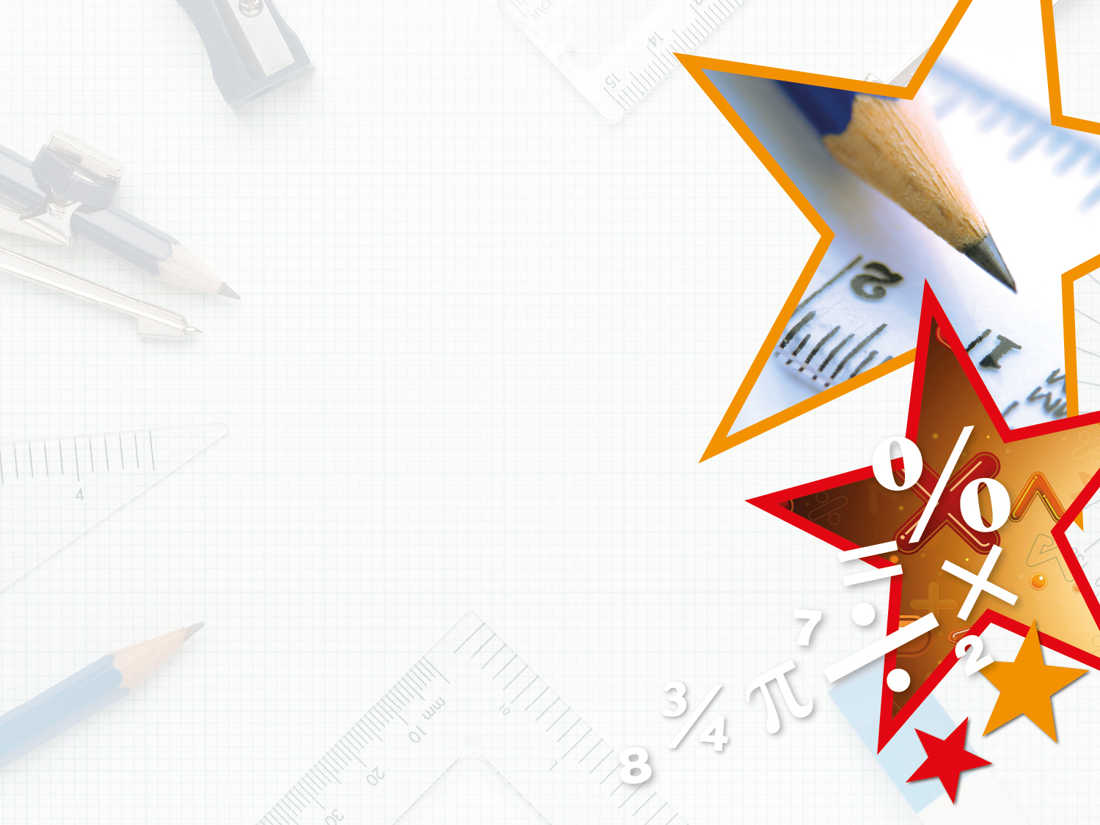
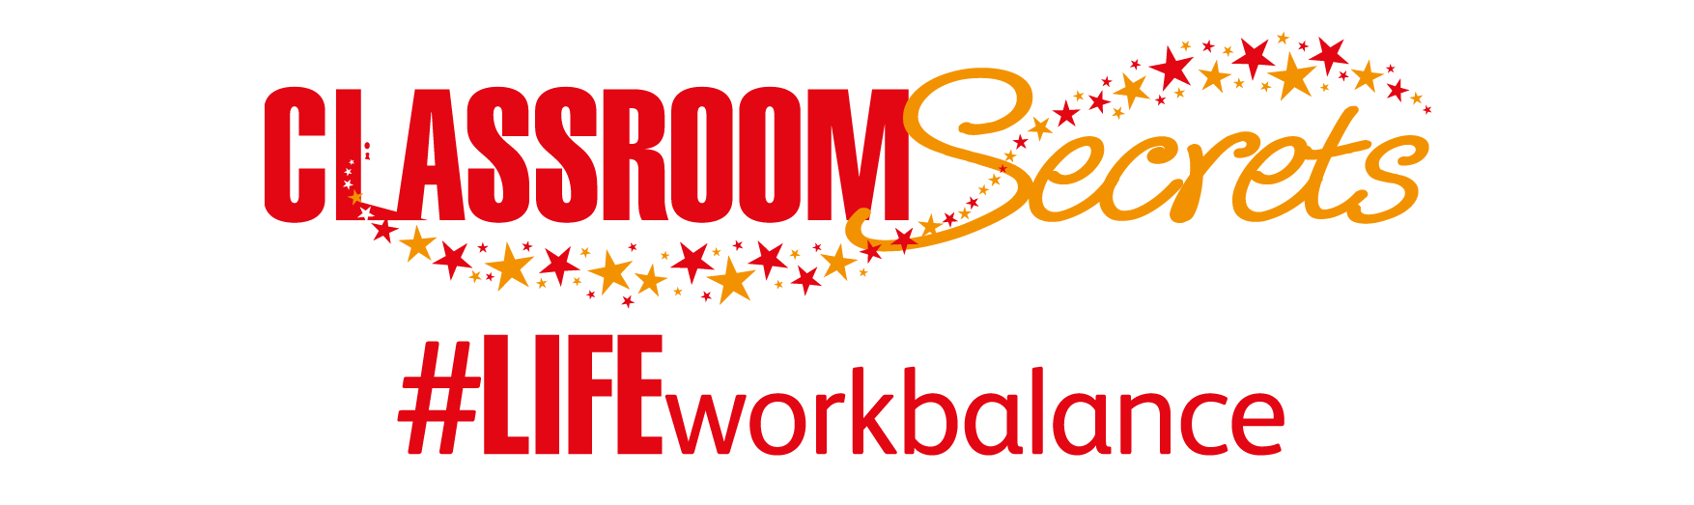

LIFE/work balance
We have started a #LIFEworkbalance campaign and we need your help to complete our LIFE/work balance survey.
We hope to publish the results soon, so please give 15 minutes of your time to help us get a true picture of school life.
Want to be a part of this campaign? Take the survey on our website and share it with your colleagues!
© Classroom Secrets Limited 2020

Slide 2
Year 4 – Spring Block 2 – Area – Comparing Area
About This Resource:
This PowerPoint has been designed to support your teaching of this small step. It includes a starter activity and an example of each question from the Varied Fluency and Reasoning and Problem Solving resources also provided in this pack. You can choose to work through all examples provided or a selection of them depending on the needs of your class.
National Curriculum Objectives:
Mathematics Year 4: (4M7b) Find the area of rectilinear shapes by counting squares
More Year 4 Area resources.
Did you like this resource? Don’t forget to review it on our website.
© Classroom Secrets Limited 2019

Slide 3
Year 4 – Spring Block 2 – Area
Step 4: Comparing Area
© Classroom Secrets Limited 2019

Slide 4
Introduction
Find the area of the shapes below.
A
B
C
© Classroom Secrets Limited 2019

Slide 5
Introduction
Find the area of the shapes below.
A
B
C
14 squares
10 squares
12 squares
© Classroom Secrets Limited 2019

Slide 6
Varied Fluency 1
Circle the shape with the largest area.
 | A |  |  |  |  |  | B
© Classroom Secrets Limited 2019

Slide 7
Varied Fluency 1
Circle the shape with the largest area.
 | A |  |  |  |  |  | B
© Classroom Secrets Limited 2019

Slide 8
Varied Fluency 2
Insert <, > or = to correctly compare the shapes below.
A |  |  |  | B
 | A |  |  |  |  |  | B
© Classroom Secrets Limited 2019

Slide 9
Varied Fluency 2
Insert <, > or = to correctly compare the shapes below.
A |  | < |  | B
 | A |  |  |  |  |  | B
© Classroom Secrets Limited 2019

Slide 10
Varied Fluency 3
Compare the shapes below.
Which statement is incorrect?
A has an area smaller than B.
The area of A is 4 squares smaller than B.
B has an area of 14 squares.
 | A |  |  |  |  | B
© Classroom Secrets Limited 2019

Slide 11
Varied Fluency 3
Compare the shapes below.
Which statement is incorrect?
A has an area smaller than B.
The area of A is 4 squares smaller than B.
B has an area of 14 squares. (B = 13 squares)
 | A |  |  |  |  | B
© Classroom Secrets Limited 2019

Slide 12
Problem Solving 1
Using the clues below, give the possible area of shape B.
 |  |  |  |  | A
The area of B is smaller than A.
B’s area is a multiple of 3.
© Classroom Secrets Limited 2019

Slide 13
Problem Solving 1
Using the clues below, give the possible area of shape B.
Any multiple of 3 squares between 3 and 15 squares.
 |  |  |  |  | A
The area of B is smaller than A.
B’s area is a multiple of 3.
© Classroom Secrets Limited 2019

Slide 14
Problem Solving 2
Draw a rectilinear shape with an area greater than 14 squares.
© Classroom Secrets Limited 2019

Slide 15
Problem Solving 2
Draw a rectilinear shape with an area greater than 14 squares.
Various answers, for example:
© Classroom Secrets Limited 2019

Slide 16
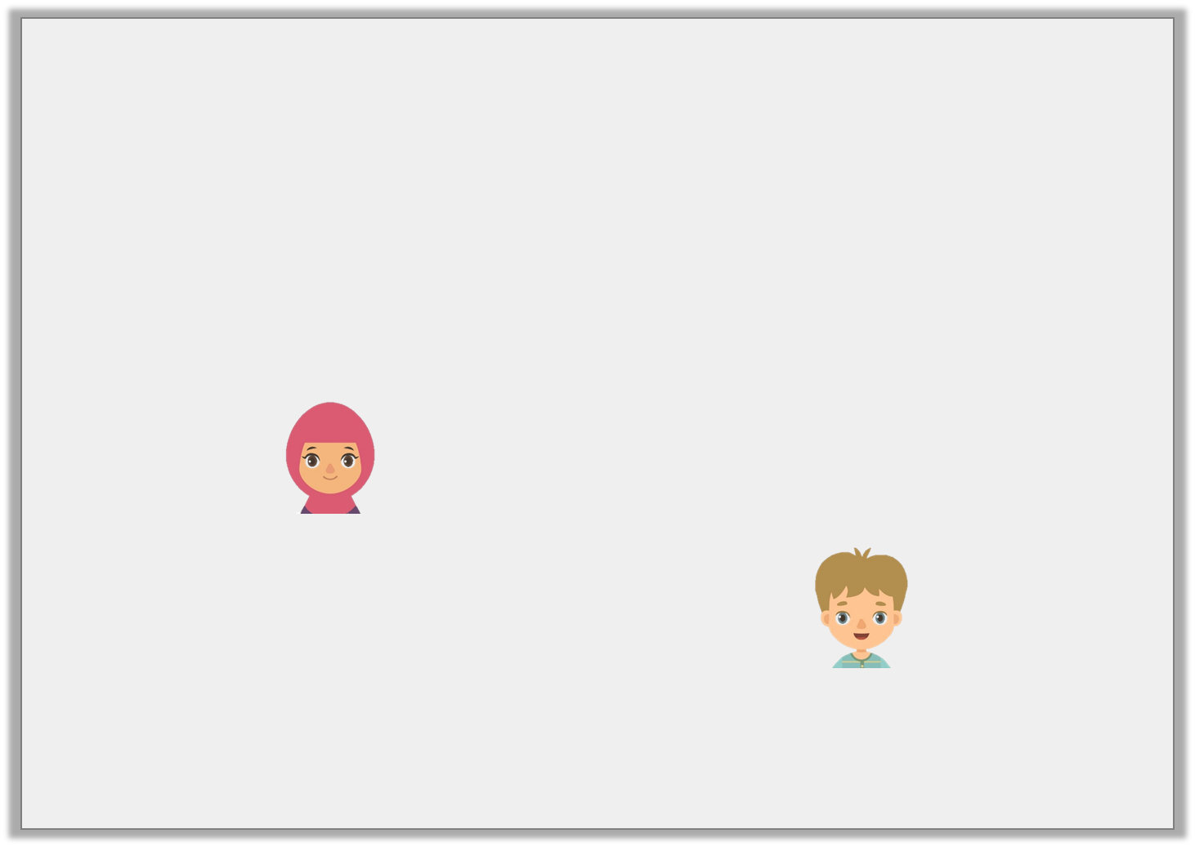
Reasoning 1
Kiran and Max are comparing the area of two shapes.
Who is correct? Prove it.
A |  |  |  |  |  |  | B
Shape A has a larger area.
Kiran
The shapes have the same area.
Max
© Classroom Secrets Limited 2019

Slide 17
Reasoning 1
Kiran and Max are comparing the area of two shapes.
Who is correct? Prove it.
Kiran is correct because…
A |  |  |  |  |  |  | B
Shape A has a larger area.
Kiran
The shapes have the same area.
Max
© Classroom Secrets Limited 2019

Slide 18
Reasoning 1
Kiran and Max are comparing the area of two shapes.
Who is correct? Prove it.
Kiran is correct because the area of A is 11 squares and the area of B is 10 squares.
A |  |  |  |  |  |  | B
Shape A has a larger area.
Kiran
The shapes have the same area.
Max
© Classroom Secrets Limited 2019

