Slide 1

Colour Recap
What are the three primary colours?
If I mix blue and yellow, what colour do I get?
If I mix red and yellow, what colour do I get?
If I mix red and blue, what colour do I get?

Slide 2


Hot or Cold?
Colours can be sorted into two categories: hot or cold.
Which colours do you think about when you hear the word ‘hot’?
Which colours do you think about when you hear the word ‘cold’?

Slide 3

Colour Wheel
Hot
Cold

Slide 4

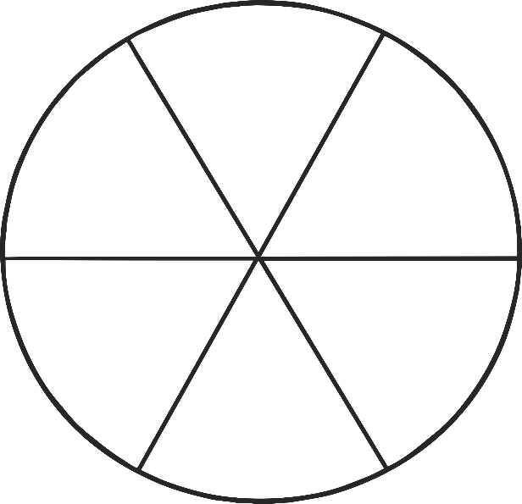
Cold Colours
Cold colours are:
Green
Blue
Purple
Apart from being cold, how do these make you feel?

Slide 5
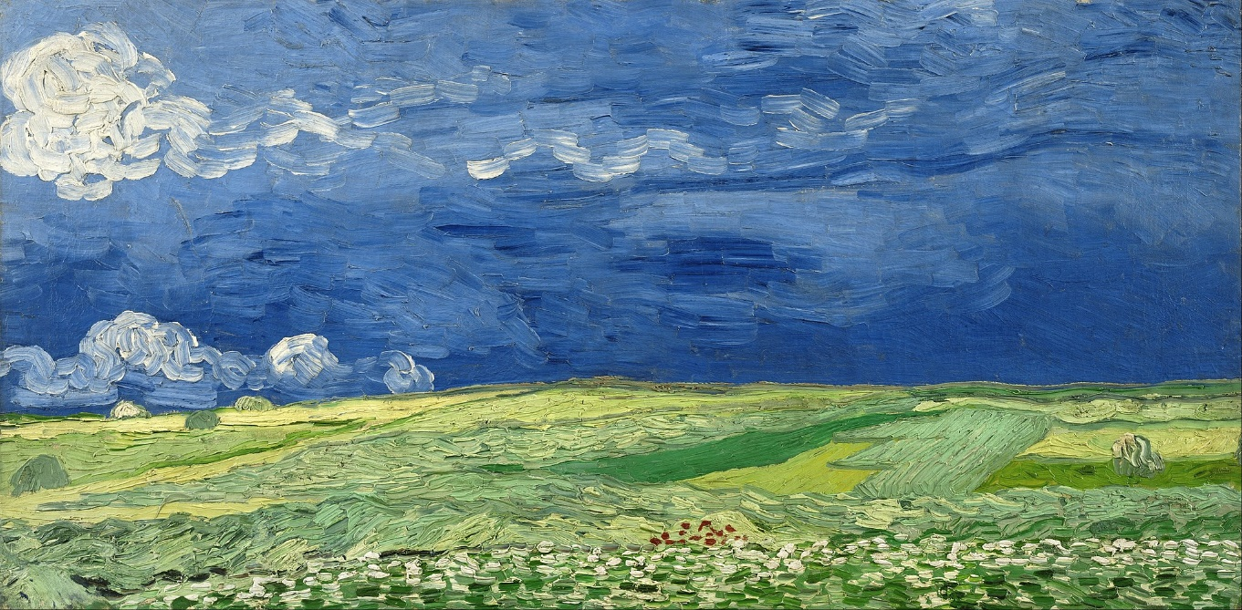
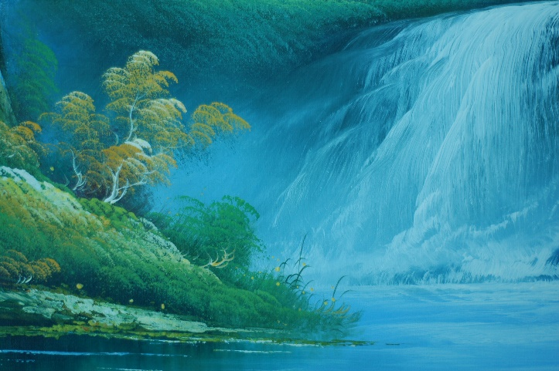
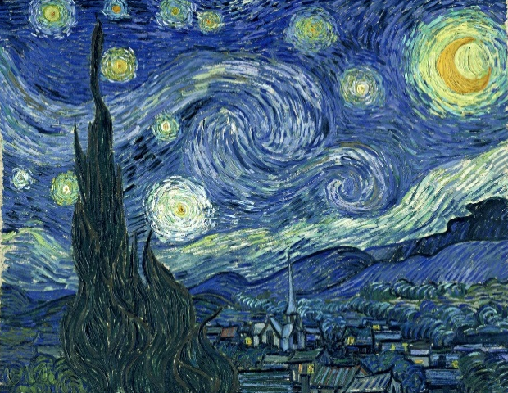
Art Using Cold Colours
Click to enlarge!
Photo courtesy of Vincent Van Gogh (@Wickimedia), Sonictk (@flickr.com) - granted under creative commons licence – attribution

Slide 6
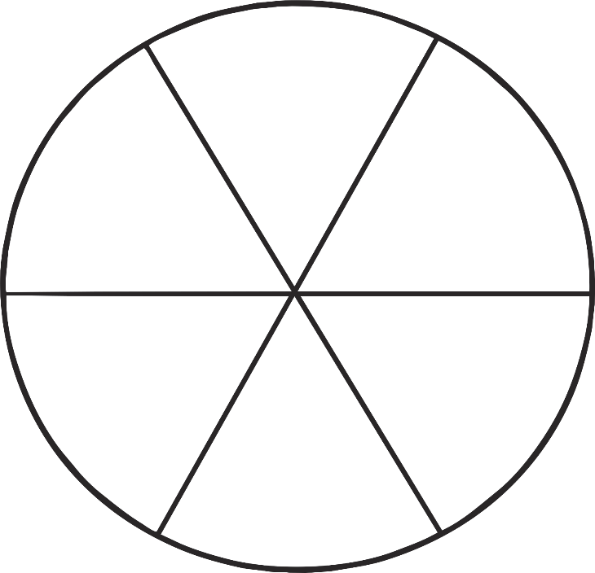

Hot Colours
Hot colours are:
Yellow
Orange
Red
What do these colours make you feel and think?

Slide 7
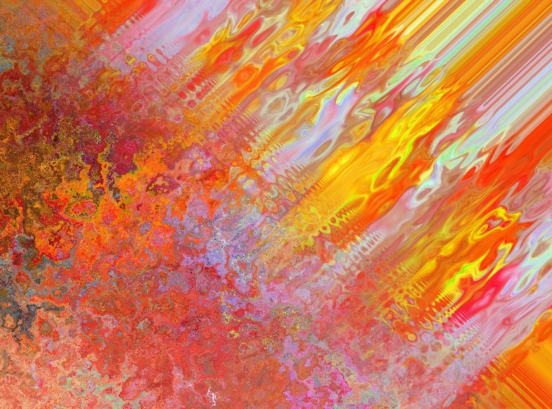
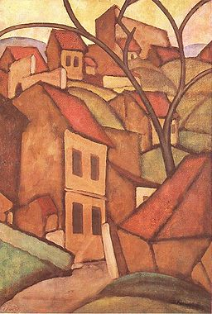
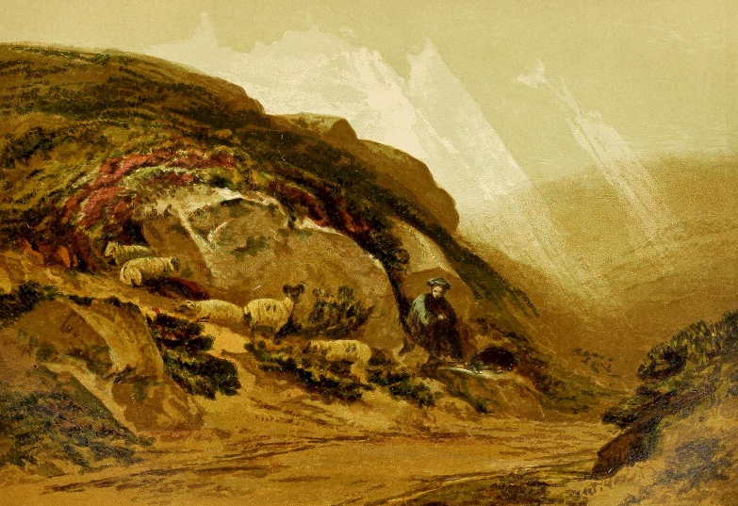
Art Using Hot Colours
Click to enlarge!
Photo courtesy of Banard, George, Jedudedek (@Wickimedia), KreativeHexenkueche (@pixabay.com) - granted under creative commons licence – attribution

Slide 8
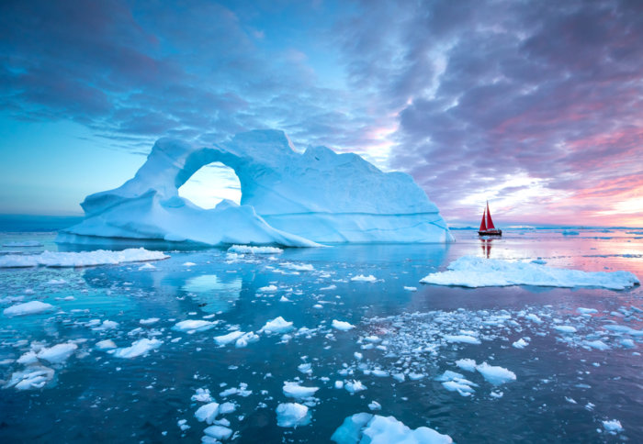
What type of colours would an artist use to create a painting of the Arctic?

Slide 9

Lets look at a real artist’s paintings of the Arctic!

Slide 10


Artist: Linda Lang
LO: To describe the work of Linda Lang and use some of the ideas in her work to create our own Arctic scenes.

Slide 11
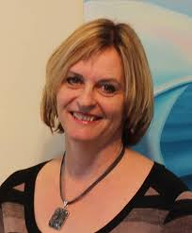
Who is Linda Lang?
Linda Lang is a Canadian expedition and climate change artist who travels to the polar regions to create paintings of what she sees there.
She believes strongly in climate change and tries to tell people that we need to change how we live our lives so that we can stop the damage to our world.
Her paintings are based on the knowledge she gained from her Inuit friends, scientists and over a dozen expeditions to the Polar Regions.
She first travelled to the Arctic in 2002

Slide 12
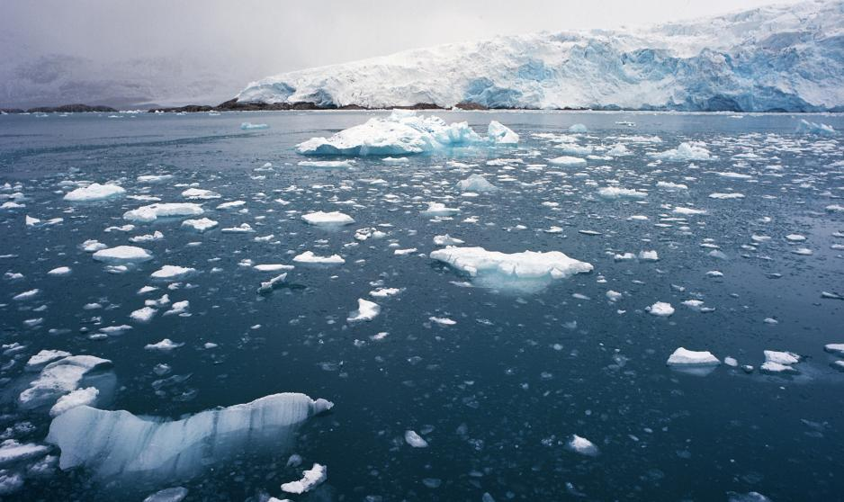
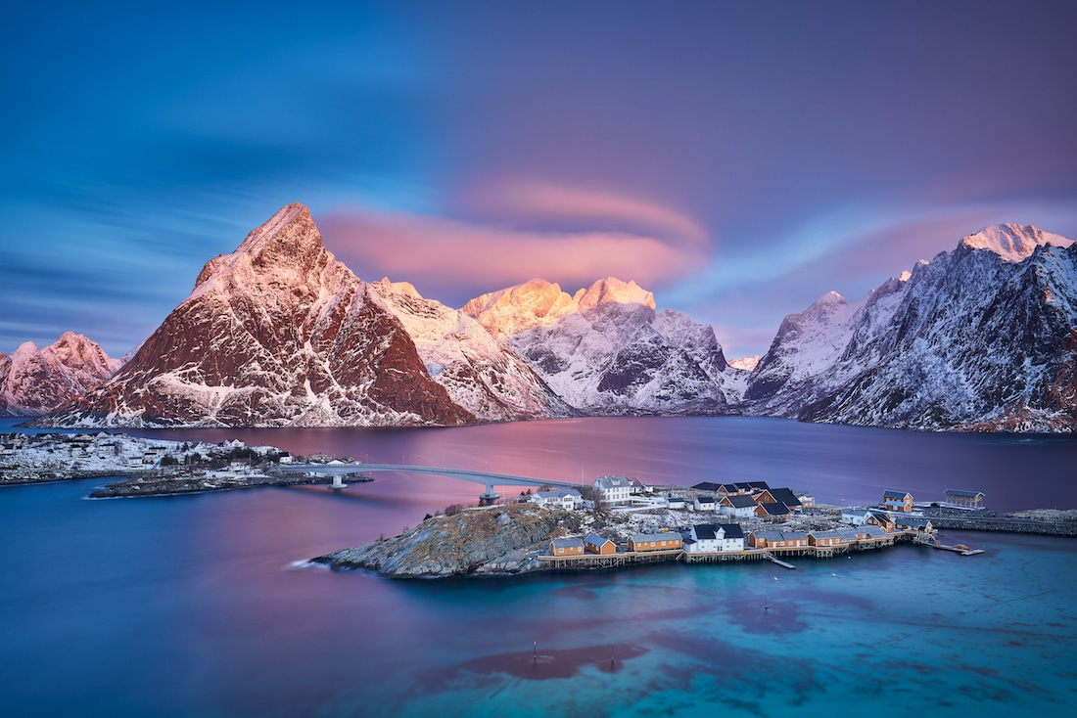
What Linda Lang see in the Arctic
What colours might she use to paint this?

Slide 13
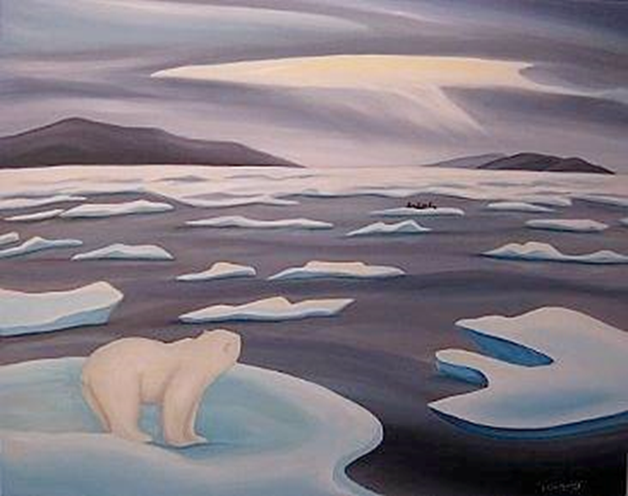
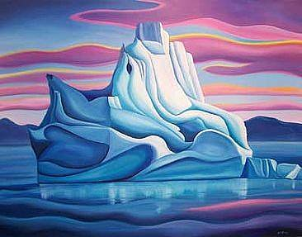
These are some of her paintings
What do you like about her paintings?
Are they the colours that you thought she would use?

Slide 14
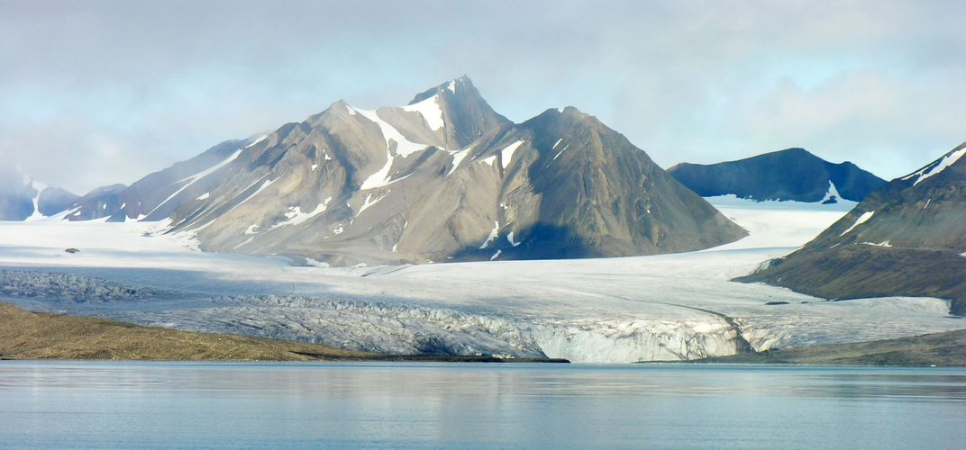
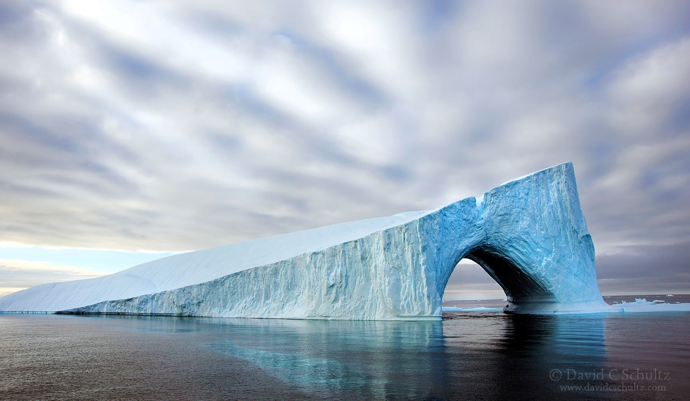
What Linda Lang might see in the Arctic
What colours might she use to paint this?

Slide 15
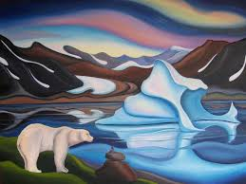
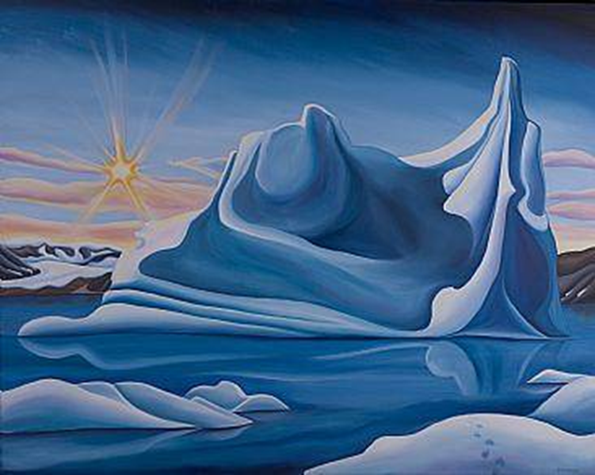
These are some of her paintings
What do you like about her paintings?
Why do you think she used those colours?

Slide 16
In your books write down what you like about her paintings and what colours you can see
I like her paintings because…
She uses______ , _______ and _______ because…

Slide 17
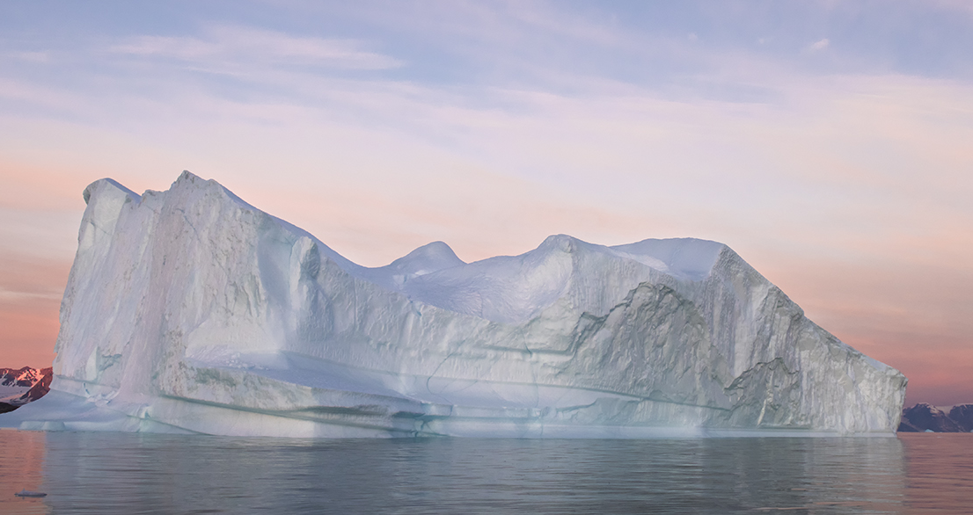
We are going to paint this iceberg in the style of Linda Lang.

Slide 18
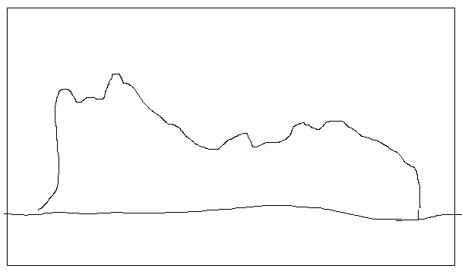
1. Use a pencil to draw an outline of the iceberg.

Slide 19
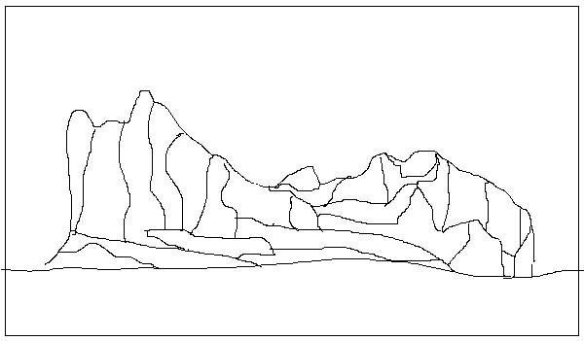
2. Look for different lines and shapes on the iceberg to make it stand out

Slide 20
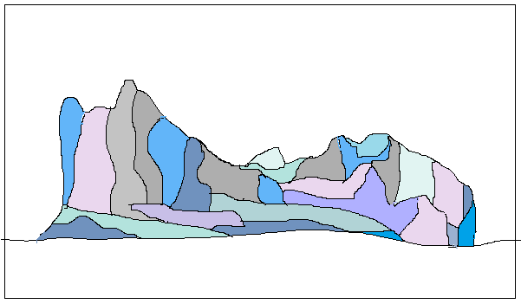
3. Use cool colours to paint in the different parts of the iceberg

Slide 21
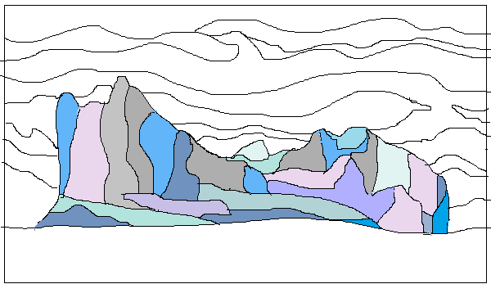
4. Draw the mountains in the background and some of the clouds

Slide 22
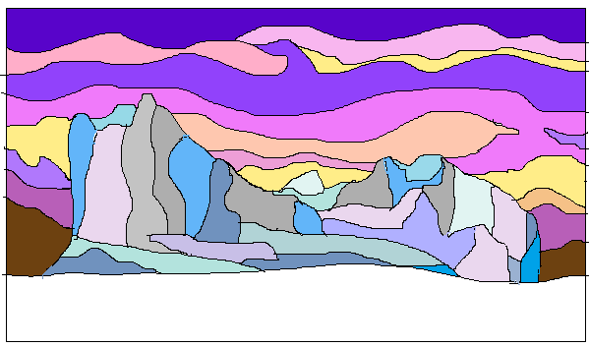
5. Paint the mountains and sky, use the photograph to help you choose colours.

Slide 23
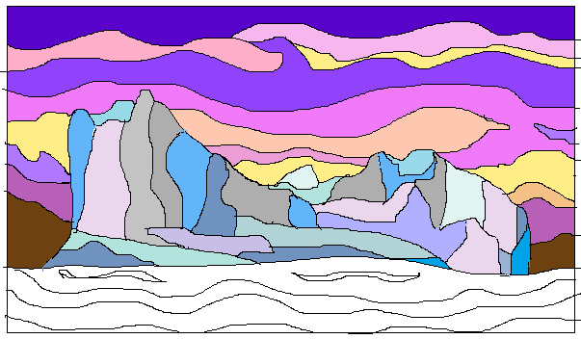
6.Draw some lines to show the ripples in the water.

Slide 24
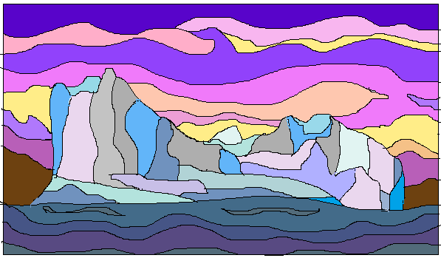
6.Use darker blue colours to show the deep ocean.

Slide 25
Now compare your work to Linda Lang’s painting, does it look similar?
WELL DONE!

