Slide 1
Your strengths and the NHS

Slide 2
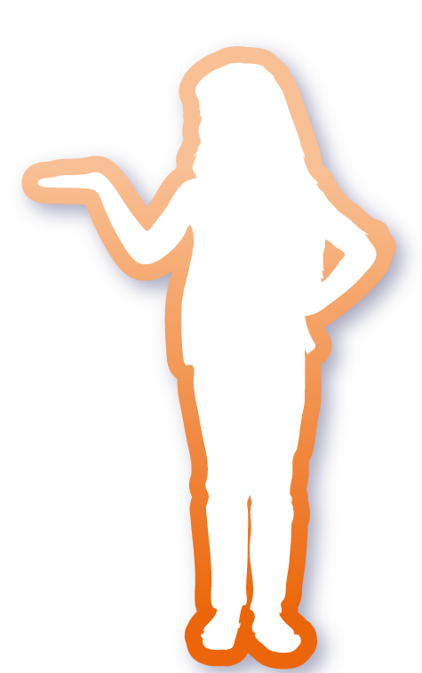
What will you learn?
You will describe what you are like, what you are good at and what you enjoy doing.
You will talk positively about what you might like to do.
You will learn about people's rights to opportunities.
You will learn about the NHS and understand there are a wide range of jobs in the NHS.

Slide 3
Who am I?
Self portrait activity

Slide 4


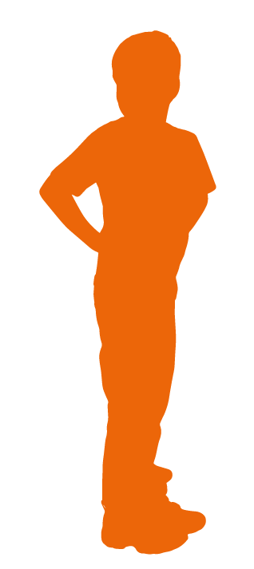
Who am I?
Tell the person next to you one thing you really like doing and why.

Slide 5
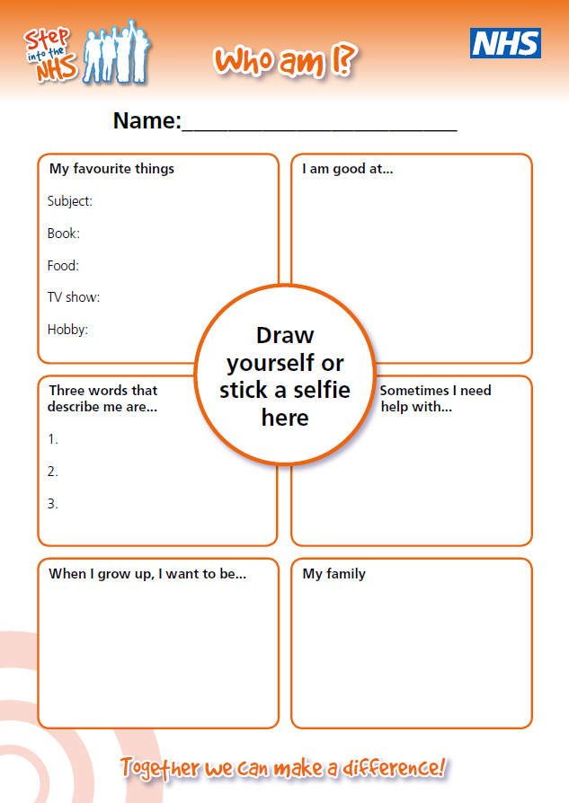
Who am I?
You are going to describe some of the things that make you who you are.
For example:
What you are like
What you are good at
What you enjoy doing

Slide 6
Who am I?
What do you think you might want to do when you grow up and why?
How do you think you can get there?

Slide 7
Who am I?
“Like me” or “Not like me”

Slide 8
Who am I?
Different jobs require different skills and knowledge.
Tick the things that are most like you.
Put a cross against the things that are least like you.

Slide 9

Who am I?
Describe yourself to the person next to you. Use the things you have ticked on the sheet to help you. Think about why you made those choices.
Did you learn something new about your partner?

Slide 10
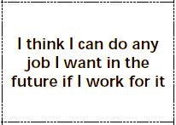

Who am I?
Show of hands
Did you put a tick against this point?
Is there anything you think you can’t do?
If so, why?

Slide 11
Did you really know?
Quiz time

Slide 12
1. Who employs the most people in the UK?
1. McDonalds | 2. National Health Service (NHS)
3. Tesco | 4. Google

Slide 13
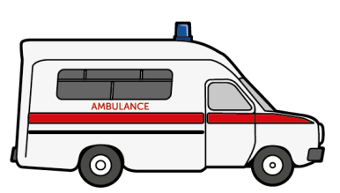
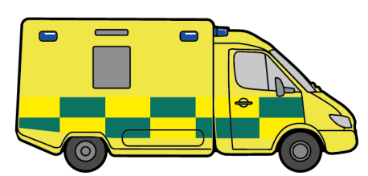



The NHS employs the most people in the UK and is the largest employer in Europe.

Slide 14
2. How many children from our school are likely to work for the NHS in the future?
1. One person from our school will work there | 2. One person from each key stage will work there
3. One person in every year group will work there | 4. One person in nearly every class will work there

Slide 15
1.7 million people work for the NHS in the UK which means someone in every class is likely to work for the NHS in the future.

Slide 16
3. If there were 100 NHS workers in a room, how many do you think would be doctors, nurses and midwives?
1. All of them | 2. More than half
3. Half of them | 4. Less than half

Slide 17
Less than half. It’s not just doctors, nurses and midwives in the NHS. A lot of jobs have nothing to do with blood whatsoever!

Slide 18
4. How many different types of jobs or roles are there in the NHS?
1. Over 350 different jobs | 2. Around 250 different jobs
3. Almost 100 different jobs | 4. Under 50 different jobs

Slide 19
There are over 350 jobs to explore in the NHS.

Slide 20
5. You need to be top of the class in science and go to university to work for the NHS.
True | False

Slide 21
False. There are lots of jobs in the NHS that are not science-based. You don’t need to go to university for them all either. You can enter different jobs in a variety of ways.

Slide 22
6. Which of these jobs can you do for the NHS?
Gardener | 2. Driver
3. Surgeon | 4. Chef

Slide 23
You can do all of these jobs and so many more for the NHS.

Slide 24
7. Can men be midwives and nurses? True or false
True | False

Slide 25
Yes. Men and women can both be midwives so long as they have all the same training and skills.

Slide 26
8. Which of these jobs can be only be done by a man or a woman?
Surgeon | 2. Children’s nurse
3. Paramedic | 4. Doctor

Slide 27
They can all be done by men or women. Different people will prefer to do different jobs. One might love caring for children and become a nurse for the NHS. Another might choose to train as a surgeon.

Slide 28
9. Everyone has the same opportunities to do a job as each other? True or false
True | False

Slide 29
True. Everyone has the same rights to opportunities as each other.

Slide 30
10. The NHS has been helping us for many years, but in which year was it born?
a) 1978 | b) 1918
c) 1998 | d) 1948

Slide 31
d) The NHS was launched in 1948
It was set up to provide free healthcare to everyone and employed 144,000 people in 1948.

Slide 32
What did you learn?
Learning outcomes

Slide 33
Learning outcomes
You can describe what you are like, what you are good at and what you enjoy doing.
You can talk positively about what you might like to do.
You know there is no such thing as a man’s or woman’s job. You have the same rights to opportunities as each other.
You know about the NHS and understand there are a wide range of jobs in the NHS.

