Slide 1


Meet the Teacher Evening
2026/27

Slide 2

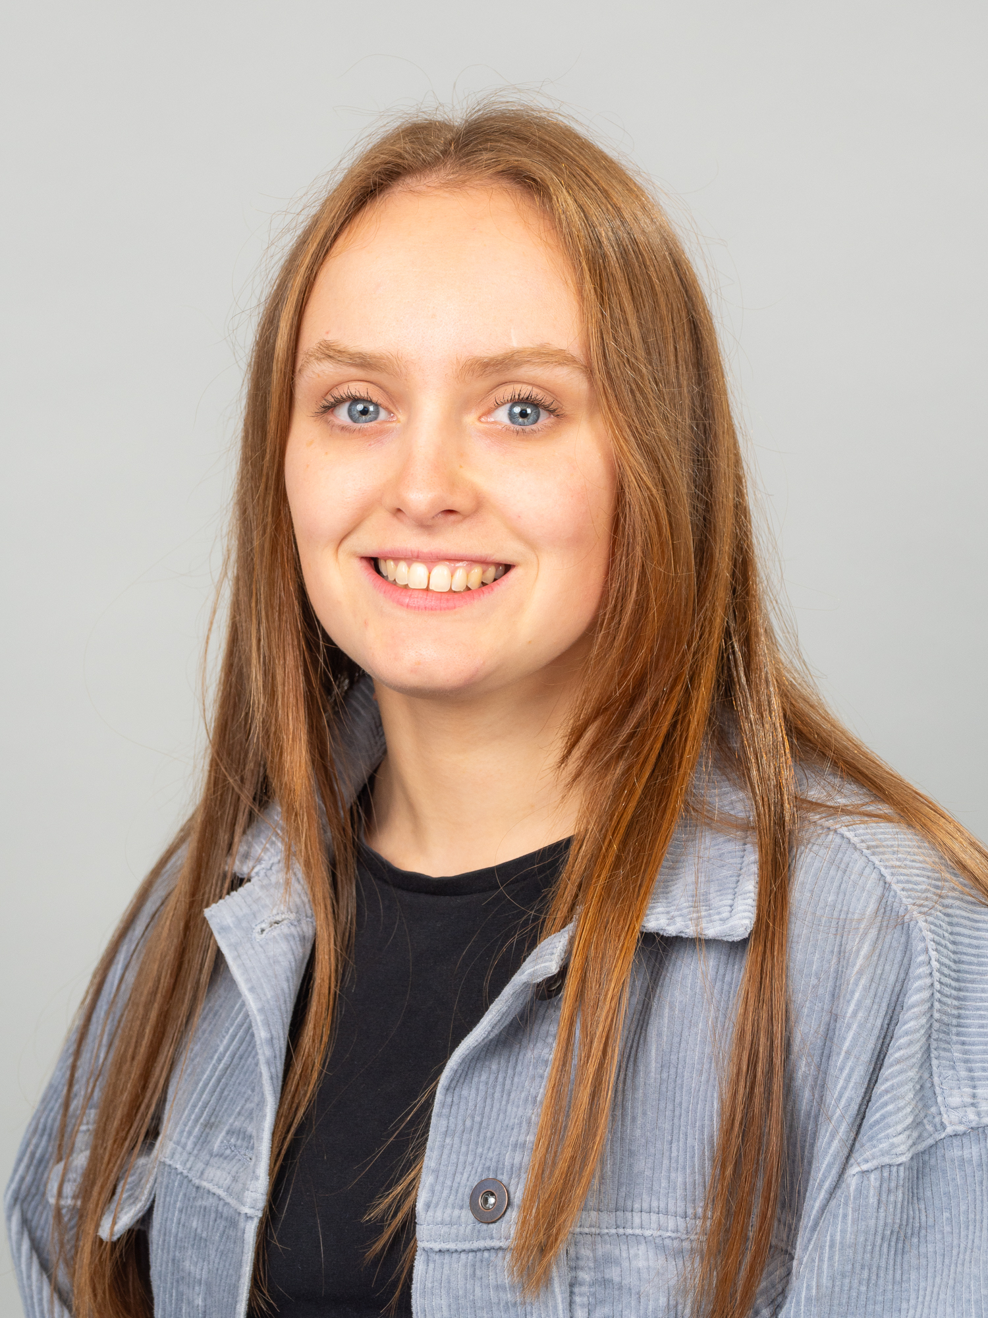
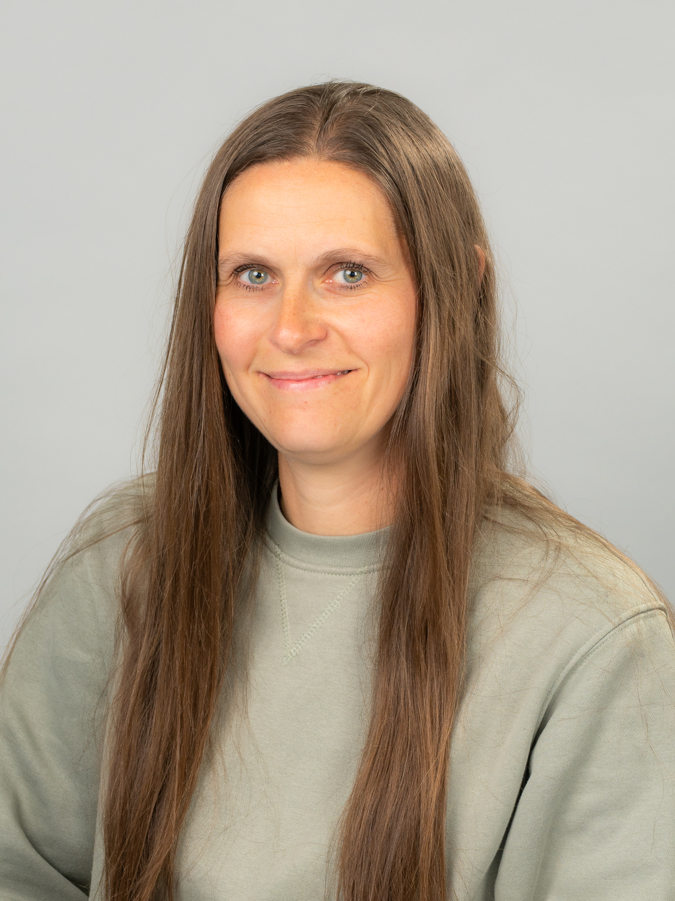
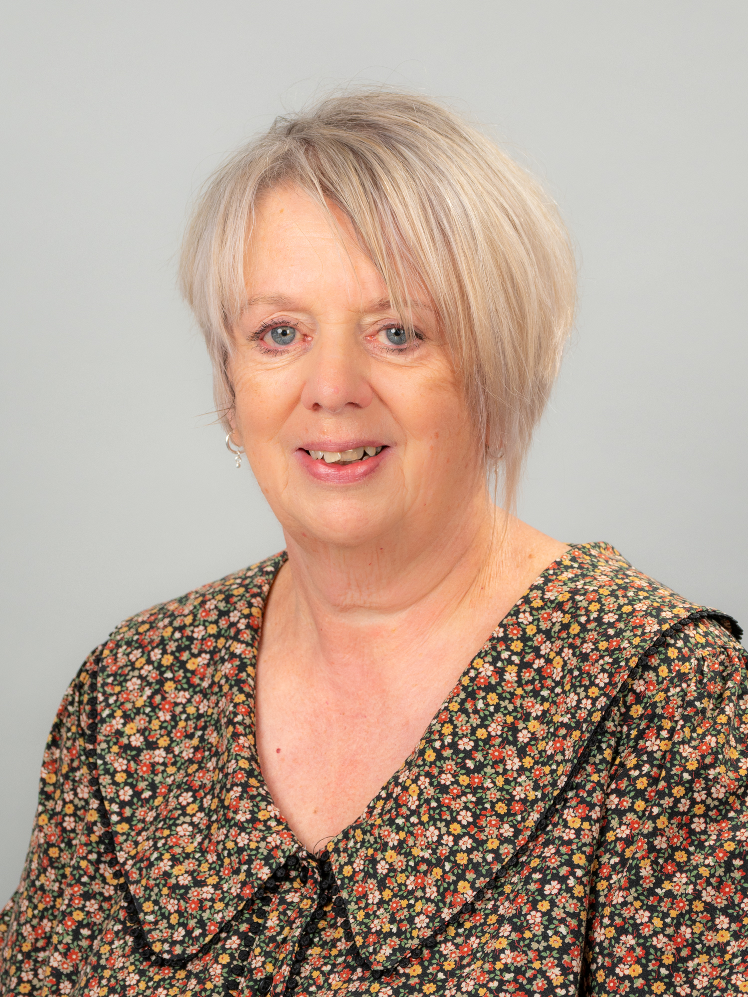

Welcome to Year 1
Class teacher:
Miss Leeson
Teaching Assistant:
Mrs Bluer
Teaching Assistant:
Mrs Platt
Telephone: 0161 439 5114 | Email: admin@mosshey.stockport.sch.uk | Web: www.mosshey-primary.co.uk

Slide 3

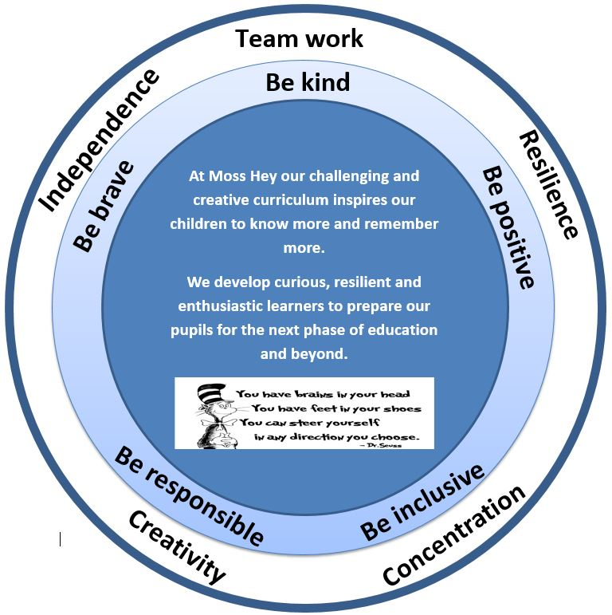

Our Intent
Nurturing curious, resilient and ambitious learners
Telephone: 0161 439 5114 | Email: admin@mosshey.stockport.sch.uk | Web: www.mosshey-primary.co.uk

Slide 4
Our School Values & Learning Behaviours
Be kind
Be brave
Be positive
Be responsible
Be inclusive
As a school we have a half termly focus on one value & one learning behaviour.
As a class we will be having weekly targets
Will keep you updated via Dojo
Concentrating Crocodile
Resilient Rhino
Creative Chameleon
Independent Iguana
Teamwork Tiger
Telephone: 0161 439 5114 | Email: admin@mosshey.stockport.sch.uk | Web: www.mosshey-primary.co.uk

Slide 5
What’s really important in Year 1…
Independence – remembering all of their belongings and bringing them into school
Resilience – facing challenges with a strong, positive mindset
Teamwork and empathy – working well with peers in lessons and provision
Phonics – confidently knowing all the sounds up to phase 5
Time to learn – having time to explore, be creative, build on prior learning, self-regulate and develop friendships.
Telephone: 0161 439 5114 | Email: admin@mosshey.stockport.sch.uk | Web: www.mosshey-primary.co.uk

Slide 6
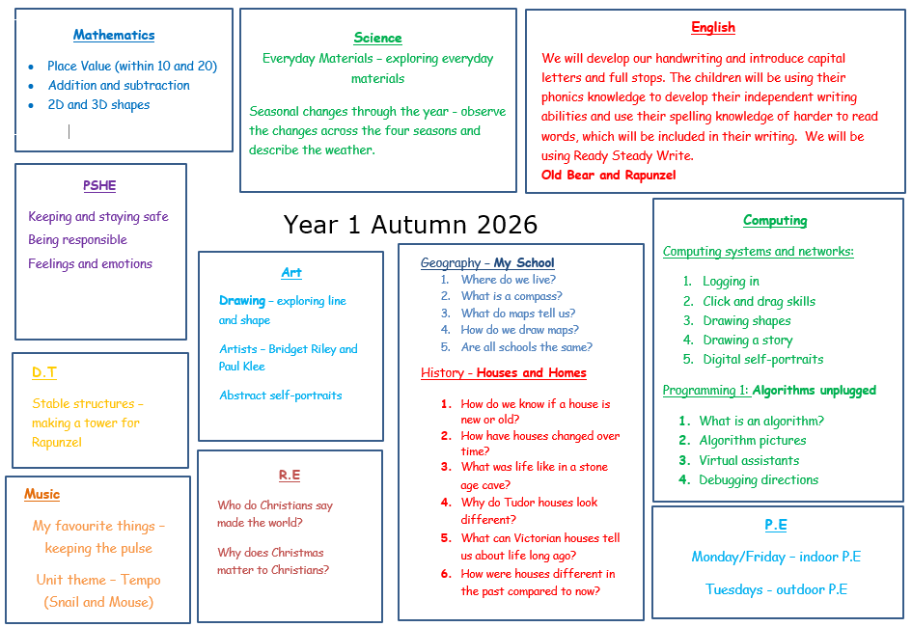
Our Curriculum
Telephone: 0161 439 5114 | Email: admin@mosshey.stockport.sch.uk | Web: www.mosshey-primary.co.uk

Slide 7
Reading in Year 1
Children need to be reading daily with you at home. It does not need to be a whole book, just a few pages is enough.
Children need to read the book more than once.
Please sign the reading record so it is clear when you have read with your child.
Staff will aim to read with your child individually once a week. As well as 1:1 reading, we use phonics and literacy sessions to assess your child’s reading skills.
Phonics Screening - 14th to 18th June 2027
.
Telephone: 0161 439 5114 | Email: admin@mosshey.stockport.sch.uk | Web: www.mosshey-primary.co.uk

Slide 8
Homework
Maths – White Rose Books – Due every Thursday
Reading – 3 books
RR books – children change these when necessary
Phonics books – changed every Friday
Library books – changed every Friday
Spellings – quiz every Friday
Telephone: 0161 439 5114 | Email: admin@mosshey.stockport.sch.uk | Web: www.mosshey-primary.co.uk

Slide 9
Trips and Workshops
Autumn – History trip TBC – Tudor Houses
- Phonics workshop –
Spring – Maths Workshop
- Library Trip
Summer – Trip to Peak Wildlife Park – Date TBC
- Castles workshop – outdoor learning
Telephone: 0161 439 5114 | Email: admin@mosshey.stockport.sch.uk | Web: www.mosshey-primary.co.uk

Slide 10
P.E
Year 1 will have outdoor P.E on a Tuesday and indoor P.E on a Monday/Friday
P.E kit: White t-shirt, navy shorts/jogging bottoms, navy jumper. Trainers must be worn for PE
A P.E kit must be in school at all times
All items to be clearly named
Children attending an after school sports club need to bring in a separate sports kit on that day
All jewellery, including earrings must be removed for all physical education
Long hair must be tied up.
Children will be unable to take part in a P.E lesson if they do not have the full correct kit.
Telephone: 0161 439 5114 | Email: admin@mosshey.stockport.sch.uk | Web: www.mosshey-primary.co.uk

Slide 11
Outdoor Learning (KS1)
In year 1 we will be having a weekly outdoor learning session on a Wednesday.
Children will need:
Waterproof trousers and coat
Wellies / walking boots
Old clothes (long sleeved tops and trousers)
Hat and gloves
Telephone: 0161 439 5114 | Email: admin@mosshey.stockport.sch.uk | Web: www.mosshey-primary.co.uk

Slide 12
Uniform
Full school uniform must be worn
Long hair tied up / off face
Hair bobbles / accessories must be appropriate and be blue or black
No type of smart watches are allowed
Telephone: 0161 439 5114 | Email: admin@mosshey.stockport.sch.uk | Web: www.mosshey-primary.co.uk

Slide 13
Things you need in Year 1
A water bottle everyday – this must not be a large or expensive bottle e.g. Stanley cup / air up
A healthy snack; fruit or veg – remember we are a nut free school
Please do not bring own pencil cases – children will be using school stationary
Fidgets – if your child requires these school will provide them
Bags – these must not be too large or with large accessories on. They need to fit in to the lockers with their P.E bags and coat
Coat – weather can change!
Telephone: 0161 439 5114 | Email: admin@mosshey.stockport.sch.uk | Web: www.mosshey-primary.co.uk

Slide 14
Class Dojo - Communicating with your Class Teacher
Class dojo is our main communication tool between parents and teachers
It is really important that you have a log in and check messages regularly
Pictures and work will be shared via class stories weekly
Children will continue to earn dojo points for showing our Moss Hey Values and Learning Behaviours.
Class Dojo is not to be used for reporting absences or for complaints
Telephone: 0161 439 5114 | Email: admin@mosshey.stockport.sch.uk | Web: www.mosshey-primary.co.uk

Slide 15
Rewards
Weekly certificates linked to our whole school values & learning behaviours
Positive postcards
Class rewards – linked to reaching their Dojo target
Handwriting superstar
Super spotter
Telephone: 0161 439 5114 | Email: admin@mosshey.stockport.sch.uk | Web: www.mosshey-primary.co.uk

Slide 16
myHappymind
At Moss Hey we follow My Happymind which is an NHS-backed curriculum for primary schools. It focuses on building resilience, self-esteem, and happiness in children.
The lessons and activities contain quizzes, songs, animations and feature lovely characters.
The children will complete five modules:
>Meet Your Brain >Celebrate >Appreciate >Relate >Engage
Each Year group works through the 5 modules allowing for a whole school culture to build.
Within each module children learn positive habits which they will then use all of the time.
The children have journals to record ideas and feelings.
Telephone: 0161 439 5114 | Email: admin@mosshey.stockport.sch.uk | Web: www.mosshey-primary.co.uk

Slide 17
Medical Needs
Please ensure the office has update medical information for your child
Inhalers must be in school at all times – your child will have access to their inhaler when needed and will be supervised by a member of staff
All medication must be labelled and in date
Please read our medical policy for administrating medication – this can be found on our school website
Telephone: 0161 439 5114 | Email: admin@mosshey.stockport.sch.uk | Web: www.mosshey-primary.co.uk

Slide 18

Talk about it wheel
We use the Talk about it wheel as a restorative tool to discuss any issues amongst peers
Zones of regulation
What happened?
How did it make you feel?
What can we do to make it better?
Let’s put things right!
Telephone: 0161 439 5114 | Email: admin@mosshey.stockport.sch.uk | Web: www.mosshey-primary.co.uk

Slide 19
Rebranding
Telephone: 0161 439 5114 | Email: admin@mosshey.stockport.sch.uk | Web: www.mosshey-primary.co.uk

Slide 20
Finally…
I hope the children thoroughly enjoy Year 1!
I have loved getting to know them this week already and cannot wait to watch them grow over the year.
We have lots of new and exciting topics that I am sure the children will be excited to learn about and I can’t wait to discover all of their knowledge.
If you have any questions during the year, please get in touch via ClassDojo and I will respond as soon as possible.
Thank you for all your support and I’m looking forward to an exciting year with them all!
Telephone: 0161 439 5114 | Email: admin@mosshey.stockport.sch.uk | Web: www.mosshey-primary.co.uk

