Slide 1


Meet the Teacher Evening
2026/27

Slide 2


Rebranding
Mos Hey has been rebranded – new owl and a new look website is on its way.
Continue to use the uniform with the former branding on ( or no brand).
Telephone: 0161 439 5114 | Email: admin@mosshey.stockport.sch.uk | Web: www.mosshey-primary.co.uk

Slide 3

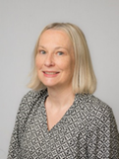

Welcome to Year 2
Class teacher:
Sarah Harriott
Teaching Assistant: Lyndsey Sturgess
Telephone: 0161 439 5114 | Email: admin@mosshey.stockport.sch.uk | Web: www.mosshey-primary.co.uk

Slide 4
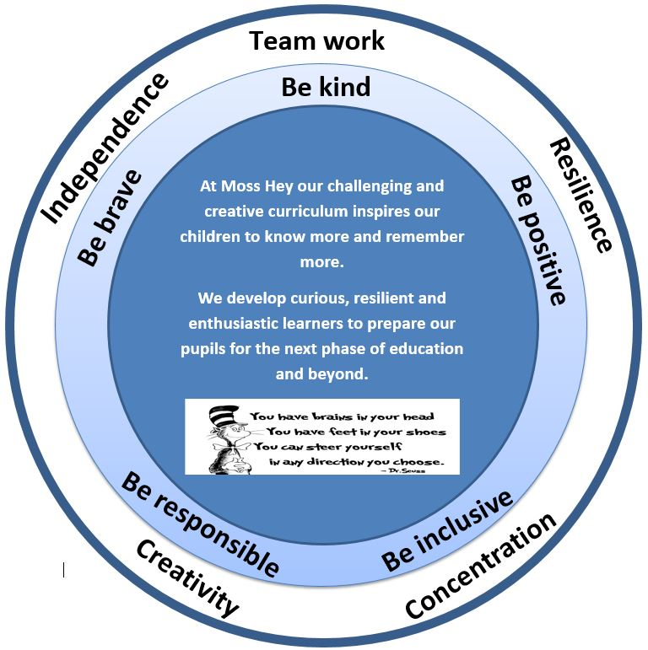
Our Intent
Nurturing curious, resilient and ambitious learners
Telephone: 0161 439 5114 | Email: admin@mosshey.stockport.sch.uk | Web: www.mosshey-primary.co.uk

Slide 5
Our School Values & Learning Behaviours
Be kind
Be brave
Be positive
Be responsible
Be inclusive
As a school we have a half termly focus on one value & one learning behaviour.
As a class we will be having weekly targets
Will keep you updated via Dojo
Concentrating Crocodile
Resilient Rhino
Creative Chameleon
Independent Iguana
Teamwork Tiger
Telephone: 0161 439 5114 | Email: admin@mosshey.stockport.sch.uk | Web: www.mosshey-primary.co.uk

Slide 6
What’s really important in Year 2
Loving learning and school life!
Achieving their potential
Developing independence
Applying skills and knowledge
reading skills across the curriculum
spelling and grammar skills in writing across the curriculum
– embedding and applying foundational maths skills
Self-regulation – using myHappymind and zones of regulation work
Telephone: 0161 439 5114 | Email: admin@mosshey.stockport.sch.uk | Web: www.mosshey-primary.co.uk

Slide 7
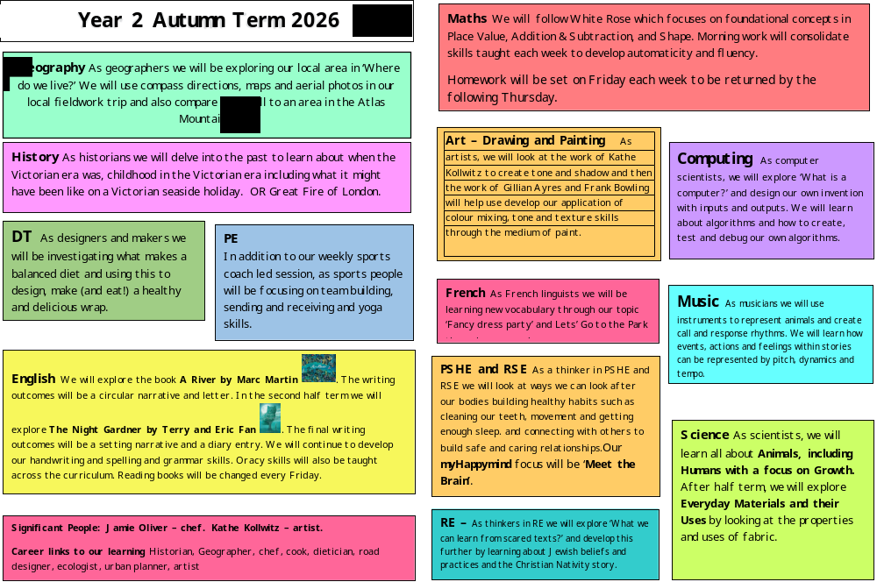
Our Curriculum (Theme Web)
Telephone: 0161 439 5114 | Email: admin@mosshey.stockport.sch.uk | Web: www.mosshey-primary.co.uk

Slide 8
Trips
– Geography fieldwork trip exploring our local area
Staircase House November 24th The Great Fire of London
Lowry workshop - 3D sculpture
Telephone: 0161 439 5114 | Email: admin@mosshey.stockport.sch.uk | Web: www.mosshey-primary.co.uk

Slide 9
Homework
Maths – White Rose Books – given out on a Thursday and collected in on Tuesday
Maths – TT Rockstars
Reading – books changed every Friday
Spellings / phonics – given on a Friday and assessed the following Friday
Telephone: 0161 439 5114 | Email: admin@mosshey.stockport.sch.uk | Web: www.mosshey-primary.co.uk

Slide 10
P.E
Year 2 will have outdoor P.E on Tuesday
P.E kit: White t-shirt, navy shorts/jogging bottoms, navy jumper. Trainers must be worn for PE
A P.E kit must be in school at all times as we will also have another PE lesson each week
All items to be clearly named
Children attending an after school sports club need to bring in a separate sports kit on that day
All jewellery, including earrings must be removed for all physical education
Long hair must be tied up.
Children will be unable to take part in a P.E lesson if they do not have the full correct kit.
Telephone: 0161 439 5114 | Email: admin@mosshey.stockport.sch.uk | Web: www.mosshey-primary.co.uk

Slide 11
Outdoor Learning (KS1)
In year 2 we will be having outdoor learning sessions.
Children will need:
Waterproof trousers and coat
Wellies / walking boots
Old clothes (long sleeved tops and trousers)
Hat and gloves
Telephone: 0161 439 5114 | Email: admin@mosshey.stockport.sch.uk | Web: www.mosshey-primary.co.uk

Slide 12
Uniform
Full school uniform must be worn
Long hair tied up / off face
Hair bobbles / accessories must be appropriate and be blue or black
No type of smart watches are allowed
Telephone: 0161 439 5114 | Email: admin@mosshey.stockport.sch.uk | Web: www.mosshey-primary.co.uk

Slide 13
Class Dojo - Communicating with your Class Teacher
Class dojo is our main communication tool between parents and teachers
It is really important that you have a log in and check messages regularly
Pictures and work will be shared via class stories weekly
Children will continue to earn dojo points for showing our Moss Hey Values and Learning Behaviours.
Please do not use Dojo for reporting absences or for complaints
Telephone: 0161 439 5114 | Email: admin@mosshey.stockport.sch.uk | Web: www.mosshey-primary.co.uk

Slide 14
myHappymind
At Moss Hey we follow myHappymind which is an NHS-backed curriculum for primary schools. It focuses on building resilience, self-esteem, and happiness in children.
The lessons and activities contain quizzes, songs, animations and feature lovely characters.
The children will complete five modules:
>Meet Your Brain >Celebrate >Appreciate >Relate >Engage
Each Year group works through the 5 modules allowing for a whole school culture to build.
Within each module children learn positive habits which they will then use all of the time.
The children have journals to record ideas and feelings.
Telephone: 0161 439 5114 | Email: admin@mosshey.stockport.sch.uk | Web: www.mosshey-primary.co.uk

Slide 15
Things you need in Year 2
A water bottle everyday – this must not be a large or expensive bottle e.g. Stanley cup / air up
A health snack; fruit or veg – remember we are a nut free school
Please do not bring own pencil cases – children will be using school stationary
Fidgets – if your child requires these school will provide them
Bags – these must not be too large or with large accessories on. They need to fit in to the lockers with their P.E bags and coat
Coat – weather can change!
Telephone: 0161 439 5114 | Email: admin@mosshey.stockport.sch.uk | Web: www.mosshey-primary.co.uk

Slide 16
Medical Needs
Please ensure the office has update medical information for your child
Inhalers must be in school at all times – your child will have access to their inhaler when needed and will be supervised by a member of staff
All medication must be labelled and in date
Please read our medical policy for administrating medication – this can be found on our school website
Telephone: 0161 439 5114 | Email: admin@mosshey.stockport.sch.uk | Web: www.mosshey-primary.co.uk

Slide 17
Closing Message From Class Teacher
Be our Best
Teamwork
Communication
Team Year 2 2026 – let’s go !
Telephone: 0161 439 5114 | Email: admin@mosshey.stockport.sch.uk | Web: www.mosshey-primary.co.uk

