Slide 1
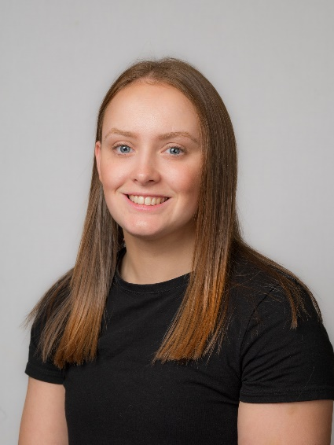
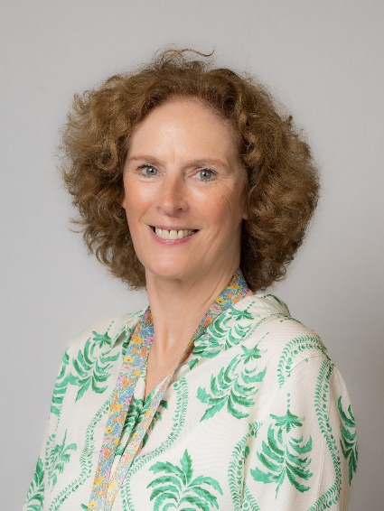

Welcome to Year 1
Mrs Evans
Miss Leeson

Slide 2
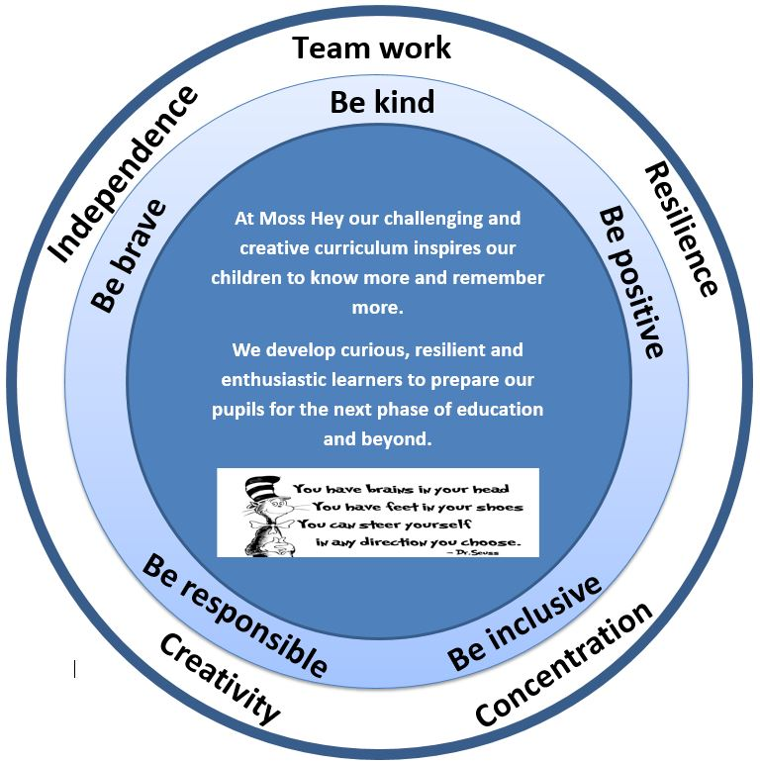
Our Intent
Nurturing curious, resilient and ambitious learners

Slide 3
Our School Values & Learning Behaviours
Be kind
Be brave
Be positive
Be responsible
Be inclusive
Concentrating Crocodile
Resilient Rhino
Creative Chameleon
Independent Iguana
Teamwork Tiger

Slide 4

Talk about it Wheel
We use the Talk about it wheel as a restorative tool to discuss any issues amongst peers
Zones of regulation
What happened?
How did it make you feel?
What can we do to make it better?
Let’s put things right!

Slide 5
Rewards
Weekly certificates linked to our whole school values & learning behaviours which will have a different focus each week
Star of the Week – dojos and behaviour
Positive postcards from adults around school
Class rewards – linked to reaching their Dojo target

Slide 6
Class Dojo
Communicating with your Class Teacher
Class dojo is our main communication tool between parents and teachers
It is really important that you have a log in and check messages regularly
Pictures and work will be shared via class stories weekly
Children will continue to earn dojo points for showing our Moss Hey Values and Learning Behaviours.
Class Dojo is not to be used for reporting absences, appointments or for complaints

Slide 7
Things you will need in Year 1
A water bottle everyday – this must not be a large or expensive bottle e.g. Stanley cup / air up
A healthy snack; fruit or veg – remember we are a nut free school
Please do not bring own pencil cases – children will be using school stationary
Bags – these must not be too large or with large accessories on. They need to fit in to the lockers with their P.E bags and coat
Coat – weather can change!

Slide 8
Uniform
Full school uniform must be worn
Long hair tied up / off face
Hairs bobbles / accessories must be appropriate and be blue or black
No type of smart watches are allowed

Slide 9
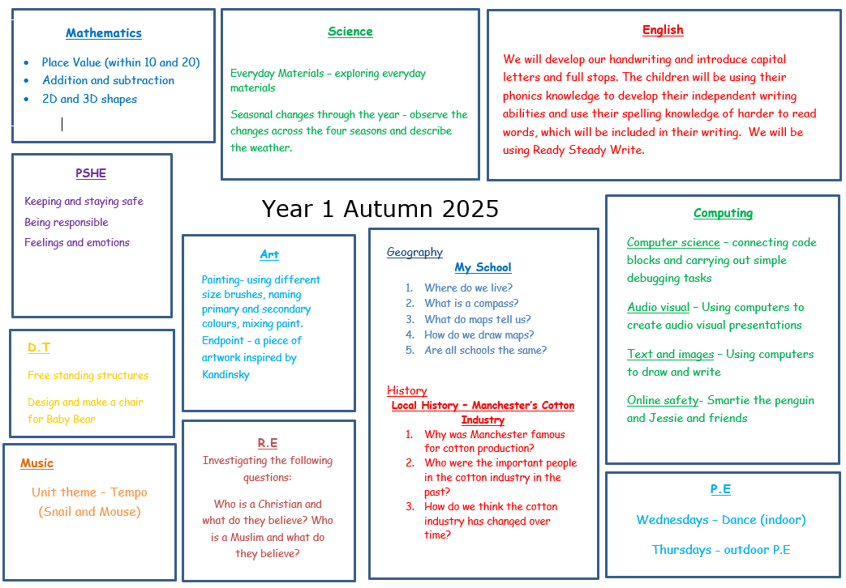

Slide 10
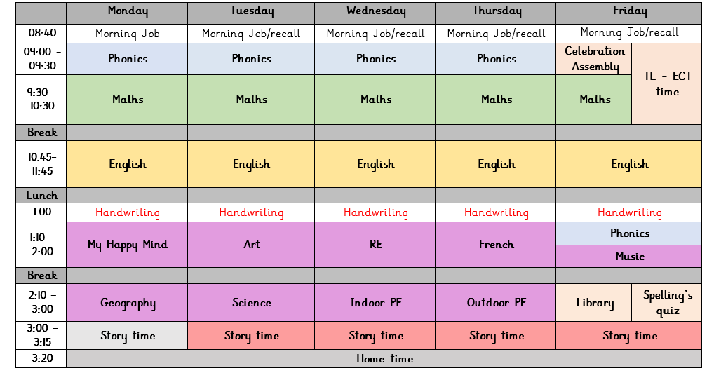
Year 1 Timetable Autumn 1

Slide 11
P.E
Year 1 will have outdoor P.E on Thursday afternoon and indoor P.E on a Wednesday afternoon.
P.E kit: White t-shirt, navy shorts/jogging bottoms, navy jumper. Trainers must be worn for PE
A P.E kit must be in school at all times
All items to be clearly named
Children attending an after school sports club need to bring in a separate sports kit on that day
All jewellery, including earrings must be removed for all physical education
Long hair must be tied up.
Children will be unable to take part in a P.E lesson if they do not have the full correct kit.

Slide 12
My Happymind
At Moss Hey we follow My Happymind which is an NHS-backed curriculum for primary schools. It focuses on building resilience, self-esteem, and happiness in children.
The lessons and activities contain quizzes, songs, animations and feature lovely characters.
The children will complete five modules:
>Meet Your Brain >Celebrate >Appreciate >Relate >Engage
Each Year group works through the 5 modules allowing for a whole school culture to build.
Within each module children learn positive habits which they will then use all of the time.
The children have journals to record ideas and feelings.

Slide 13
Outdoor Learning
Year 1 will have outdoor learning in a variety of lessons throughout the week.
Children will need:
Waterproof trousers and coat (we do have some spare)
Wellies (we do have some spare)
Hat and gloves
These can be kept in lockers all year
Dojo to be sent home in advance of a lesson if the weather is cold/wet.

Slide 14
Medical Needs
Please ensure the office has update medical information for your child
Inhalers must be in school at all times – your child will have access to their inhaler when needed and will be supervised by a member of staff
All medication must be labelled and in date
Please read our medical policy for administrating medication – this can be found on our school website

Slide 15
What is really important in Year 1
Independence – remembering all of their belongings and bringing them into school
Resilience – facing challenges with a strong, positive mindset
Teamwork and empathy – working well with peers in lessons and discovery
Phonics – confidently knowing all the sounds up to phase 5
Discovery – having time to explore, be creative, self-regulate and develop friendships.

Slide 16
Phonics
Phonics will be taught daily.
It is a significant part of early reading and teaches children to read.
We have a government approved phonics scheme. Essential Letters and Sounds.
We learn 4 new sounds a week and send home a reading book linked to those sounds at the end of the week.
Phonics screening test – W/C June 8th

Slide 17
Reading
Children need to be reading daily with you at home. It does not need to be a whole book, just a few pages is enough.
Children need to read the book more than once.
Please sign the reading record so it is clear when you have read with your child.
We will be changing books once a week but please have books in school every day.
Staff will aim to read with your child individually once a week. As well as 1:1 reading, we use phonics and literacy sessions to assess your child’s reading skills.

Slide 18
Homework
Maths – White Rose books – these are linked directly to lessons and will come home on a Friday and should be returned on a Thursday.
Spellings – Weekly spellings – tested every Friday afternoon
Reading – please read with your child every day if possible. Focus on sounding out and blending words to build fluency and asking questions to check comprehension.

Slide 19
Trips and Workshops
Autumn – Quarry Bank Mill – 1st October
Spring – Library trip ( date TBC)
Summer – Forest school trip (TBC)
Summer – Castles workshop (date TBC)

Slide 20
Finally…
I hope the children thoroughly enjoy Year 1!
I have loved getting to know them this week already and cannot wait to watch them grow over the year.
We have lots of new and exciting topics that I am sure the children will be excited to learn about and I can’t wait to discover all of their knowledge.
If you have any questions during the year, please get in touch via ClassDojo and I will respond as soon as possible.
Thank you for all your support and I’m looking forward to an exciting year with them all!

