Slide 1
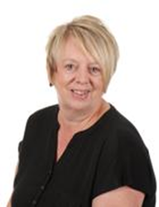

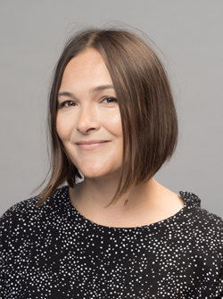
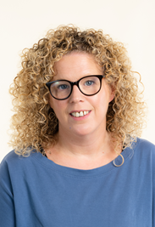

Welcome to Year 2
Class Teachers
Teaching Assistants
Mrs Malkin
Mondays, Tuesdays and Wednesdays
Mrs Platt
Mrs Rennocks
Thursdays
and Fridays
Mrs Peters

Slide 2
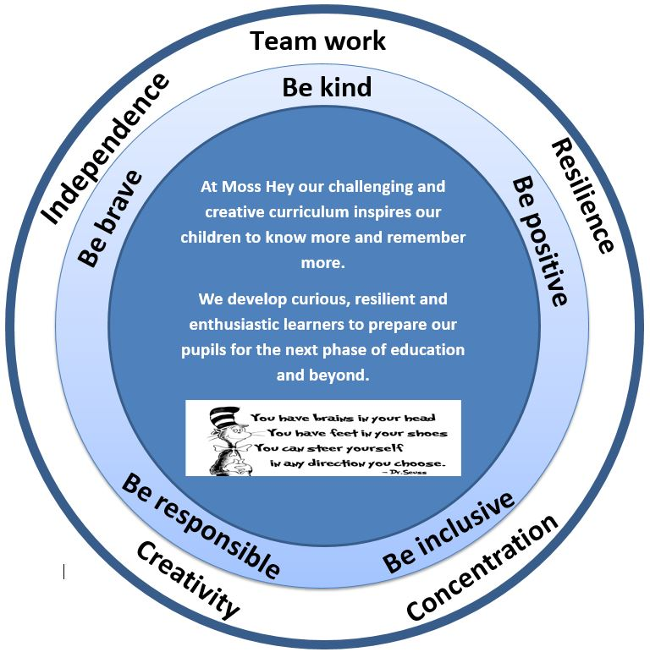
Our Intent
Nurturing curious, resilient and ambitious learners

Slide 3
Our School Values & Learning Behaviours
Be kind
Be brave
Be positive
Be responsible
Be inclusive
Concentrating Crocodile
Resilient Rhino
Creative Chameleon
Independent Iguana
Teamwork Tiger

Slide 4
Rewards and Wellbeing
Every Friday, there will be a celebration assembly.
A certificate for ‘Star of the Week’
A certificate for showing the Moss Hey Values
A sticker for showing the learning behaviours
Positive postcards
Secret student
Zones of regulation
My Happy Mind
Individual Dojos
Whole class rewards

Slide 5
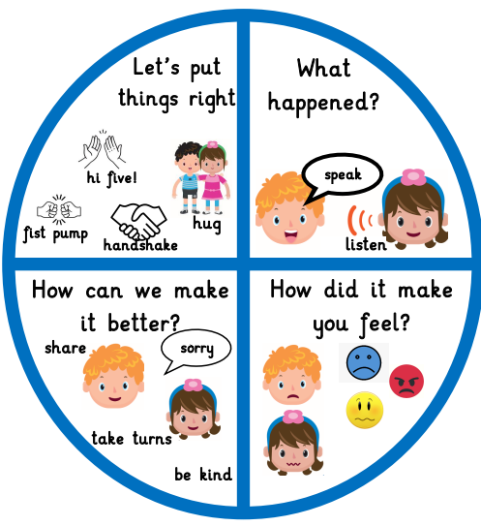
Talk about it Wheel
We use the Talk about it wheel as a restorative tool to discuss any issues amongst peers
What happened?
How did it make you feel?
What can we do to make it better?
Let’s put things right!

Slide 6
Class Dojo
Communicating with your Class Teacher
Class dojo is our main communication tool between parents and teachers
It is really important that you have a log in and check messages regularly
Pictures and work will be shared via class stories
Children will continue to earn dojo points for showing our Moss Hey Values and Learning Behaviours.
Class Dojo is not to be used for reporting absences, appointments or for complaints

Slide 7
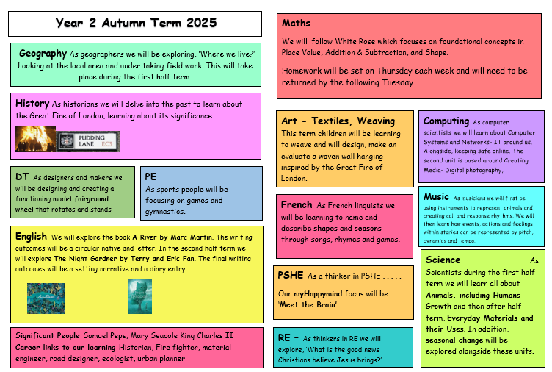
Our Curriculum

Slide 8
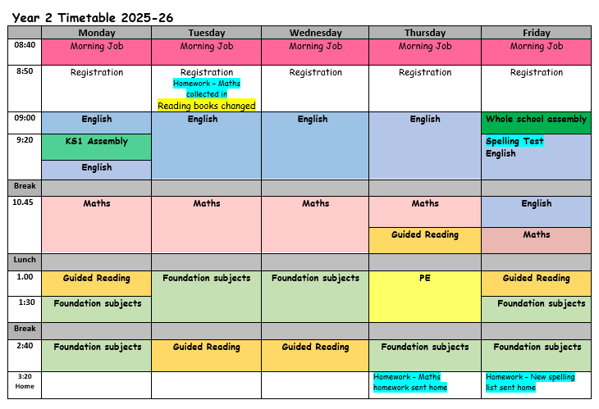
Year 2 Timetable

Slide 9
myHappymind
At Moss Hey we follow myHappymind which is an NHS-backed curriculum for primary schools. It focuses on building resilience, self-esteem, and happiness in children.
The lessons and activities contain quizzes, songs, animations and feature lovely characters.
The children will complete five modules:
>Meet Your Brain >Celebrate >Appreciate >Relate >Engage
Each Year group works through the 5 modules allowing for a whole school culture to build.
Within each module children learn positive habits which they will then use all of the time.
The children have journals to record ideas and feelings.

Slide 10
Things you will need in Year 2
A water bottle everyday – this must not be a large or expensive bottle e.g. Stanley cup / air up
A health snack; fruit or veg – remember we are a nut free school
Please do not bring own pencil cases – children will be using school stationary
Bags – these must not be too large or with large accessories on. They need to fit in to the lockers with their P.E bags and coat
Coat – weather can change!

Slide 11
Medical Needs
Please ensure the office has update medical information for your child
Inhalers must be in school at all times – your child will have access to their inhaler when needed and will be supervised by a member of staff
All medication must be labelled and in date
Please read our medical policy for administrating medication – this can be found on our school website

Slide 12
Uniform
Full school uniform must be worn
Long hair tied up / off face
Hairs bobbles / accessories must be appropriate and be blue or black
No type of smart watches are allowed

Slide 13
P.E
Year 2 will have outdoor P.E on Thursday
P.E kit: White t-shirt, navy shorts/jogging bottoms, navy jumper. Trainers must be worn for PE
A P.E kit must be in school at all times
All items to be clearly named
Children attending an after school sports club need to bring in a separate sports kit on that day
All jewellery, including earrings must be removed for all physical education
Long hair must be tied up.
Children will be unable to take part in a P.E lesson if they do not have the full correct kit.

Slide 14
Homework
Reading – please listen to your child read every day and sign and date the diary each time. All books will be changed on Tuesday. Children will bring two books home (2 RR books). We encourage them to read them more than once and read additional things from home.
Spelling lists will be sent home weekly on Fridays. Children will do a test the following Friday.
Maths Homework - White Rose books – these are linked directly to lessons. They will come home on a Thursday and should be returned the following Tuesday.

Slide 15
What is really important in Year 2
Applying reading skills across the curriculum
Accessing resources independently (e.g. word banks, 100 squares, number lines, sentence stems etc..)
Maths – embedding and applying foundational skills (e.g. independently using known number facts, counting in 10s and ones, bonds to 10, avoiding using fingers)
Self-regulation – using myHappymind and zones of regulation work

Slide 16
Trips
Autumn - Geography fieldwork trip in the local area
-History workshop TBC
Spring - Trip to the Lowry art Gallery in Salford
- Friday 30th January
Summer - Explorers workshop TBC
- History and science taught through a fantastic outdoor learning workshop

Slide 17
Closing message from teachers
We are absolutely delighted to be working with Year 2 this year and we are looking forward to a fantastic year. The children are adjusting well to their new routines and have already impressed us with their enthusiasm this week!
If you have any questions please do not hesitate to contact us via Dojo and we will respond as soon as we possibly can.
Thank you for your support.
The Year 2 Team

