Slide 1
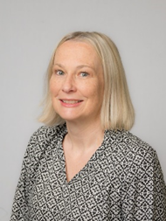
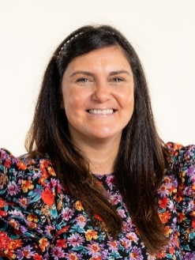
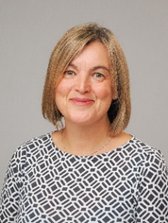
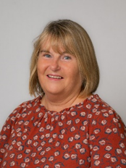

Welcome to Reception
Mrs Dunning
Mrs Harriott
Ms Green
Mrs Carroll

Slide 2
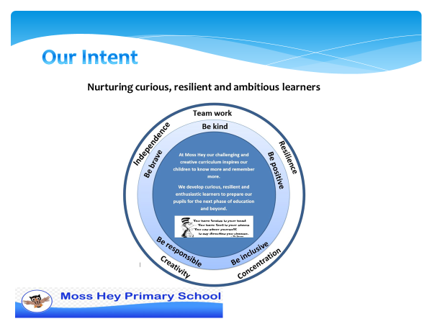

Slide 3
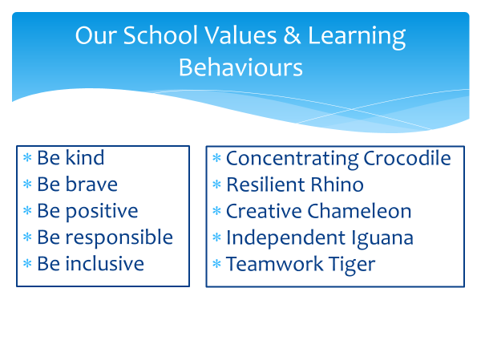

Slide 4

Talk about it Wheel
We use the Talk about it wheel as a restorative tool to discuss any issues amongst peers
What happened?
How did it make you feel?
What can we do to make it better?
Let’s put things right!

Slide 5
EYFS Assessment
Statutory Baseline assessment – this is reported but no feedback is given
We will do our own benchmark assessments
Regular progress checks – phonics/maths
End of year assessments – met or not yet met

Slide 7
Reception Timetable Autumn 1
8.40
–
9.00
9.00
–
9.30
9.30
–
10.30
10.30
–
10.40
10.40
–
10.50
10.50
-
11.00
11.00
-
12.00
1.00
–
1.15
1.15
–
1.30
1.30
–
2.30
2.30
–
3.10
–
Funky
Assembly
Discovery
Literacy
Circle time
Maths
Discovery
Lunch
PPA
PPA
3.00
PPA
3.20
Monday
fingers
Phonics
time
Counts
and snack
Handwriting
Discovery
French and
Readers 1
Sentence
interest time
accuracy
Library
Funky
Phonics
Discovery
Literacy
Circle time
Maths
Discovery
Lunch
Handwriting
Theme
Discovery
PSHE
Story
fingers
time
Counts
and snack
Geography
Tuesday
History
/
time
One
Time
Readers 2
decision
Wednesday
Funky
Phonics
Discovery
Literacy
Circle time
Maths
Discovery
Lunch
Handwriting
Theme
Discovery
Happy
Story
fingers
time
Counts
and snack
Science
time
minds
Time
Readers 3
/ICT
Thursday
Funky
Phonics
Discovery
Literacy
Circle time
Maths
Discovery
Lunch
Handwriting
Theme
Discovery
RE
Story
fingers
time
Counts
and snack
Art/DT
time
Time
Readers 4
Funky
Assembly
PE and circle time snack
Discovery time
Lunch
Phonics and
Theme: o
utdoor learning
Music
Story
Friday
fingers
1:1 readers catch up
change
Time
Readers 5
1:1 maths catch up
reading
books

Slide 8
Reception Timetable
Monday afternoons ( PPA time)
Library to change library books
Fridays
PE
Outdoor learning
Change Reading books

Slide 9
P.E
Reception will have PE on a Friday (inside until Christmas)
PE kit: White t-shirt and navy shorts and pumps
Keep the PE in school at all times - we will send PE kits home in the holidays to be washed
Please name all items
Any jewellery, including earrings must be removed for all physical education and long hair tied up.

Slide 10
Outdoor Learning
Reception we will be having a weekly outdoor learning session on Friday afternoons
Children will need:
Waterproof trousers and coat (we do have some spare)
Wellies (we do have some spare)
Hat and gloves
These can be kept in lockers all year or brought in on Fridays

Slide 11
Trips
-Dentist visit
-Library visit
- Outdoor Forest School (TBC)

Slide 12
Phonics in Reception
Phonics will be taught daily.
It is a significant part of early reading and teaches children to read.
We have a government approved phonics scheme. Essential Letters and Sounds.
We learn 4 new sounds a week and send home a reading book linked to those sounds at the end of the week.
Letter formation rhymes

Slide 13
Reading
Individual reading books will come home with a reading record.
Children need to be reading daily with you at home. It does not need to be a whole book, just a few pages is enough.
Children need to read the book more than once.
Please sign the reading record so it is clear when you have read with your child.
We will be changing books once a week but please have books in school every day.
Staff will aim to read with your child individually once a week. As well as 1:1 reading, we use phonics and literacy sessions to assess your child’s reading skills.

Slide 14
Homework
Please read with your child daily
You will receive a phonics sheet each week that has letter formation rhymes and words to read and write.

Slide 15
Buddies
Each child is buddied up with a year 6 child.
Children will have lunch with their buddies and play with them outside.
They also have a midday supervisor at lunch time

Slide 16

Class Dojo
Communicating with your Class Teacher
Class dojo will be our main communication tool for parents and teachers.
As this is our main communication tool, it is really important that you check messages regularly
Children will earn dojo points for showing our Moss Hey Values and Learning Behaviours.
We will also send photos home of the children on this platform.
Please share photos and videos from home with school using the app.
Class Dojo is not to be used for reporting absences or for complaints

Slide 17
Rewards and Wellbeing
Every Friday, there will be a celebration assembly.
A certificate for ‘Star of the Week’
A certificate for showing the Moss Hey Values
A sticker for showing the learning behaviours
Positive postcards
Zones of regulation
My Happy Mind
Individual Dojos
Whole class rewards

Slide 18
Medical Needs
Please ensure the office has update medical information for your child
Inhalers must be in school at all times – your child will have access to their inhaler when needed and will be supervised by a member of staff
All medication must be labelled and in date
Please read our medical policy for administrating medication – this can be found on our school website

Slide 19
Your child will need…
A named uniform
A named coat
A full named water bottle everyday
A healthy nut free snack – if you wish
A set of spare underwear and clothes in case of accidents
A named outdoor PE kit
Wellies and waterproofs

Slide 20
And finally…
We can’t wait to get started on our 2025/26 Reception journey and see your child’s potential unfold along the way !
Happy
Kind
Emotionally literate
Fulfilling potential
#Moss Hey Reception Team – children, parents and staff working together

