Slide 1
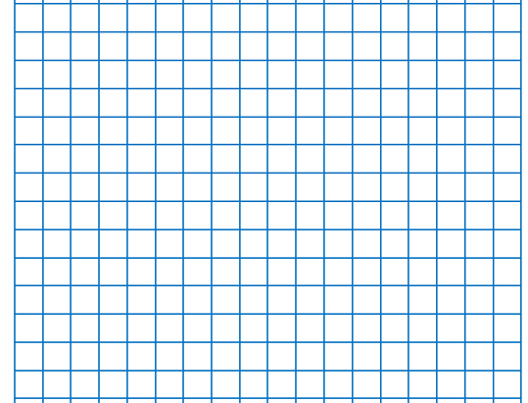
Date and QFL layout model
1)Draw the margin line two cells in using a ruler and sharp pencil.
2)On the second row, write the date, underline it using a ruler. Next write the QFL under the date and underline.
26/6/26 (skip a line)
QFL: Can I compare angles?
skip a line)
FB5:
Main Activity:

Slide 2
26/6/26
QFL: Can I compare angles?
Bronze: I can identify right angles.
Silver: I can compare angles as bigger or smaller than a right angle.
Gold: I can explain my comparisons using mathematical vocabulary.
Star Words:
angle
right angle
greater than
less than
compare

Slide 3
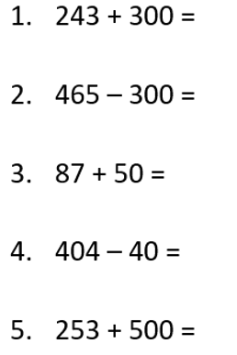
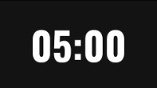
FB5:

Slide 5
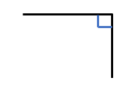
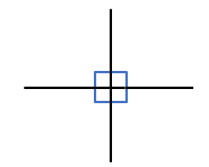
right angle
A right angle is a quarter of a full turn.
There are 4 right angles in a full turn.

Slide 6

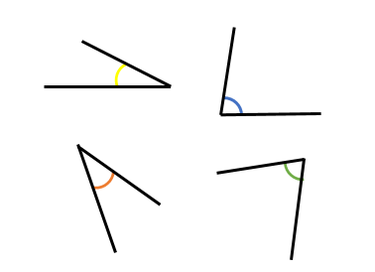
Here are 4 angles.
Have a think
smaller than
All of the angles are ___________ a right angle.
smaller
An angle _______ than a right angle is an ______ angle.
acute
Where can you see an acute angle in the classroom?

Slide 7
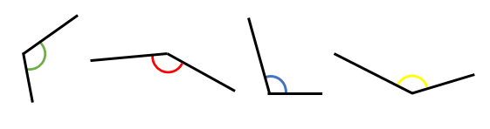
Here are 4 more angles.
Have a think
greater than
All of the angles are ___________ a right angle.
greater
An angle _______ than a right angle is an ______ angle.
obtuse
Where can you see an obtuse angle in the classroom?

Slide 8
Put these angles in order from smallest to greatest.
a)
b)
c)
d)
right
angle
acute
obtuse
Have a think

Slide 9



I think these are both right angles.
The angle on the left is smaller.
Is Tiny correct?
Have a think
Both angles are equal.
They are both right angles.

Slide 10
I can see some obtuse angles
I can see some acute angles.
obtuse
obtuse
acute
acute
What types of angles do you see?

Slide 11


Write $<$, $>$ or $=$ to compare the sizes of angles.
a
acute
b
obtuse
$<$
Have a think

Slide 12

Tiny is drawing a shape that has one obtuse angle and two acute angles.
Which of Tiny’s angles is the greatest?
How do you know?
Have a think
acute
obtuse
acute

Slide 13
Have a go at questions

Slide 14
Complete as many questions as you can

