Slide 1
  Qfl: Can I subtract decimals with the same number of decimal places?

Slide 3

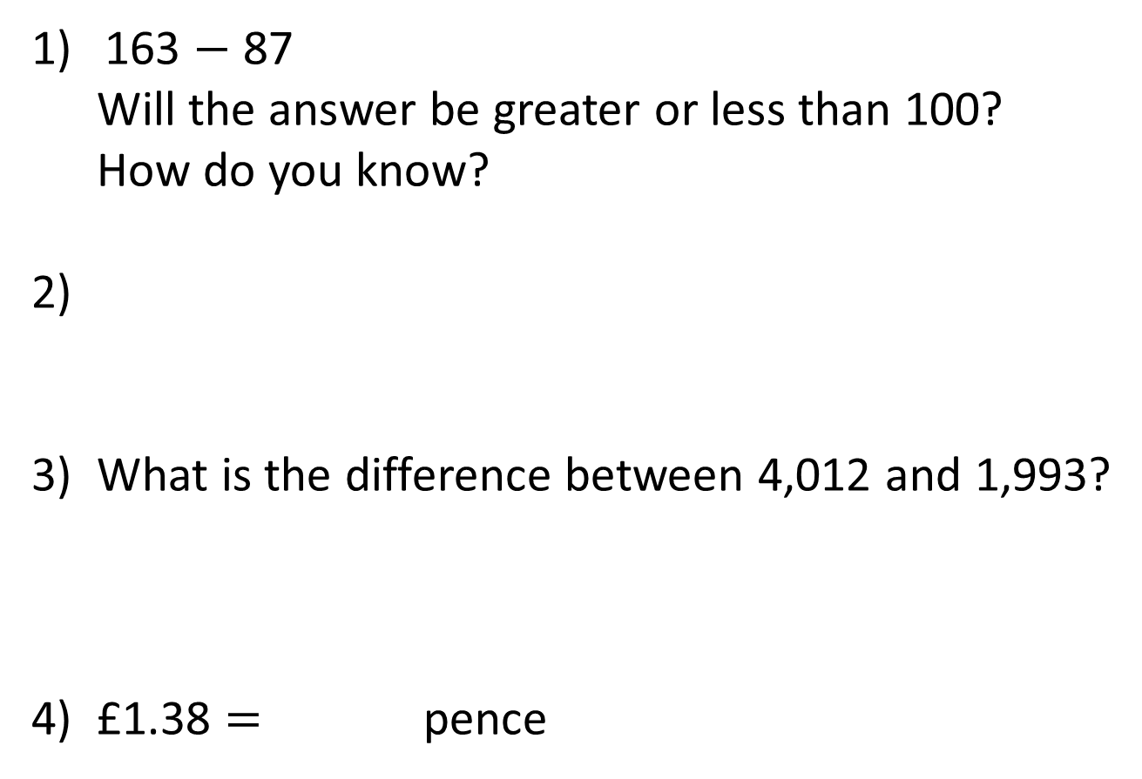
163 $−$ 87
Will the answer be greater or less than 100?
How do you know?
2)
3) What is the difference between 4,012 and 1,993?
4) £1.38 $=$ pence
$\frac{\text{1}}{\text{10}}$ $=$ $\frac{}{\text{100}}$

Slide 4
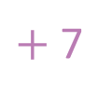
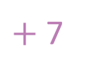
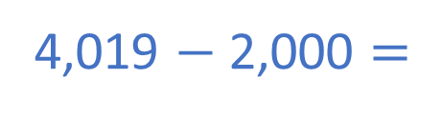
163 $−$ 87
Will the answer be greater or less than 100?
How do you know?
2)
3) What is the difference between 4,012 and 1,993?
4) £1.38 $=$ pence
Less than 100
10
$\frac{\text{1}}{\text{10}}$ $=$ $\frac{}{\text{100}}$
4,019 $−$ 2,000 $=$
2,019
$+$ 7
$+$ 7
138

Slide 6



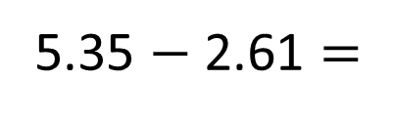
Use the place value chart to help complete the subtraction.
5.35 $−$ 2.61 $=$
2.74
Ones | Tenths | Hundredths
2
7
4
I need to exchange 1 ____ for 10 ______.
one
tenths

Slide 7

Complete the sentences.
10
1 one can be exchanged for ___ tenths.
10
1 tenth can be exchanged for ___ hundredths.
10
1 hundredth can be exchanged for ___ thousandths.
Have a think
What do you notice?

Slide 8



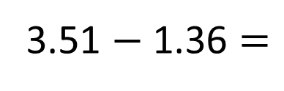
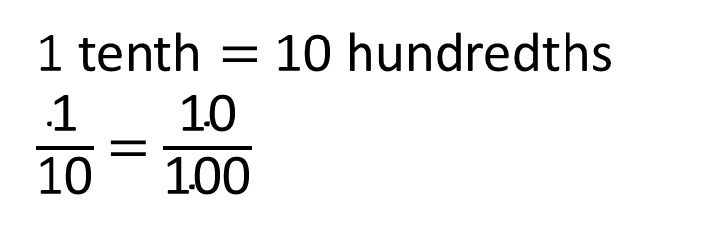
3.51 $−$ 1.36 $=$
2.15
1 tenth $=$ 10 hundredths
$\frac{\text{1}}{\text{10}}$ $=$ $\frac{\text{10}}{\text{100}}$
4
1
Ones | Tenths | Hundredths
3 | 5 | 1
1 | 3 | 6
$$−$$
2
1
5
2
1
5

Slide 9

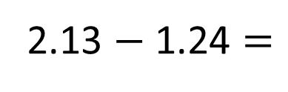
2.13 $−$ 1.24 $=$
0.89
1
1
0
1
2 | 1 | 3
1 | 2 | 4
Ones | Tenths | Hundredths
$$−$$
0
8
9
0
8
9
Have a think

Slide 10
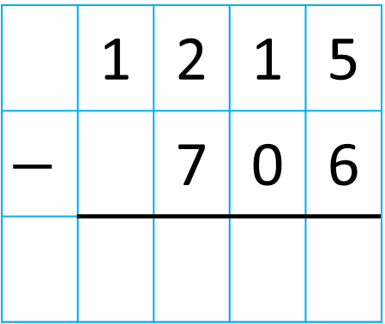
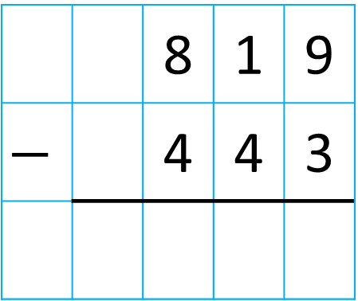
Complete the column subtractions.
7
1
0
1
0
1
 |  | 8 | 1 | 9
$$−$$ |  | 4 | 4 | 3
 | 1 | 2 | 1 | 5
$$−$$ |  | 7 | 0 | 6
3
7
6
0
5
0
9
Have a think
Will you need to make an exchange in these calculations? How do you know?

Slide 11

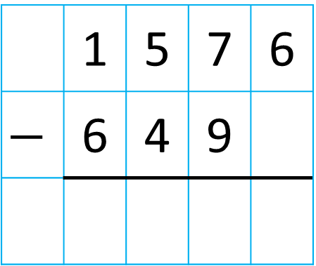
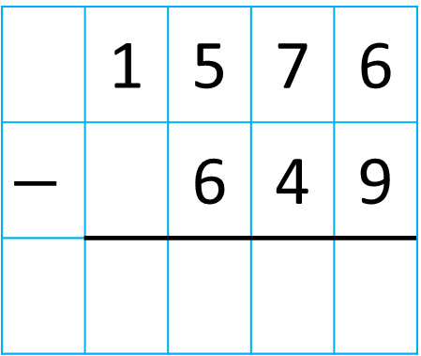
Tiny is calculating 15.76 $−$ 6.49
0
1
6
1
 | 1 | 5 | 7 | 6
$$−$$ | 6 | 4 | 9
 | 1 | 5 | 7 | 6
$$−$$ |  | 6 | 4 | 9
This is impossible to complete!
9
2
7
Do you agree with Tiny? Explain why.
Have a think
Tiny is incorrect. Tiny has not lined up the place value columns correctly.

Slide 12



£1.63
£1.18
How much more does the bag of apples cost than the bunch of bananas?
£0.45
45p
£1.63
Have a think
Apples
5
1
1 | 6 | 3
1 | 1 | 8
£1.18
$$−$$
Is there another method?
?
Bananas
0
4
5

Slide 13
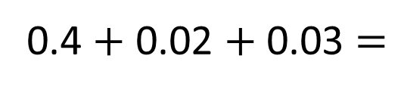
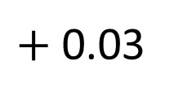
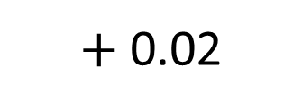
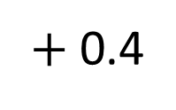
£1.63
£1.18
How much more does the bag of apples cost than the bunch of bananas?
£0.45
45p
$+$ 0.02
$+$ 0.4
$+$ 0.03
1.18
1.2
1.6
1.63
0.4 $+$ 0.02 $+$ 0.03 $=$
0.45

Slide 14
How will the zero affect the calculation?
400
437.97
?
470.13
500
A
B
What is the difference between A and B?
032.16
6
1
9
1
0
1
4 | 7 | 0 | 1 | 3
4 | 3 | 7 | 9 | 7
$$−$$
Have a think
0
3
2
1
6

Slide 15


Teddy and his mum together weigh 95.2 kg.
His mum weighs 65.4 kg.
Does Teddy weigh more or less than 30 kg?
How do you know?
Have a think
Less than 30 kg
Teddy weighs 29.8 kg
65.4 kg
8
1
4
1
9 | 5 | 2
6 | 5 | 4
95.2 kg
$$−$$
?
2
9
8

Slide 16

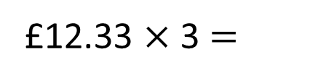
Dora has some money.
She spends £12.33 on a football.
She spends double the cost of the football on a new pair of trainers.
She has £7.01 remaining.
How much money did Dora have to begin with?
Football
£12.33
Total amount spent
Trainers
£12.33
£12.33
£12.33 $×$ 3 $=$

Slide 17
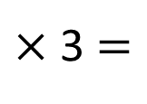
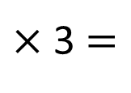
£12
$×$ 3 $=$
£36
£12.33
33p
$×$ 3 $=$
99p
Dora spends £36.99 in total.
She has £7.01 remaining.
How much money did Dora have to begin with?

Slide 18
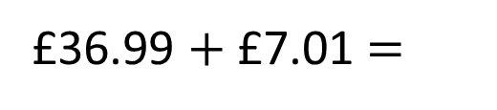
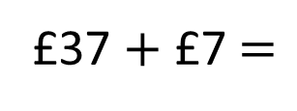
Dora spends £36.99 in total.
She has £7.01 remaining.
How much money did Dora have to begin with?
Have a think
£36.99
Spends
£36.99 $+$ £7.01 $=$
?
£37 $+$ £7 $=$
£44
£7.01
Remaining

Slide 19
Have a go at questions

