Slide 1
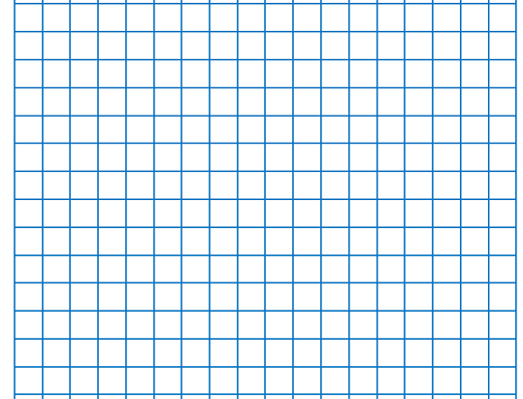
Date and QFL layout model
1)Draw the margin line two cells in using a ruler and sharp pencil.
2)On the second row, write the date, underline it using a ruler. Next write the QFL under the date and underline.
24/6/26 (skip a line)
QFL: Can I describe turns and angles?
skip a line)
FB5:
Main Activity:

Slide 2
24/6/26
QFL: Can I describe turns and angles?
Bronze: I can identify a quarter, half and three-quarter turn.
Silver: I can describe turns using clockwise and anticlockwise.
Gold: I can explain how a turn changes direction.
Star Words:
quarter turn
half turn
three-quarter turn
clockwise
anticlockwise

Slide 3
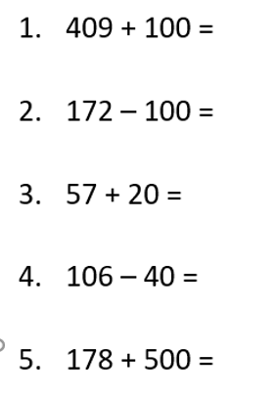
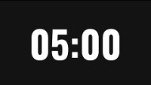
FB5:

Slide 5

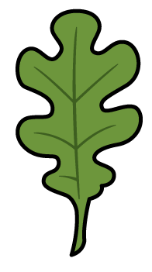
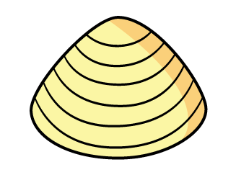
What patterns do you notice?

Slide 6
What patterns do you notice?

Slide 7
What is an angle?
We see angles where 2 straight lines meet at a point.
An angle is a measure of the amount of turn between two lines.

Slide 8
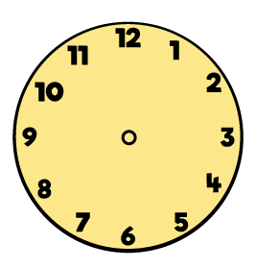
How do we describe turns?
We can describe the direction of turn.
clockwise
anticlockwise

Slide 9
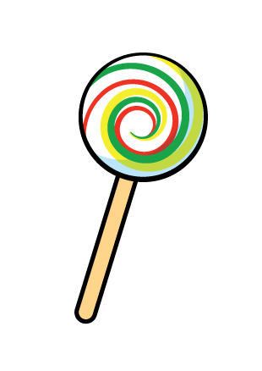
How do we describe turns?
We can describe the size of turn.
quarter turn
half turn
full turn

Slide 10
How would you describe these turns?
half turn clockwise
half turn anticlockwise
quarter turn anticlockwise
full turn clockwise

Slide 11
How would you describe these turns?
three-quarter turn clockwise
quarter turn clockwise
three-quarter turn anticlockwise
full turn clockwise

Slide 12
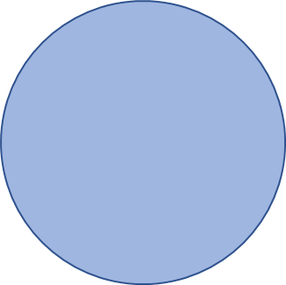

What time will show on each clock after half an hour?
quarter past 3
5 minutes to 4
Have a think

Slide 13

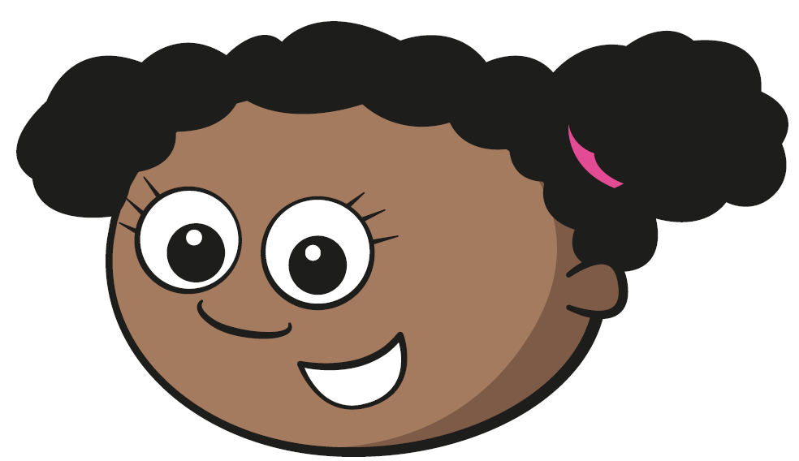
Here is a leaf before and after a turn.
before
after
The leaf made a quarter turn anticlockwise.
The leaf made a quarter turn clockwise.
Have a think

Slide 14
Here is a leaf before and after a turn.
before
after
The leaf made a half turn anticlockwise.
The leaf made a half turn clockwise.
Have a think

Slide 15
Here is a leaf before and after a turn.
before
after
half
half
A ____ turn clockwise is the same as a ____ turn anticlockwise.

Slide 16
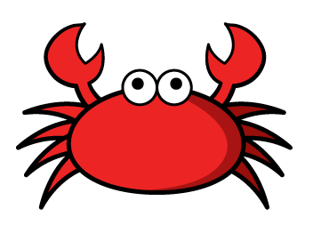
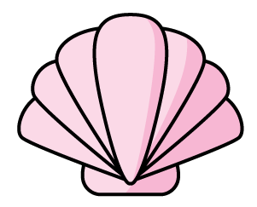
The crab turns to face the pink shell.
How could we describe the turn?
Have a think
The crab could make a quarter turn anticlockwise.
The crab could make a three-quarter turn clockwise.
three-quarter
A ____________ turn clockwise is the same as
a _______ turn anticlockwise.
quarter

Slide 17
Complete as many questions as you can

