Slide 1
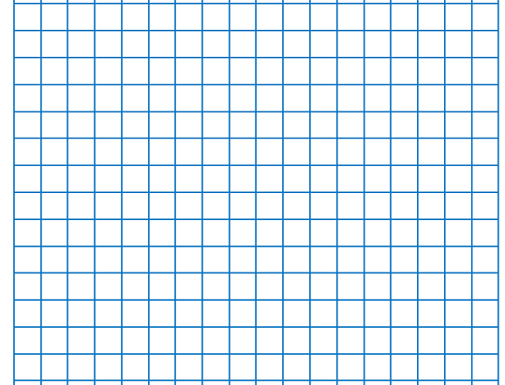
Date and QFL layout model
1)Draw the margin line two cells in using a ruler and sharp pencil.
2)On the second row, write the date, underline it using a ruler. Next write the QFL under the date and underline.
24/6/26 (skip a line)
QFL: Can I identify right angles?
skip a line)
FB5:
Main Activity:

Slide 2
25/6/26
QFL: Can I identify right angles?
Bronze: I can spot a right angle.
Silver: I can identify right angles in shapes and objects.
Gold: I can explain how I know an angle is a right angle.
Star Words:
right angle
square corner
angle
vertex
shape

Slide 3
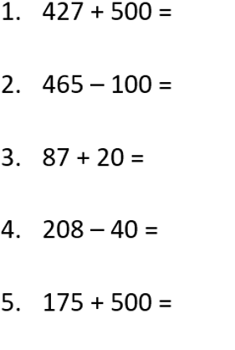
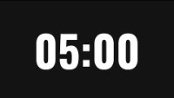
FB5:

Slide 5
What is an angle?
We see angles where 2 straight lines meet at a point.
An angle is a measure of the amount of turn between two lines.

Slide 6
A quarter turn is called a right angle.
Where can you see right angles in the classroom at school?

Slide 7



Which pairs of lines make right angles?
Which do not make right angles?
Have a think

Slide 8
Which shapes have right angles?
Have a think

Slide 9
There is 1 right angle in a quarter turn.
There are 2 right angles in a half turn.

Slide 10
There is 1 right angle in a quarter turn.
There are 2 right angles in a half turn.
There are 3 right angles in a three-quarter turn.

Slide 11
There is 1 right angle in a quarter turn.
There are 2 right angles in a half turn.
There are 3 right angles in a three-quarter turn.
There are 4 right angles in a full turn.

Slide 12
How many right angles do you see?
Have a think
There are 12 right angles.

Slide 13
Complete as many questions as you can

