Slide 1
Reading Comprehension

Slide 2
Wednesday 24th June 2026

Slide 3
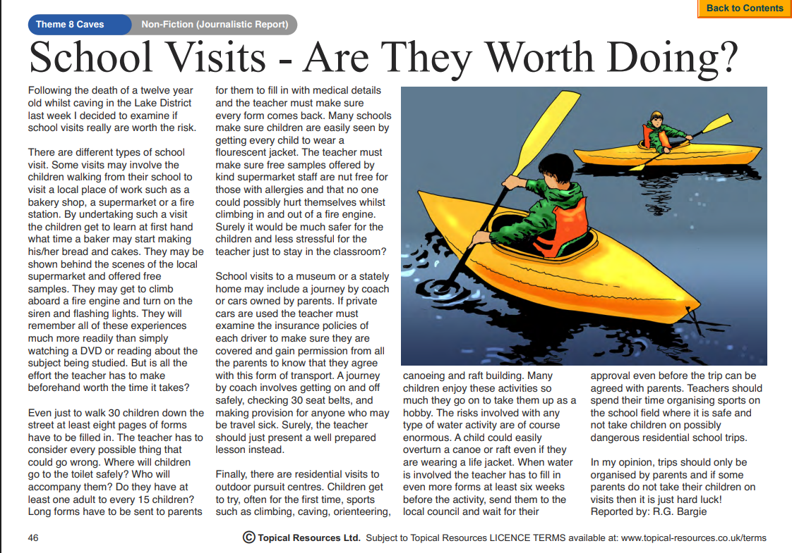

Slide 4
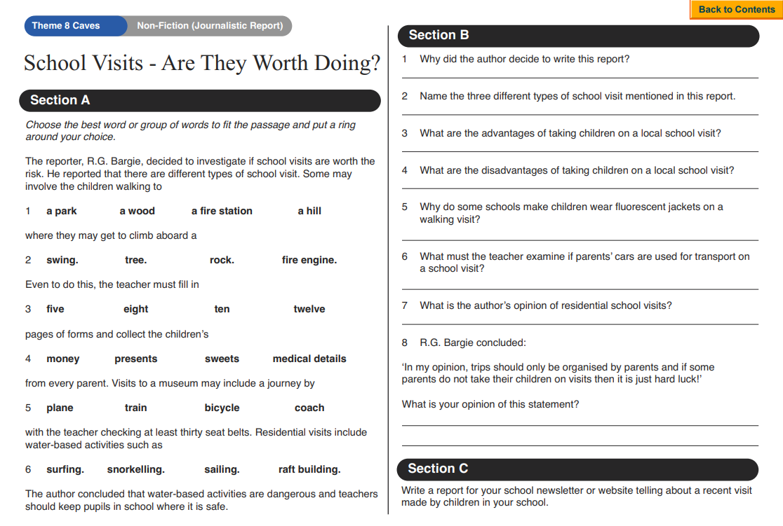

Slide 5
Thursday 25th June 2026

Slide 6
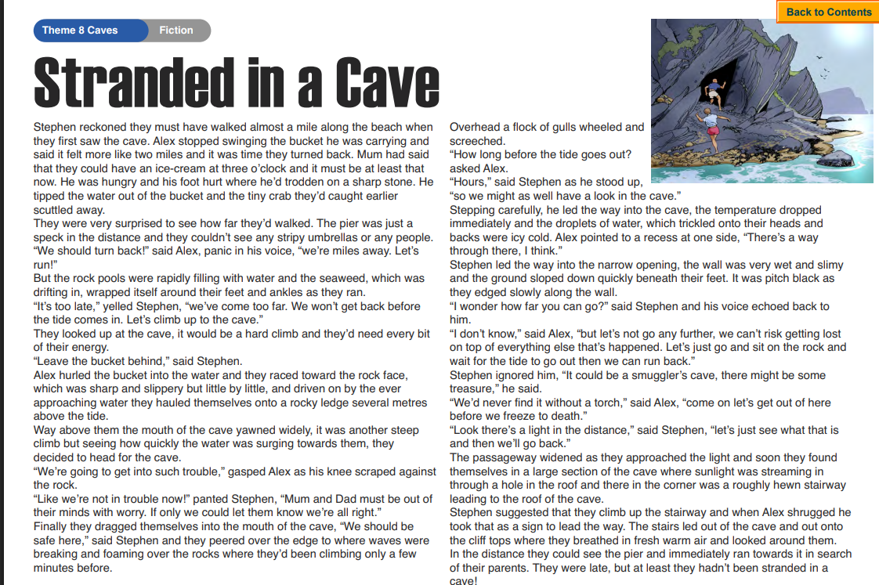

Slide 7
