Slide 1
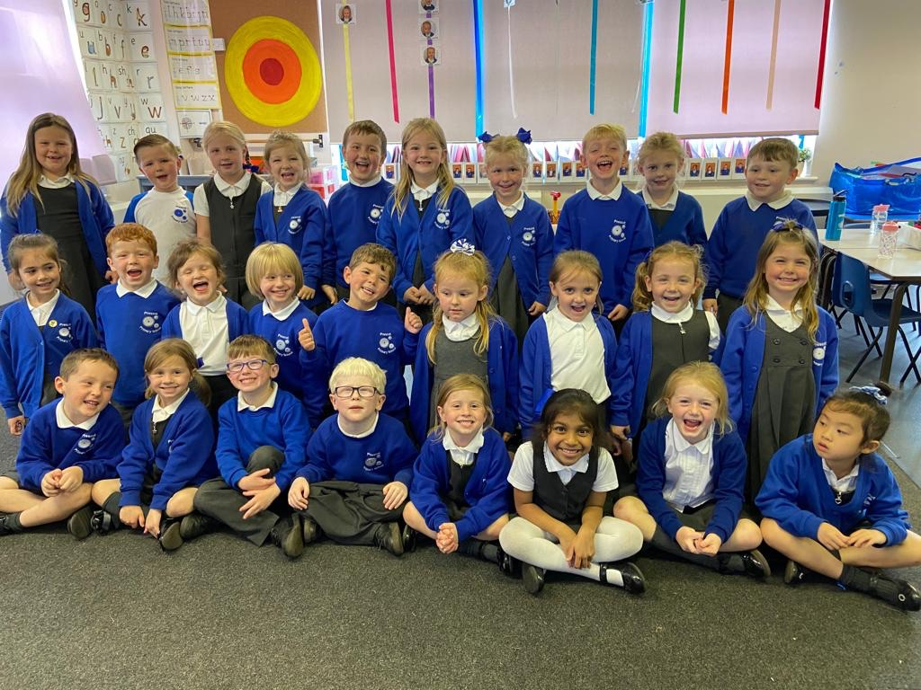
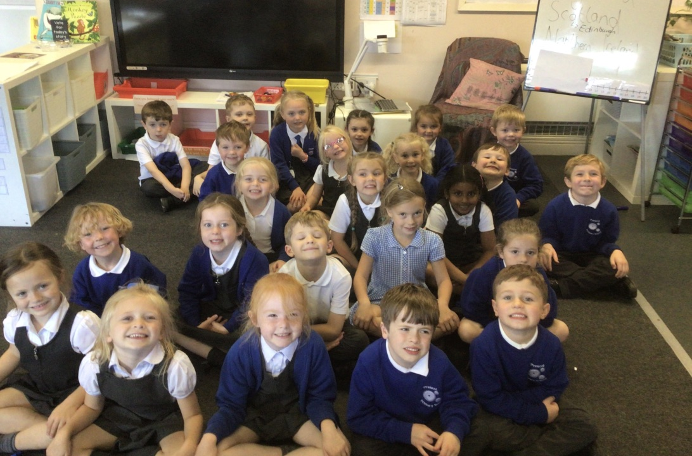
Welcome to Year 1

Slide 2
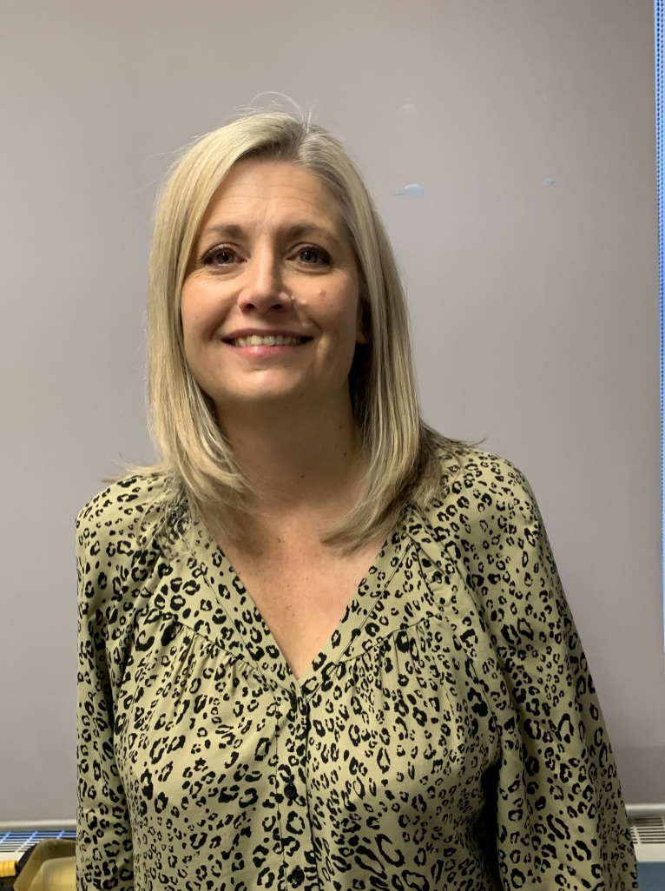
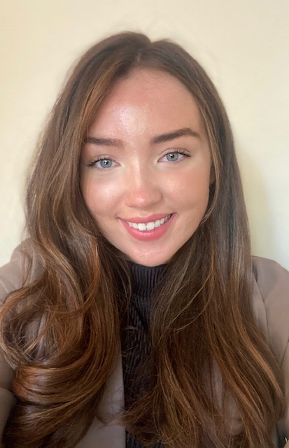
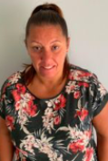
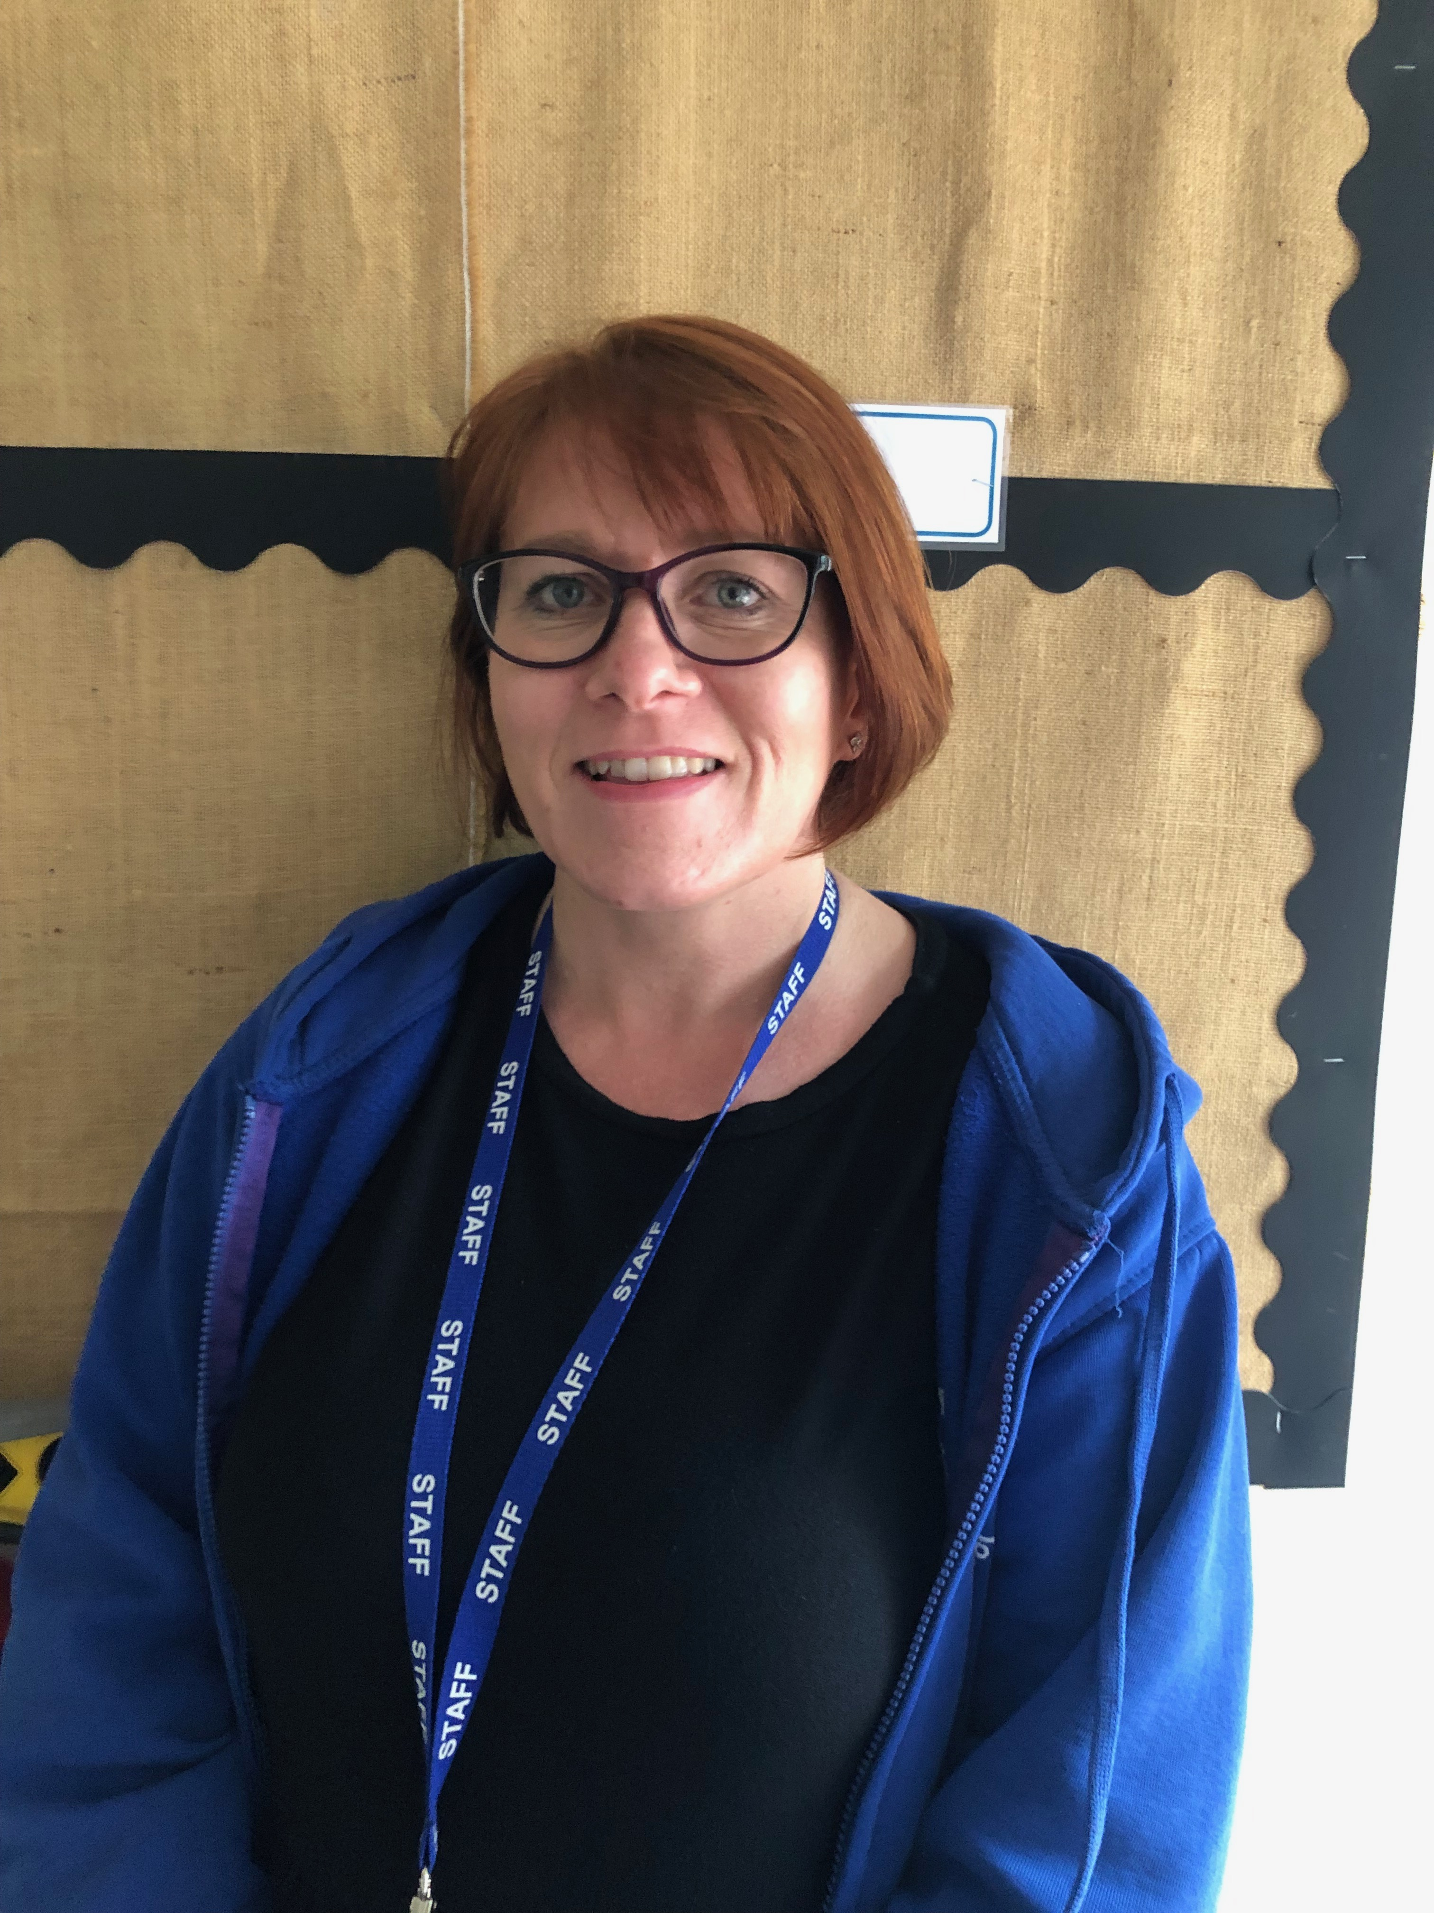
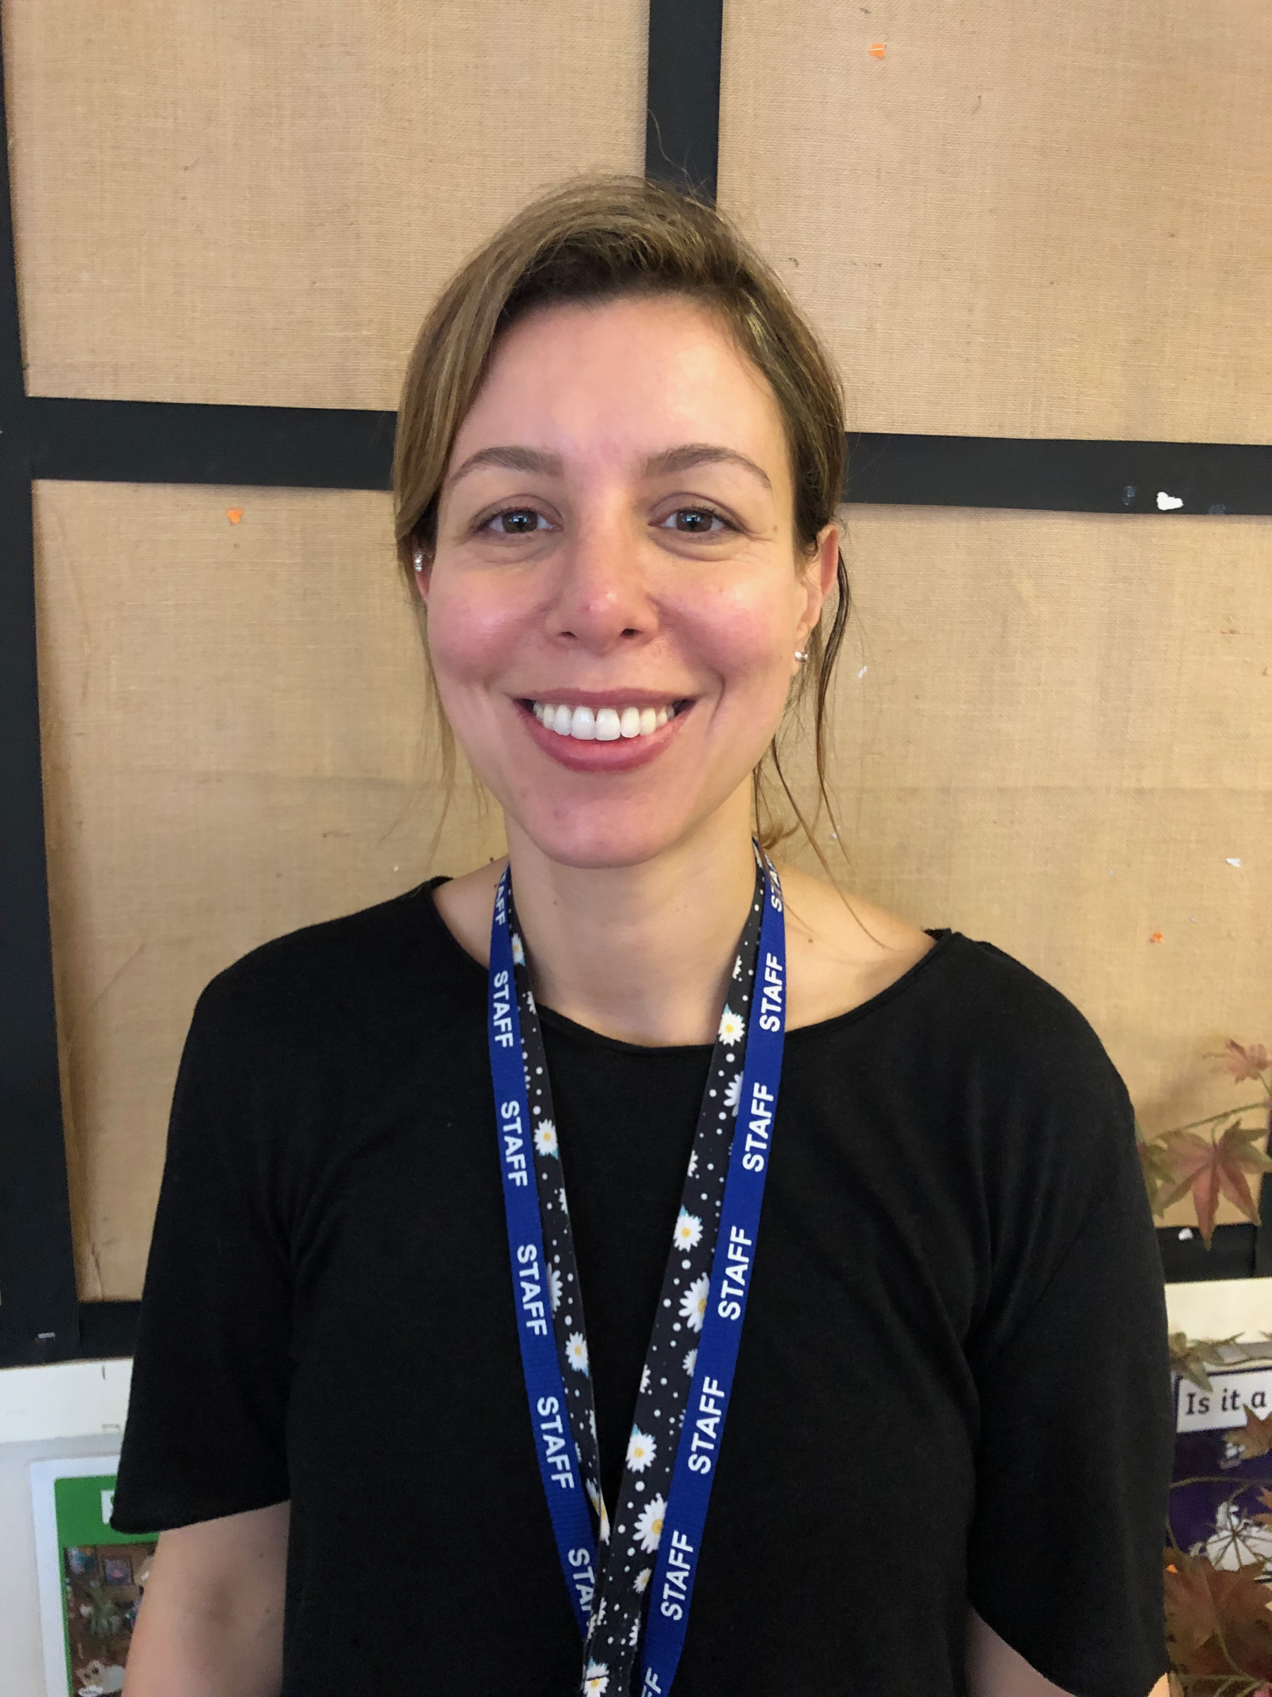
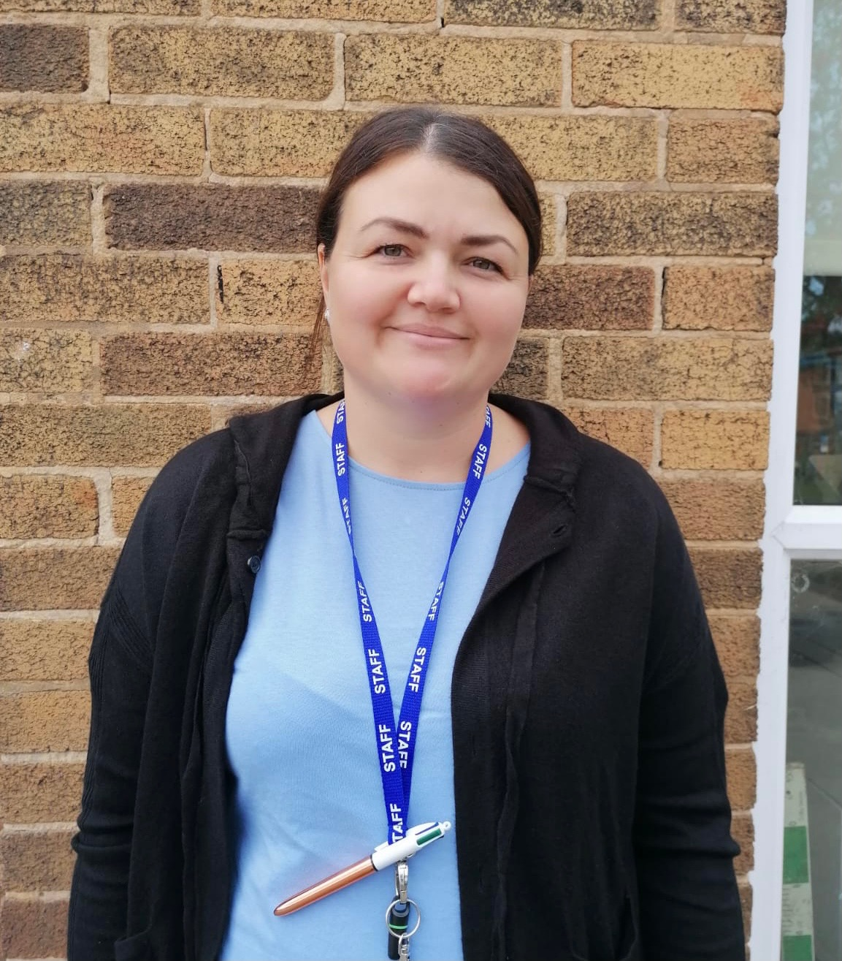
Meet the Year 1 Team
Mrs Ewing
Y1E
Class Teacher
Miss Hoffman
Y1H
Class Teacher
Mrs Hodgson
Teaching
Assistant
Mrs Herbert
Teaching
Assistant
Mrs Ferro
Teaching Assistant
Mrs Leary
Teaching Assistant

Slide 3
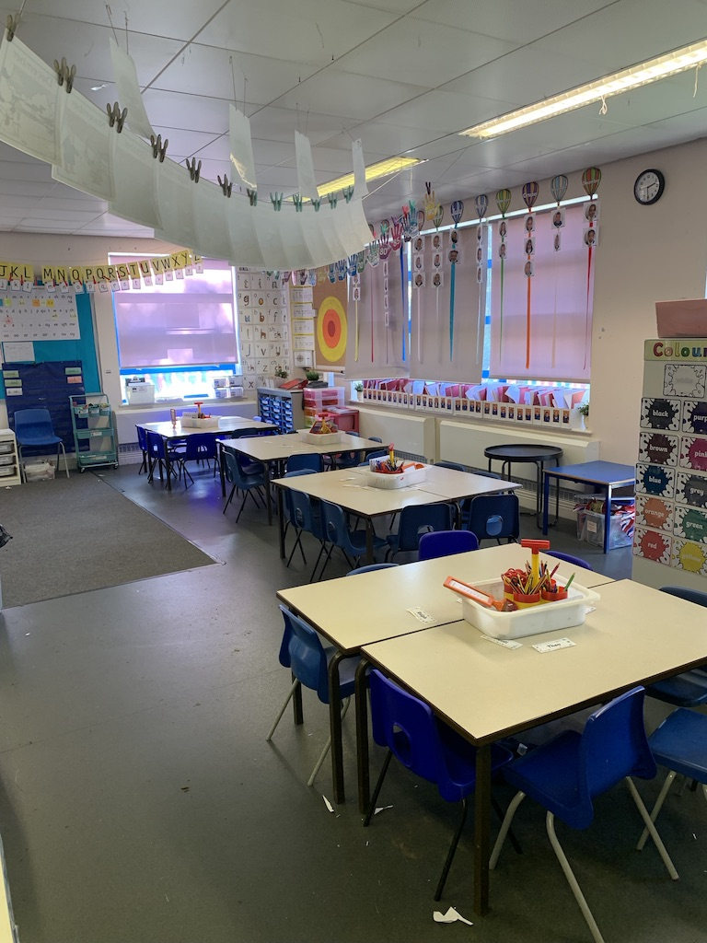
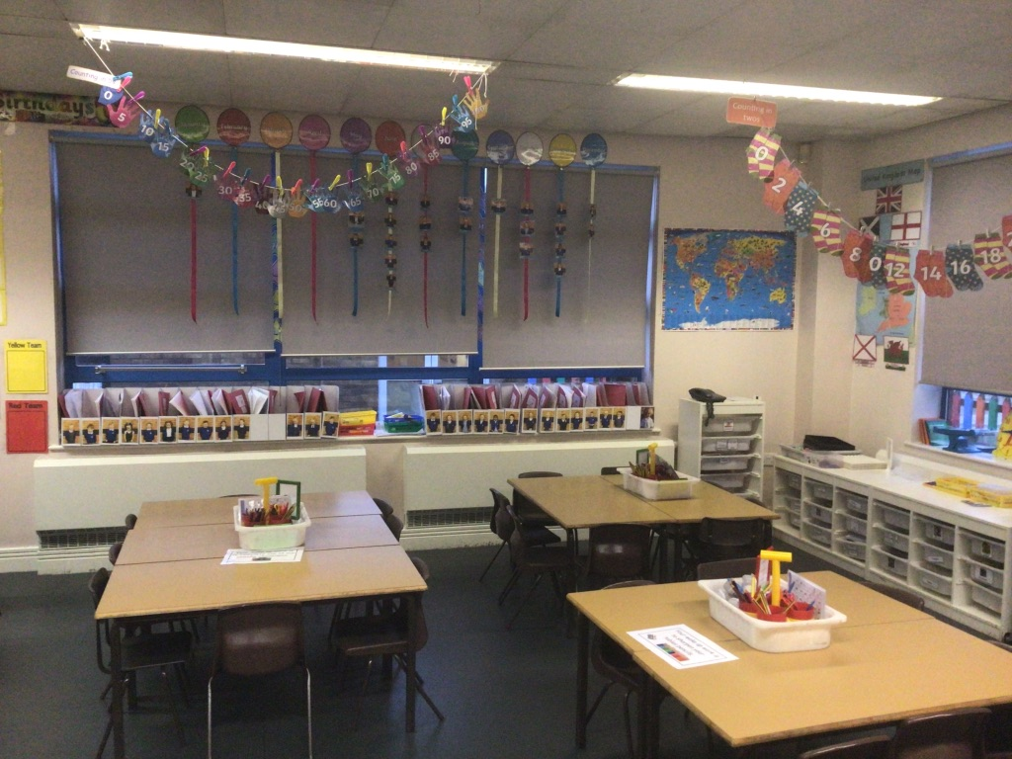
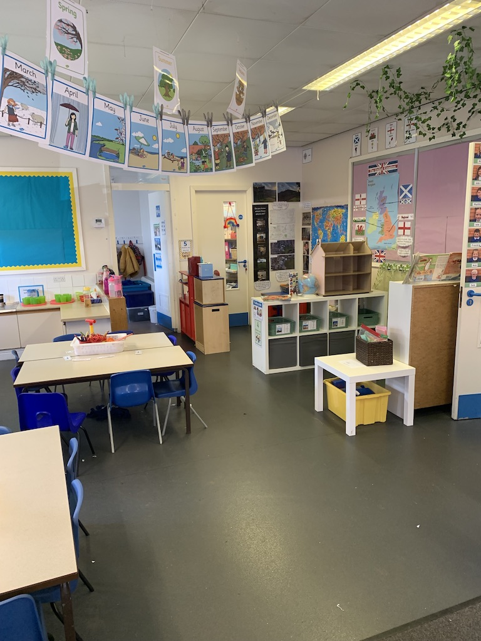
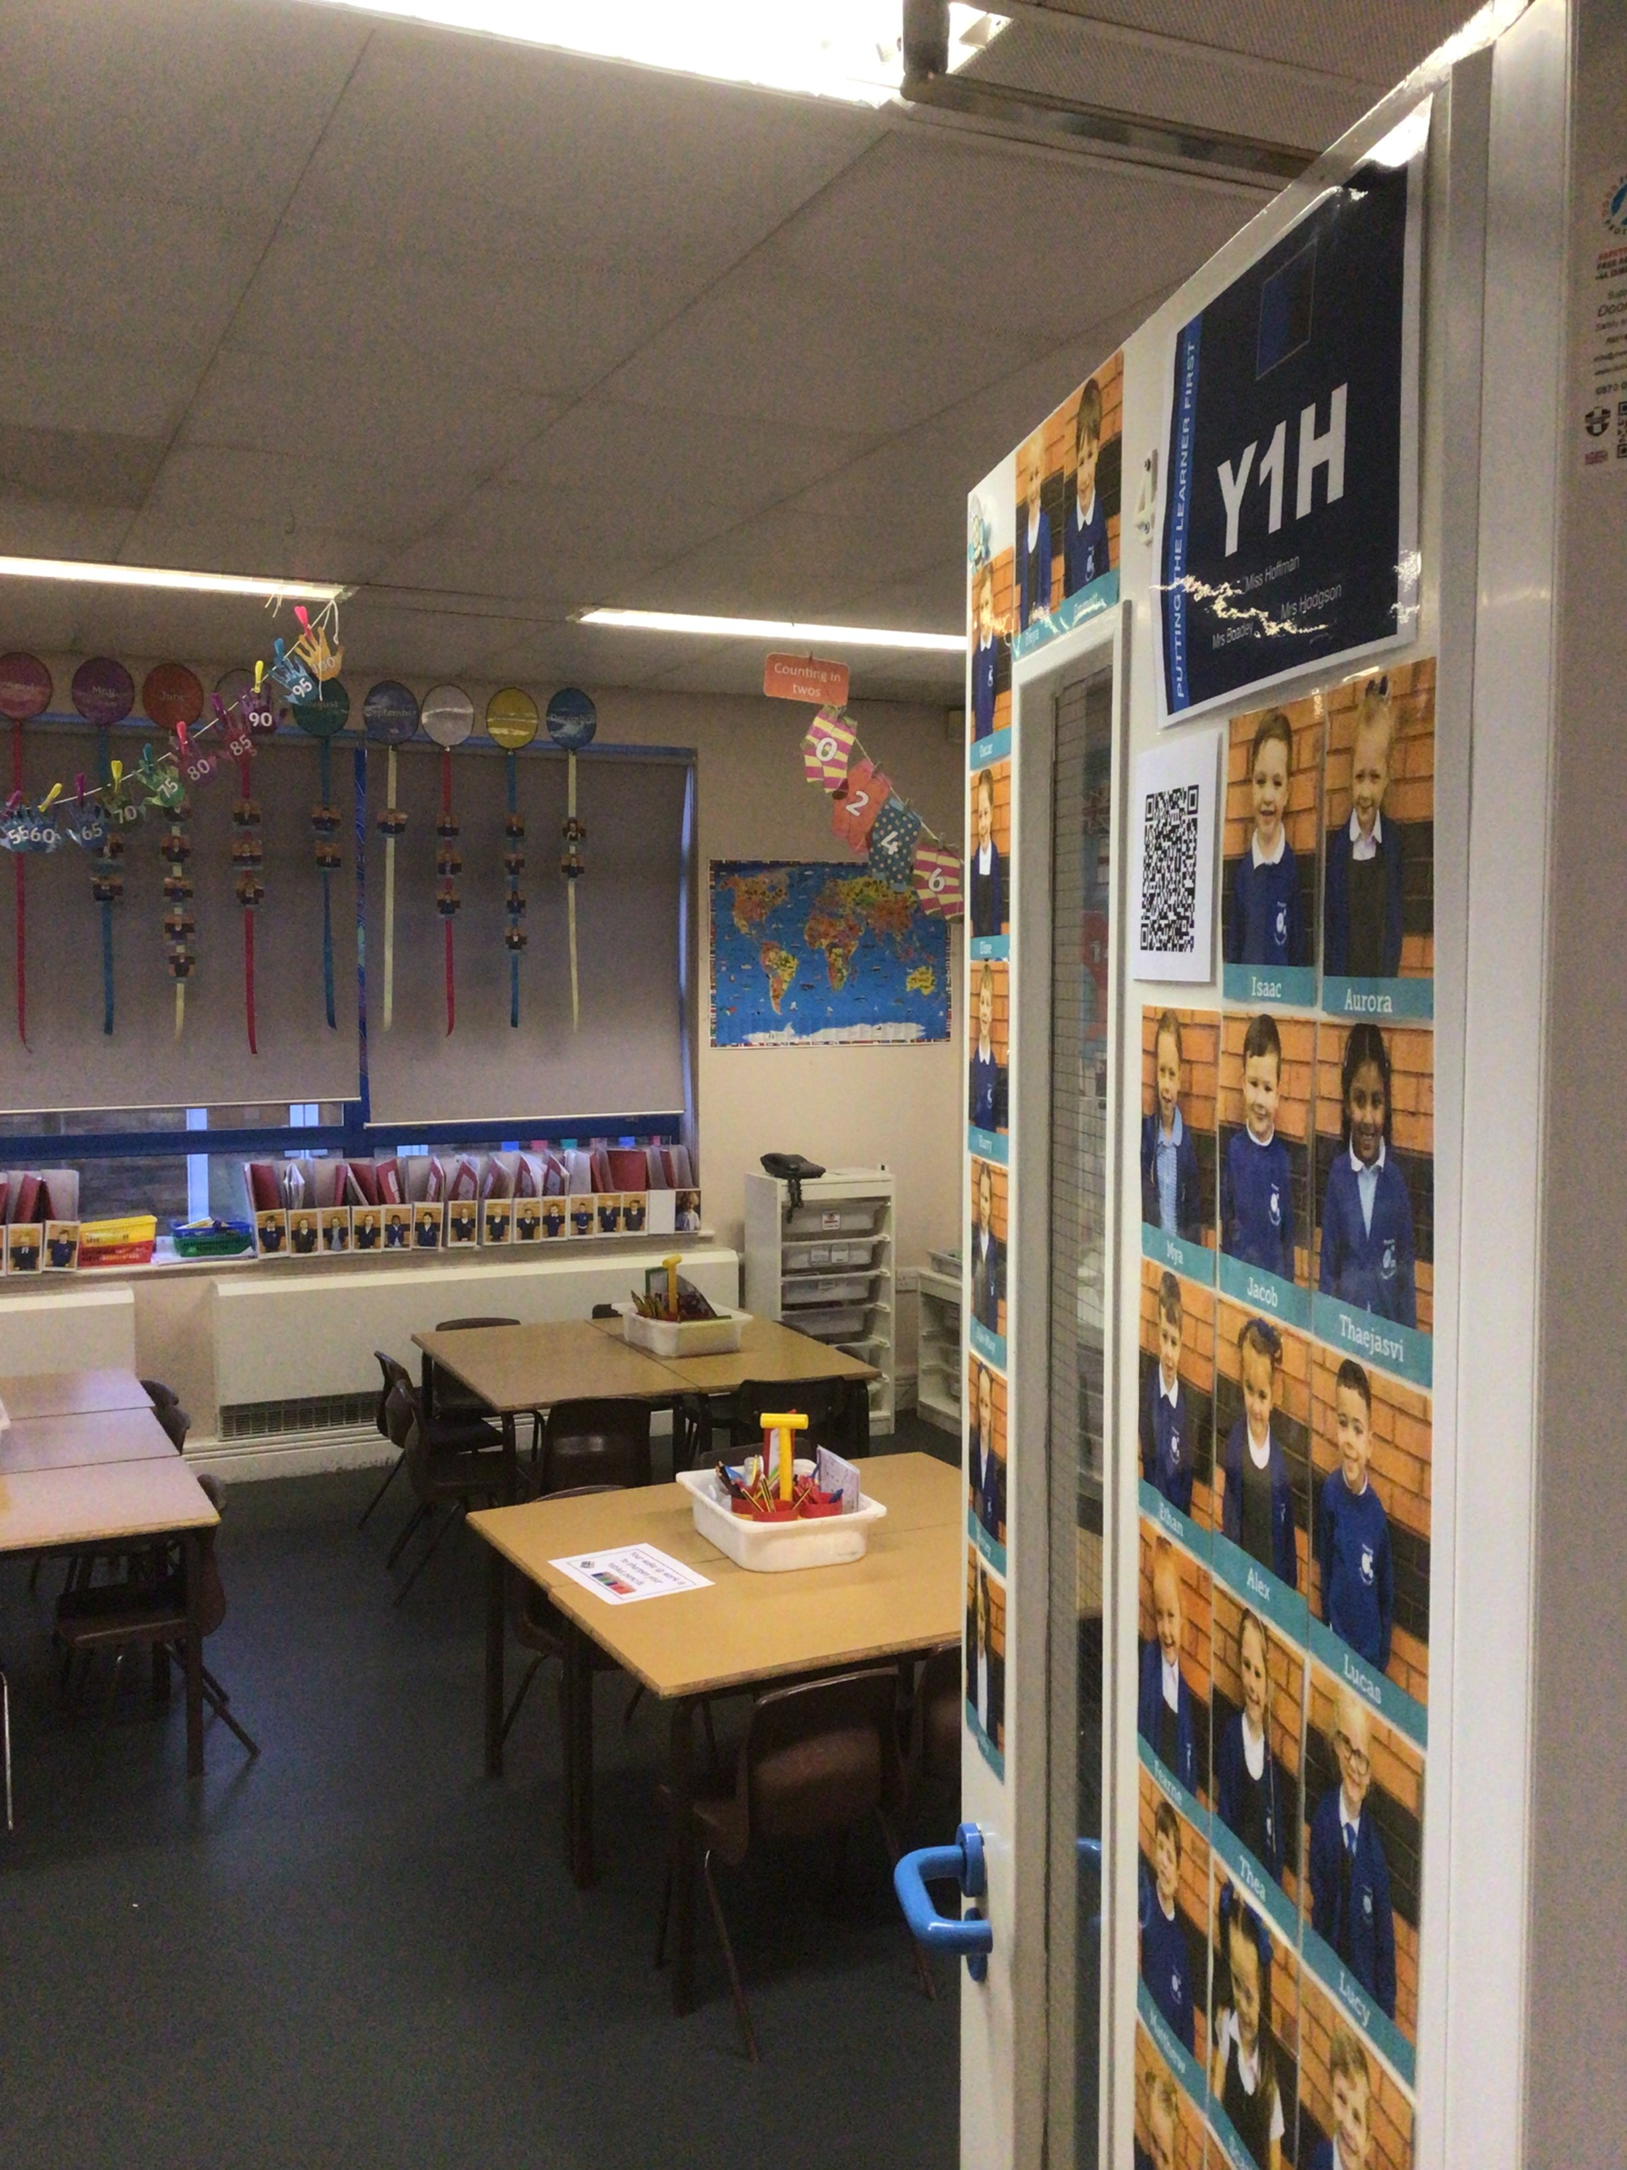
Our Classrooms

Slide 4




National Curriculum
We follow the NC Programme of Study for each subject and use the Curriculum to enhance our topic work.
English is taught daily through in ability groups. The children are assessed every half term and re-grouped accordingly.
After half term we will also have extra English lessons every day in our own classes.
Maths is taught daily and focuses on quick mental maths, direct teaching, group and independent work.
We follow the scheme of work.

Slide 5

The Curriculum
We are continuing to use the Cornerstones Curriculum.
This is a topic based approach to the National Curriculum.
Our first topic is Bright Lights, Big City!
In this topic we learn about the UK,
London and The Queen.

Slide 6



Topics to follow…
Dinosaur Planet
Moon Zoom
Y1 – Whole School Conservation Project

Slide 7
Oracy
We work on teaching the children to give answers in full sentences in all lessons. This in turn helps when writing sentences.
Daily maths meetings are held where the children orally rehearse previous learning. We teach the children to give their responses in full sentences.
We teach the children how to be good listeners and to share their ideas with each other and the whole class.
Each week the children are given new talking partners to help develop oracy skills.

Slide 8

Reading
In school we read every day. Reading is vital and we encourage children to not only read, but gain pleasure from reading.
Guided Reading
Guided reading takes place daily in RWI.
This includes a variety of differentiated texts and materials.
We teach reading skills together in RWI and the children learn how to use phonic knowledge to decode words.
Home Reading
Please comment in your child’s reading record after you have listened to them read so we can change your child’s book.
Reading bags need to be in school everyday for quiet,
independent reading sessions.

Slide 9

Favourite Five
These are texts we read and enjoy throughout year 1.

Slide 10
New to Year 1
STAR Tests - Early Literacy and Maths. The children are assessed each half term using this online programme. It allows us to track the children’s progress throughout year 1 and each subsequent year.
Communication – please email the office if you need to contact Mrs Ewing or Miss Hoffman, your email will be forwarded to us.
admin@prescotprimary.org.uk
REAL PE – Y1H- Tuesday and Y1E Friday (PE kit to be worn all day - jogging pants during Winter)

Slide 11
Marking / Feedback
The children are assessed against the lesson’s learning objective (WILMA) and in year 1 we introduce RAG marking system - red, amber and green. Over the year we show the children how to correct mistakes, complete work or to revisit the lesson objective in a different way.
We focus on verbal feedback during each lesson as it is more effective than written marking.

Slide 12

iPads
At present we are building iPads for the children to use in class - in pairs. We will work on building skills and independence by showing the children how to open and use a variety of apps.
We will use Google classroom to support learning and share resources.

Slide 13
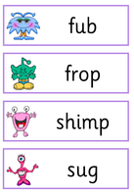
Y1 Phonics Screening
In summary:
This is a national, statutory test that every Y1 child across the county will undertake in June.
It assesses their ability to sound out and decode 40 real and non-real / alien words.
The children will not be aware that they are ‘sitting a test’ and it will be completed with their class teacher.
They will be given a pass/fail mark and you will be informed of this with the end of year report.
If they do not reach the required standard they will retake the phonics screening in Y2.

Slide 14
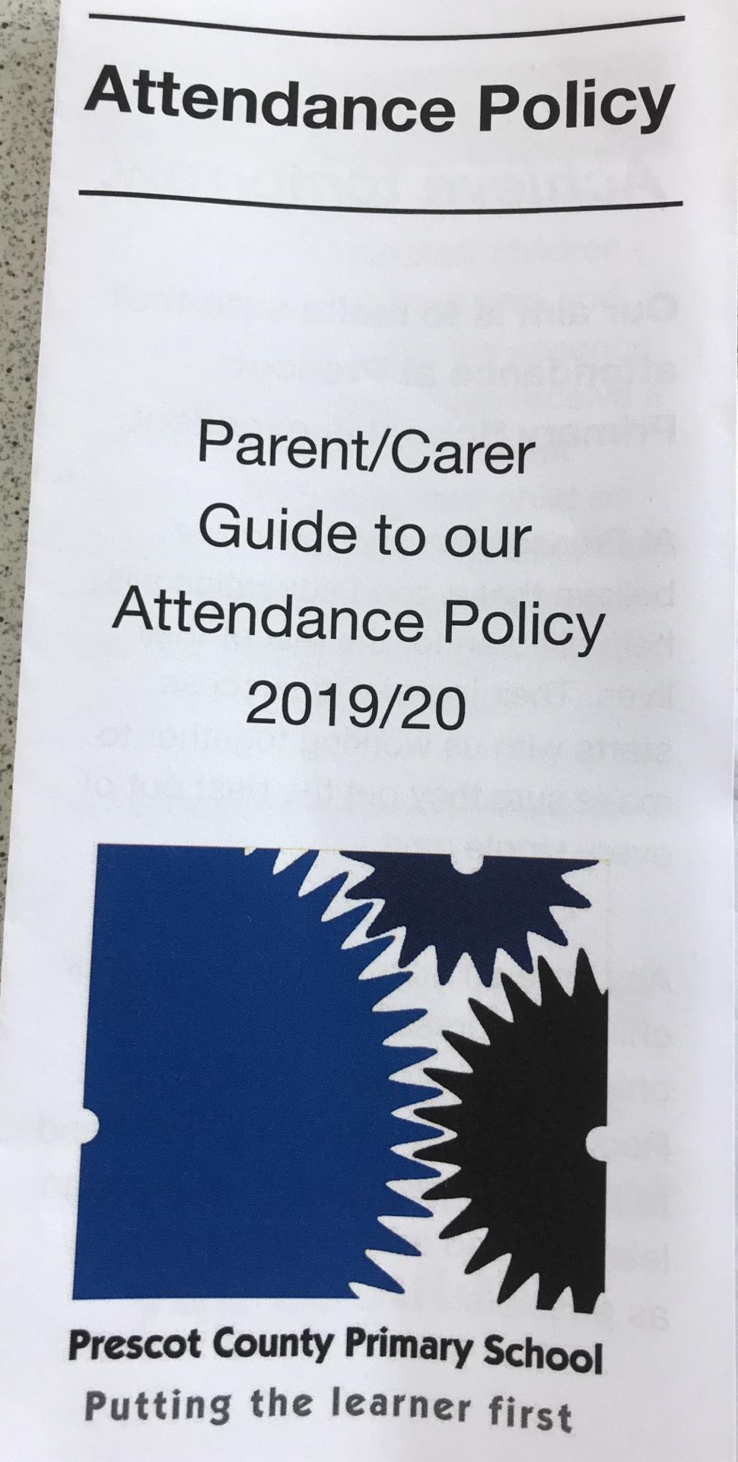
Attendance
Remember!!
There are 175 non school days a year!

Slide 15
Things you can do at home?
Any extra reading or encouraging your child to read for pleasure.
Share books together.
Maths - Number bonds to 10, counting in 2s, 5s and 10s to 100 (forwards & backwards).
Year 1 common exception words to read and spell.
Share any books/photos about our topics.
Encourage independence – zipping own coats, laces, jumpers.

Slide 16

Parents evening – Wed 20th October
Break up for half term – Fri 22nd October
Nasal Flu Spray – Mon 1st November
Phonics Screening Check – WB 6th June 2022

Slide 17

Follow us…
Follow @PCPZebras to find out what the children are learning on a daily basis
Year 1 information can be found on our school website. www.prescotprimary.org.uk
@PCPZebras

