Slide 1
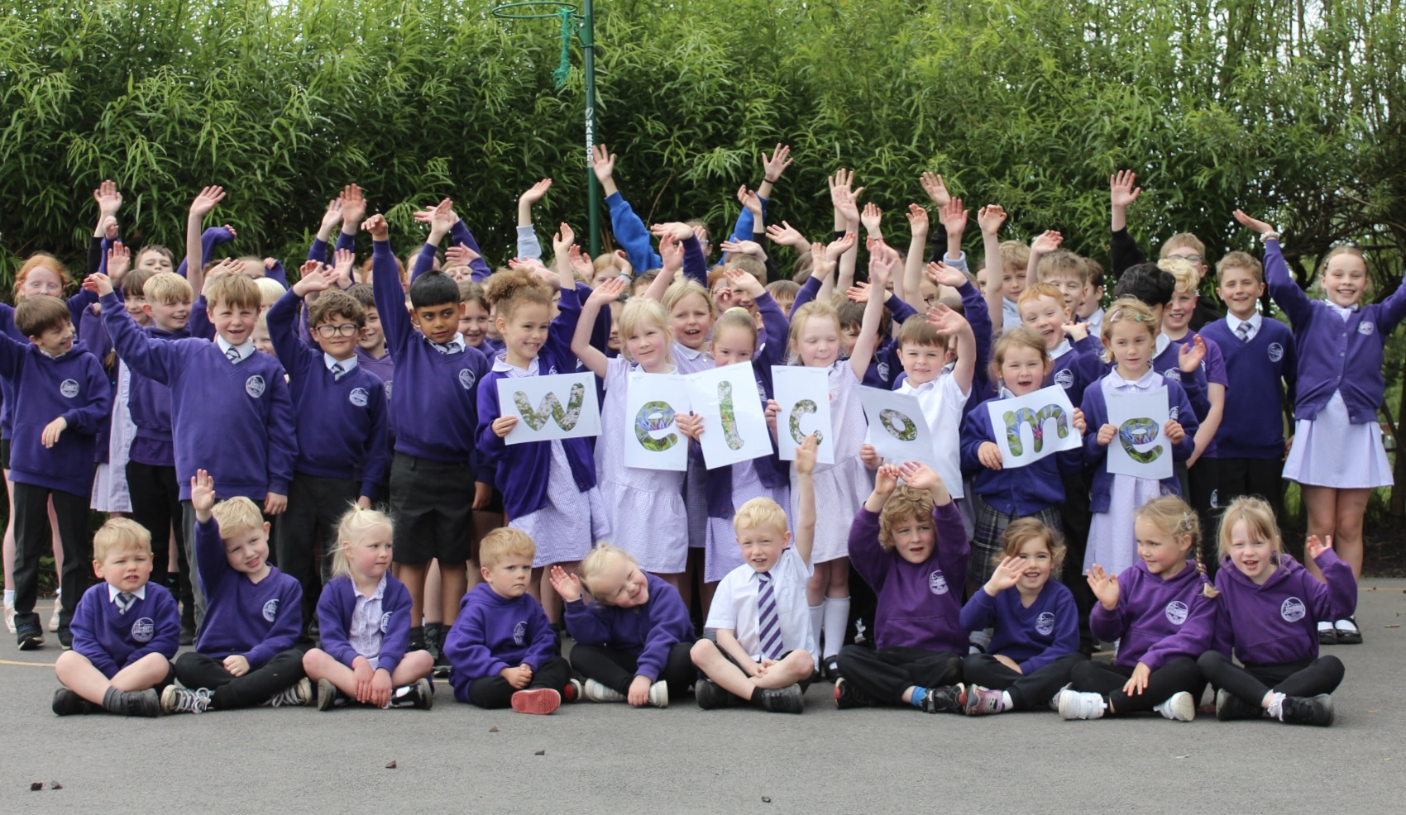

Sycamore Class (Year 1 & Year 2) 2026/2027
Meet the Teacher
Tuesday 7th July 2026

Slide 2
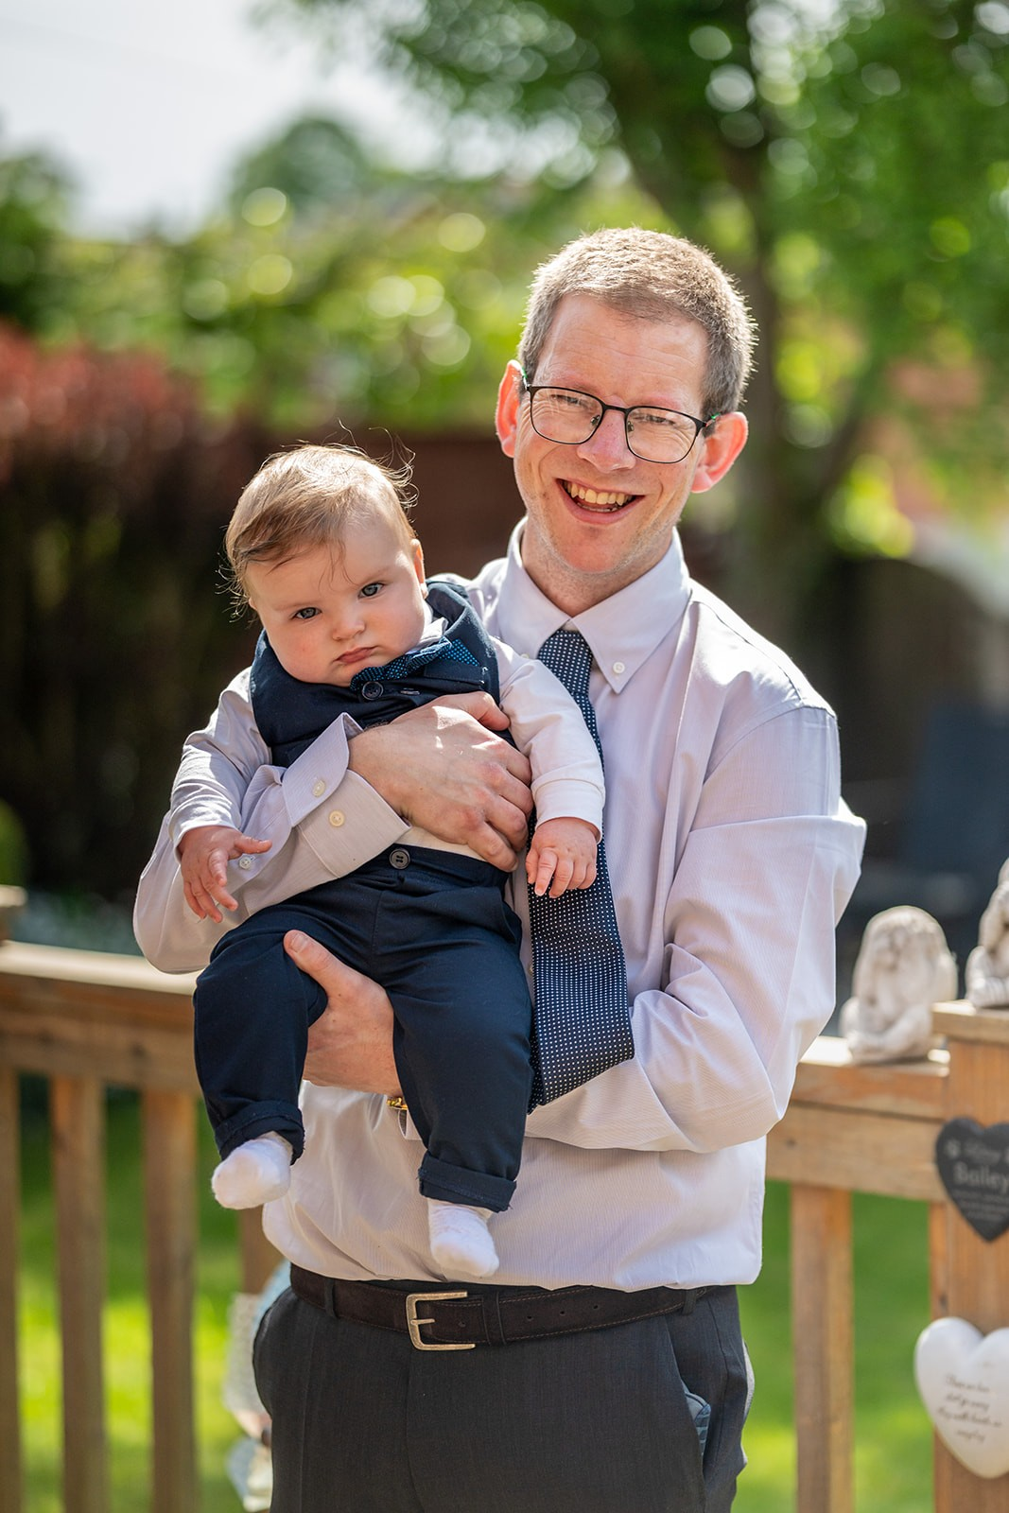
Meet Mr Wormleighton
I’ve been teaching for 12 years and have taught at St Mary’s for 7 years.
At St Mary’s, I have taught KS2 so I am looking forward to teaching KS1.
I come from Lytham St Annes and live with my wife, Monty and Toby.
My hobbies are walking, bell ringing and supporting Liverpool.

Slide 3
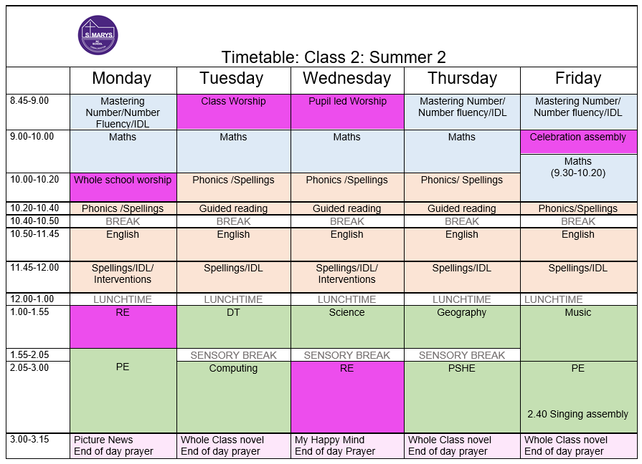

Slide 4

Transition from
EYFS:
Active learning

Slide 5
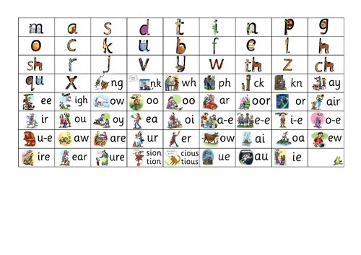
Phonics & Screening Check

Slide 6
Reading at
home

Slide 7

Reading
READING IS SO IMPORTANT ☺
Children should read their reading book for a short time every day.
Please keep a record of how much they have read and when in the home reading diary
Notes on how they got on can be written in the comments section
There is the opportunity for children to change their book every day, once they have completed it
In school, children read during daily guided reading sessions.

Slide 8
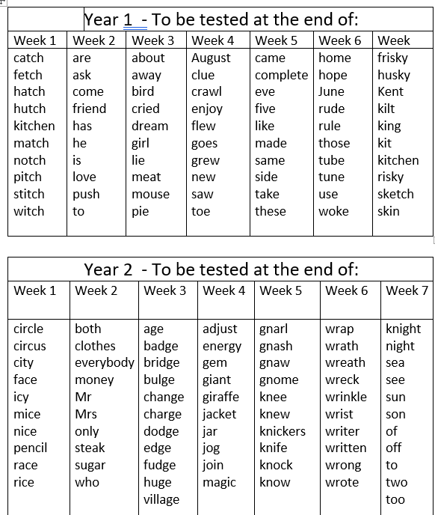
Weekly Spellings

Slide 9
Maths
-White Rose Maths
-Number bonds to 10 off by heart
-Counting in 2s, 5s, 10s

Slide 10

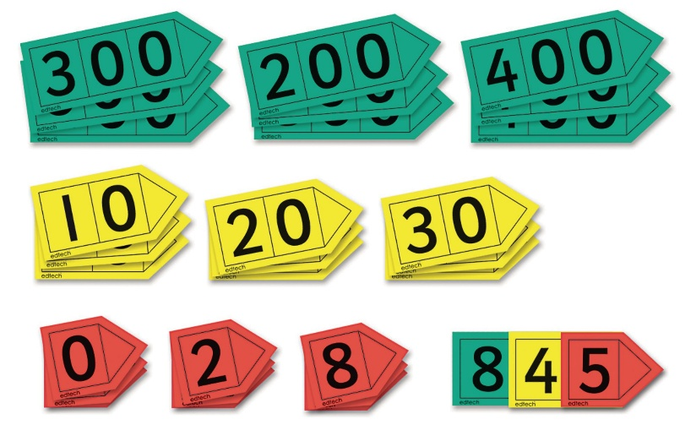
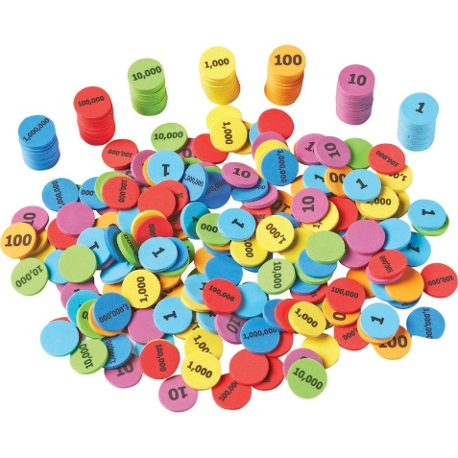
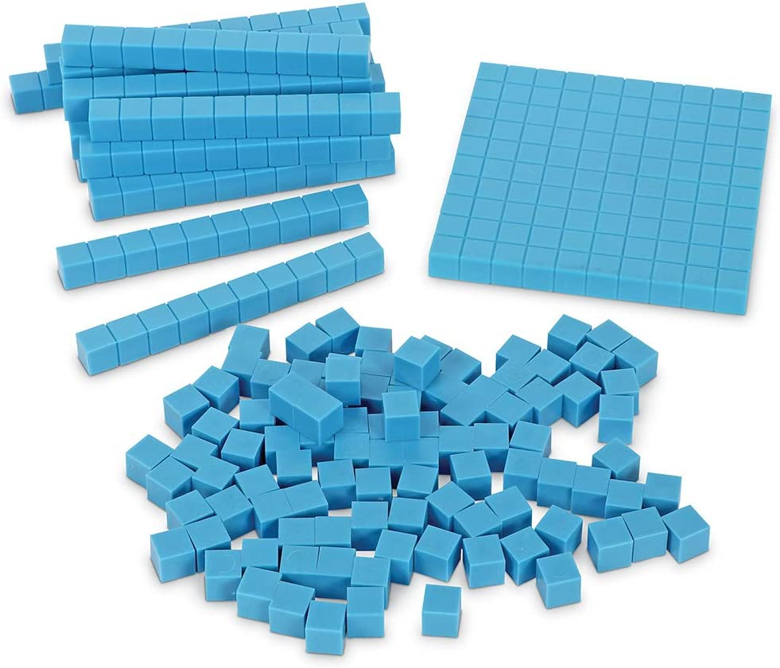
Maths Mastery
Our mastery curriculum rejects the idea that a large proportion of people ‘just can’t do maths’ and instead focuses on the idea that all pupils can achieve depth in their learning which can be accomplished by using key principles including:
Using different resources to represent numbers to achieve a deep understanding of how the number system works
Progressive approach- children make small steps and build on their learning each lesson
Encouraging mathematical thinking rather that just ‘knowing the answer’
Presenting the same concept in a variety of different ways

Slide 11
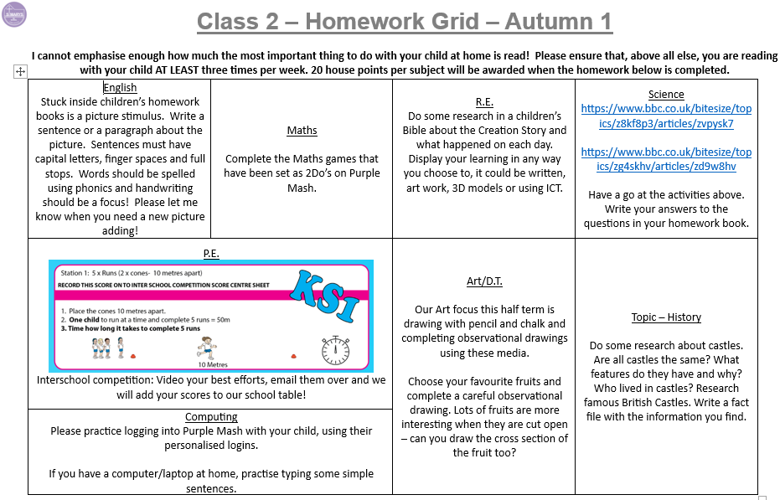
Optional Homework – life is busy!!

Slide 12

Bits and Bobs
Please ensure your child brings a coat to school. We send the children out at break time as much as possible.

Slide 13
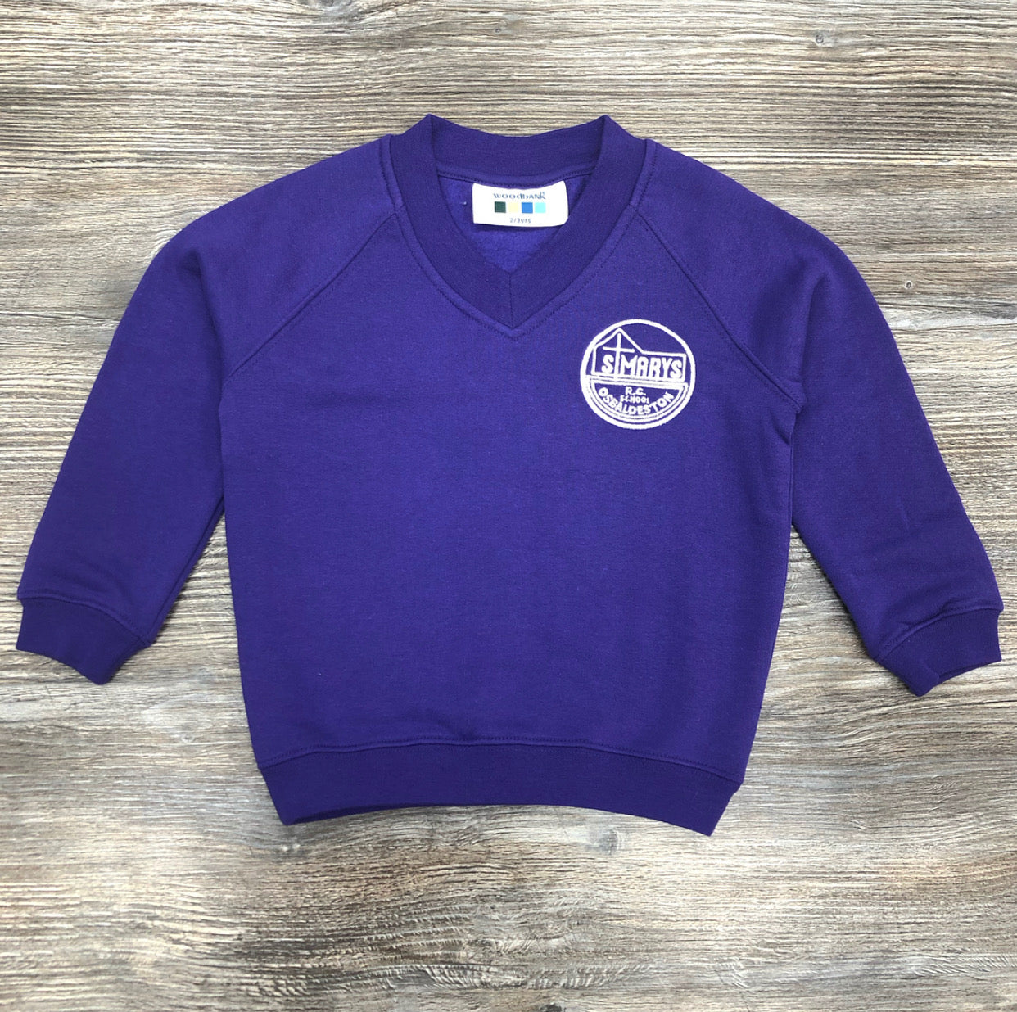
Bits and Bobs
Please ensure all your children’s uniform is labelled with their name.

Slide 14
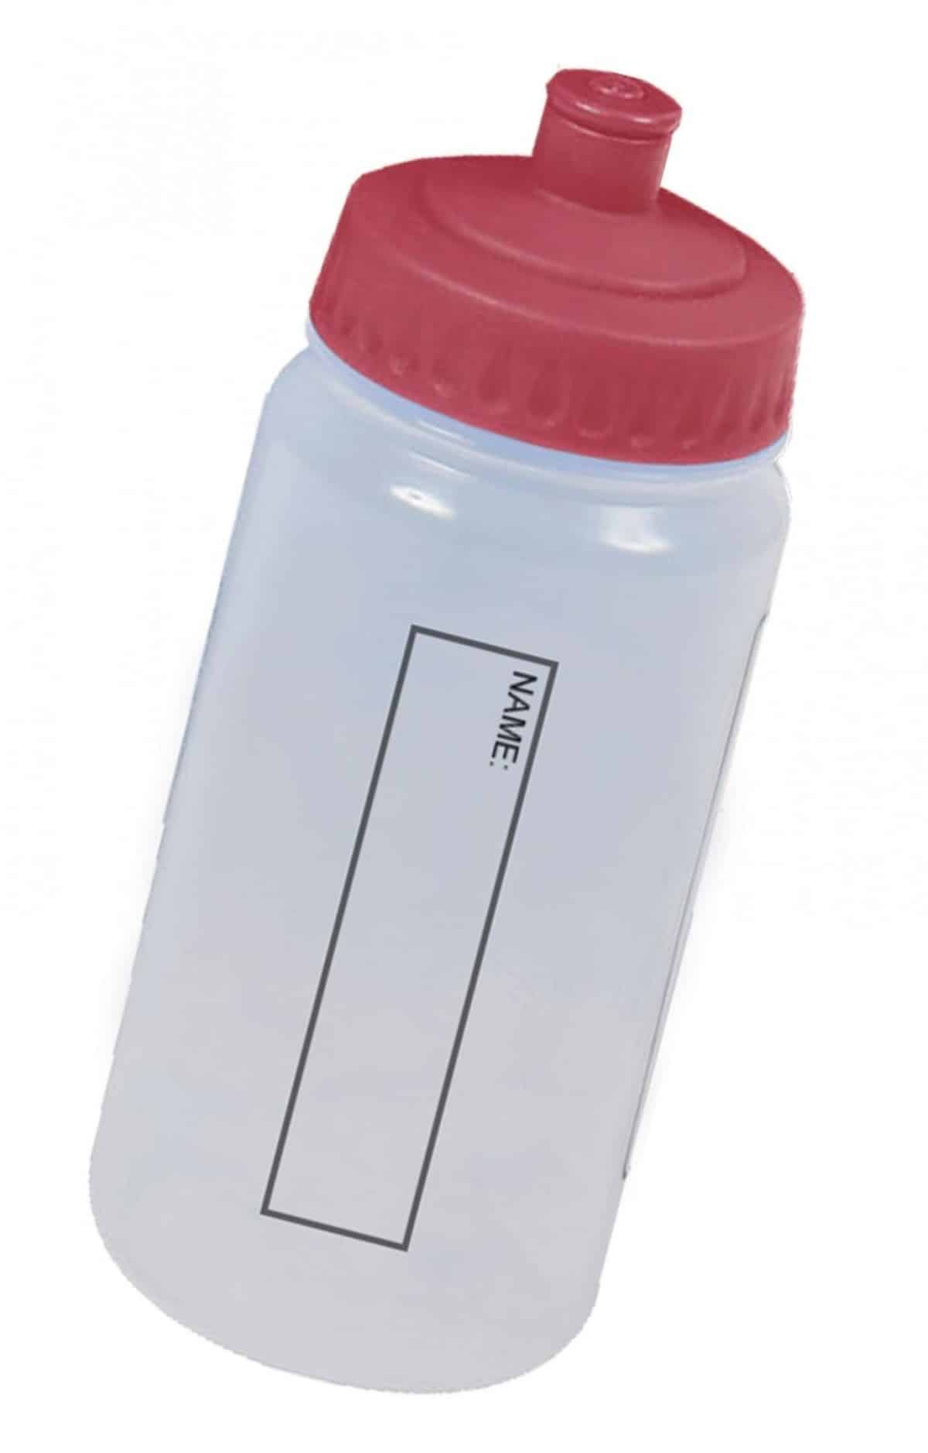
Bits and Bobs
Children should bring a bottle of water to school.

Slide 15

P.E.
Children are required to wear school uniform to school on PE days. They get changed at school for PE.
PE day TBC
Earrings must be removed.

Slide 16


Please check the school webpage, social media channels on a regular basis to keep up to date.
https://www.smrc.lancs.sch.uk/

Slide 17
Further
Information
If you require any further information, send emails to:
parents@smrc.lancs.sch.uk

Slide 18
parents@smrc.lancs.sch.uk
Please email us if someone different is picking your child up.
Snack – school/own snack. Grapes and cherry tomatoes MUST be cut in half lengthways.

Slide 19
Over the holidays:
-Have fun
-Spend time as a family
-Enjoy not doing the school run!
If you want to do little bits here and there:
-Practise number bonds/counting in 2s, 5s, 10s when you’re in the car
-Lots of reading – local libraries
-Writing – maybe a diary of a holiday?

Slide 20
Any questions?

