Slide 1
Music from the USA
All music for this unit can be found on Spotify, Amazon Music, Apple Music or Youtube. Have a hunt about and choose your favourite track from the artists suggested below.

Slide 2
What is ‘American Music’ to you?
What does it sound like?
What does it not sound like?

Slide 3
LO: To understand and appreciate the roots and influences of Blues Music

Slide 4
Blues Music
What do you know about it?
What do you expect it to sound like?

Slide 5
Definition
…Blues is the name given to both a musical form and a music genre that originated in African-American communities of primarily the "Deep South" of the United States around the end of the 19th century from spirituals, work songs, field hollers, shouts and chants, and rhymed simple narrative ballads.

Slide 6
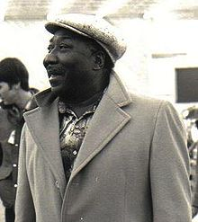
Track 1 – Muddy Waters
McKinley Morganfield
1913 – 1983
The father of “modern Chicago Blues”
Shocked audiences in the 1950s with his blending of musical styles.

Slide 7
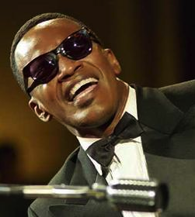
Track 2 – Ray Charles
Ray Charles Robinson
1930 – 2004
Pioneered combining different types of music, including country, rock, blues, jazz and gospel.
Frank Sinatra called him "the only true genius in show business"

Slide 8
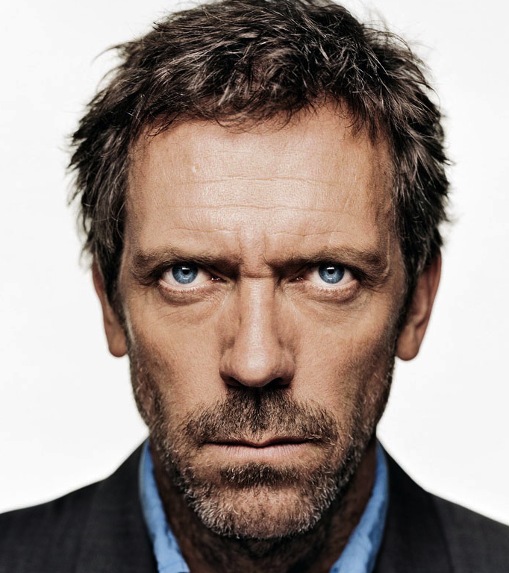
Track 3 – Hugh Laurie
British actor
Began playing Blues music when working in the USA for the TV series House.
Produced 2 albums of classic and modern Blues songs.

Slide 9
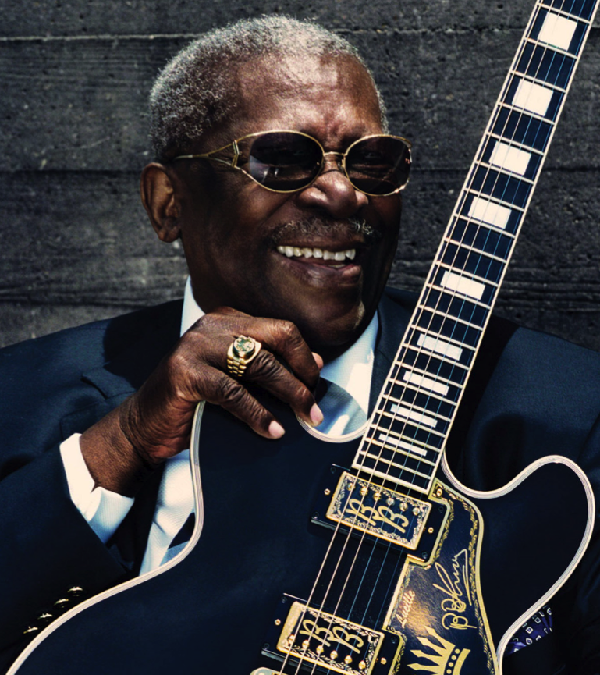
Track 4 – B B King
Riley B. King
born 1929
One of the best guitarists in the world.
Blends different styles of music into his Blues theme.

Slide 10
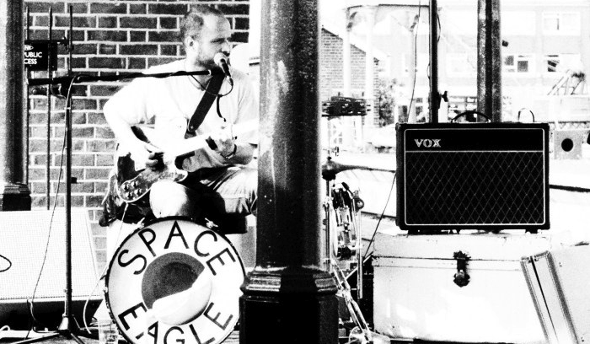
Track 5 – Space Eagle
A local band based in Norwich

Slide 11
LO: To understand and appreciate the roots and influences of Jazz Music

Slide 12
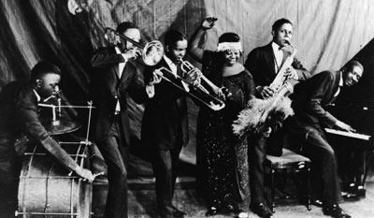
What is Jazz to you?

Slide 13
Prohibition in the United States (from 1920 to 1933) banned the sale of alcoholic drinks, resulting in illicit speakeasies becoming lively venues of the "Jazz Age", an era when popular music included current dance songs, novelty songs, and show tunes. Jazz started to get a reputation as being immoral and many members of the older generations saw it as threatening the old values in culture and promoting the new decadent values of the Roaring 20s.
The birth of jazz music is often accredited to African Americans but expanded and modified to become socially acceptable to middle-class white Americans. White performers were used as a vehicle for the popularization of jazz music in America. Even though the jazz movement was taken over by the middle class white population, it facilitated the mesh of African American traditions and ideals with the white middle class society. Cities like New York and Chicago were cultural centers for jazz, and especially for African American artists.

Slide 14
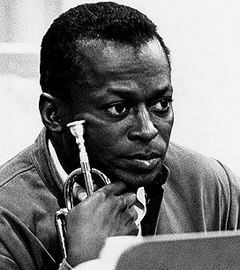
Track 1 – Miles Davis
Miles Dewey Davis III
1926 – 1991
“one of the great innovators in jazz”
Brilliant trumpet player.
“Kind of Blue” has sold over 4 million copies.

Slide 15
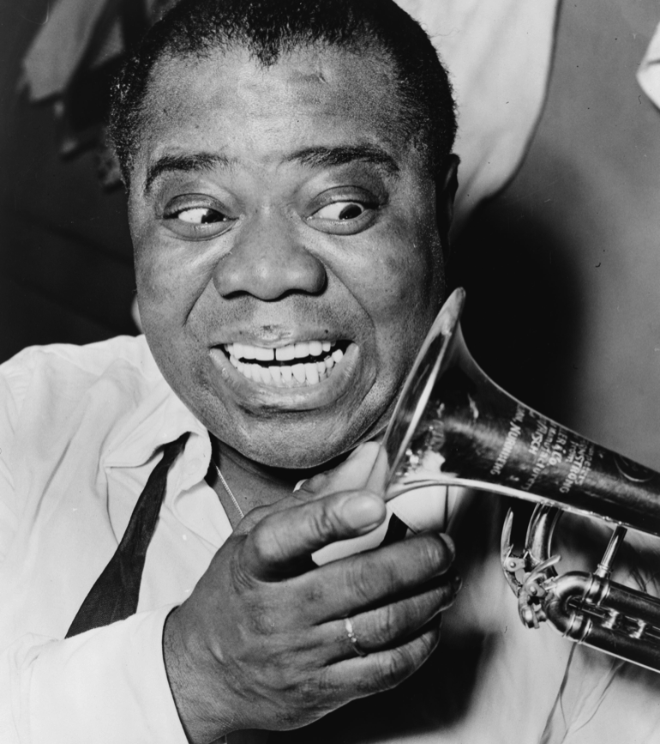
Track 2 – Louis Armstrong
Born in New Orleans, Louisiana.
1901 – 1971
One of the first true jazz performers, pioneering its sound and style.
Active promoter of desegregation and Civil Liberties.

Slide 16
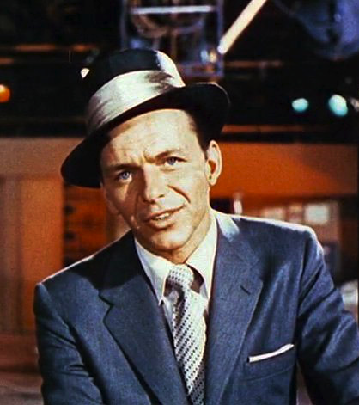
Track 3 – Frank Sinatra
Known as ‘Old Blue Eyes’ due to his light blue eye colour.
Part of the 1960’s ‘Rat Pack’ – a group of musical actors that appeared in popular films of the time.

Slide 17
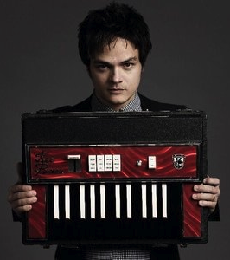
Track 4 – Jamie Cullum
British jazz/pop artist.
born in 1979 in Essex.
DJ on Radio 2
Married to Sophie Dhal, granddaughter of the author.

Slide 18
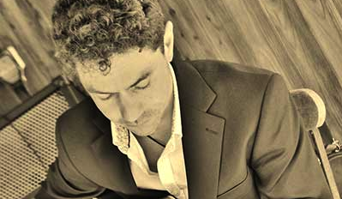
Track 5 – Jack Austin
A local artists based in Norwich

Slide 19
LO: To understand and appreciate the roots and influences of Rock and Roll.

Slide 20
What is Rock and Roll to you?
Can you name an artist or a song?
What does it sound like?

Slide 21
Rock and Roll
Mix of electric guitars, vocals and drums. Sometimes piano, and later keyboard.
Written in the 4/4 time signature. creates a simple rhythm, similar to what is used in Pop music today.
Influenced by the blues and jazz music before it.
Linked with the rise of ‘teen culture’ in the 1950s

Slide 22
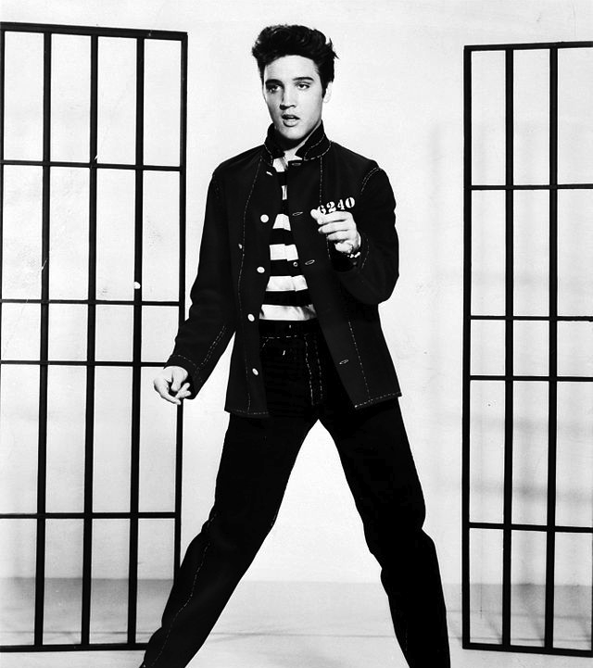
Track 1 – Elvis Presely
Elvis Aaron Presley
1935 – 1977
‘King of Rock and Roll’
Numerous apparent sittings since his death. Some fans think he faked his death so he could retire in peace.

Slide 23
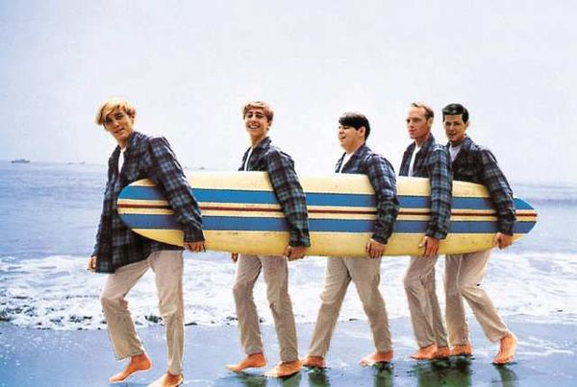
Track 2 – The Beach Boys
California rock and roll band.
Formed in 1961
9 different men have been members at different times.
Famous for their Surf Rock sound.

Slide 24
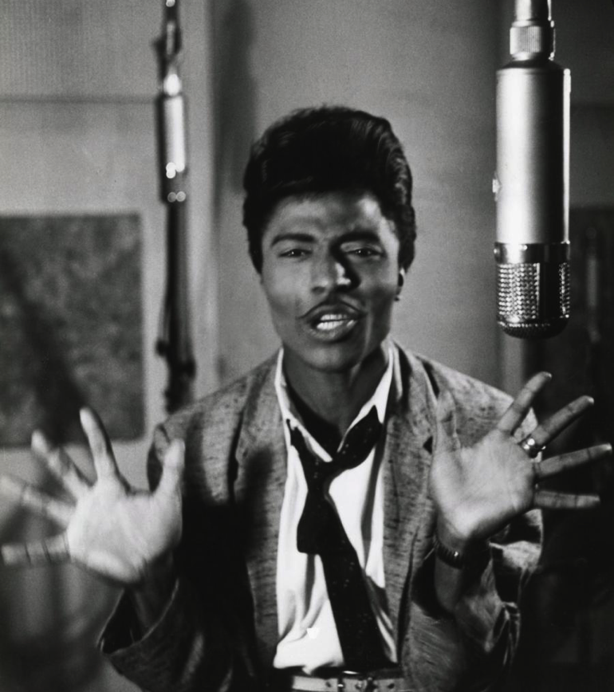
Track 3 – Little Richard
Richard Wayne Penniman
born 1932
His mix of Rock and Roll with jazz lead to modern Hip Hop music.

Slide 25
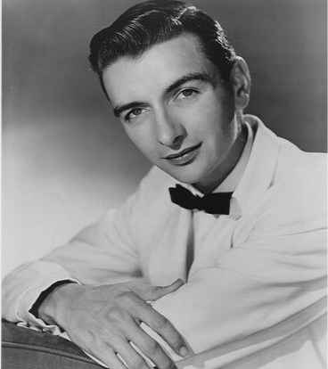
Track 4 – Ray Peterson
Ray T. Peterson
1939 - 2005
Early Pop singer
Went on to become great friends with Elvis Presley, who he recorded music with.

Slide 26
LO: To understand and appreciate the roots and influences of Country Music

Slide 27
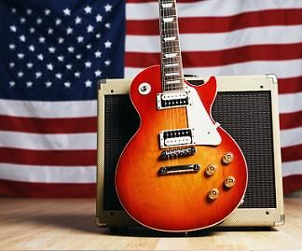
What does Country Music sound like to you?

Slide 28
Country Music
Founded in the Southern States of the USA.
First heard as genre in the 1920s, taking themes from Southern folk/church songs.
Has changed over time to include influences from Blues, Jazz and Rock and Roll.
Themes of nature, love songs, Christianity.
Vocals, guitar (acoustic and electric), banjo, double bass, fiddle, drums, harmonica

Slide 29
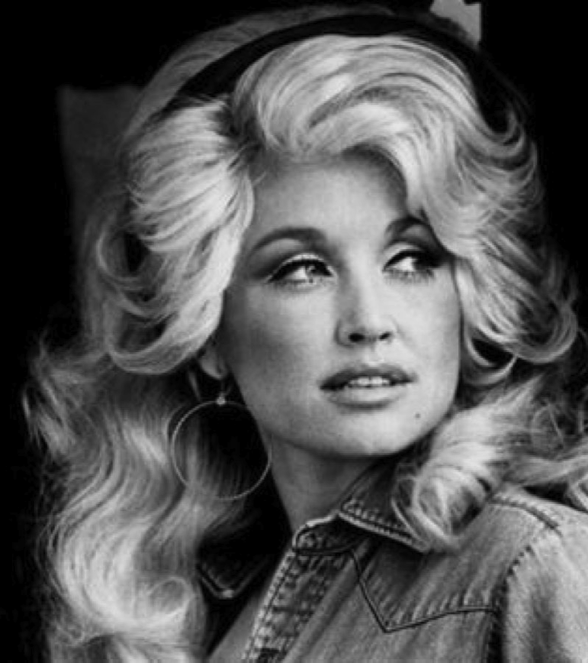
Track 1 – Dolly Parton
Dolly Rebecca Parton
born 1946
Career start on TV as a variety show singer.
Country and Pop singer.
Most honored country singer of all time (25 major awards)

Slide 30
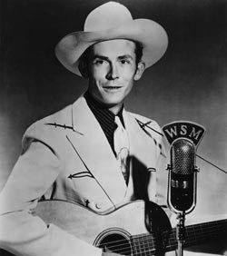
Track 2 – Hank Williams
Hank King Williams
1923 – 1953 (aged 29). Died due to alcoholism.
Released 35 singles in his career.
Created the Honky-Tonk form of country.

Slide 31
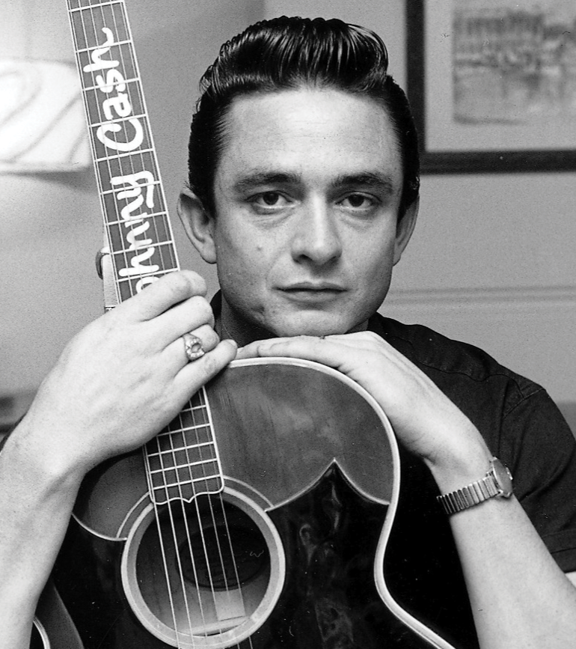
Track 3 – Jonny Cash
J R Cash
1932 – 2003
Famous for his cross over of Country and Rock and Roll music.
Trademark look as the Man in Black.
Famous for giving free concerts in prisons and for other “downtrodden groups”.

Slide 32
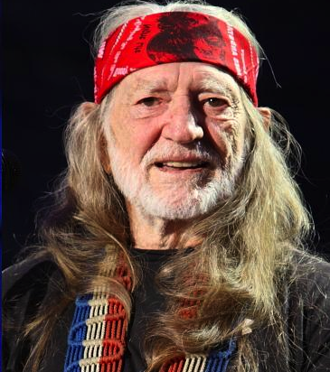
Track 4 – Willie Nelson
Willie Hugh Nelson
born 1933
Started the ‘outlaw country’ style of music.
Famous for his anti-establishment views and promoting the use of bio-fuels.

Slide 33
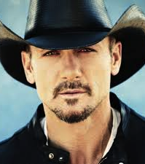
Track 5 – Tim McGraw
Samuel Timothy McGraw
born in 1967.
Has had 25 No1 singles from his thirteen albums.
Member of the American Red Cross.
Has helped raise millions of dollars for charitable causes.

Slide 34
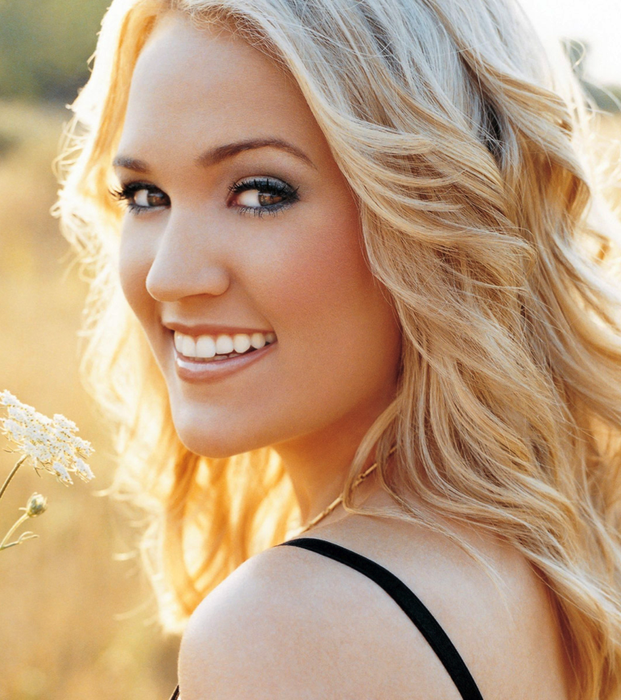
Track 6 - Carrie Underwood
Carrie Marie Underwood
born 1983 in Muskogee, Oklahoma.
Rose to fame through the TV Show American Idol. The most successful winner, earning over $110million.
Famous for her charitable work, especially to the schools in her home town of Checotah.

