Slide 2

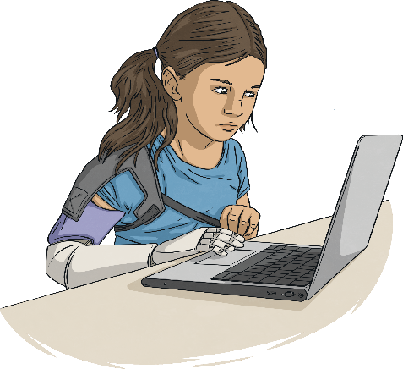
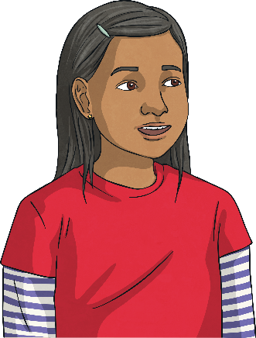
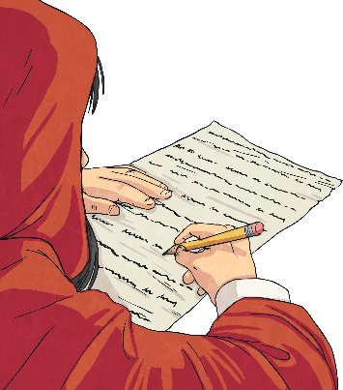
Writing to Persuade
When you are writing to persuade, you want to convince your reader about something. It might be that you’re persuading them to buy your product or you could be persuading them that what you’re saying is true.
There are different ways of writing to persuade. These are the ones you’re likely to see:
adverts/posters;
a persuasive talk/speech;
a persuasive letter.
Can you think of a time when you’ve had to persuade someone? Think about what you said and the words that you used.

Slide 3
Features of Writing to Persuade
The most important part of writing to persuade is being able to convince your reader. To do this effectively, you’ll need to use a range of
different features.
Expanded Noun Phrases
Whatever you’re persuading your reader about, you need to make it seem like the best idea ever.
Do this by including plenty of expanded noun phrases with amazing, incredible adjectives and modifying nouns.
Imperative Verbs
Imperative verbs tell the reader what to do. They help to get your message across really clearly.
Buy this spaghetti stretcher today!
Improve our school and our community.
Repetition
At the end of your persuasive text, the reader needs to be really clear about the main points. Ensure this by occasionally repeating key words throughout your writing.
Rhetorical Questions
Rhetorical questions are questions which don’t need to be answered. They can help your reader to feel like you are talking specifically to them. How could you live without it?

Slide 4
Features of Writing to Persuade
Imperative verbs tell the reader what to do. They help to get your message across really clearly.
Buy this spaghetti stretcher today!
Improve our school and our community.
Imperative
Verbs
At the end of your persuasive text, the reader needs to be really clear about the main points. Ensure this by occasionally repeating key words throughout your writing.
Repetition
Whatever you’re persuading your reader about, you need to make it seem like the best idea ever.
Do this by including plenty of expanded noun phrases with amazing, incredible adjectives and modifying nouns.
Expanded
Noun Phrases
Rhetorical questions are questions which don’t need to be answered. They can help your reader to feel like you are talking specifically to them.
How could you live without it?
Rhetorical
Questions

Slide 5
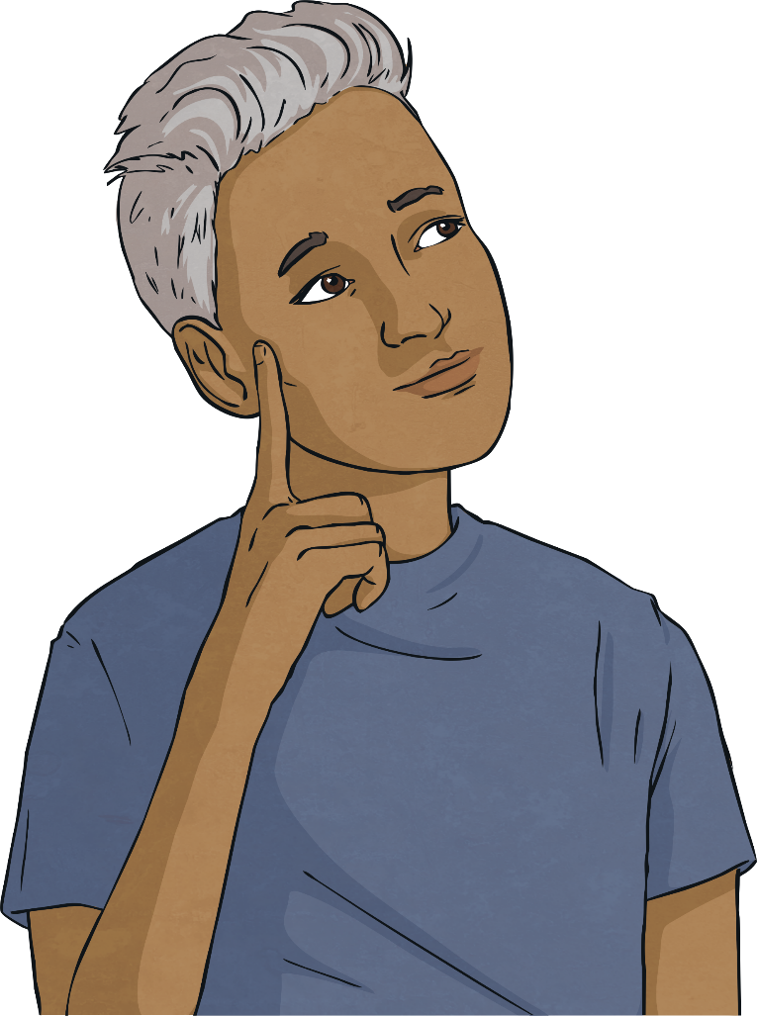
Can You Spot These Features?
Have a look at these different types of persuasive writing. Can you spot the features?
imperative verbs
repetition
expanded noun phrases
rhetorical questions

Slide 6
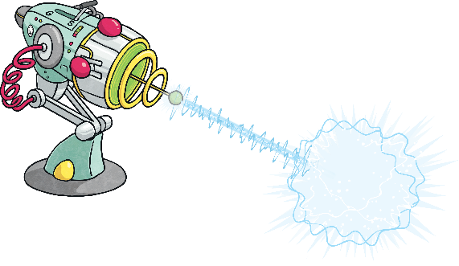

Advert
The Zap-Tastic Silencer!
Are your siblings giving you a rough time? Are your friends always bragging about winning at football? Is the neighbour’s cat keeping you awake at night? You need the Zap-Tastic Silencer!
With one press of the smooth-action trigger, you’ll have peace and quiet in no time. Our Zap-Tastic Silencer is filled with astounding alien technology and is available for you to take home today. Say goodbye to irritating sounds and restless nights. Just aim at the irritant, fire the harmless rays and enjoy one hour of complete silence. Yes – it really is that easy!
It’s available for a limited time only so don’t miss out: buy your Zap-Tastic Silencer now!
Which features did you manage to spot?

Slide 7
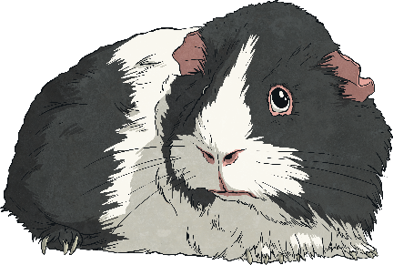
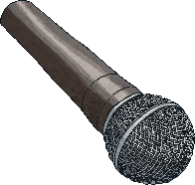
Persuasive Speech
This is an extract from the speech given by Fluffles McSpice during the annual guinea pig meeting at 34 Garden Terrace.
We must not allow ourselves to be treated like this. How many more guinea pigs have to suffer before we say that enough is enough? I have been into next door’s garden and I have seen the food that is available there. Juicy pellets, dried strawberries and delicious dandelion leaves: the kind of food that we should be getting instead of the brown filth and mouldy hay that they try to feed us. No! We want what they’re having. We deserve what they’re having. Stand up for what you believe in, fellow guineas of 34 Garden Terrace, and demand better of our owners!
Which features did you manage to spot?

Slide 8
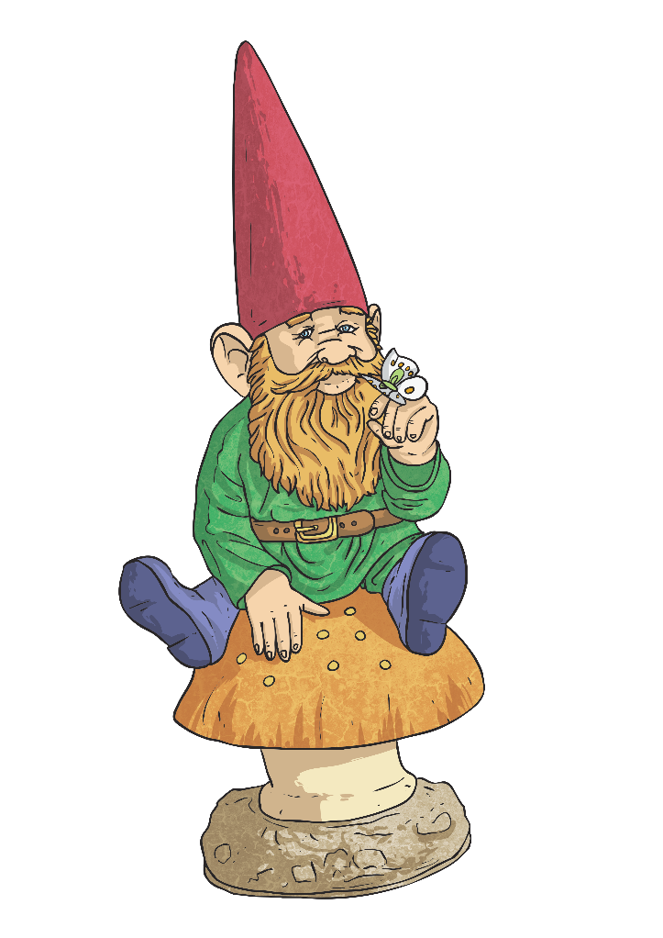
Persuasive Letter
Dear Sir/Madam,
I am writing to ask you to please reduce your extensive garden gnome collection so that I may deliver your letters without fear of injury.
For the past few years, I have found it increasingly difficult to work my way through your garden without treading on an unsuspecting gnome. Last week, when I arrived home and found a miniature fishing rod stuck in my shoe, I realised that this had gone on for too long. Surely you don’t want me to be injured, do you?
I enjoy gnomes and I think that a small collection can brighten up the garden substantially but the situation has become ridiculous. From now on, I will leave your letters beneath Goswald the Great until you significantly reduce your collection.
Yours sincerely,
Postal Worker Patricia
Which features did you manage to spot?

Slide 9

Did You Spot the Features?
Did you manage to spot any of these features in the persuasive writing?
imperative verbs
repetition
expanded noun phrases
rhetorical questions
Were there any other features you spotted which weren’t on this list?

