Slide 1
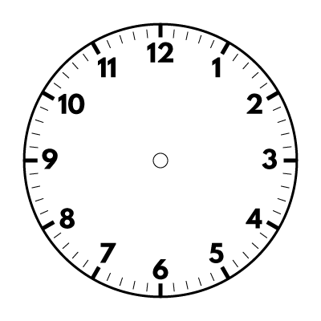
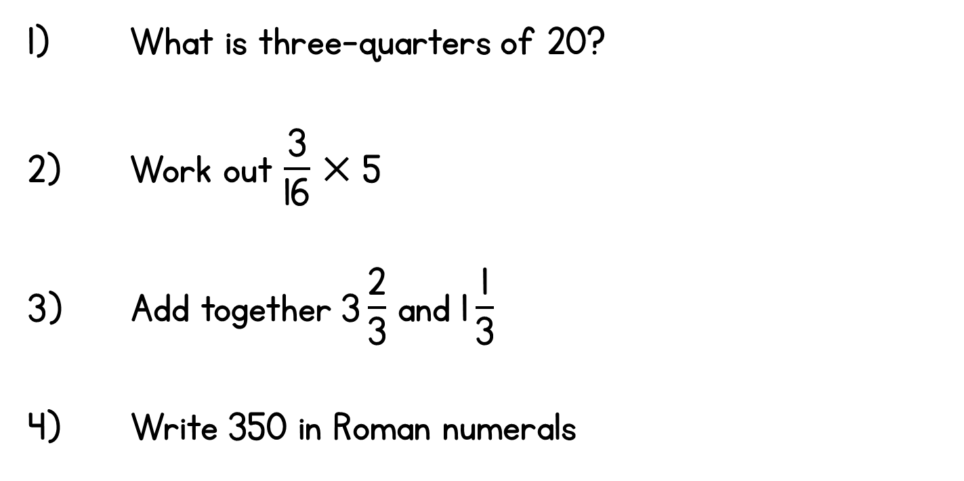
Year 5 | Week 10 | Day 1

Slide 2
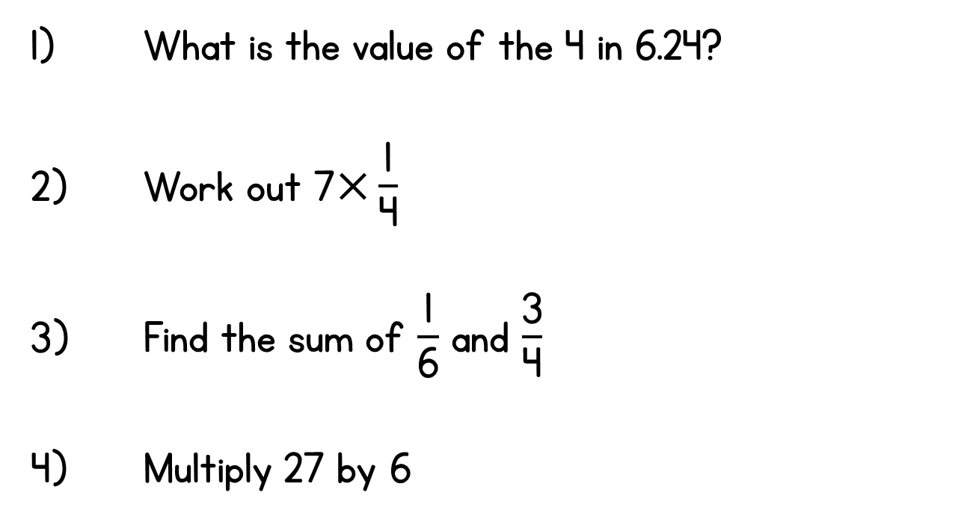
Year 5 | Week 10 | Day 2

Slide 3
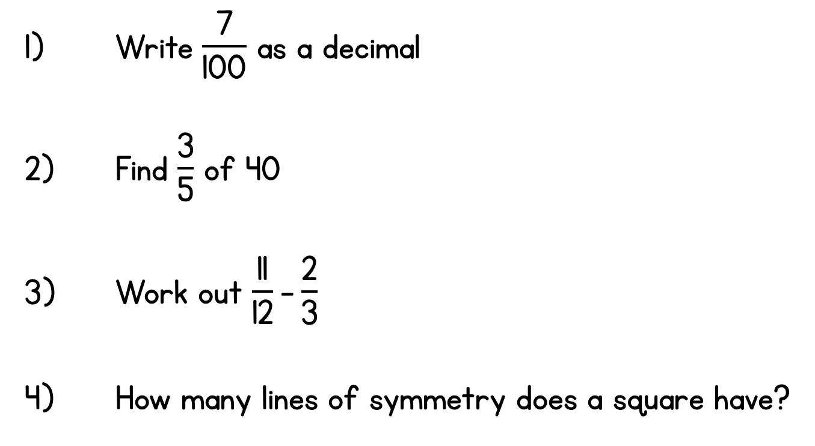
Year 5 | Week 10 | Day 3

Slide 4
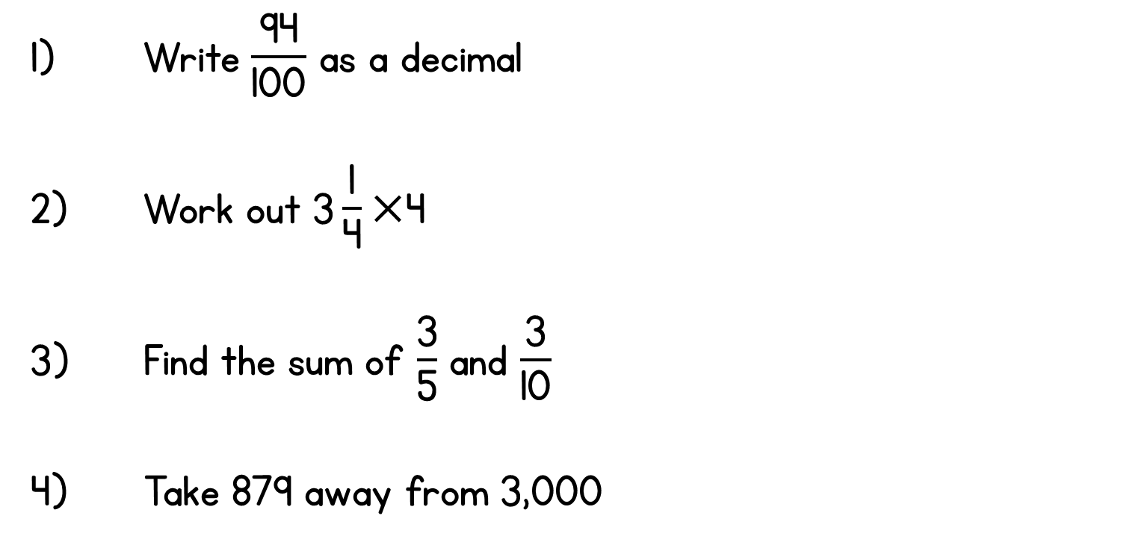
Year 5 | Week 10 | Day 4

Slide 5
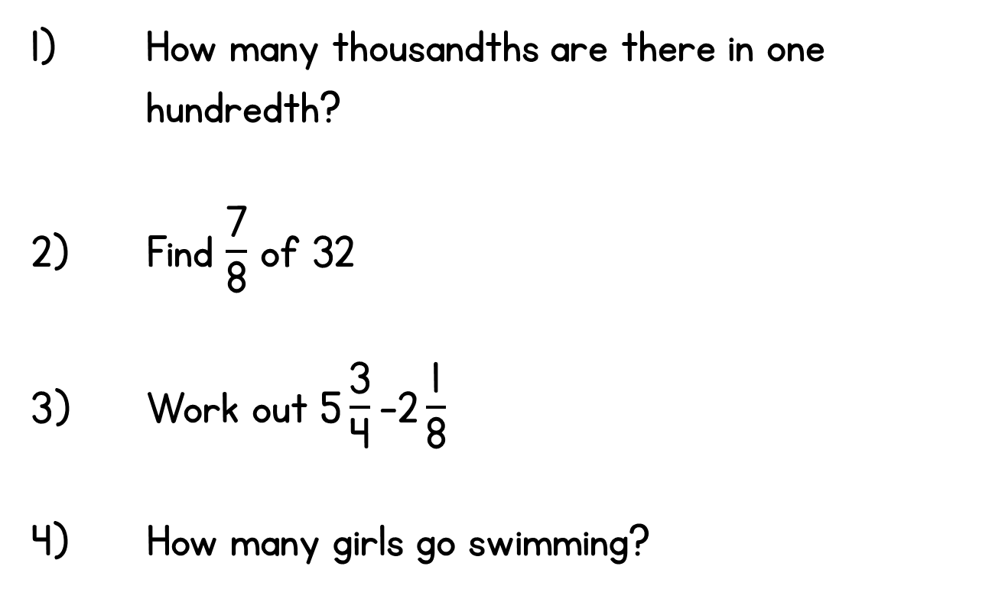
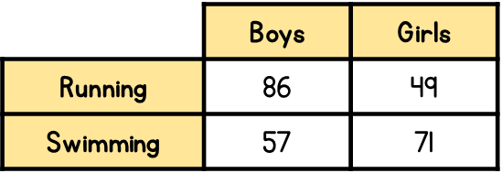
Year 5 | Week 10 | Day 5

Slide 6
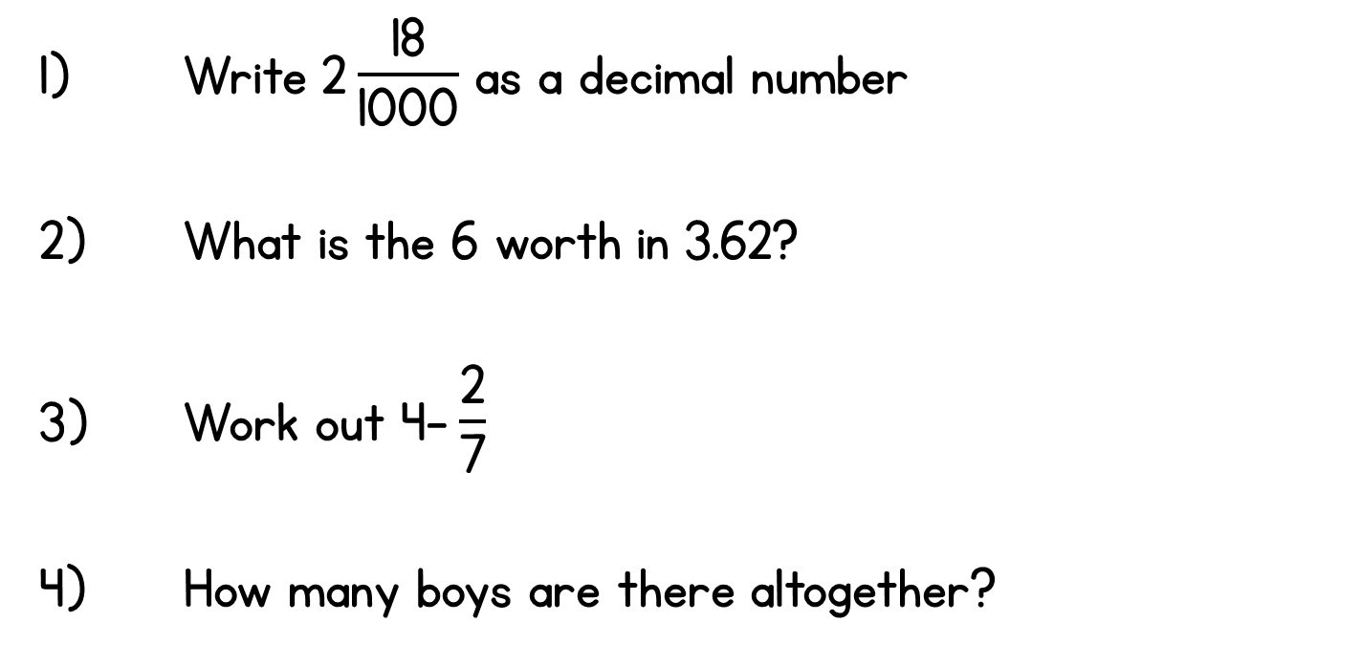

Year 5 | Week 11 | Day 1

Slide 7
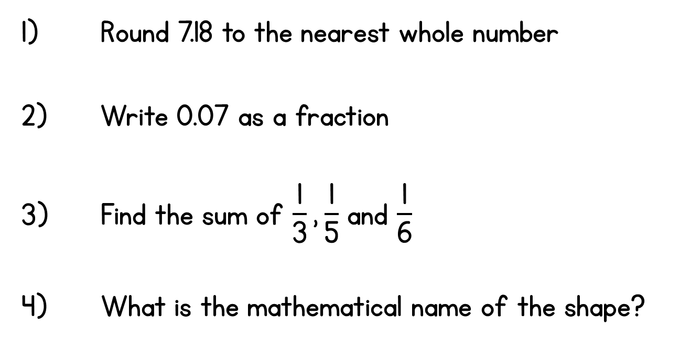

Year 5 | Week 11 | Day 2

Slide 8
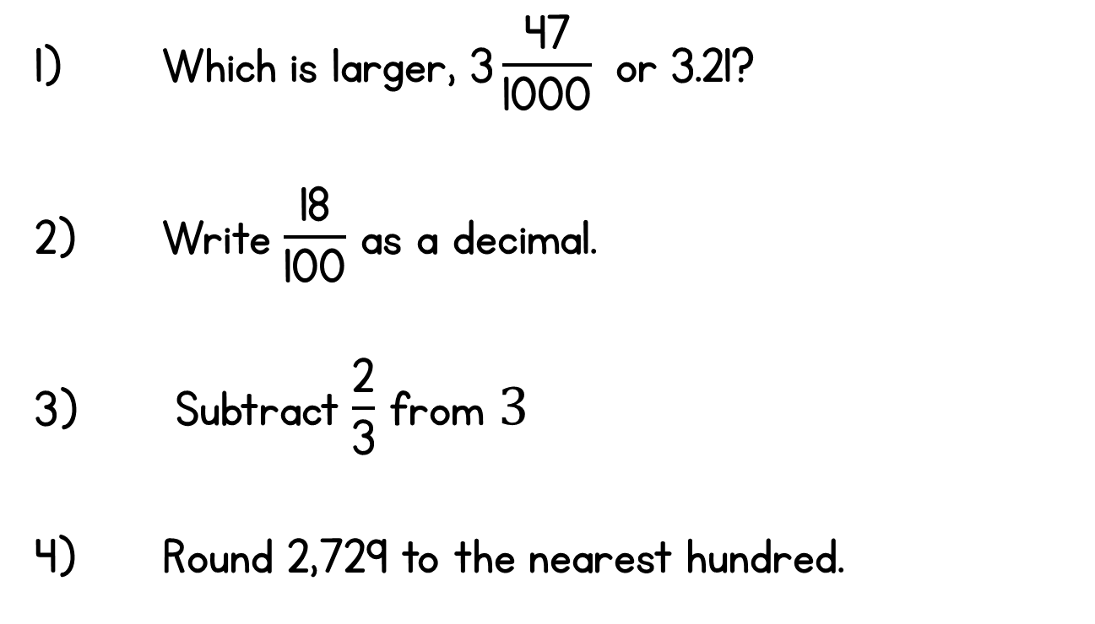
Year 5 | Week 11 | Day 3

Slide 9
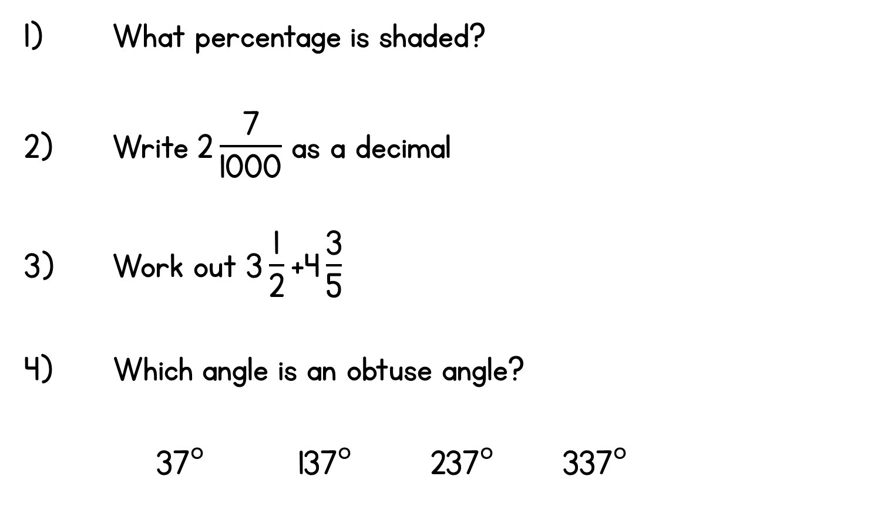
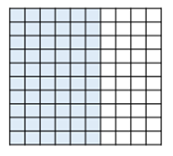
Year 5 | Week 11 | Day 4

Slide 10
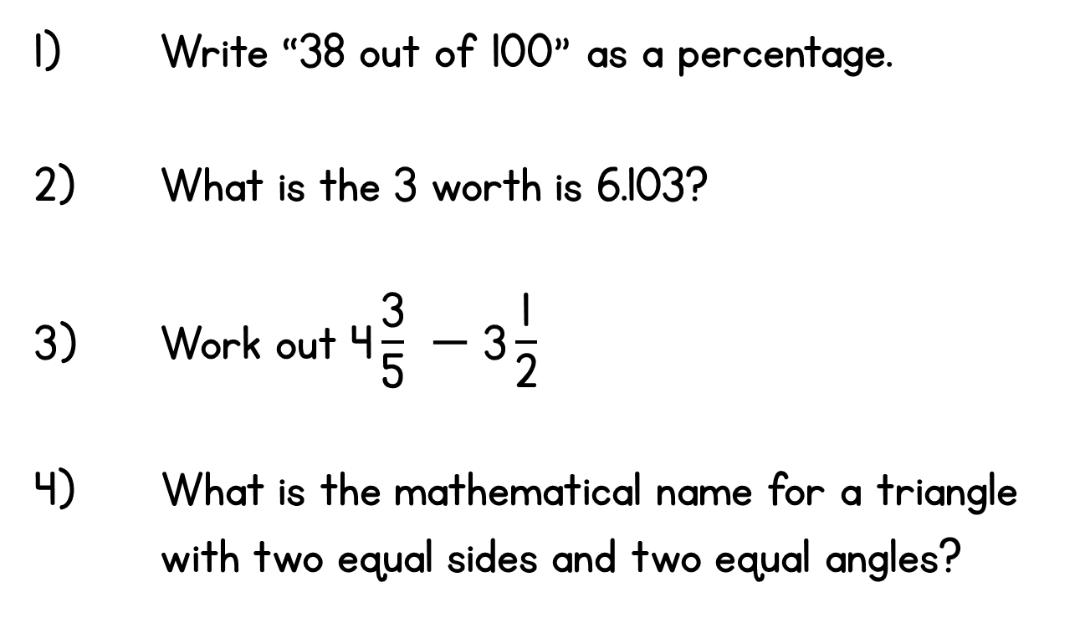
Year 5 | Week 11 | Day 5

