Slide 1
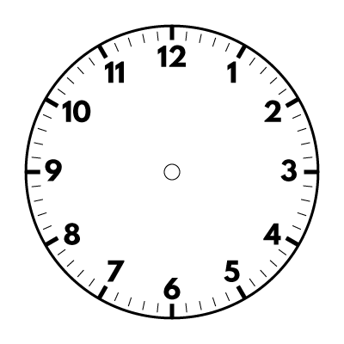
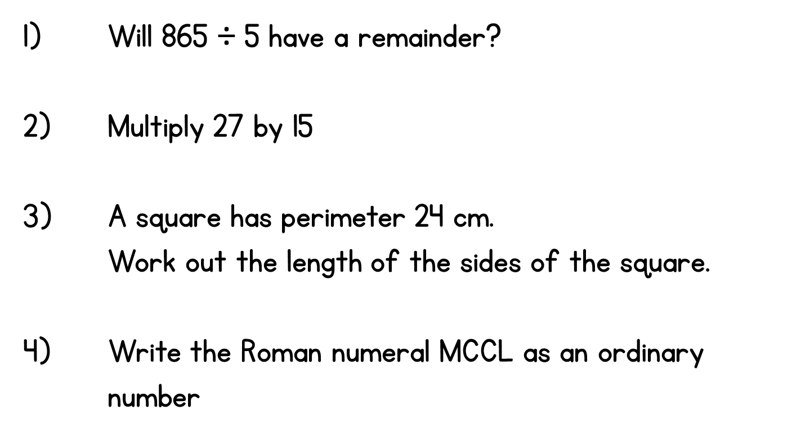
Year 5 | Week 3 | Day 1

Slide 2
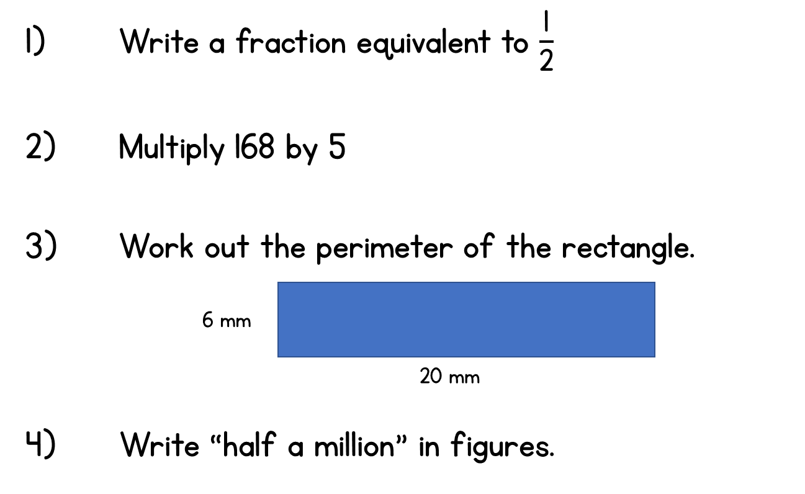
Year 5 | Week 3 | Day 2

Slide 3
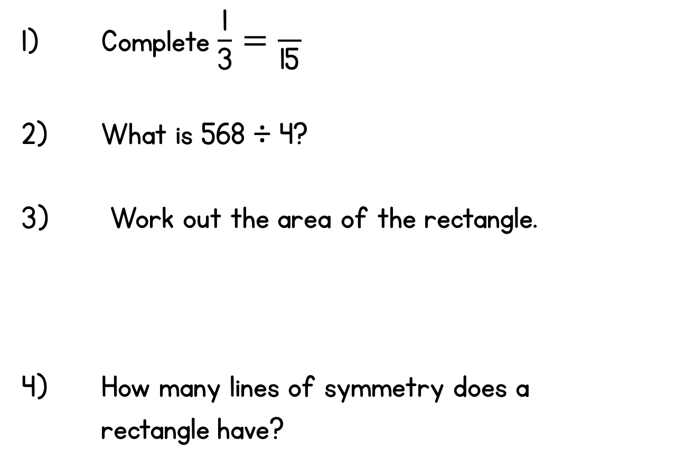
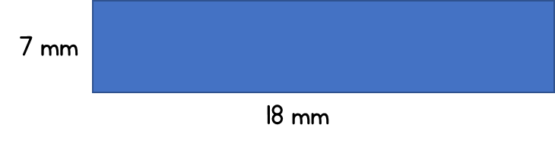
Year 5 | Week 3 | Day 3

Slide 4

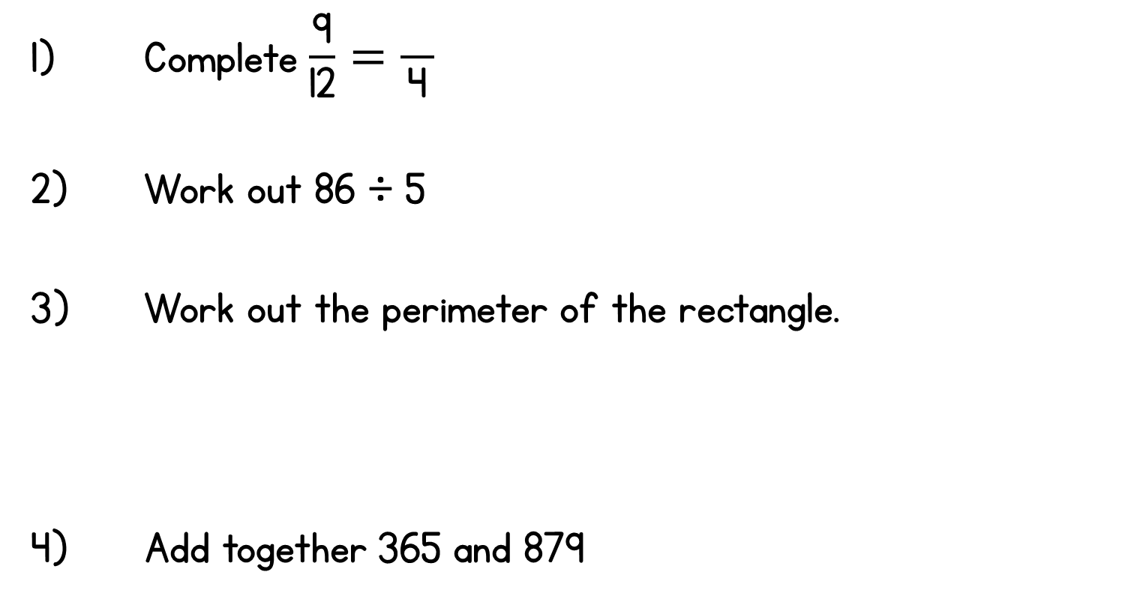



Year 5 | Week 3 | Day 4

Slide 5
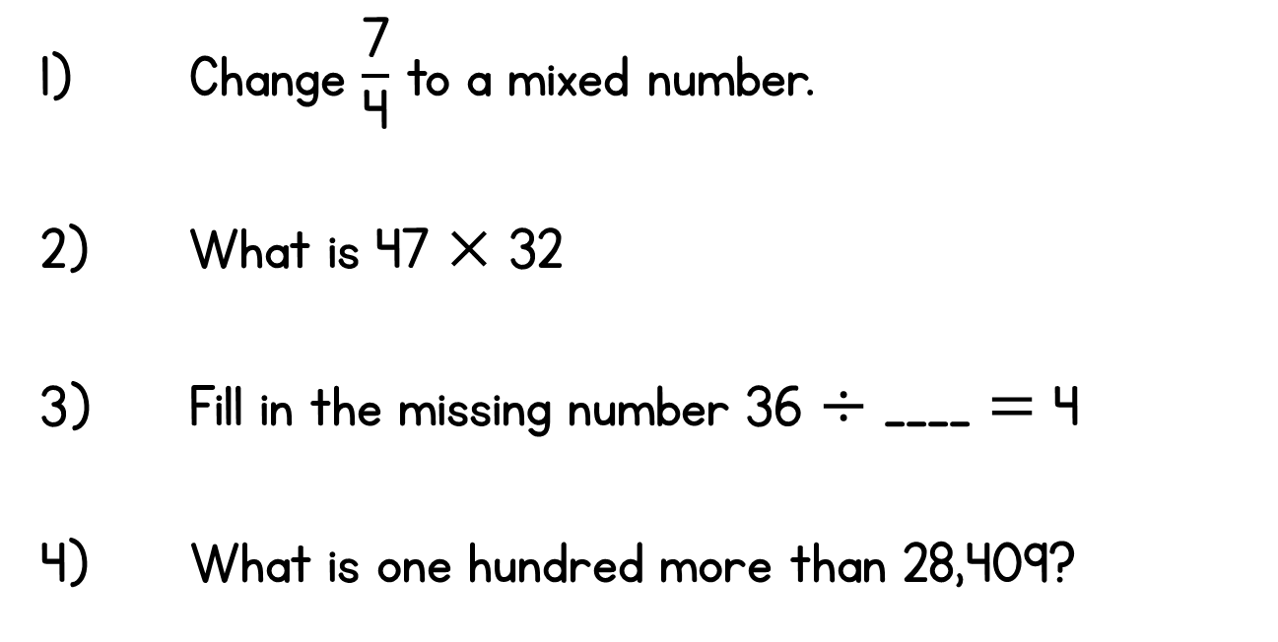

Year 5 | Week 3 | Day 5

Slide 6
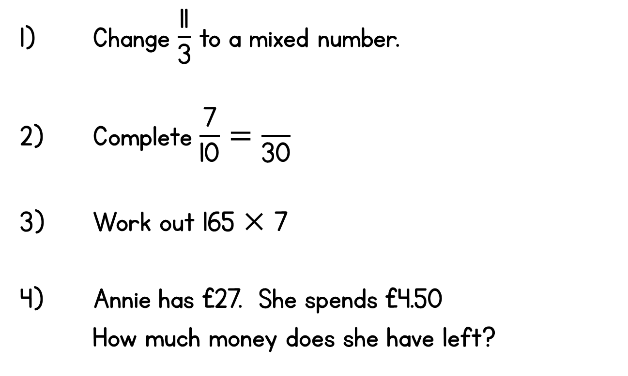

Year 5 | Week 4 | Day 1

Slide 7

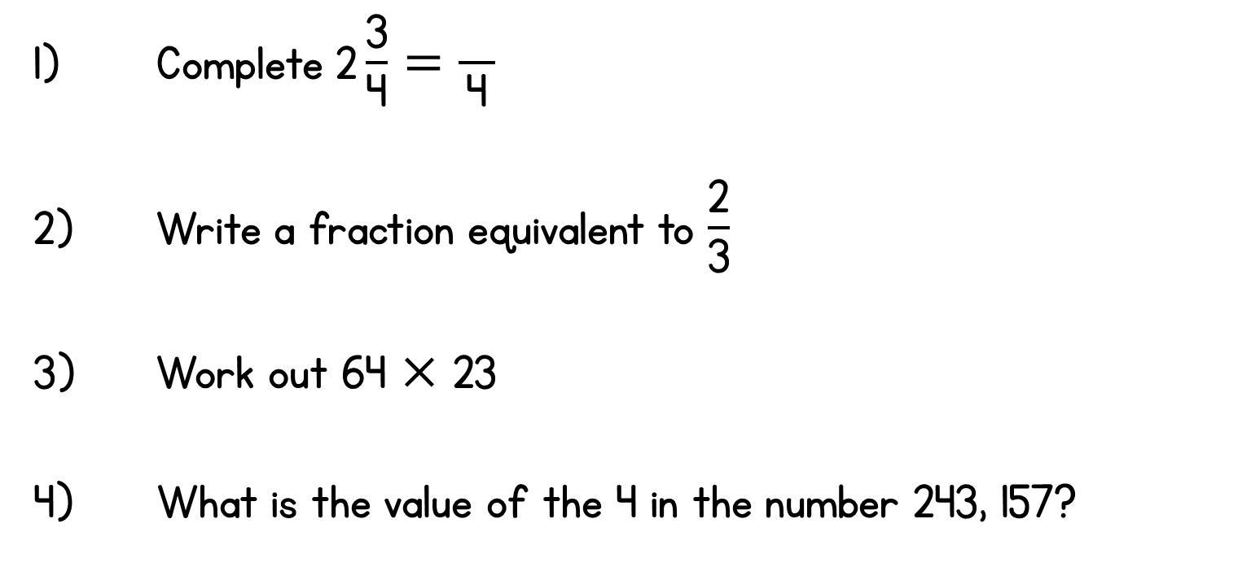
Year 5 | Week 4 | Day 2

Slide 8
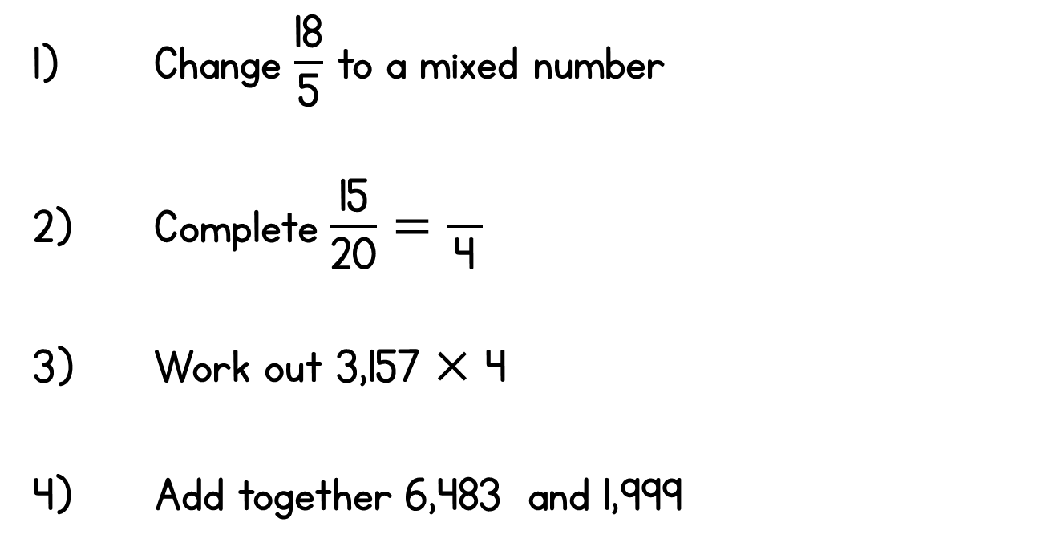
Year 5 | Week 4 | Day 3

Slide 9
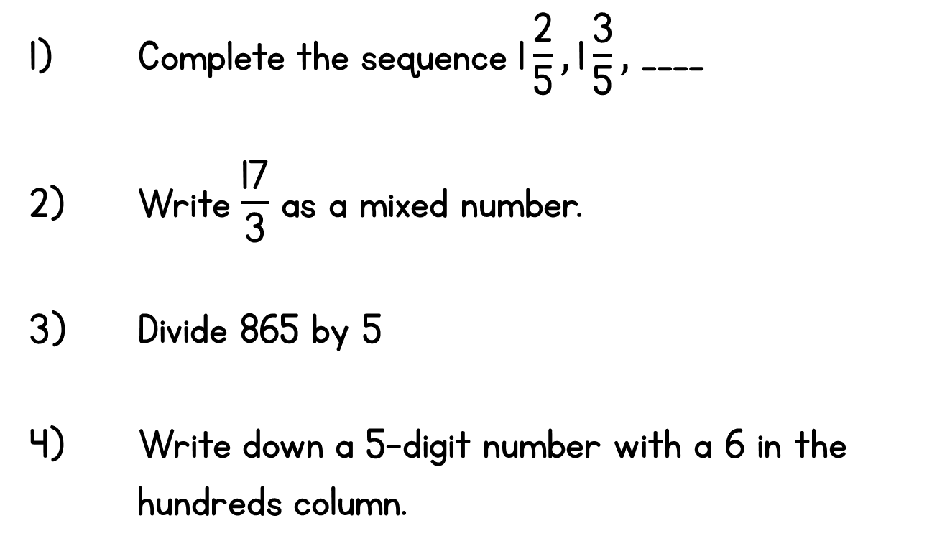
Year 5 | Week 4 | Day 4

Slide 10
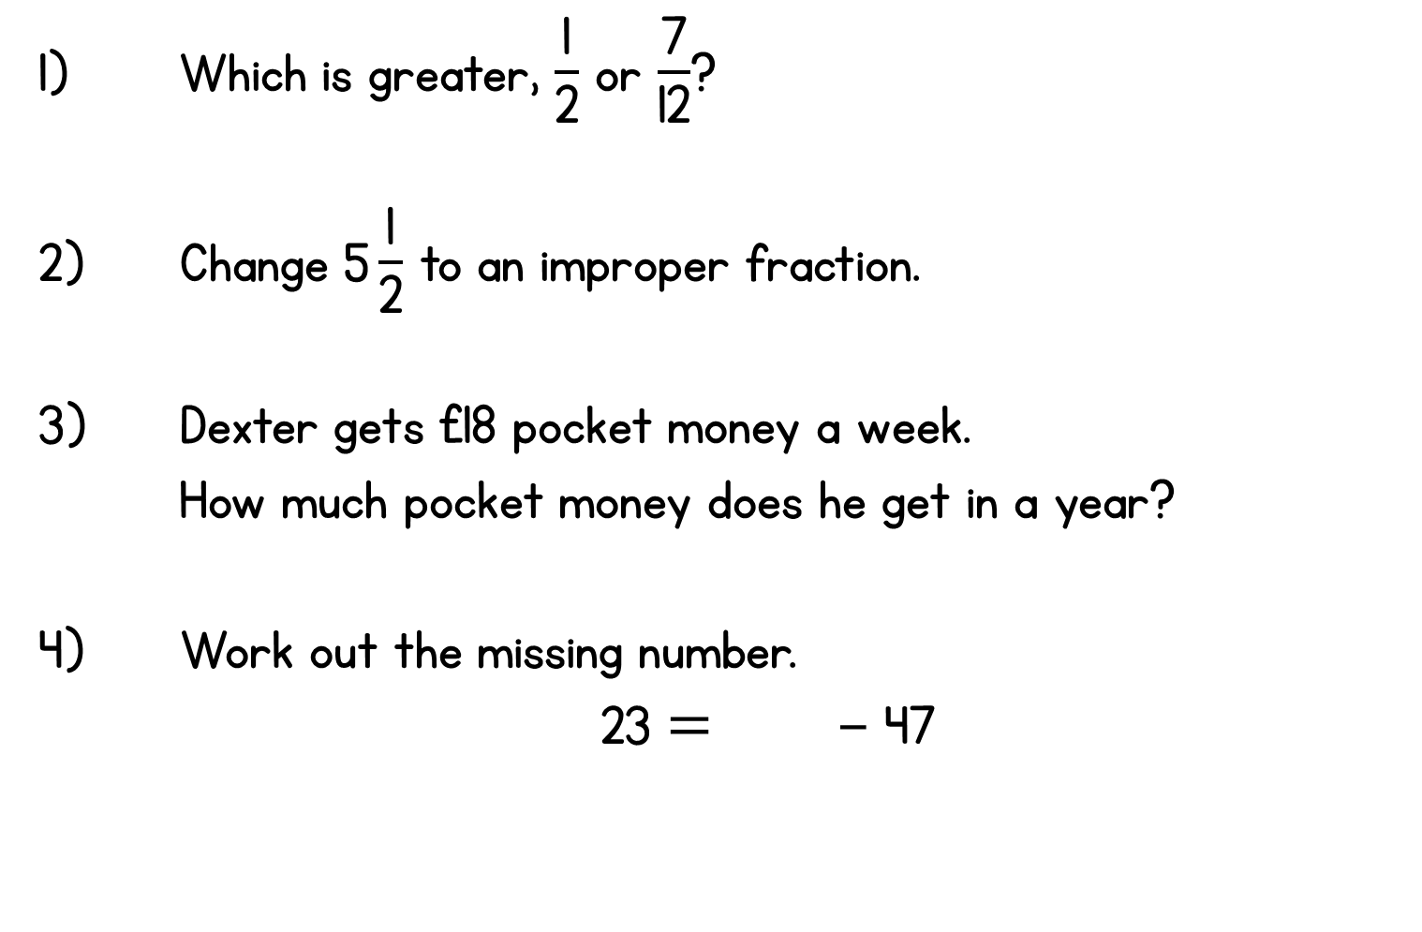

Year 5 | Week 4 | Day 5

Slide 11
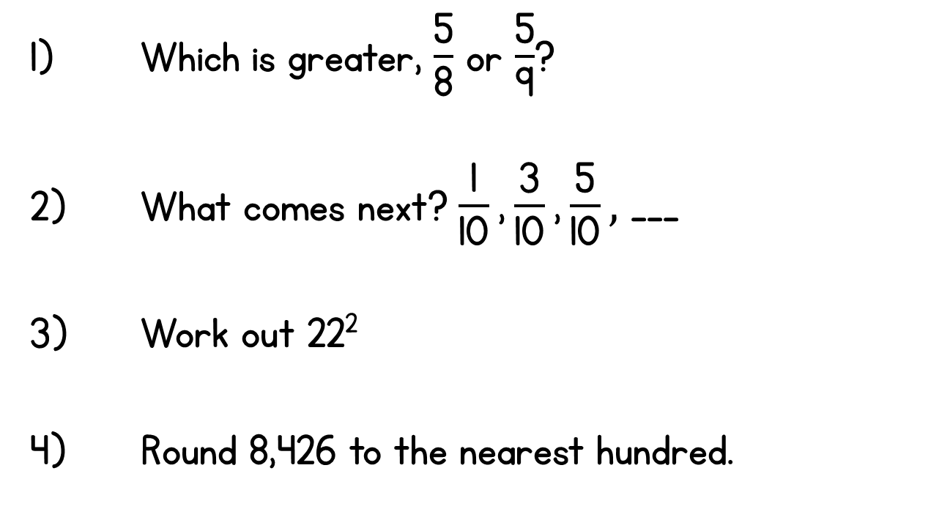
Year 5 | Week 5 | Day 1

Slide 12
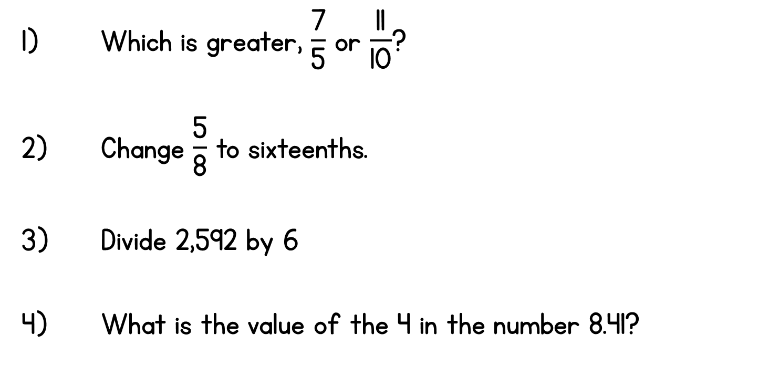
Year 5 | Week 5 | Day 2

Slide 13
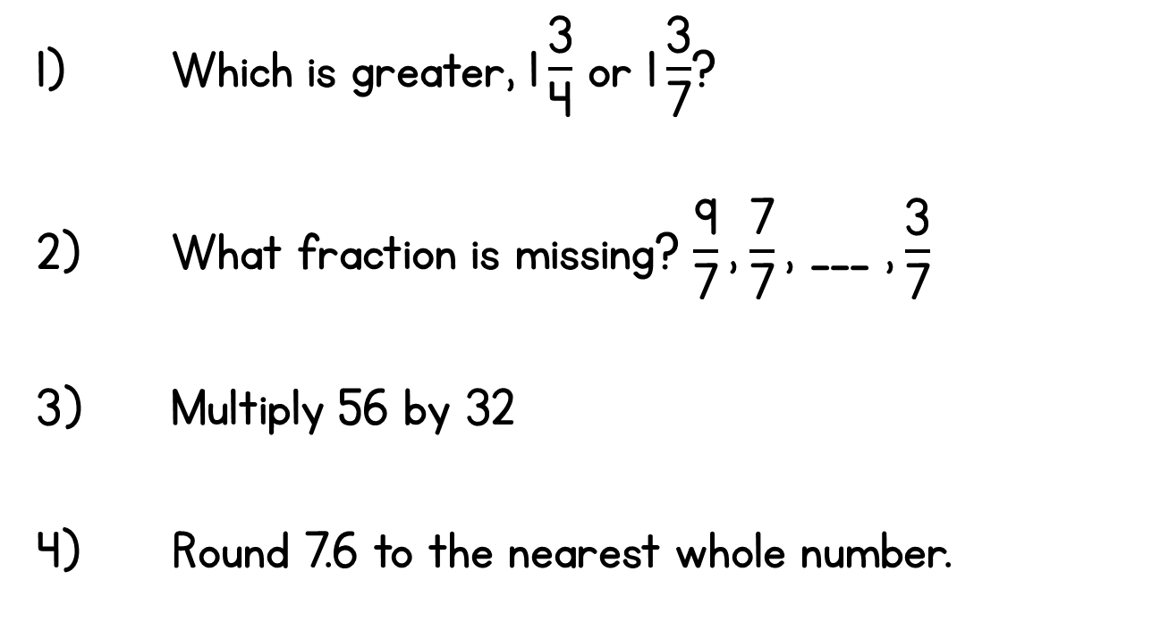
Year 5 | Week 5 | Day 3

Slide 14
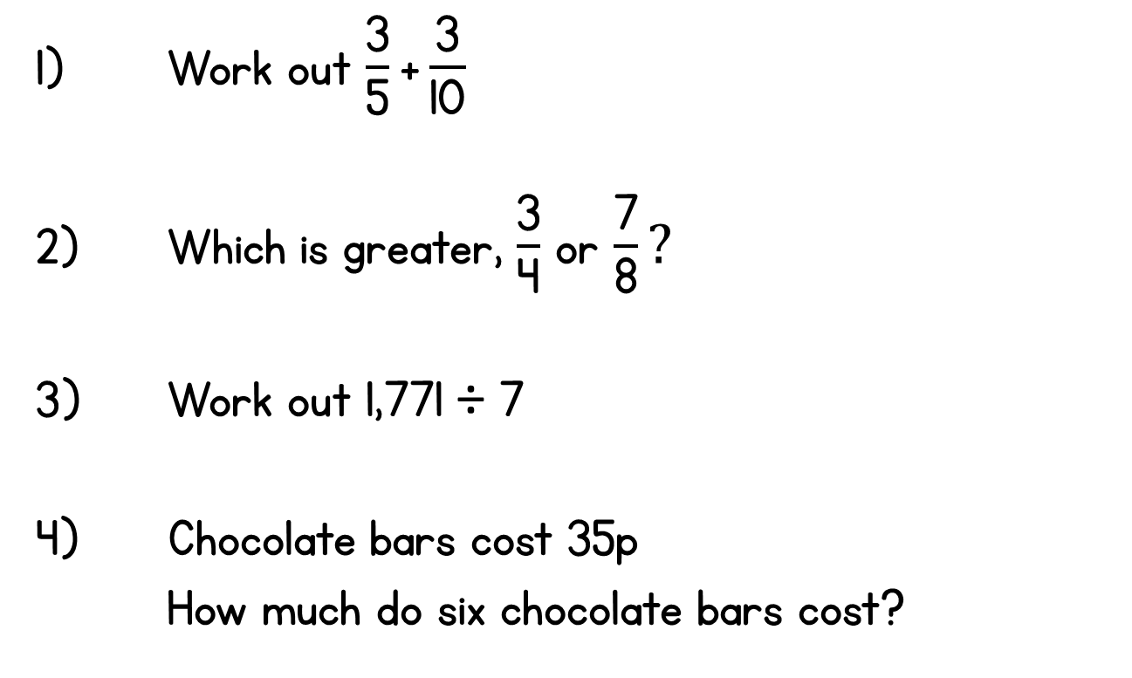
Year 5 | Week 5 | Day 4

Slide 15
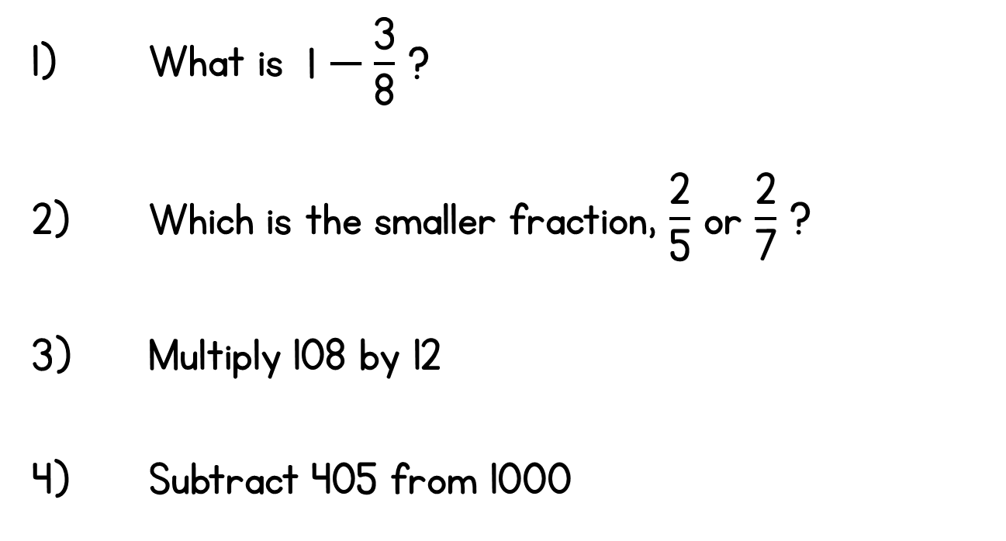
Year 5 | Week 5 | Day 5

