Slide 1

Astrea Academy Dearne - Transition 2020
Virtual Induction
Polaris Project Transition 2020
Adventures in learning that allow our “Northern Stars” to shine bright.
Vicky Conway Vice Principal – Learning Behaviours; Terry Simon Head of Y7 – Transition Lead

Slide 2
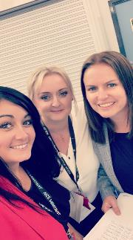
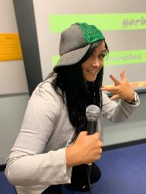
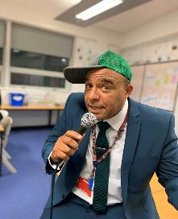
Executive Senior Leadership Team, Head of Year & Designated Safe Guarding Leads
Miss Conway, Mrs Wilson, Mrs Fisher
Principal – Mrs Wilson
Senior Vice Principal Mr Child
Vice Principal – Mrs Brough
Vice Principal Miss Conway
Head of Year 7 – Mr Simon
DSL - Mrs Dowling
Deputy DSL – Mrs Fisher
Mr Simon
Transition
Task

Slide 3
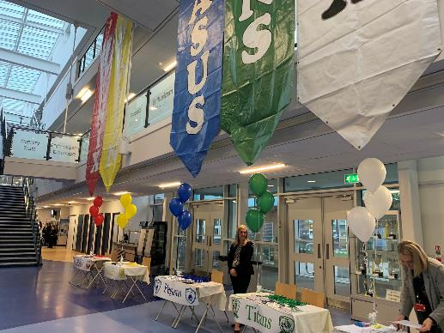
Our Value Words…Each house has ownership of two of these words
RESPECT
DETERMINATION
COURAGE
DIGNITY
HONESTY
TRUST
INCLUSIVITY
KINDNESS
ENTHUSIASM
AMBITION
Transition
Task

Slide 4
We would love you all to come visit, and take a wonder around our lovely school...in the meantime look out for our virtual tour coming soon!

Slide 5
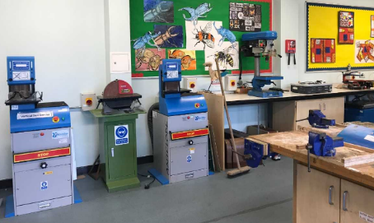
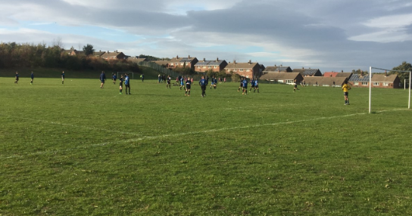
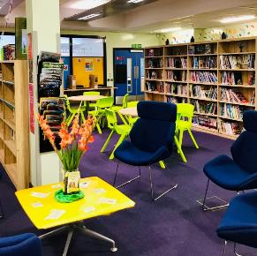
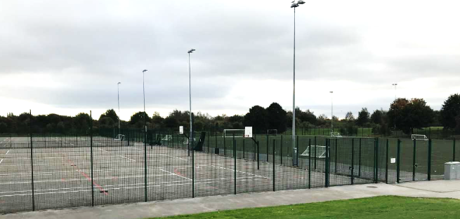
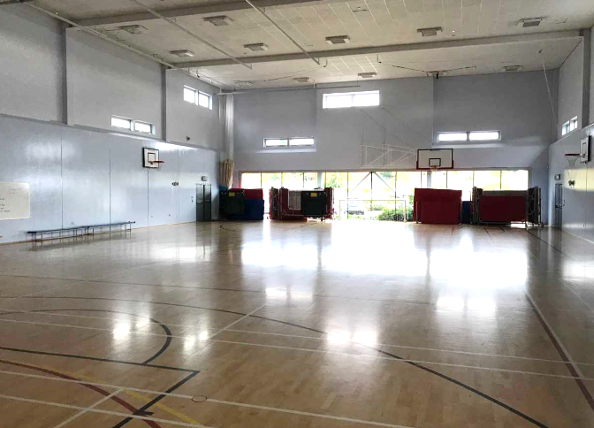
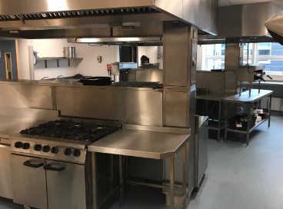
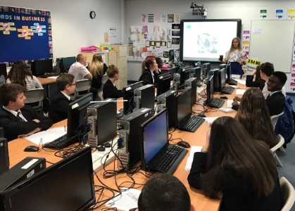
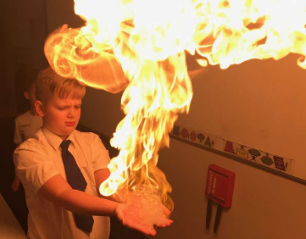
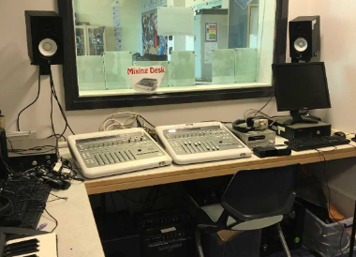
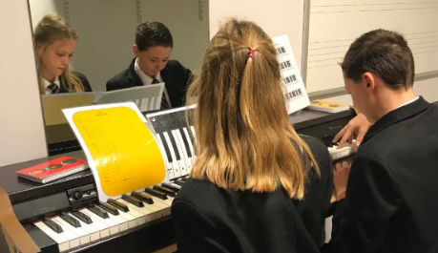
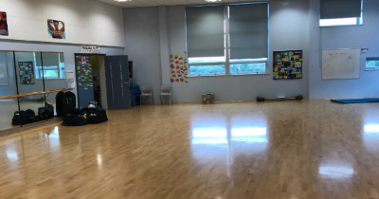
More of our awesome facilities
FOOTBALL PITCH
WORKSHOP
CATERING KITCHEN
LIBRARY
SPORTS HALL
RECORDING STUDIO
ICT SUITES
SCIENCE LABS
DANCE STUDIO
MUSIC PRACTICE ROOM

Slide 6







Celebrating Success – 2019
64% achieved GCSE Science at Grade 4+
66% achieved both English and Maths GCSEs at Grade 4+
75% achieved GCSE Maths at Grade 4+
Most students who attend the Dearne make more progress than the national average
45 students achieved a Grade 9: the top 2% of the UK
75% achieved GCSE English at Grade 4+
Transition
Task
ASTREA ACADEMY DEARNE #TeamDearne

Slide 7










Our House System…
Transition
Task
Pegasus | Griffin | Titans | Phoenix | Sphinx
Mr Simon | Mrs Green | Miss Cleary | Mrs Child | Mrs Fisher
Enthusiasm Trust | Kindness Dignity | Honesty Determination | Courage Ambition | Inclusivity Respect

Slide 8
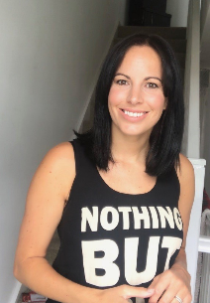
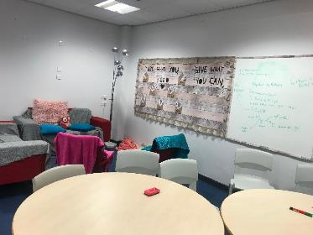
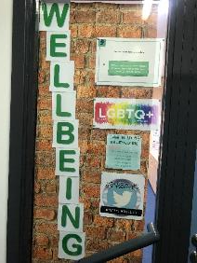

Welcome to The Wellbeing Hub
The Wellbeing Hub is on the top floor, next to the Languages Faculty. Everybody is welcome to come on in.
Hi, I’m Mrs Crawford and I run The Wellbeing Hub.
We all have days when we find things a little too much to deal with. The best way to help yourself is to talk to somebody. The Wellbeing Hub is a safe space where you can speak to a staff member about something which is worrying you, have a quiet space to calm yourself or mix with other students who will always be friendly, kind and welcoming.

Slide 9
What happens in The Wellbeing Hub?
We have lots happening in the Wellbeing Hub and people come in for many different reasons:
Mental Health
We hold lots of group work around mental health such as anxiety, low mood and self-esteem. Ambassadors plan exciting events through the year to raise awareness and get the whole school involved.
Workshops
Outside agencies often join us to run training sessions and workshops to students on lot’s of different topics.
Anti-Bullying
It is the base for all our anti-bullying work which you will see more about on the next slide.
One to one chat
You can arrange to speak to Mrs Crawford without other students around or she can arrange for you to speak to someone from outside school if we think this is appropriate.
Pride Group
It is the base for out LGBTQ+ group who do lots of work throughout the year on equality to make sure everyone in our school feels safe and supported.
Calm time
During certain parts of the day the hub is a calm zone if you are feeling things are too much to deal with. We do activities such as meditation and mindful colouring.
If you are worried about something in school it is important you speak to someone so they can help you. You could speak to your form teacher, head of year, Mrs Crawford or any other member of staff you feel comfortable with. If you are worried about speaking to a teacher, look out for student mentors who will be happy to support you.

Slide 10
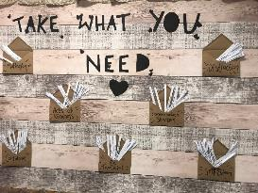

Wellbeing – Anti-bullying
Every break time there is an anti-bullying drop in where you can come along to have a chat if you are worried about yourself or someone else being bullied.
In school we have anti-bullying ambassadors who do a lot of work for you around bullying.
You can recognize ambassadors with this badge.
If you are worried about talking to a teacher about bullying you could speak with one of the anti-bullying ambassadors or you could send an email to Mrs Crawford:
Please come along to the Wellbeing Hub to say hi. I look forwards to meeting you all,
Mrs Crawford
Reportbullying@thedearnealc.org

Slide 11
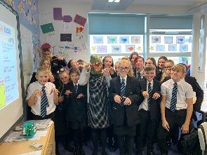
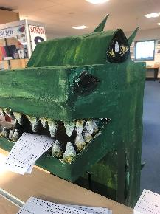
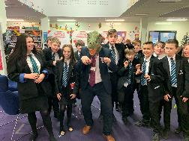
Fantastic Friday…Dearneasaur…
Throughout the week at Astrea Academy Dearne, pupils and staff vote for a staff member to win “Fantastic Friday” votes are posted in our Dearneasaur postbox and the school has to solve who has won by the song choice played over the tannoy…not forgetting the infamous ROOOAAARRRR!
Transition
Task

Slide 12
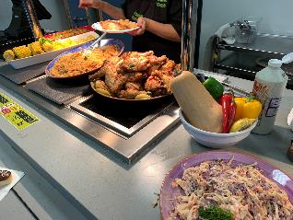
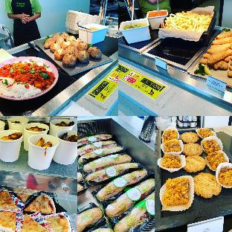
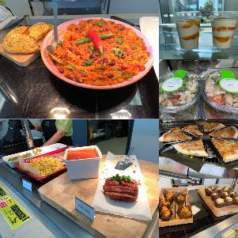
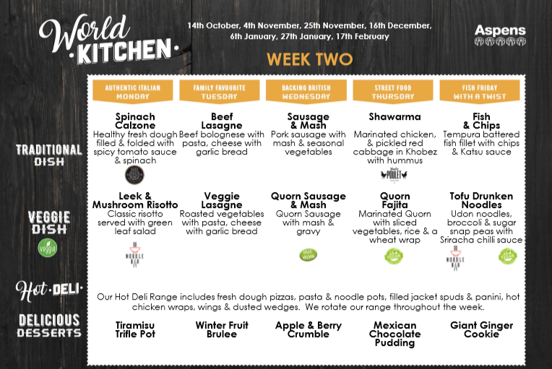
Aspens Catering
Aspens is the catering company we use in school. It provides a range of nutritious and balanced meals. Check out an example menu from our website… https://www.astreadearne.org/wp-content/uploads/2019/10/WORLD_KITCHEN_CORE_MENU_SECONDARY_OCT_2019-1.pdf
Transition
Task

Slide 13
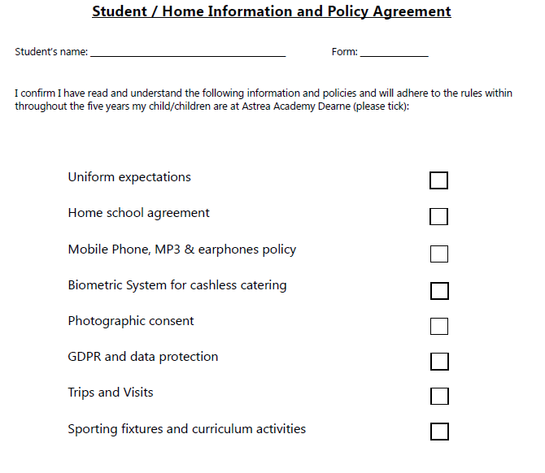
Transition Information Pack…
In your transition pack you will receive a student/home information policy agreement. This will need to be completed and returned to school as soon as possible to Mr Simon.
Vicky Conway Vice Principal – Learning Behaviours; Terry Simon Head of Y7 – Transition Lead

Slide 14
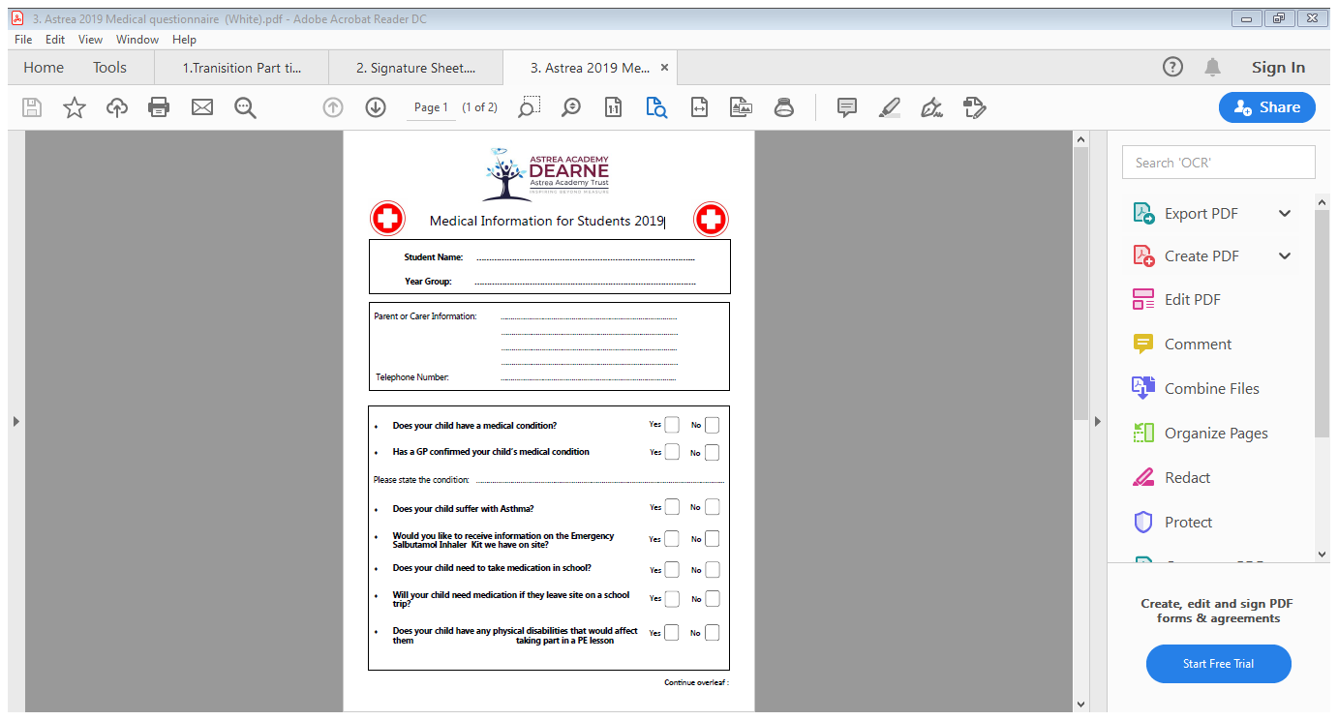
Transition Information Pack…
In your transition pack you will receive a student medical information form. This will need to be completed and returned to school as soon as possible to Mr Simon.
Vicky Conway Vice Principal – Learning Behaviours; Terry Simon Head of Y7 – Transition Lead

Slide 15
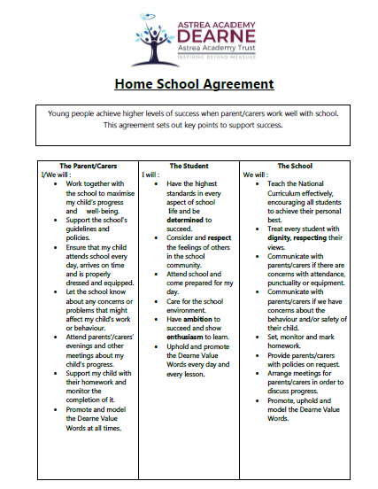
Transition Information Pack…
In your transition pack you will receive a home school agreement. Please read through this document carefully.
Vicky Conway Vice Principal – Learning Behaviours; Terry Simon Head of Y7 – Transition Lead

Slide 16
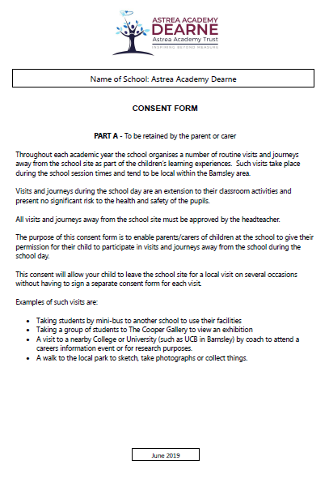
Transition Information Pack…
In your transition pack you will receive an annual consent form for trips and one for sporting fixtures. This will need to be completed and returned to school as soon as possible to Mr Simon.
Vicky Conway Vice Principal – Learning Behaviours; Terry Simon Head of Y7 – Transition Lead

Slide 17
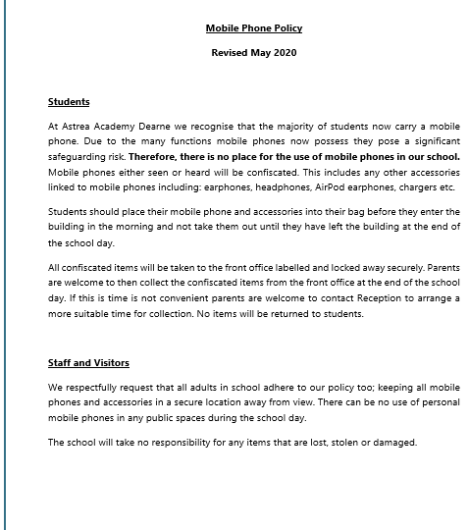
Transition Information Pack…
Transition
Task
In your transition pack you will receive a copy of the mobile phone, MP3 and Earphones Policy.
Please read through this document carefully.
Vicky Conway Vice Principal – Learning Behaviours; Terry Simon Head of Y7 – Transition Lead

Slide 18
Uniform Expectations
All Students are expected to wear the following uniform:
Blazer Compulsory: Black with blue lining only available from School Shop.
Trousers: Tailored, black smart trousers with a button and a zip.
Trousers must not be tight fitting.
No jeans, chinos, hareem pants, tracksuit bottoms or lycra jeggings/leggings
Shirts: Formal white shirt with a collar (long or short sleeves).
Skirts: Tailored black skirts, that reach the knee, with a button and a zip.
Thick opaque black tights, no footless tights.
No mini skirts, no Lycra, no knitted or elasticated tube skirts,
Tie: The school tie for the appropriate year group.
Footwear: Completely black sensible SHOES ONLY.
NO TRAINERS (OR TRAINER STYLE), CANVAS PUMPS, SANDALS OR BOOTS.
Cardigan/Jumper: Optional: Black school cardigan/jumper embroidered with the school logo (to wear under blazer).
PE Kit: Black plain shorts or black plain tracksuit bottoms. School PE top. Trainers that have anti-scuff soles and football boots if required. Trainers must be sensible and not canvas pumps.
Please note students arriving in incorrect uniform will be offered alternative clothing from our uniform loan department or will be placed in internal exclusion until the matter is resolved.

Slide 19
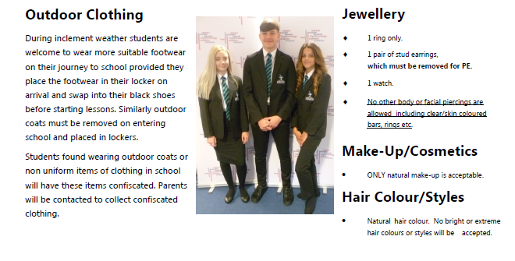
Uniform Expectations

Slide 20
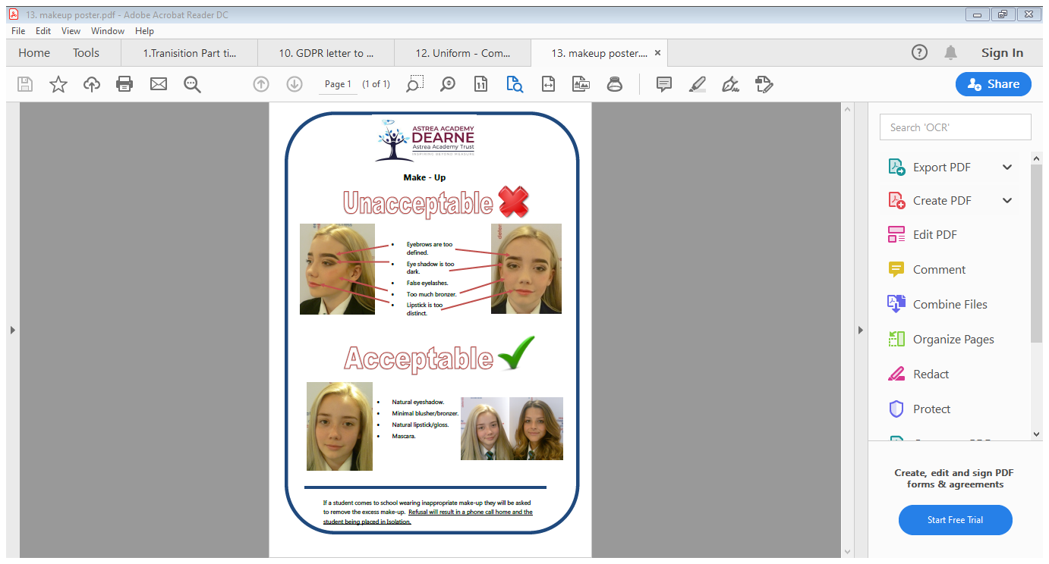
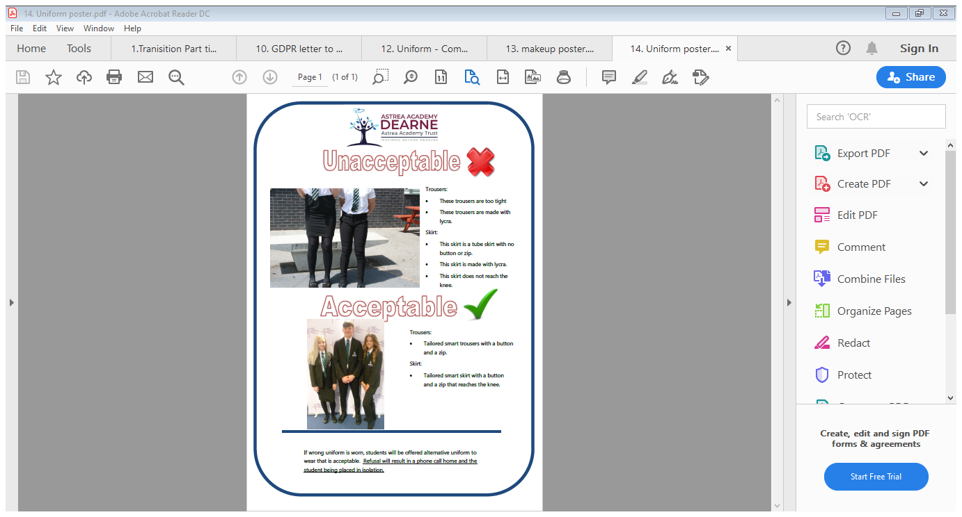
Uniform Expectations
Transition
Task

Slide 21
Ordering Uniform
Due to current social distancing measures as a result of the Corona Virus situation we will not have any sizing sessions in school.
All orders for uniform are now done online. The link to purchase the school uniform is https://www.pbuniform-online.co.uk/dearne
Ian agreement is in place that orders received by 31st July will get free delivery, which is believed to be £3.99.
Parents will be responsible for any return costs if item wrong size.
Price Buckland to supply a paper order form for anyone who can’t or do not have internet.
Uniform not expected to PB until mid-August, they will endeavour to get orders out to all parents but can’t guarantee due to current circumstances around COVID-19

Slide 22
Suggested Transition Day Timetable*
 | Day 1
Class | Lesson 1 | Lesson 2 | Lesson 3 | Lesson 4 | Lesson 5
A | Introduction and tour of grounds | Maths Taster Session | English Taster Session | Science Taster Session | Health and Wellbeing Session
B | Introduction and tour of grounds | Health and Wellbeing Session | Maths Taster Session | English Taster Session | Science Taster Session
C | Introduction and tour of grounds | Science Taster Session | Health and Wellbeing Session | Maths Taster Session | English Taster Session
D | Introduction and tour of grounds | English Taster Session | Science Taster Session | Health and Wellbeing Session | Maths Taster Session
*Each school will receive their individual transition date, subject to government guidance on the reopening of schools
Vicky Conway Vice Principal – Learning Behaviours; Terry Simon Head of Y7 – Transition Lead

Slide 23
In the meantime… We have a challenge!
From the 1st of June we will set you 5 weeks of transition activities. Send your transition activities and pictures to:
Twitter: - @AADTransition or @VConway85
Email: Transition@AstreaDearne.org

Slide 24
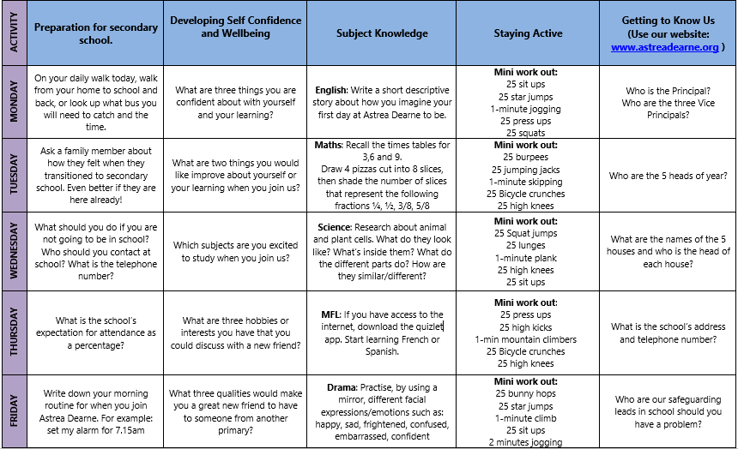
Week 1 – 5 A Day Transition Activities…

Slide 25
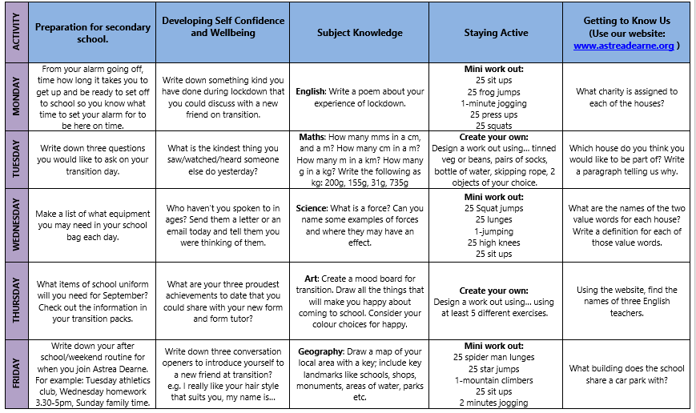
Week 2 – 5 A Day Transition Activities…

Slide 26
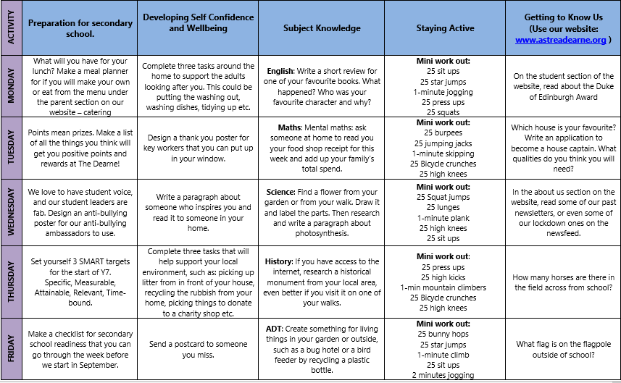
Week 3 – 5 A Day Transition Activities…

Slide 27
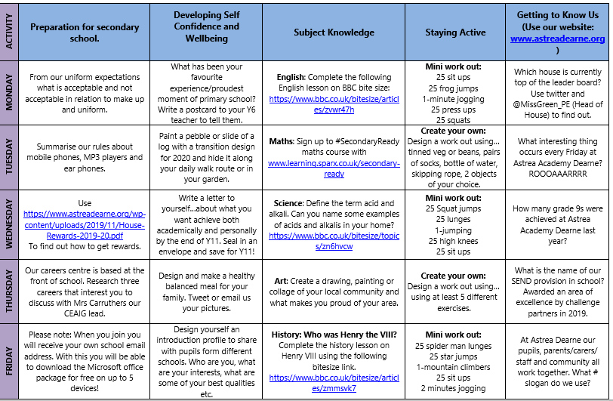
Week 4 – 5 A Day Transition Activities…

