Slide 1
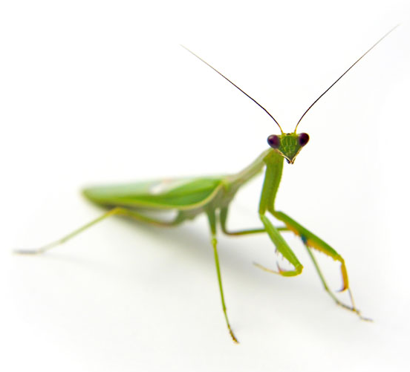
Arthropods (Phylum Arthropoda)
Over 1,000,000 species
Found on land, in oceans & freshwater
Invertebrates with exoskeletons, segmented bodies & jointed limbs
Photo: Federico Rodriguez

Slide 2
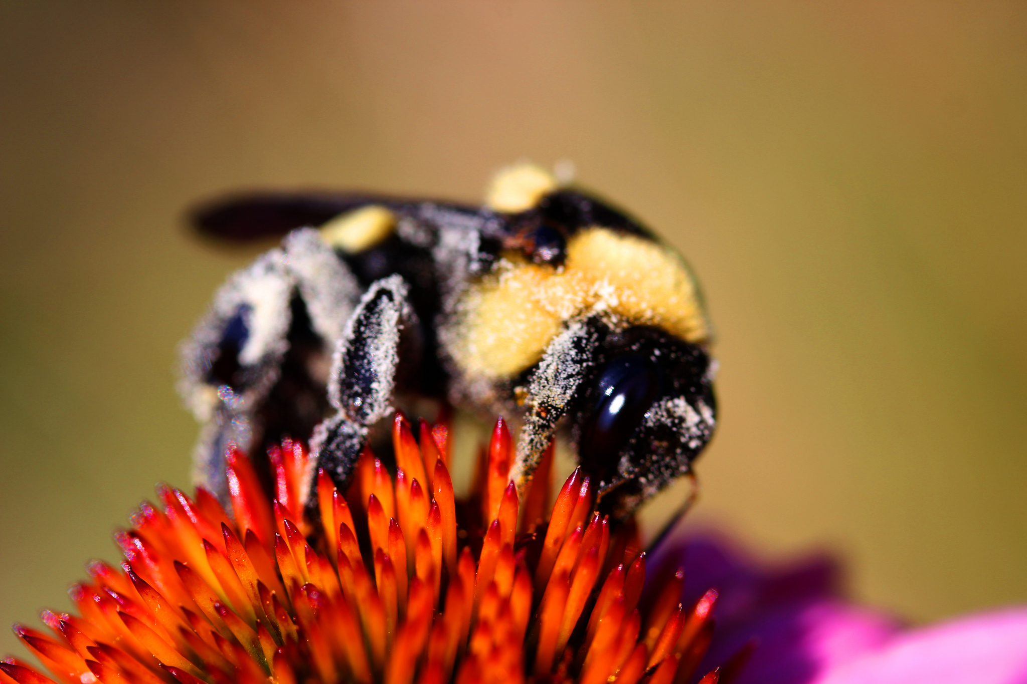
Arthropod: Insect (insectum)
3 parts to their bodies
2 eyes
2 antennae
6 jointed legs at some point in their lives
Often have wings
wasp, bee, butterfly, moth, beetle, ant, fly, dragon fly, praying mantis
Photo: Kathi

Slide 3
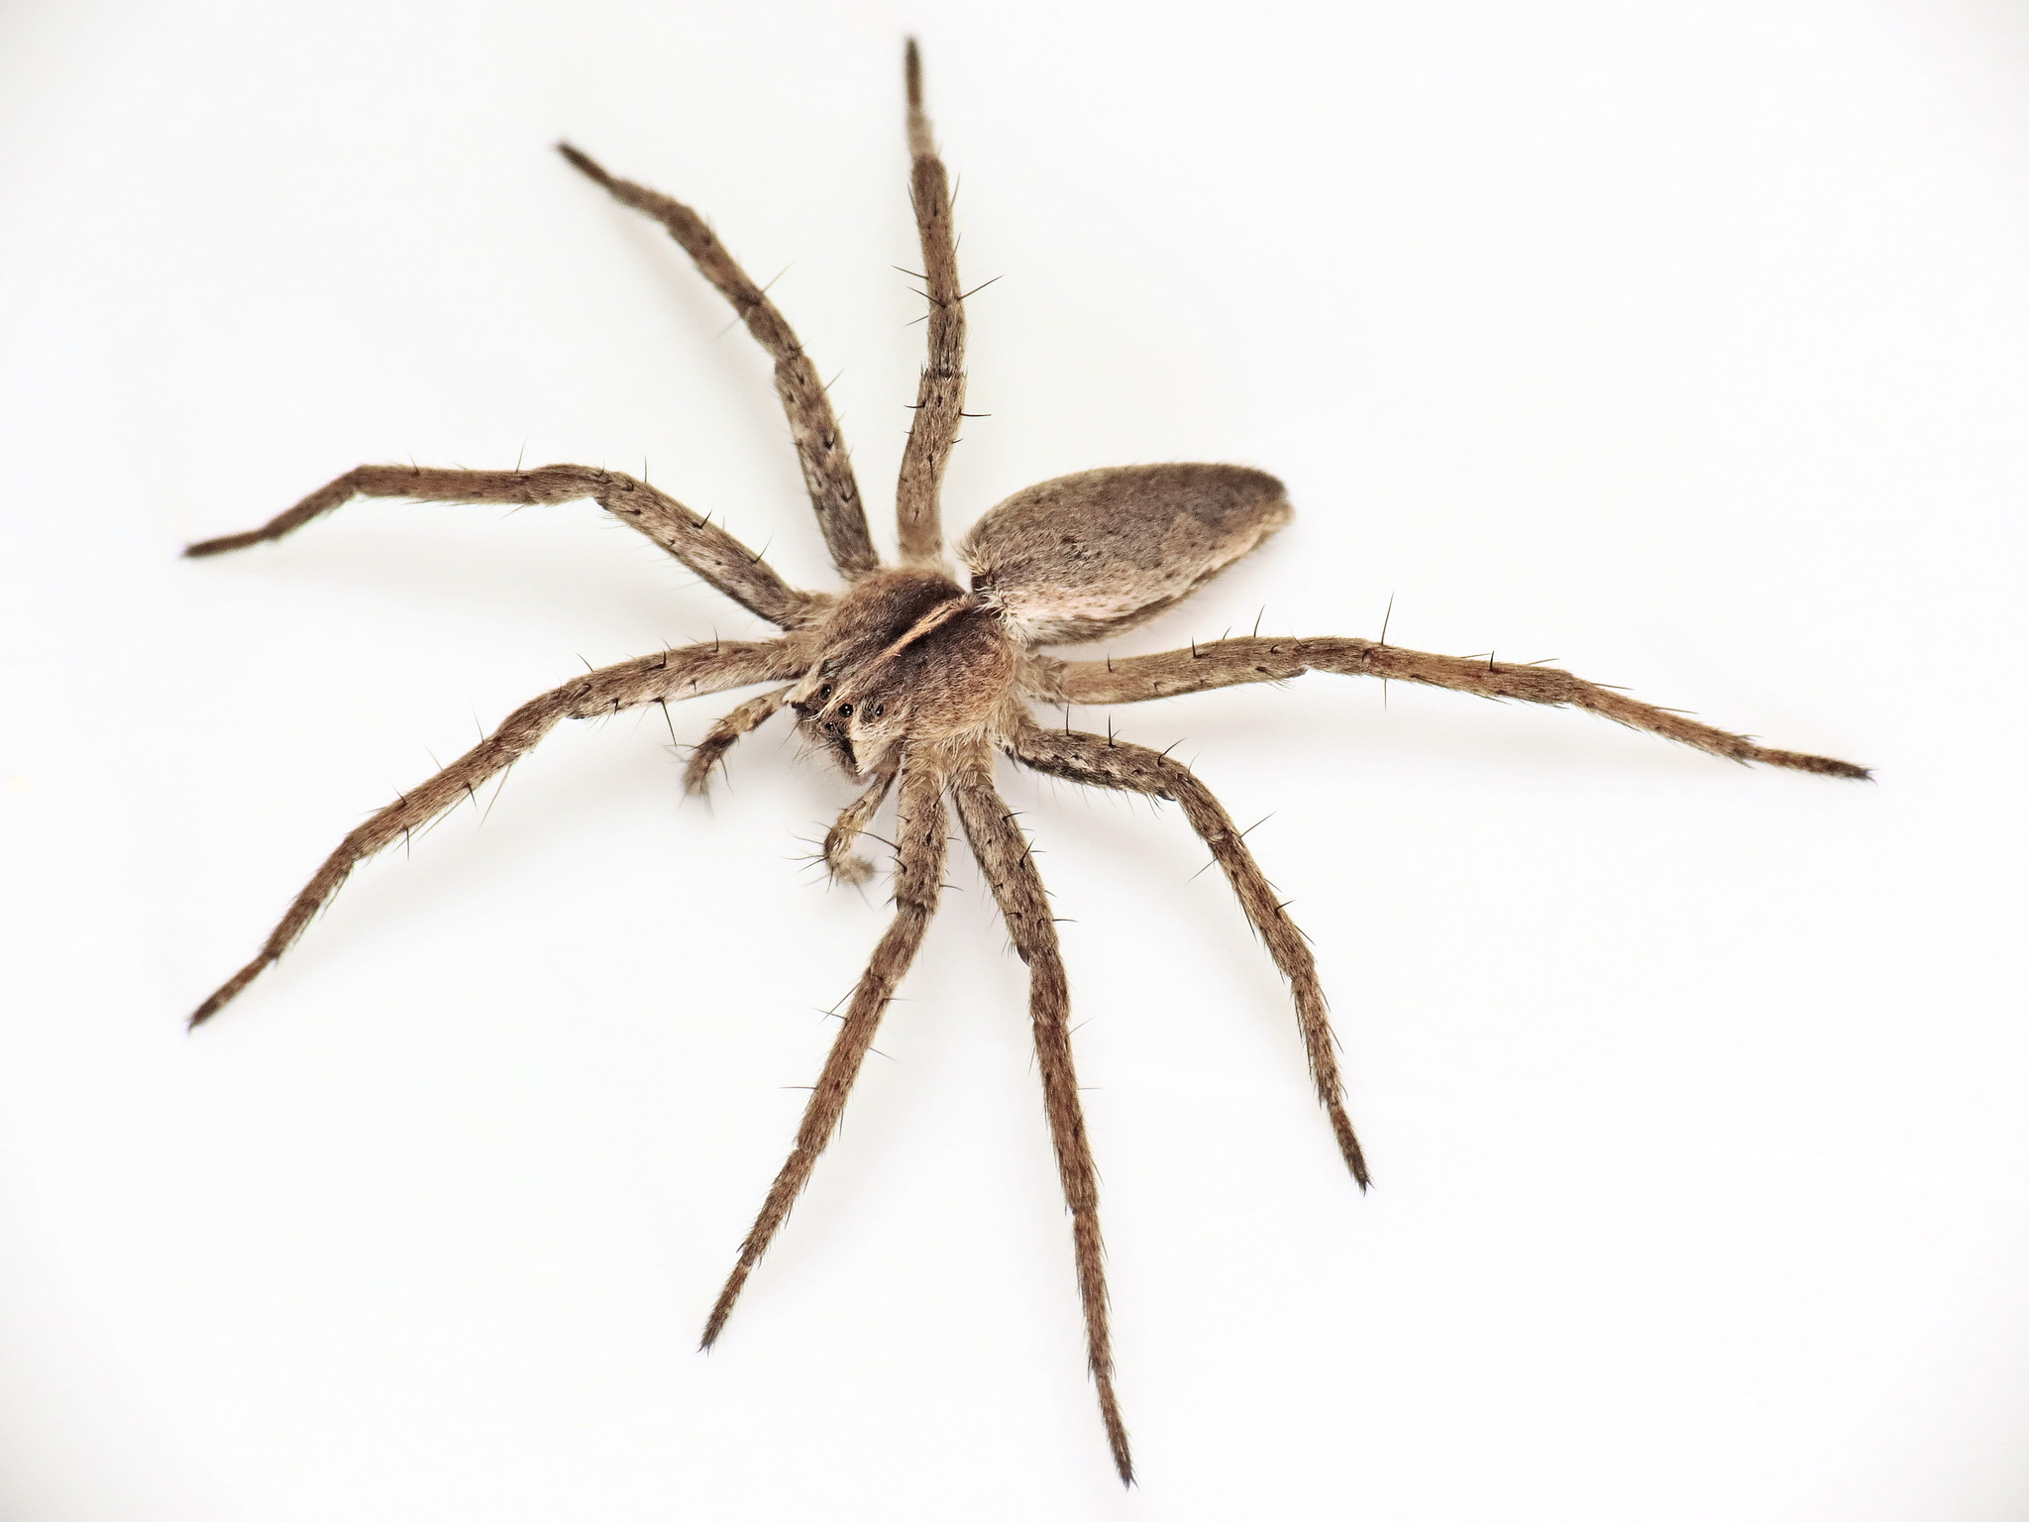
Arthropod: Arachnid (arachnida)
spider, scorpion, tick, mite,
daddy-long-legs (harvestman)
2 parts to their body
8 legs
2 pincers for biting or piercing prey
No antennae
Photo: Martin Cooper

Slide 4
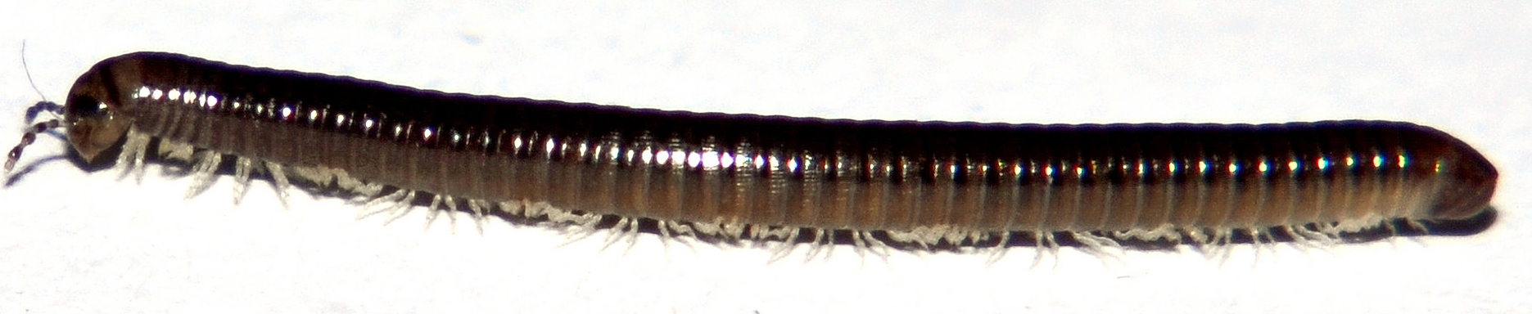
Arthropod: Myriapod (myriapoda)
About 15,000 species
Most have many pairs of legs
2 body sections (head and trunk)
One pair of antennae on head
Photo: Colin Avison
Centipede, millipede

Slide 5
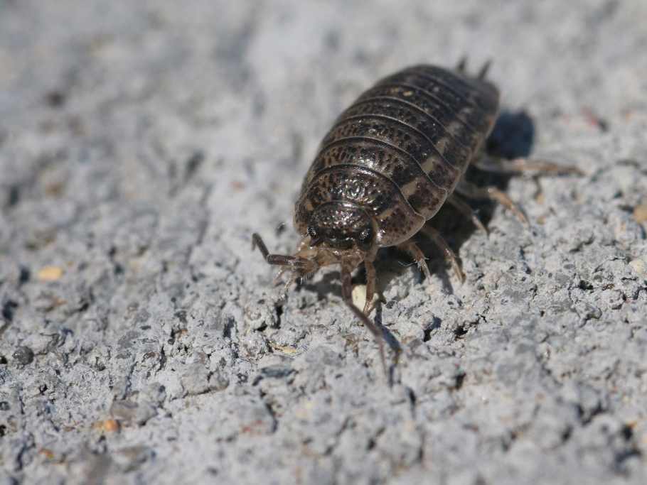
Arthropod: Crustacean (crustacea)
A hard outer shell or case
10-14 legs
2 pairs of antennae
woodlouse, crab, lobster, barnacle, shrimp
Photo: sankax

Slide 6
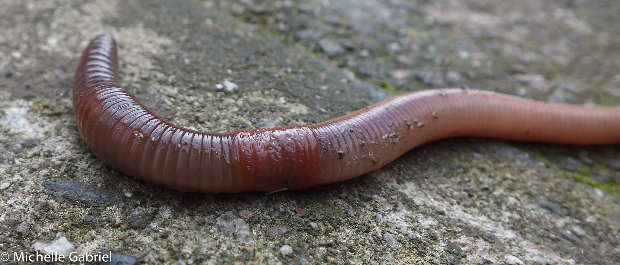
Worms
(Phyla Annelida, Nematoda & Platyhelminthes)
No true limbs
Body shapes vary but the two sides of their bodies are always symmetrical
Some live inside other animals, others in water or on land
Earth worm, flat worm, round worm, leech

Slide 7
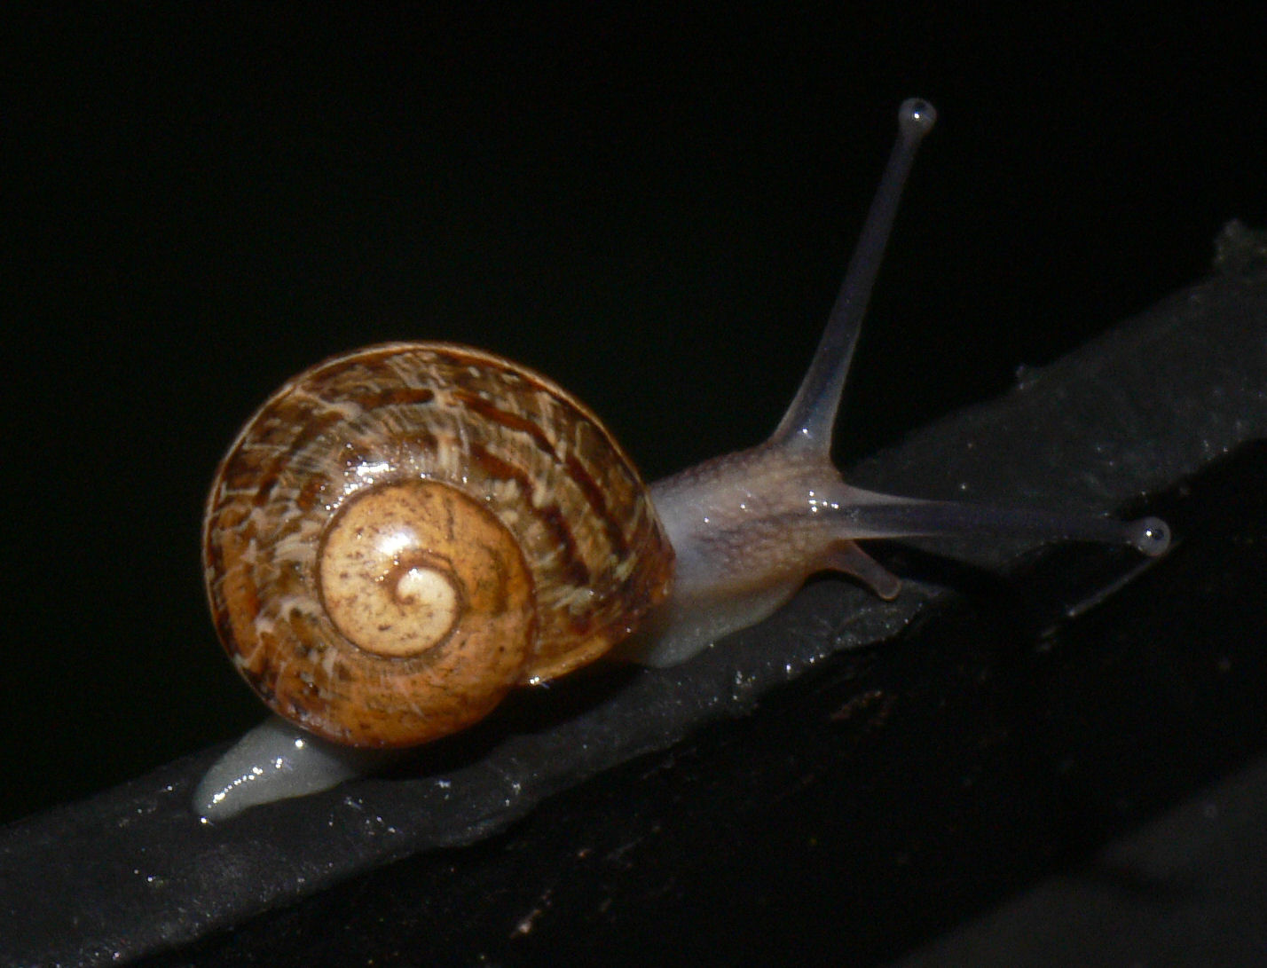
Molluscs (Phylum Mollusca)
One main part to their body
Soft bodies, many have a shell
All have one muscly foot or tentacles to help them move around
Most are slimy to help them slide along the ground
snail, slug, octopus, oyster, mussel, clam, squid
Photo: bramblejungle

