Slide 1
LO: To be able to understand, identify and use active and passive voice in sentences

Slide 2
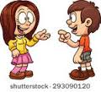
Active
and passive verbs
What was said just now?

Slide 3
Subject, Verb, Object
Milo grabbed the postman’s leg.
Subject: Who we are talking about in the sentence. For example, Milo is who we are talking about.
Verb: The ‘doing word’ of the sentence, which tells you what the subject is up to. For example ‘grabbed’.
Object: This is the thing the verb is working on. In this case, the postman’s leg.

Slide 4
Subject and object (revision)
What is the subject of each of these sentences?
The dog barked.
The dog bit me.
I bit the dog.
You must get off the bus.
This bus goes to Leeds.
I am a dog.
The dog barked.
The dog bit me.
I bit the dog.
You must get off the bus.
This bus goes to Leeds.
I am a dog.

Slide 5
Subject and object (revision)
What is the object of each of these sentences? Do they all have an object?
The dog barked.
The dog bit me.
I bit the dog.
You must go to Leeds on the bus.
I’m sharpening my pencil.
Get a new pencil.
The dog barked.
The dog bit me.
I bit the dog.
You must go to Leeds on the bus.
I’m sharpening my pencil.
Get a new pencil.

Slide 6

All in order…
object subject verb
What is their usual order in an English sentence?
Subject
Verb
Object

Slide 7
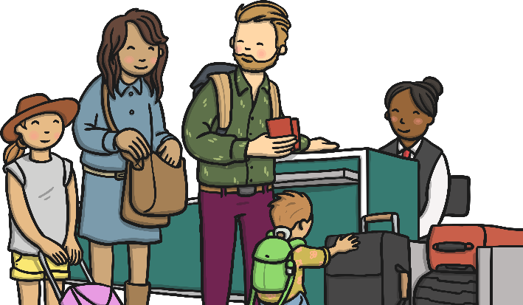
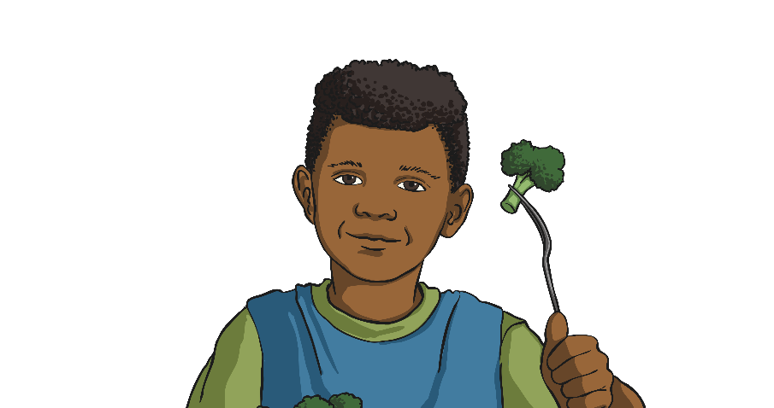
Active Voice (An Active Verb Sentence)
In English, active sentences are used much more often than passive sentences. In active sentences, the subject performs the action (the verb) to the object.
The family boarded the plane.
The boy ate the broccoli.

Slide 8

Passive Voice (A passive Verb Sentence)
In passive sentences, the word order is reversed. The subject receives the action and the object is performing it.
The plane was boarded by the family.
The plane is now the subject but is receiving the action.
The verb ‘boarded’ now comes after a past tense form of the auxiliary verb ‘to be’, e.g. was or were.
The family are still performing the verb but the preposition word ‘by’ is added to show this.

Slide 9

The boy ate the broccoli.
becomes…
The broccoli was eaten by the boy.
The broccoli is now the subject but is receiving the action.
The verb ‘was’ is used again but this time ‘ate’ is changed to the past participle ‘eaten’.
The boy is still performing the verb but the preposition work ‘by’ is added to show this.

Slide 10
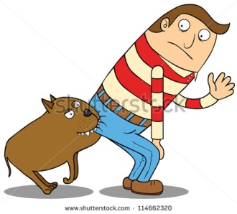
Passive verbs
A passive verb lets us use the object of the action as the subject of the sentence.
The dog bit me.
(active verb)
I was bitten by the dog.
(passive verb)

Slide 11
Turn these active verb sentences into passive verb sentences:
Bees make honey. Honey is…
Honey is made by bees
The sun warmed and dried him.
He was warmed and dried by the sun.
A passing herd of buffalo nearly flattened us.
We were nearly flattened by a passing herd of buffalo.
A projecting ledge of rock broke my fall.
My fall was broken by a projecting ledge of rock.

Slide 12
Turn these passive verb sentences into active verb sentences:
My fall was broken by a projecting ledge of rock.
A projecting ledge of rock broke my fall.
The robbers were seen by a member of the public.
A member of the public saw the robbers.

Slide 13

Passive verb forms
What have we learned?
Write down on your whiteboard two things you have learned.

Slide 14
Remember!
Sometimes the person or thing that the action is done to appears as the subject of the sentence. Then we use a passive verb form.
To make a verb passive, use a form of the verb “to be” (am, are, is, was, were, be) with the past participle of the action verb (broken, taken, helped, stolen, created, pleased, eaten ...)
Use the preposition by to indicate the person or thing that does the action.

Slide 15
Task 1:
Rewrite each of the following sentences using a passive form of the verb :
Greta skillfully milked the cow.
The loggers cut down a giant redwood tree.
The immune system defends the body from infection.
The examiners will carefully mark your papers.
5. A dog bit two children in the park.

Slide 16
Task 2
Now rewrite these sentences using an active form of the verb:
Philip was persuaded to come along by Gloria.
Drivers who break the speed limit will be caught by automatic cameras.
3. The field was ploughed by the farmer with his blue tractor.

Slide 17
Challenge: Sentences with two objects
Find the subject, verb and object of this sentence:
My granny gave me a new game for my birthday.
My granny gave me a new game for my birthday.
What is the object: “me” or “a new game”?
How do we make this sentence passive?

Slide 18
Sentences with two objects
My granny gave me a new game for my birthday.
There are two ways because there are two objects.
“A new game” is called the direct object – it’s the thing that was given.
“Me” is called the indirect object – you are the person it was given to.
So we can say:

Slide 19
Sentences with two objects
A new game was given to me by my granny.
Or: I was given a new game by my granny.
Which one do you think sounds better?
Now turn these into passive verb sentences:
The head teacher awarded Abbie a prize.
Adult birds bring food to their chicks.

