Slide 2
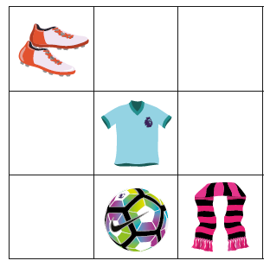
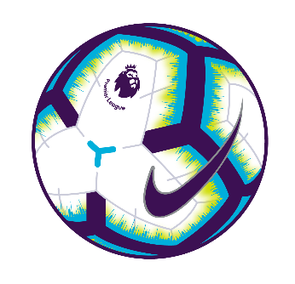
Q1
What is above the ball?
The boots
The scarf
The shirt
Nothing
Notes:
Q1. Answer is C – The shirt

Slide 3
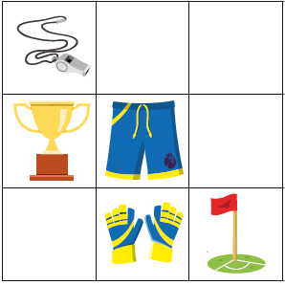
Q2
What is below the shorts?
The gloves
The trophy
The flag
Nothing
Notes:
Q2. Answer is A – The gloves

Slide 4
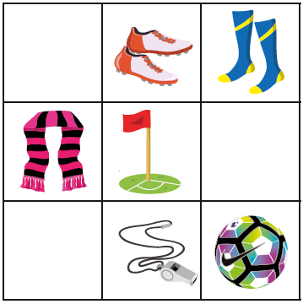
Q3
What is to the right of the flag?
The scarf
The boots
The whistle
Nothing
Notes:
Q3. Answer is D – Nothing

Slide 5
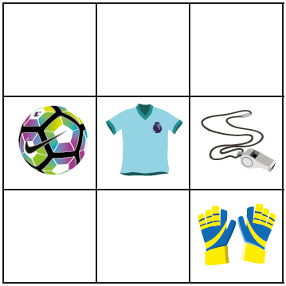
Q4
Which object is in the middle?
The ball
The gloves
The shirt
The whistle
Notes:
Q4. Answer is C – The shirt

Slide 6
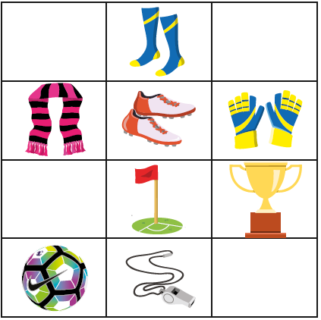
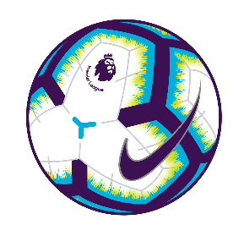
Q5
What is between the whistle and the boots?
The flag
The socks
The ball
Nothing
Notes:
Q5. Answer is A – The flag

Slide 7
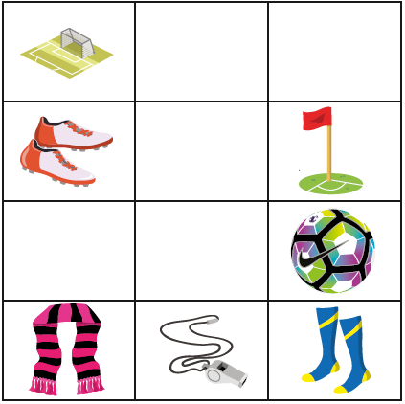
Q6
The ________ are near the goal.
ball
boots
socks
scarf
Notes:
Q6. Answer is B – boots

Slide 8
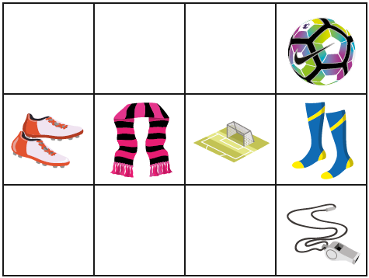
Q7
Which of these is true?
The ball is at the top
The boots are at the bottom
The whistle is at the top
The socks are at the bottom
Notes:
Q7. Answer is A – The ball is at the top

Slide 9
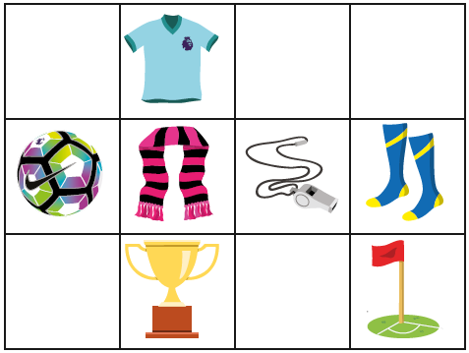
Q8
What is two spaces above the trophy?
The flag
The scarf
The ball
The shirt
Notes:
Q8. Answer is D – The shirt

Slide 10
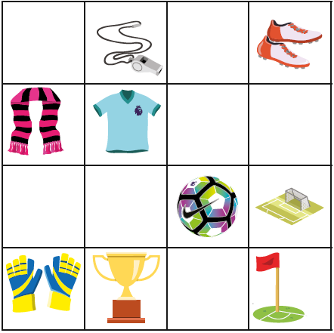

Q9
What is three spaces to the left of the goal and one space up?
The gloves
The scarf
The boots
The shirt
Notes:
Q9. Answer is B – The scarf

Slide 11
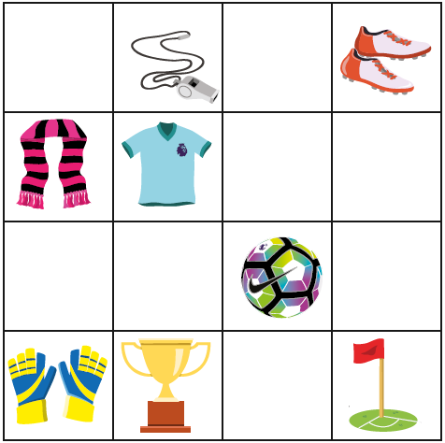
Q10
What is two spaces down from the whistle and two to the right?
The ball
The boots
The flag
Nothing
Notes:
Q10. Answer is D – Nothing

