Slide 1

It’s a snow day!
I hope you all have a wonderful day in the snow. Enjoy it, but remember to keep safe too. When you aren’t making snowmen and sledging here are some activities to do whilst you warm up.

Slide 2

Maths

Slide 3
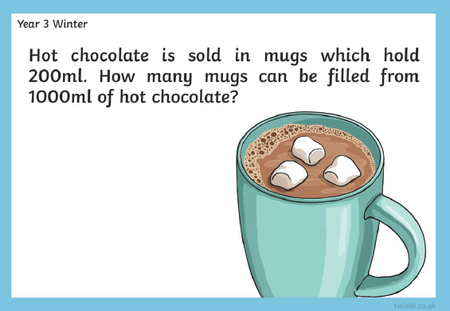
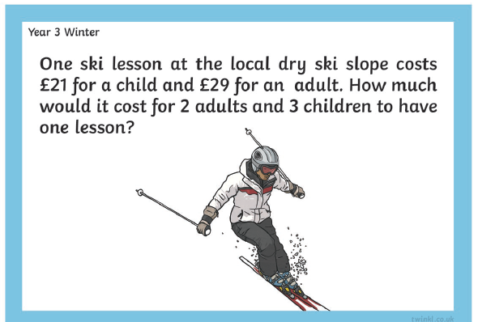
Maths

Slide 4
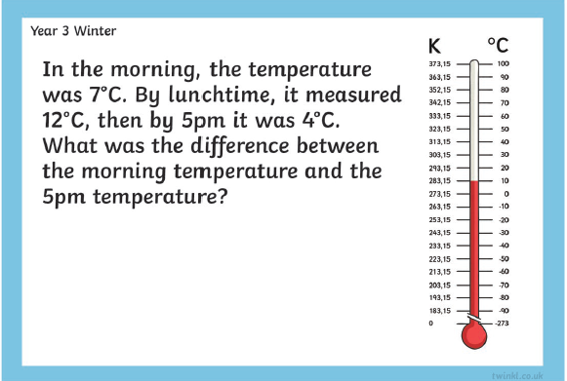
Maths
Who can make the tallest snowman?
Can you measure it in cm?
Sam and Jill share a pizza by cutting it into 8 slices. Sam eats ¼ of it and Jill eats ³/₈. What fraction is left?

Slide 5

Literacy

Slide 6
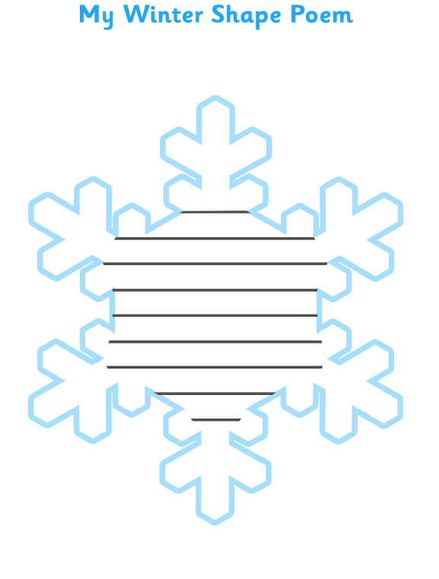
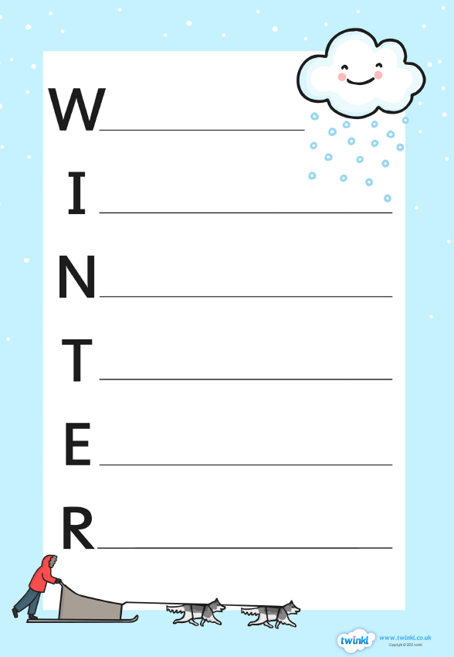
Literacy – write a winter poem

Slide 7
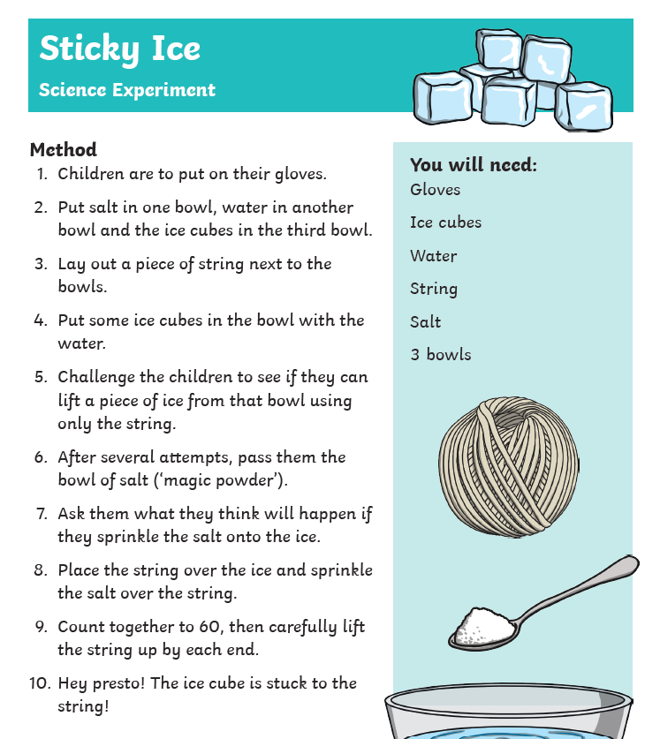
Science – Try an experiment.
You could try this one →
Or try to work out the best way to keep a snowman when it starts to get warm. How could you keep it insulated?

Slide 8
You also have your reading packs and homework to do.
Where is the cosiest place you could read your book?

