Slide 1
L.O. Nouns – Singular and Plural

Slide 2
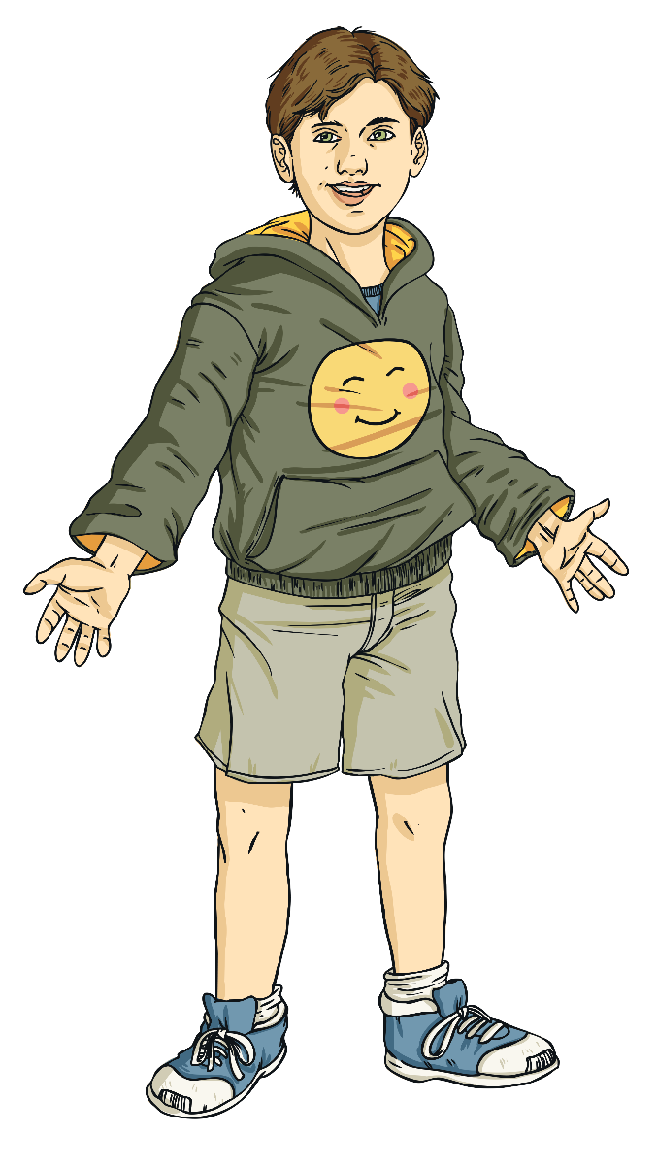
Recap: What is a noun?
Which one of these descriptions describes a noun?
Describes characteristics
Describes actions
Names people, places and things

Slide 3
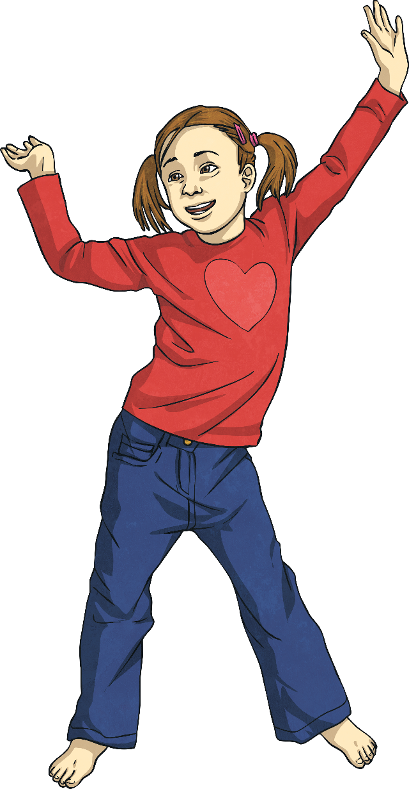

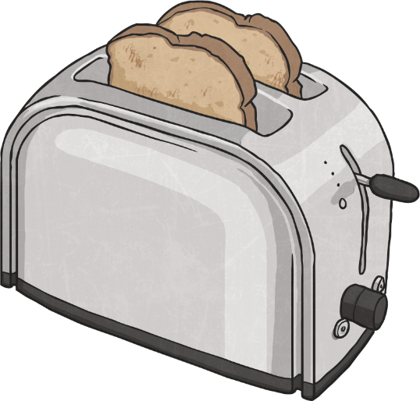
Recap: What is a noun?
A noun…
Names people, places and things
Toast, head, computer, London and happiness.
These are all nouns!

Slide 4
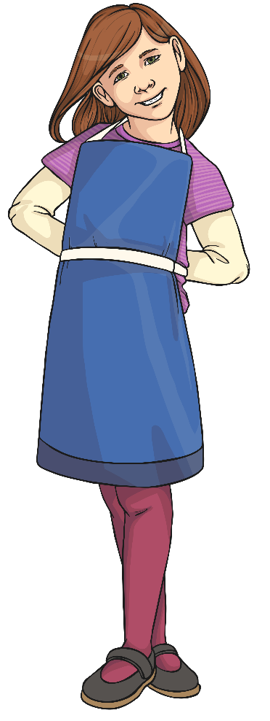
Grouping Nouns
Nouns can be grouped into different types:
abstract
concrete
collective
proper
compound
common
We will find out more about these later!

Slide 5
Task: Complete the first side of your sheet.

Slide 6
Singular and Plural
The word singular means just one of something, for example a house or a dog.
The word plural means more than one of something, for example houses or dogs.
The word singular is very similar to single. This can help us remember the meanings of singular and plural.

Slide 7

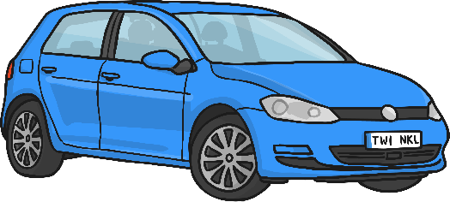
Most singular nouns form the plural by adding –s.
singular form | plural form
boat | boats
car | cars
house | houses
tree | trees
t

Slide 8
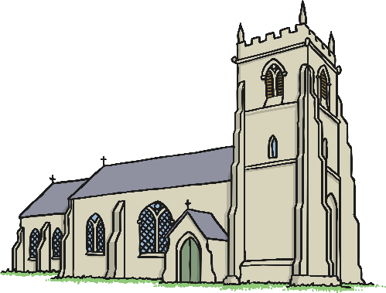
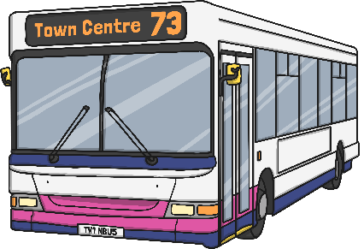
Singular nouns ending in ‘s’, ‘x’, ‘z’, ‘ch’ or ‘sh’ form the plural by adding –es.
singular form | plural form
bus | buses
box | boxes
church | churches
wish | wishes
t
Try saying ‘buss’, ‘boxs’ or ‘wishs’ and you will see why nouns which end in a hissing sound use –es in the plural!

Slide 9

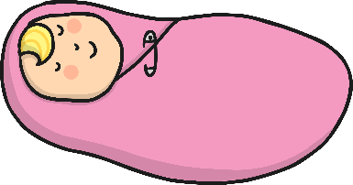
Singular nouns ending in a consonant and the letter ‘y’ form the plural by dropping the ‘y’ and adding –ies.
singular form | plural form
penny | pennies
baby | babies
daisy | daisies
spy | spies

Slide 10
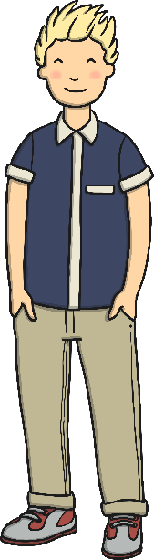
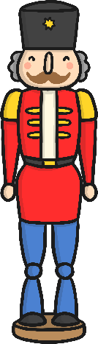
Singular nouns ending in a vowel and the letter ‘y’ form the plural by simply adding –s.
singular form | plural form
boy | boys
toy | toys
valley | valleys
tray | trays

Slide 11
So, most of the time, we make a plural noun by adding an -s, -es or –ies.
-ies.
BUT
The English language has some rule-breaking nouns in it. These are nouns that have their own special rules or spellings for making them into plurals.

Slide 12
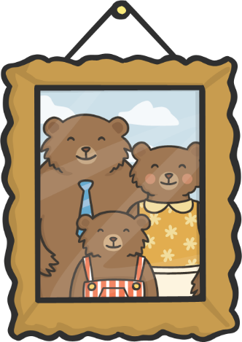
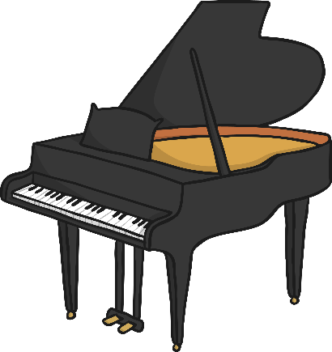
Some singular nouns ending in ‘o’ form the plural by adding –s.
singular form | plural form
piano | pianos
solo | solos
photo | photos
memo | memos
kilo | kilos
video | videos

Slide 13

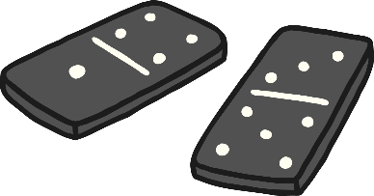
But some singular nouns ending in ‘o’ form the plural by adding –es!
singular form | plural form
potato | potatoes
hero | heroes
tomato | tomatoes
echo | echoes
torpedo | torpedoes
domino | dominoes

Slide 14
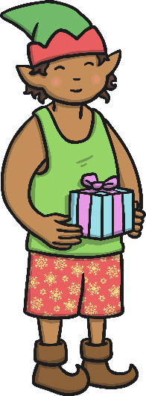

Nouns that end in ‘f’ or ‘fe’ usually form the plural by dropping the ‘f’ and adding -ves.
singular form | plural form
thief | thieves
knife | knives
wife | wives
elf | elves
leaf | leaves

Slide 15
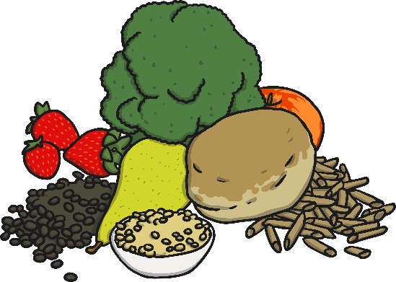

However, some nouns that end in ‘f’ form the plural by simply adding -s.
singular form | plural form
cliff | cliffs
earmuff | earmuffs
foodstuff | foodstuffs
cuff | cuffs
playoff | playoffs
roof | roofs

Slide 16
Top Tip
If you can hear the sound ‘f’ in the plural noun (for example ‘cliffs’, you probably spell the plural form with an ‘f’. If you can hear a ‘v’ sound (as in ‘wives’), then you will probably need to use a -ves plural.

Slide 17
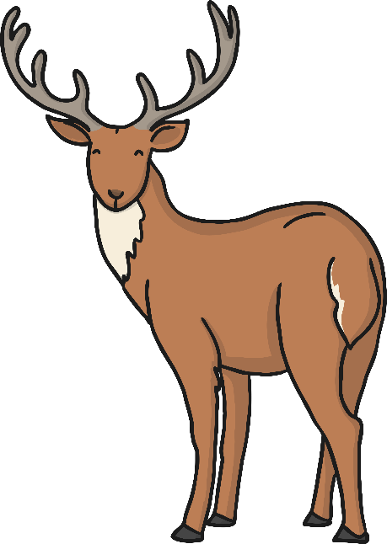

Some tricky nouns are the same in the singular and the plural forms.
singular form | plural form
sheep | sheep
fish | fish
deer | deer
aircraft | aircraft
species | species

Slide 18

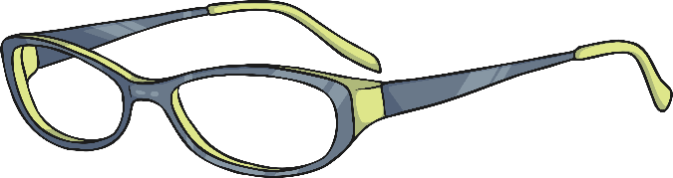
Pairs of things usually only have a plural form.
plural form
trousers
glasses
scissors
jeans

Slide 19
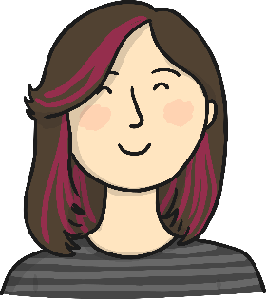

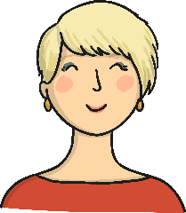
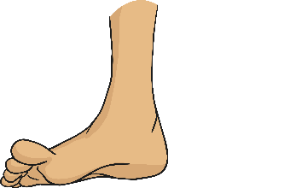
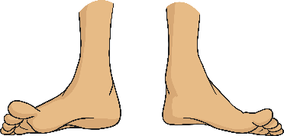

Some nouns are completely irregular and do not follow any of these patterns.
For example:
woman women foot feet

Slide 20


More Examples of Irregular (Mutated) Plural Nouns
singular form | plural form
man | men
child | children
tooth | teeth
die | dice
mouse | mice
goose | geese
person | people

Slide 21
Making Singular English Nouns Plural
singular form | To form the plural….. | plural form
boat | add -s | boats
bus | add -es | buses
penny | drop y, add -ies | pennies
piano | add -s | pianos
domino | add -es | dominoes
thief | drop f, add -ves | thieves
cliff | add -s | cliffs
sheep | do nothing | sheep
trousers | do nothing | trousers
die | change the word | dice
foot | change the word | feet
person | change the word | people

Slide 22
Making Singular English Nouns Plural
singular form | To form the plural….. | plural form
boat | add -s | boats
bus | add -es | buses
penny | drop y, add -ies | pennies
piano | add -s | pianos
domino | add -es | dominoes
thief | drop f, add -ves | thieves
cliff | add -s | cliffs
sheep | do nothing | sheep
trousers | do nothing | trousers
die | change the word | dice
foot | change the word | feet
person | change the word | people

Slide 23

What is the plural form of ‘cuff’ ?
A) cuffes
B) cuff
C) cuves
D) cuffs

Slide 24
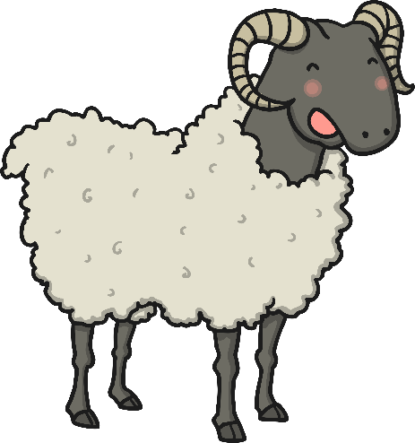
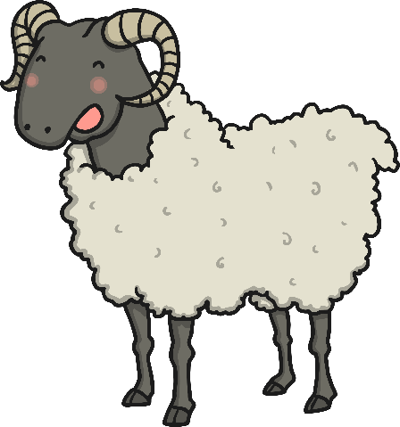
What is the plural form of ‘sheep’ ?
A) sheeps
B) sheepes
C) sheep
D) sheepies

Slide 25


Can you find the singular and plural noun pairs?
die
teeth
gateaux
virtuoso
baby
elves
virtuosi
gateau
elf
dice
domino
babies
tooth
dominoes

