Slide 1

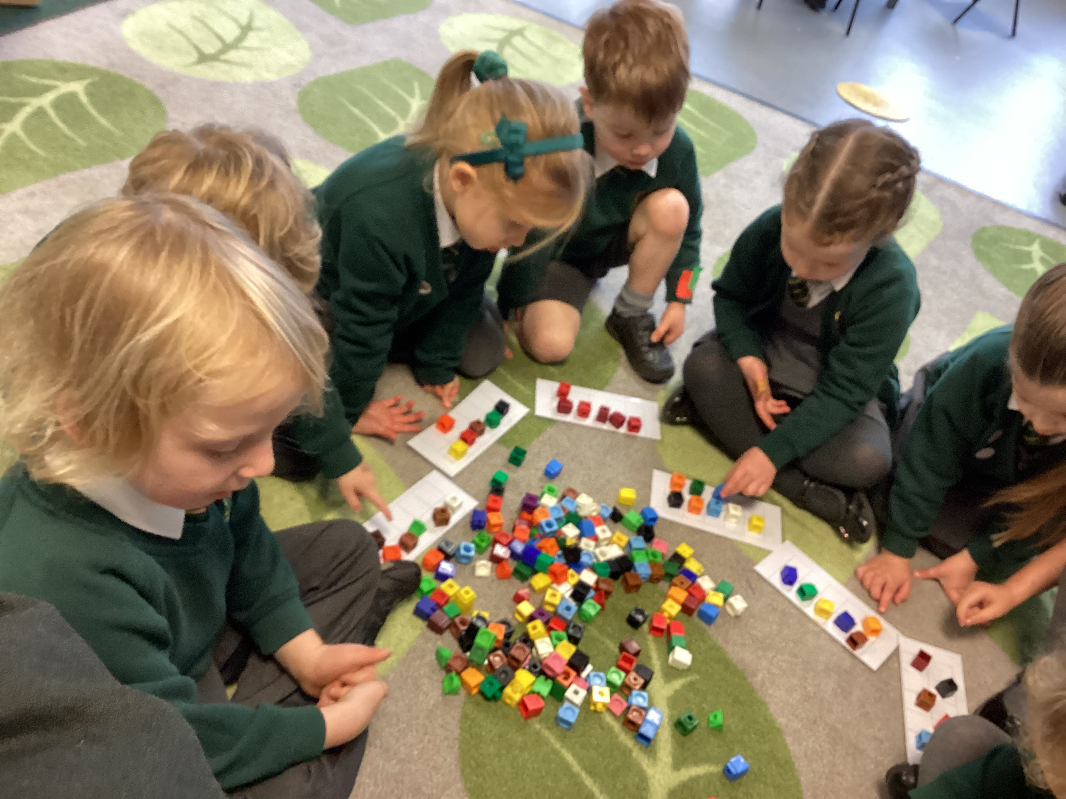
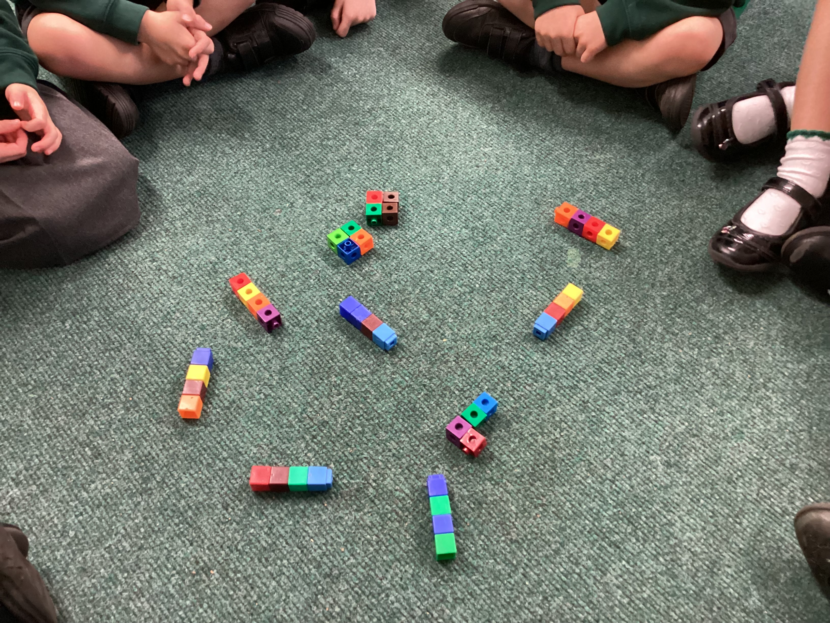
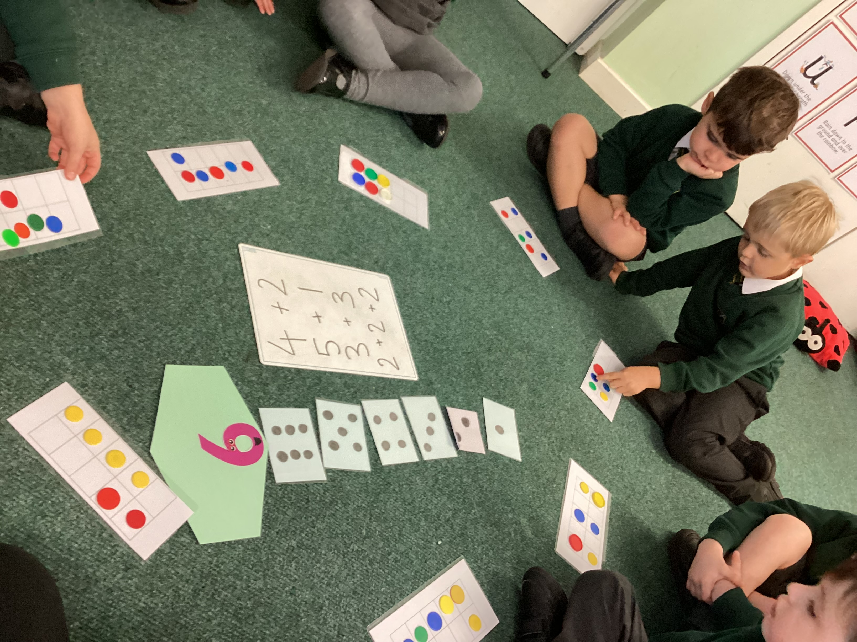
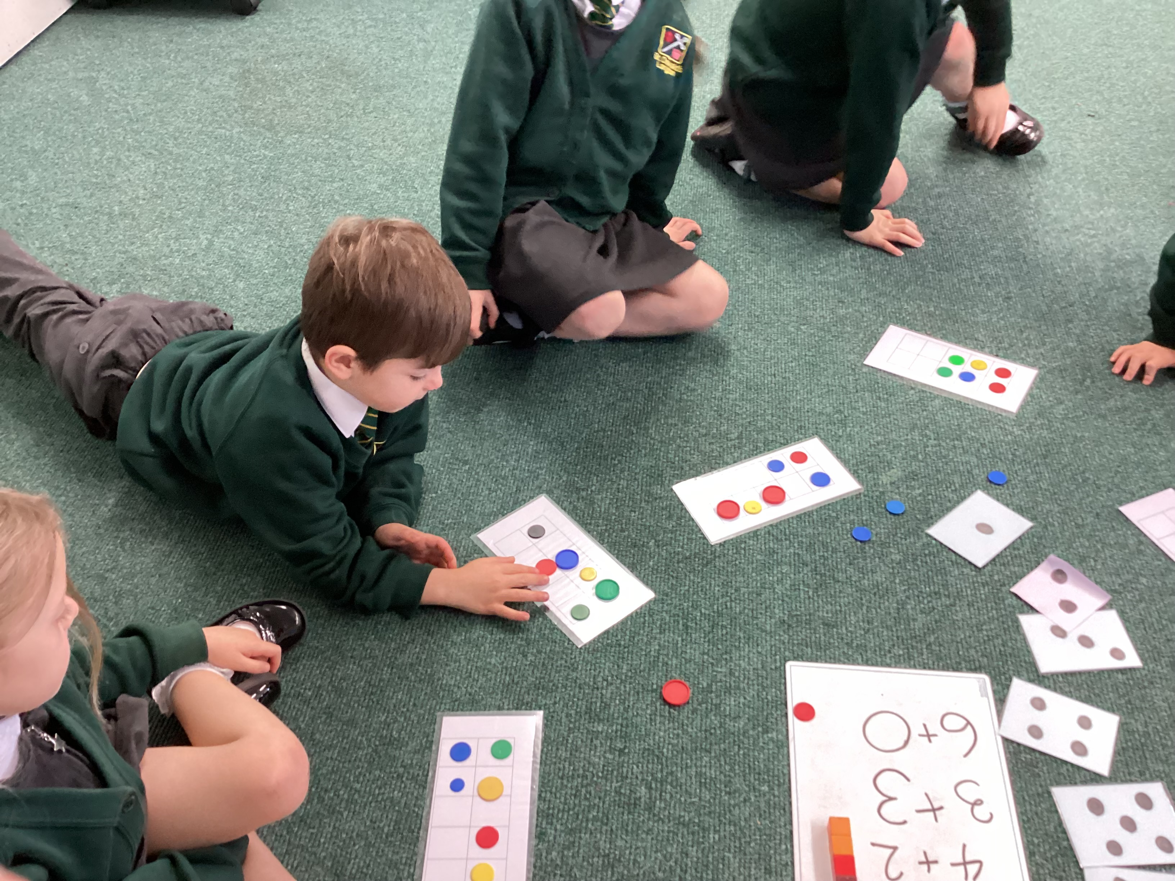

Number Workshop
2024

Slide 2
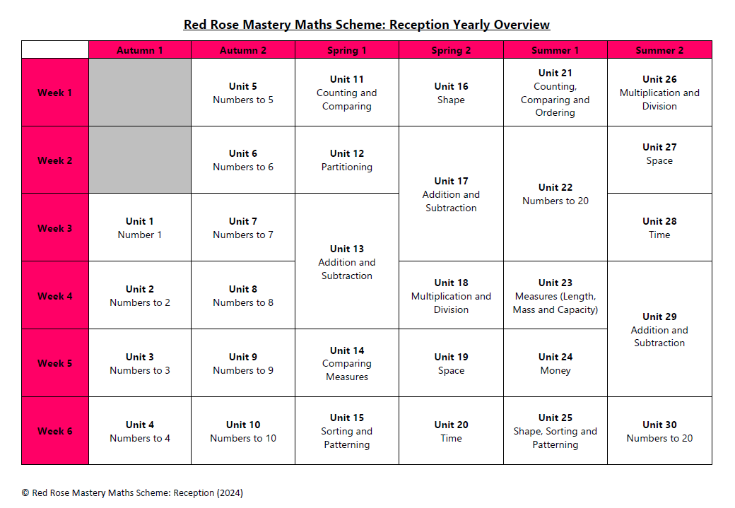
Yearly Overview

Slide 3
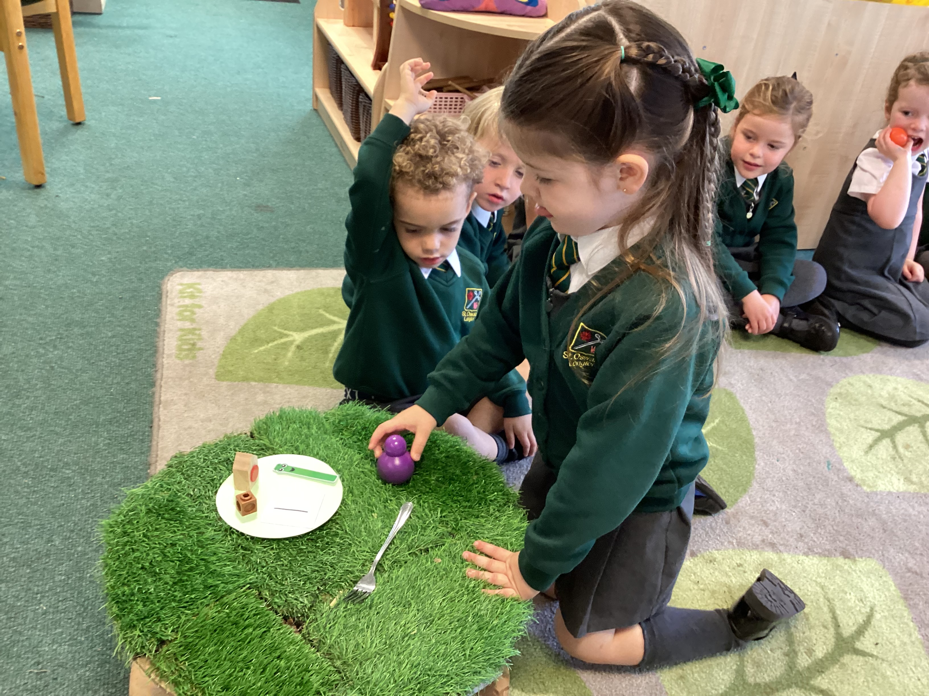
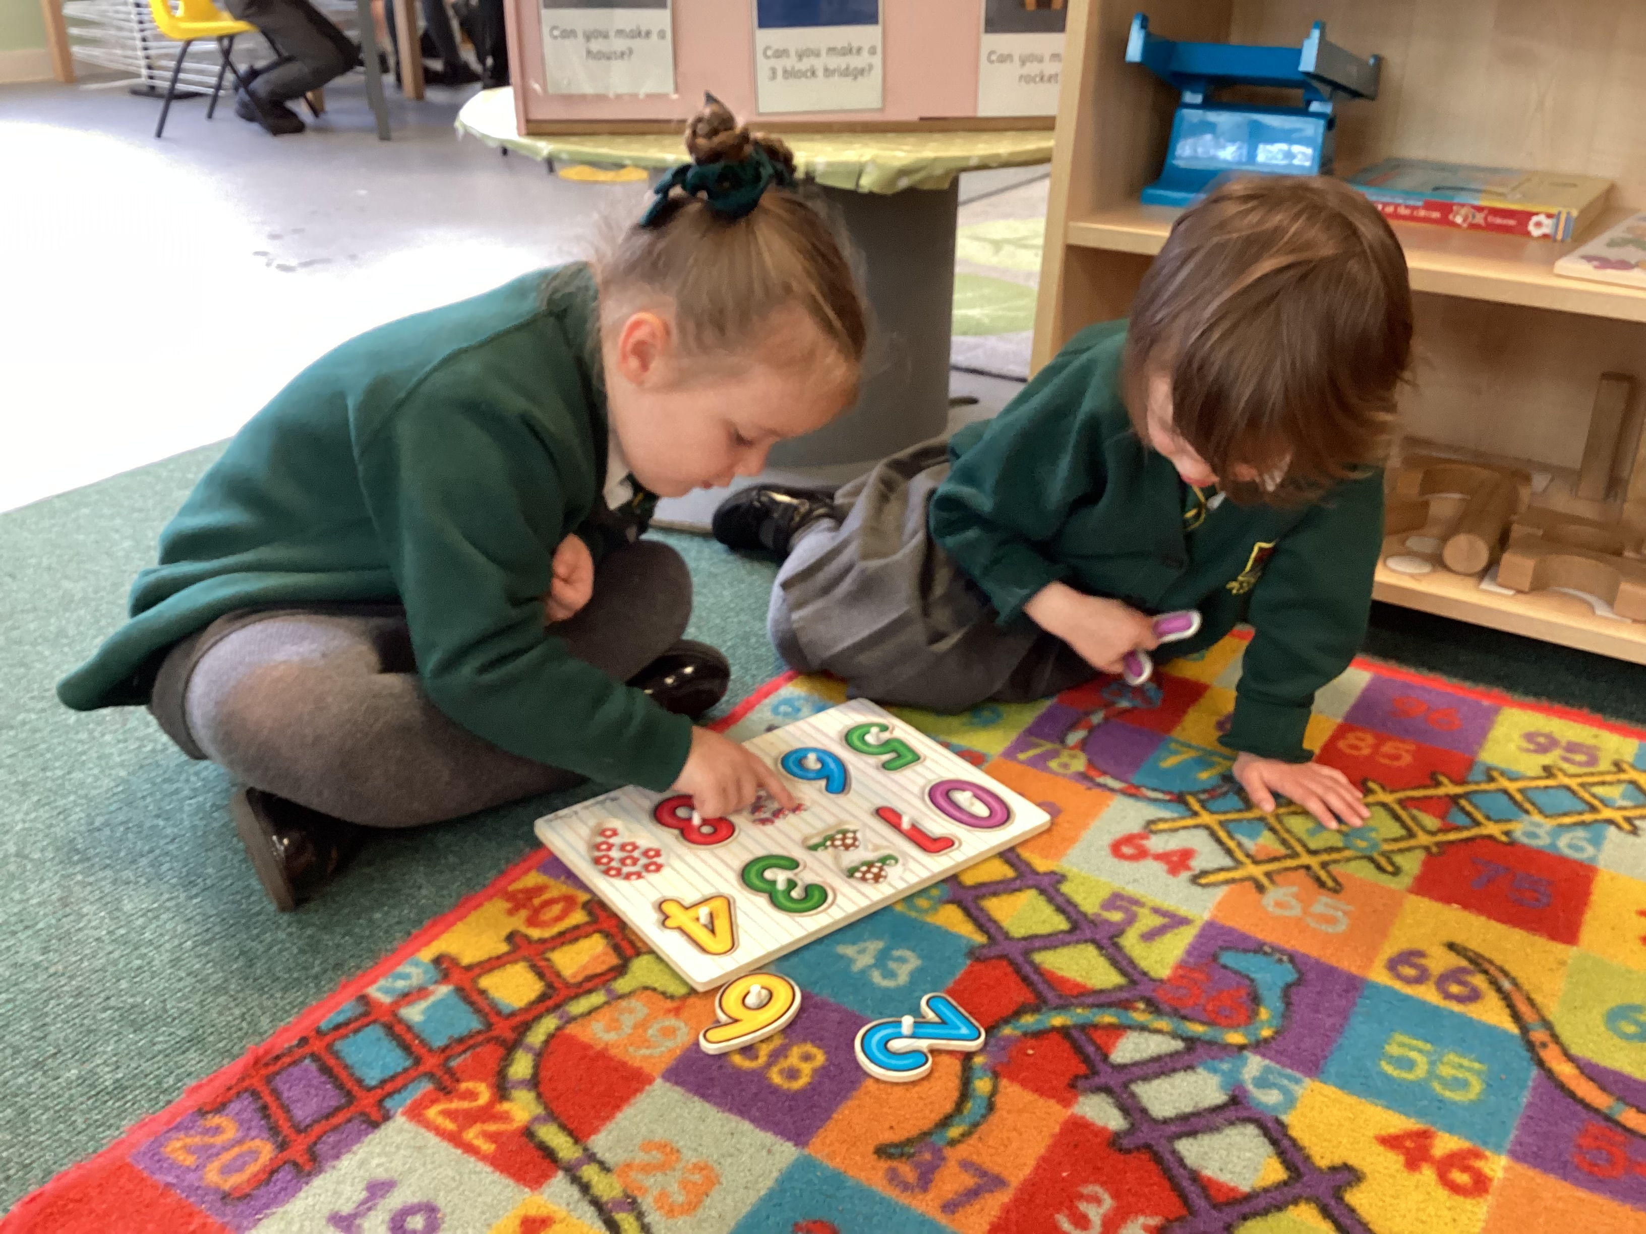
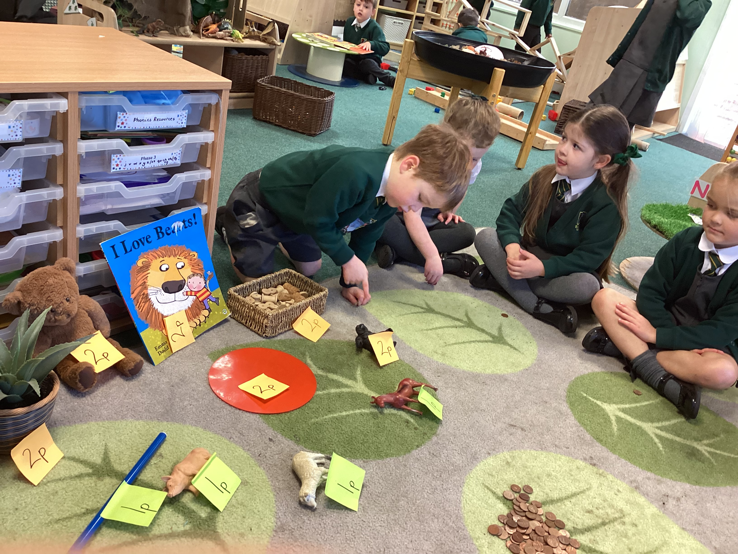
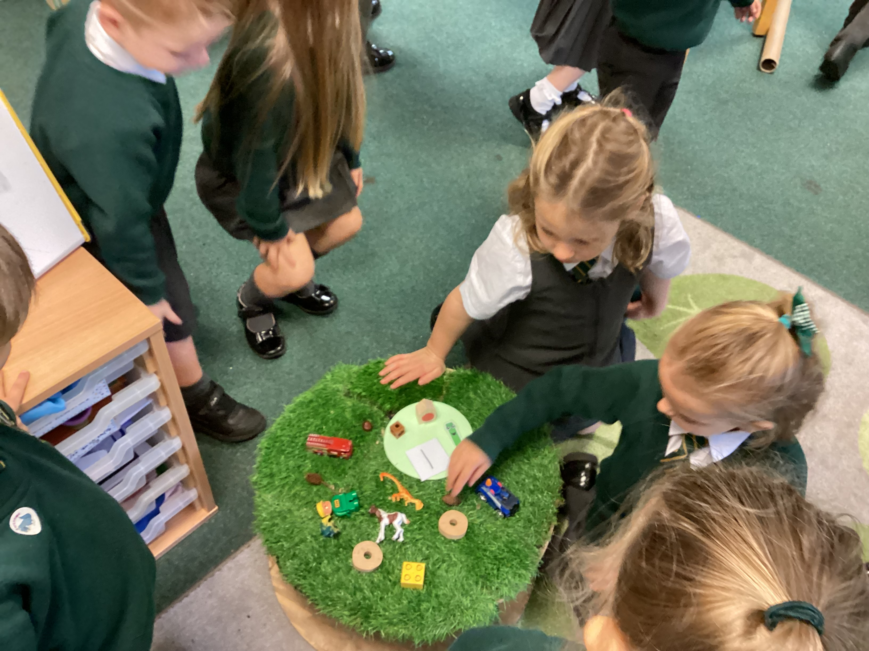
What is the mastery approach?
A mastery approach to teaching and learning supports all children to develop a board and deep understanding of mathematics.
It is about deep and secure learning for all.
“Challenge isn’t bigger numbers, it is bigger thinking”

Slide 4
Number
We teach number daily for half an hour in small groups of 8/9 children.
We call our number learning ‘NUMBERLAND’ – so the children get excited when its their turn to visit number land.
The children will also join in with number songs throughout the day and watch the corresponding number blocks episode for the week.
Each child has a focused guided task with an adult in a group of 4 throughout the week to revisit their knowledge of the number of the week.
Intervention or any revisiting of misconceptions will be actioned on the same day.

Slide 5
What is Number land?
A very visual way or representing number.
Every number lives in a different house with a different shaped garden, which all reflects the number that lives there.
Number land has a number lane leading up to the houses which allows for the children to practise their forwards and backwards counting skills as they move up and down the lane.
Each Number has:
A garden with the same amount of sides as the number e.g. 1 sided shape for number 1, 6 sided shaped for number 6.
A house with the corresponding amount on the door. Using the dice/domino pattern.
A number tower using cubes to give a linear visualisation of the number.
A flower bed – using a 5 or 10 frame, were the ‘flowers’ represent the number of the house.
A numeral character of the number, so the children see what the numeral looks like.
Each number also has a rhyme pattern to help with the formation of each numeral.

Slide 6
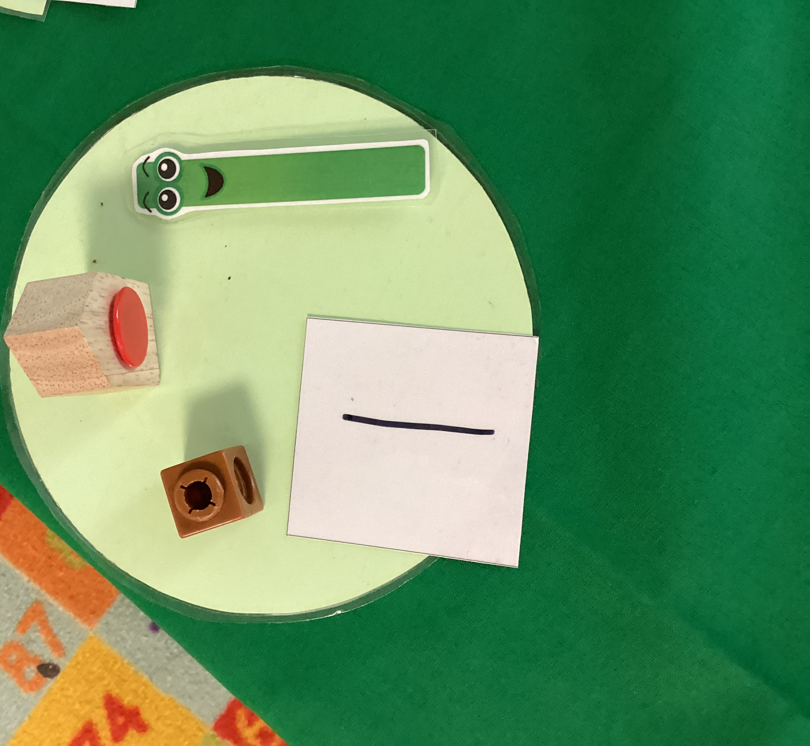
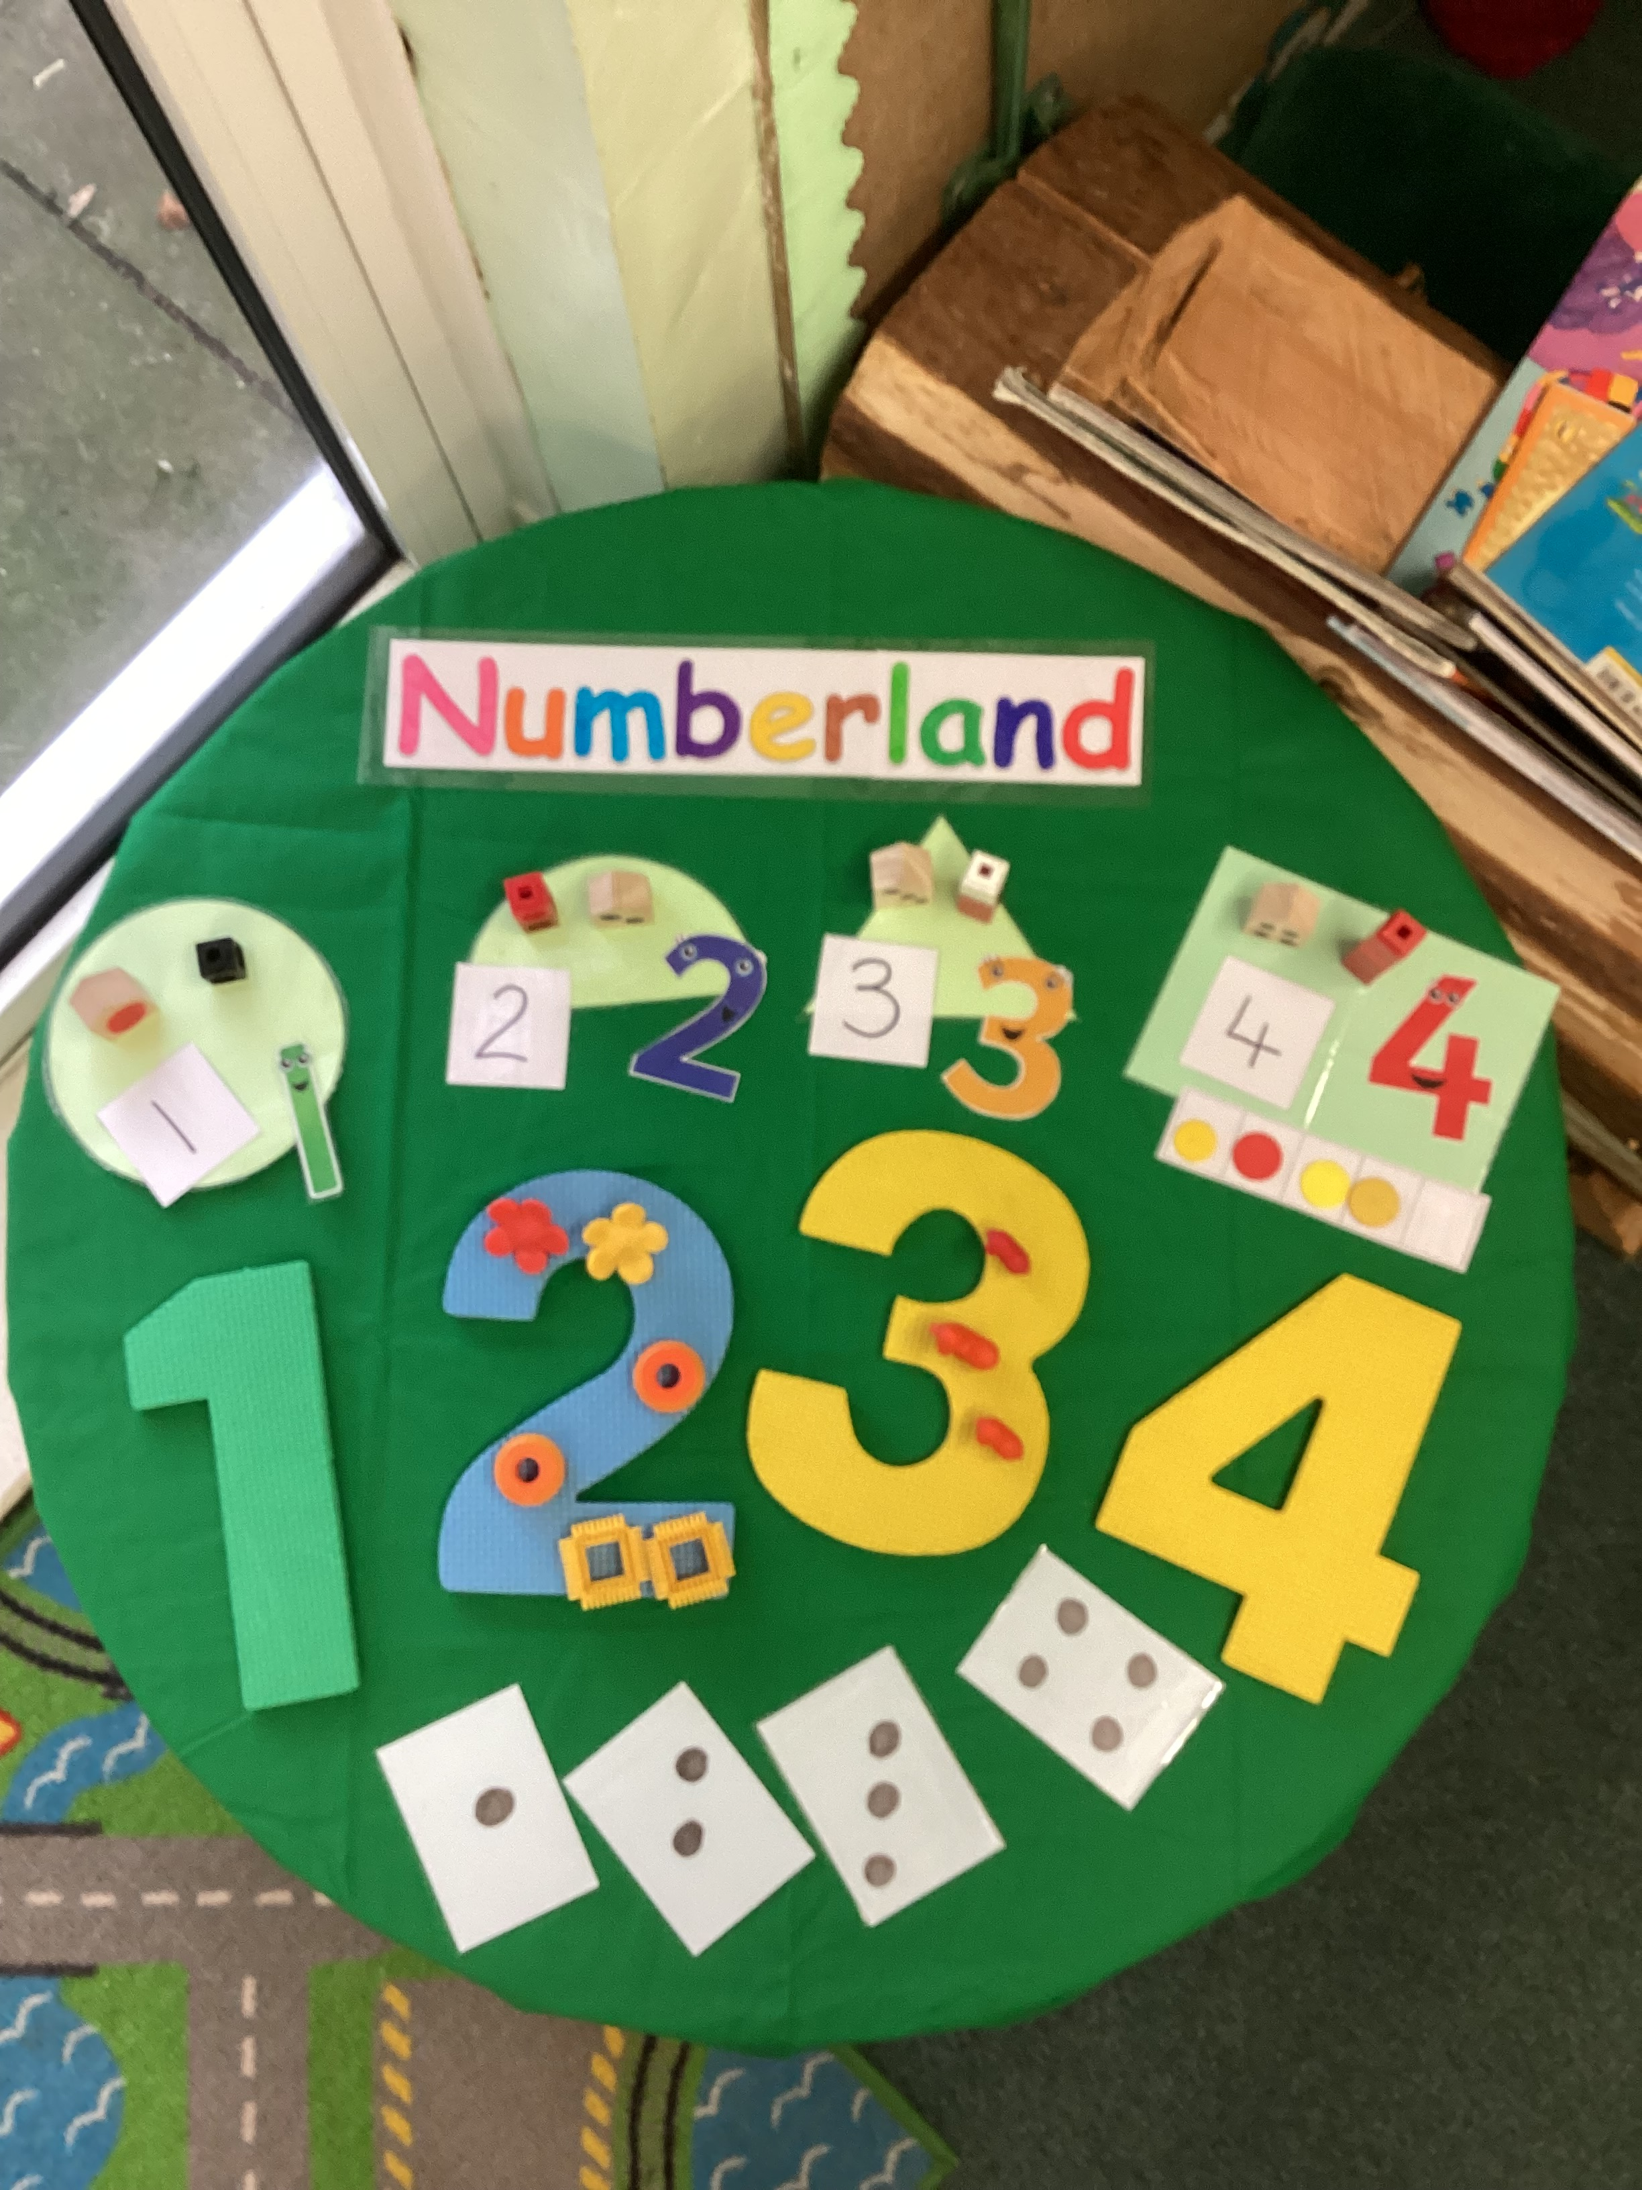
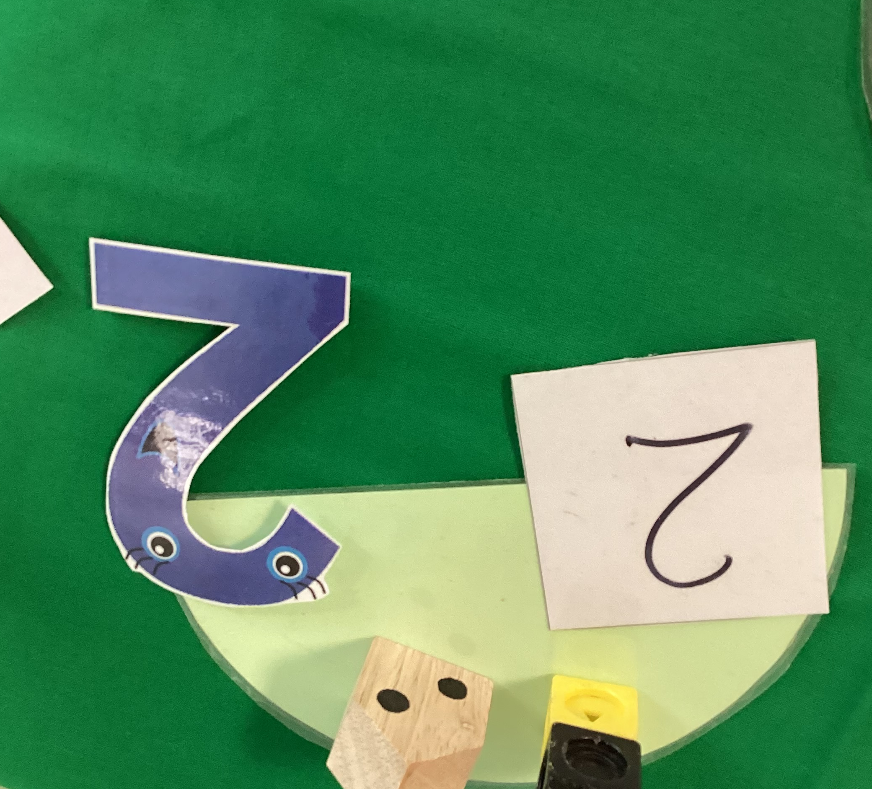
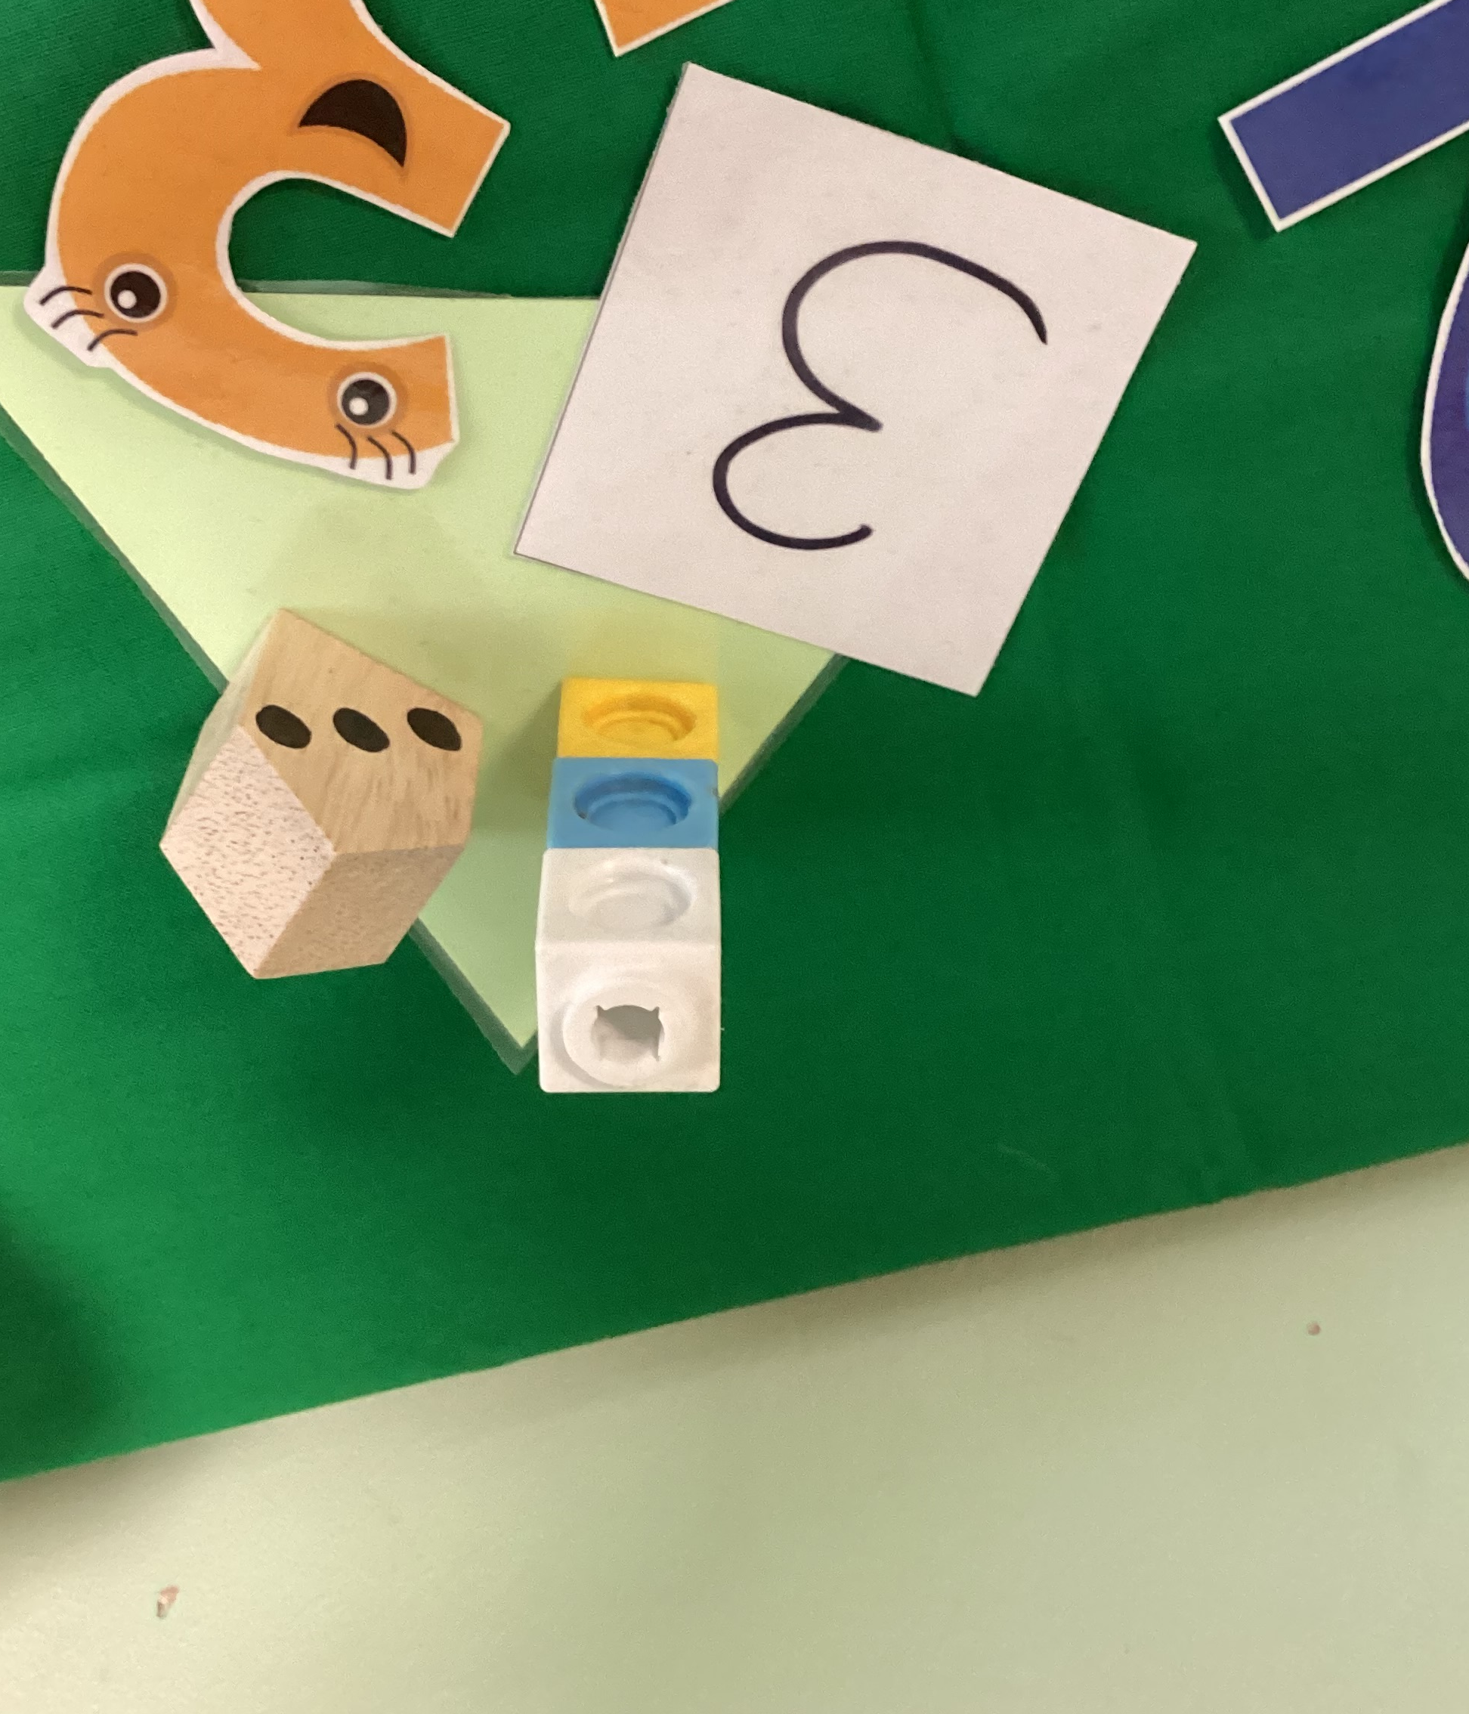
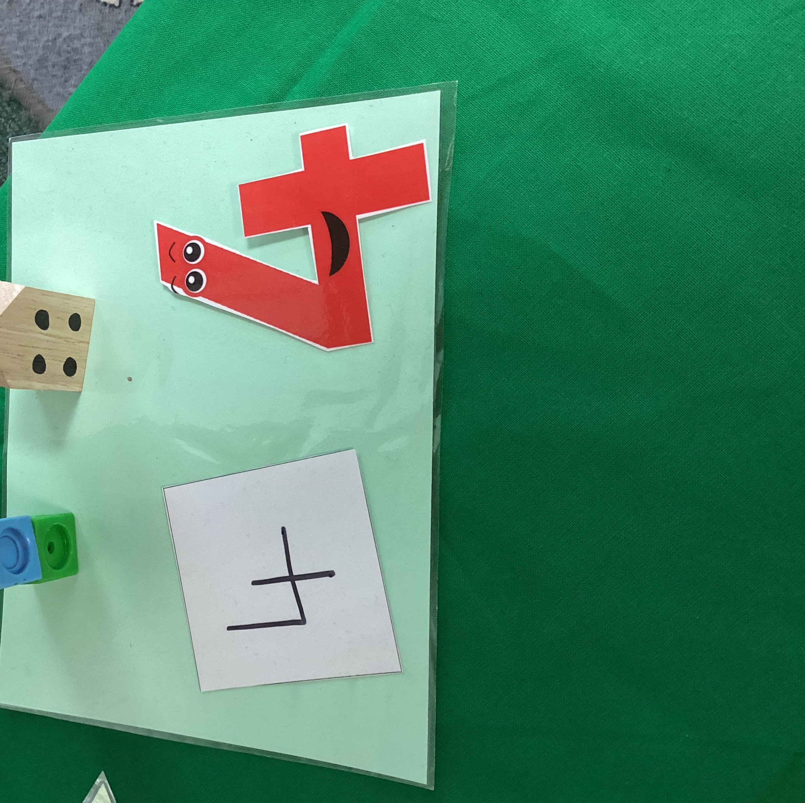
What does it look like?

Slide 7
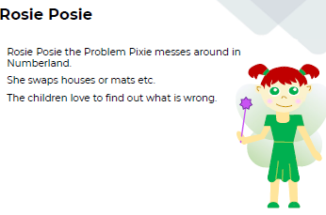
What does this number land show us?
What does this
image tell us about
the number 6?
6 is:
5 and 1 or 1 and 5
4 and 2 or 2 and 4
3 and 3
2 and 2 and 2
double 3
1 and 2 and 1 and 2
3 and 2 and 1

Slide 8
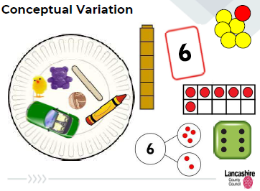
Within each week:
All the children have a go at practical counting using a variety of equipment. This helps to build 1 to 1 correspondence between an object and an amount.
The children see a variety of equipment which allows them to spot numbers and number patterns in many different ways.
We explicitly show the children examples which are correct and not correct to develop their reasoning skills.
Subitising numbers PowerPoint – to revisit the number facts that they have learnt.
The children visit the number land shop.
The children make their own number booklets.

Slide 9
Activities to have a go at:
Building Number land
The Number land Shop
Make your own board game and dice
All these activities should give you an idea of how you can help your children with their number learning at home ☺

