Slide 1
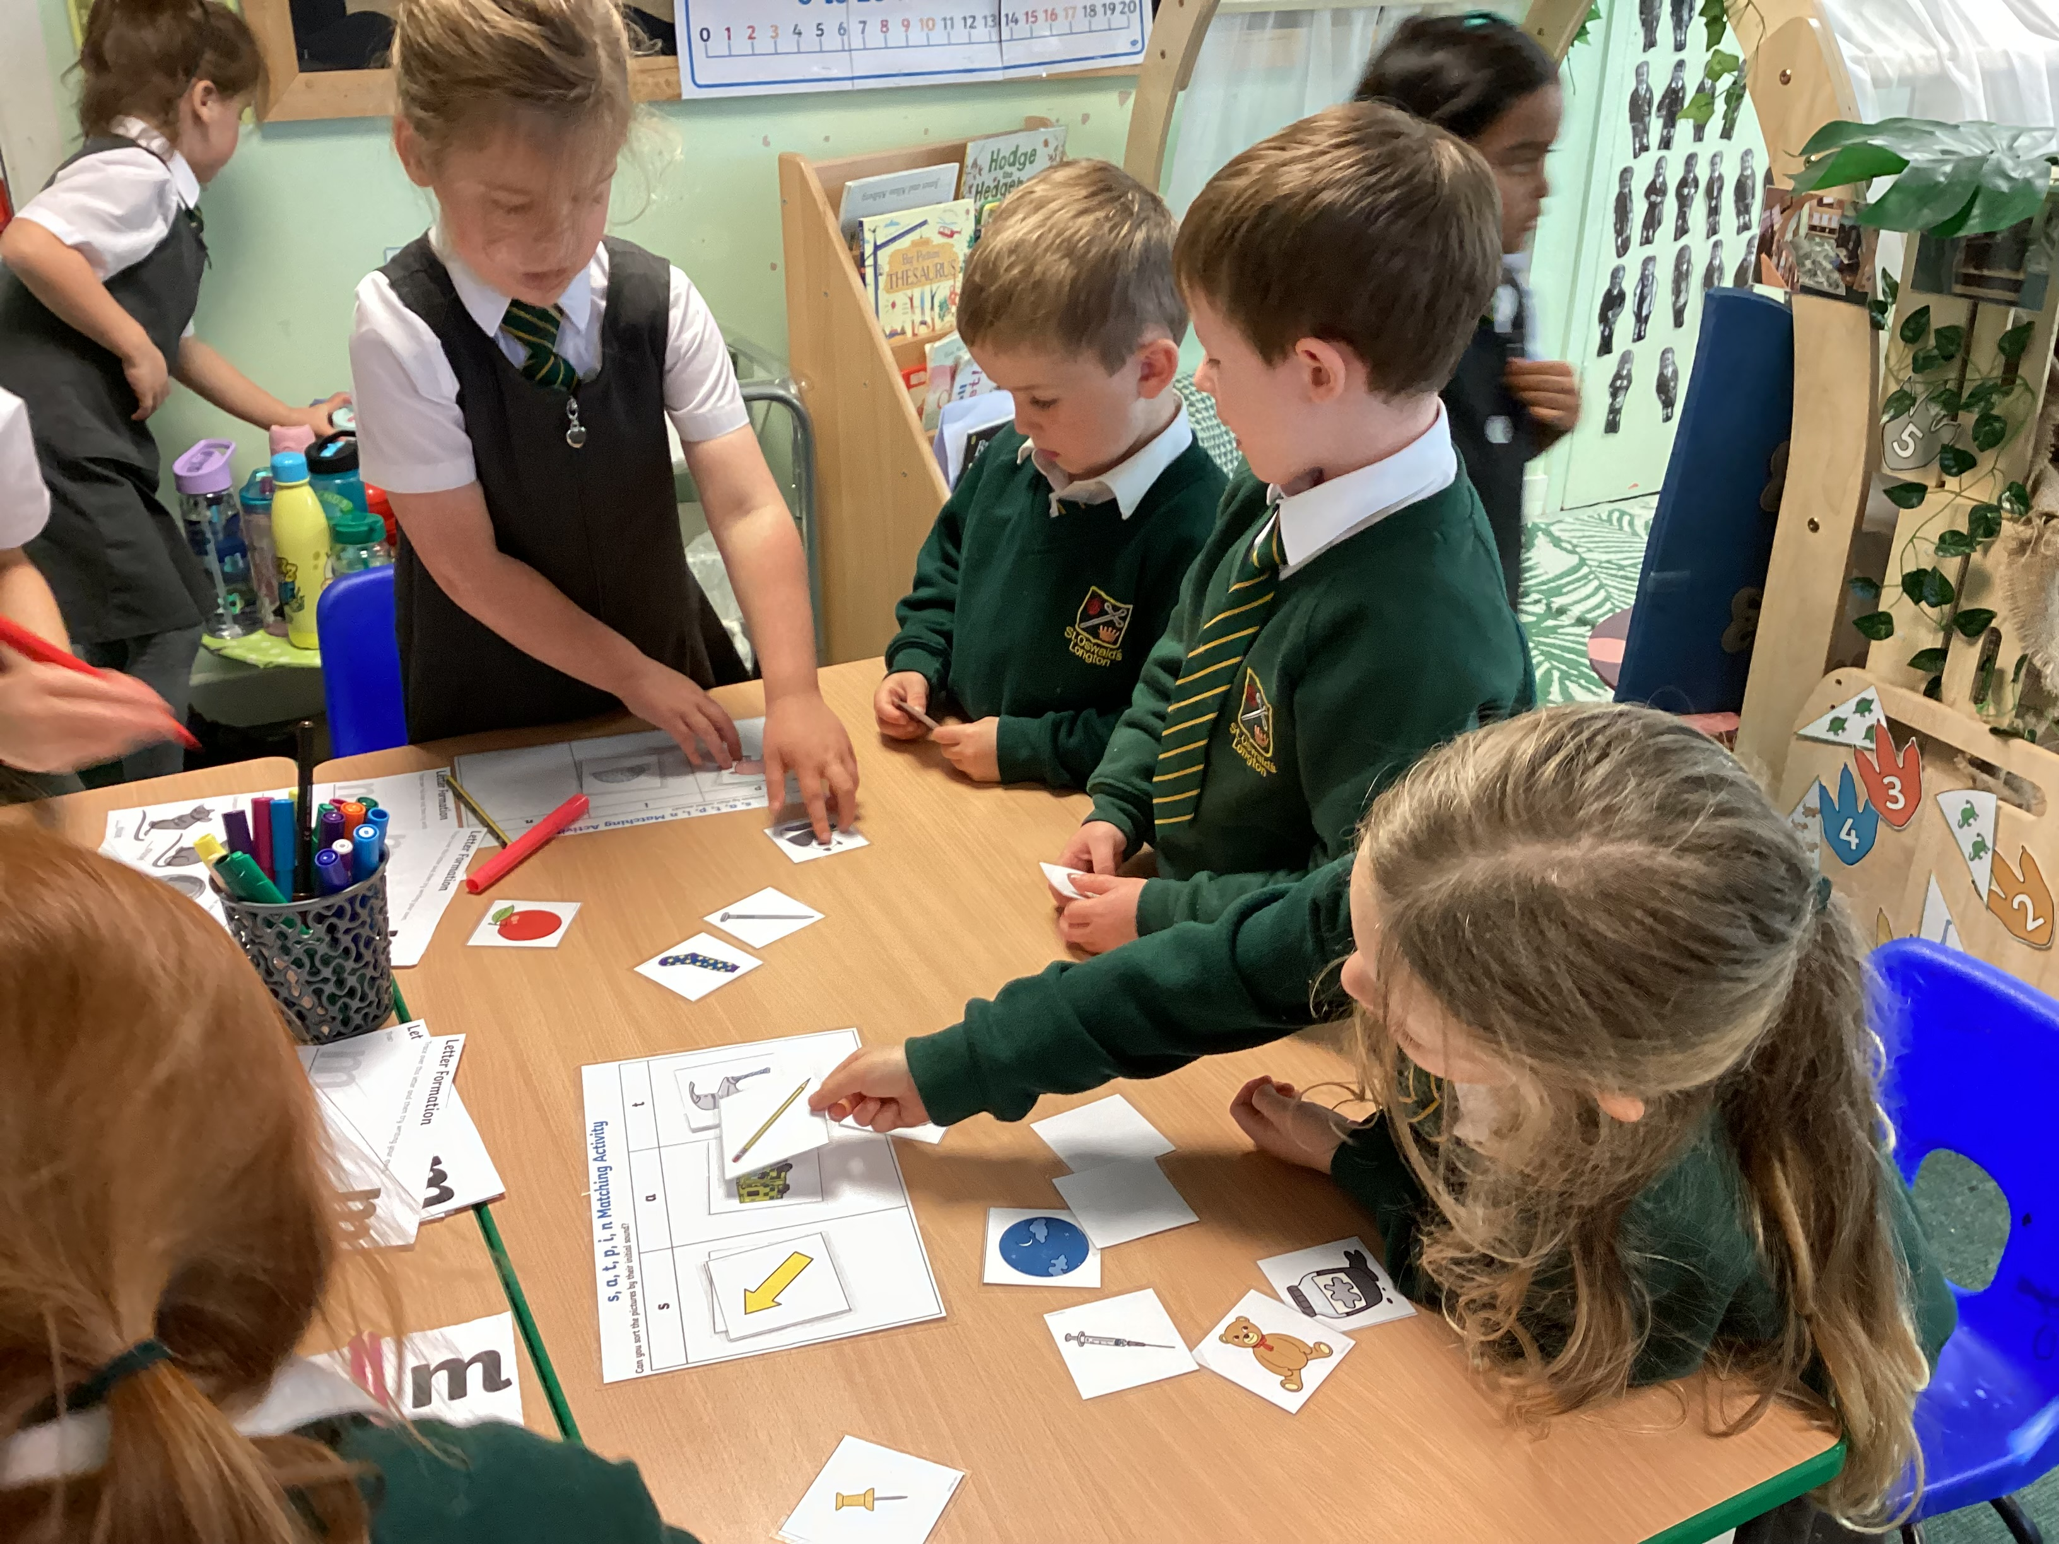
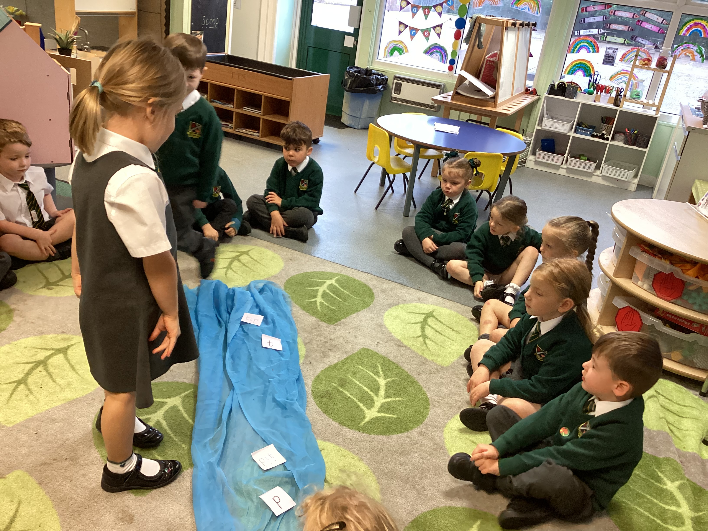
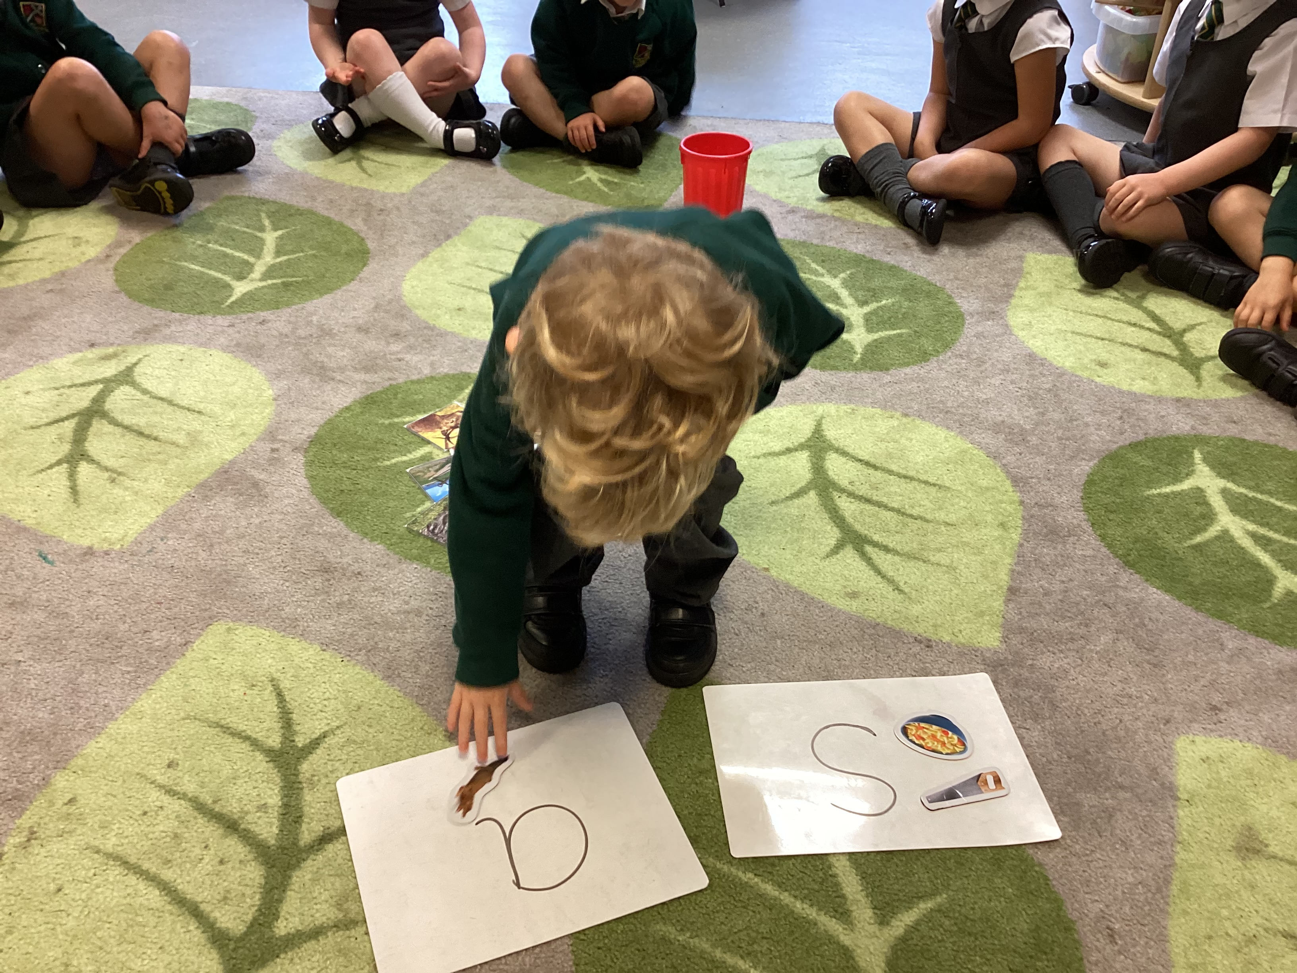
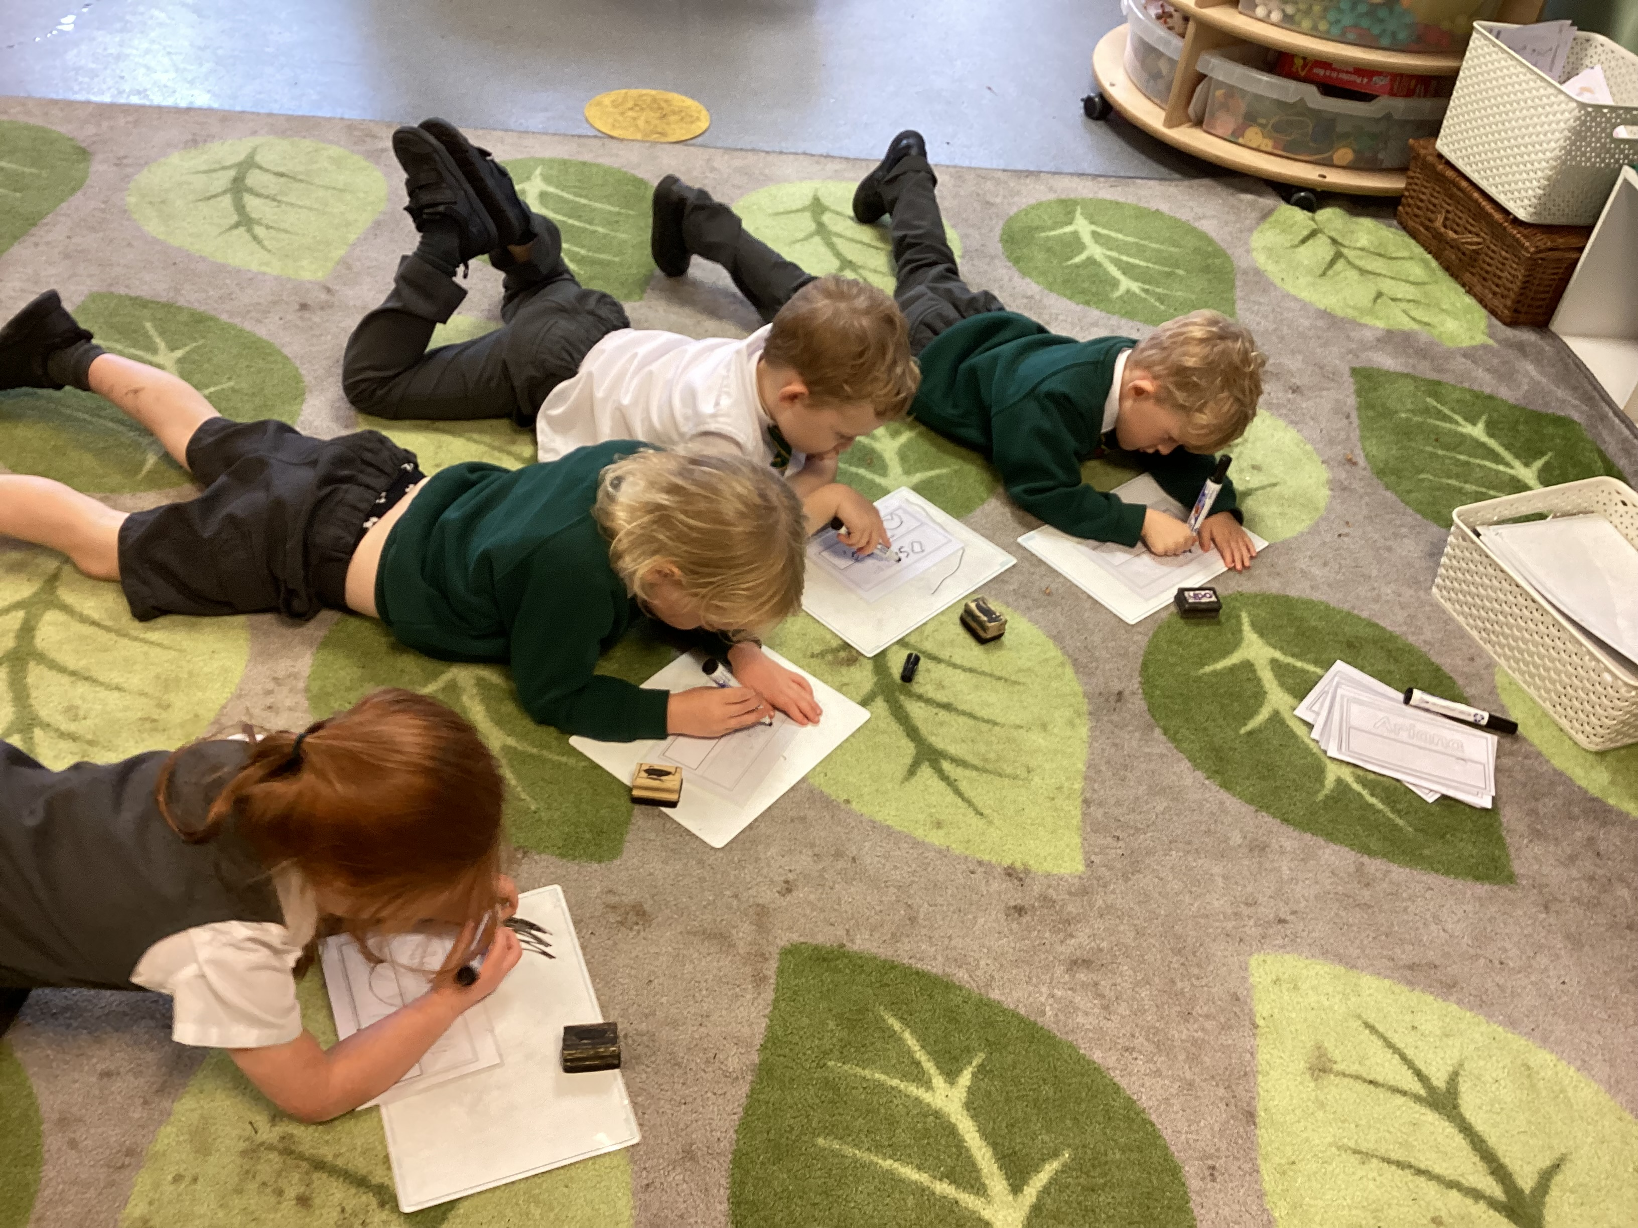

Phonics Workshop
2024

Slide 2
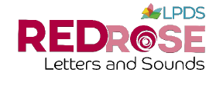
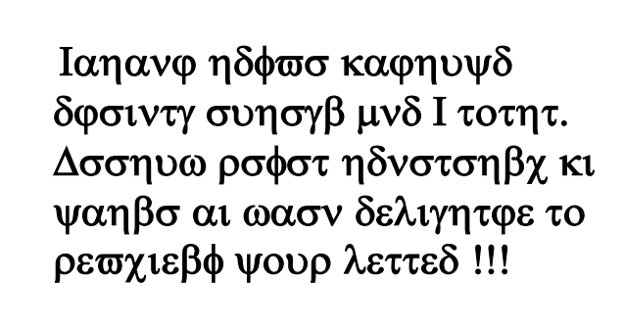
Our English Language
Notes:
Why phonics?
Research shows that when phonics is taught in a structured way-starting with the easiest sounds and progressing to the most complex-it is the most effective way of teaching young children to read. It is particularly helpful for children aged 5 to 7 years old. Almost all children who receive good teaching of phonics will learn the skills that they need to tackle new words. Children can go on to read any kind of text fluently and confidently, and read for enjoyment (Department for Education).

Slide 3
What is phonics?
Phonics is how we teach the children to learn their letters and sounds.
This helps the children learn to read and write.
Phonics is taught in school across Reception and KS1 for at least 20 minutes each day.

Slide 4
Key words
Phoneme – is the sound that the letter makes
Grapheme – is what the actual letter looks like
Blending – putting sounds together to make a word
Segmenting – chopping up the sounds to hear which sounds make the word
Digraph – when two letters together make one sound e.g. sh
Trigraph – when three letters together make one sound e.g igh
Tricky Words – words that you have to learn from sight
CVC – consonant vowel consonant words

Slide 5
How do we teach it?
Revisit – recapping prior learning
Teach – new learning - hear it, say it, write it
Practise – we play a game to practise reading or writing our new learning
Apply – we apply our learning through reading or writing in our groups or the provision
Phonics is taught in small groups, these groups will change throughout the year in order to meet the needs of each individual child.

Slide 6
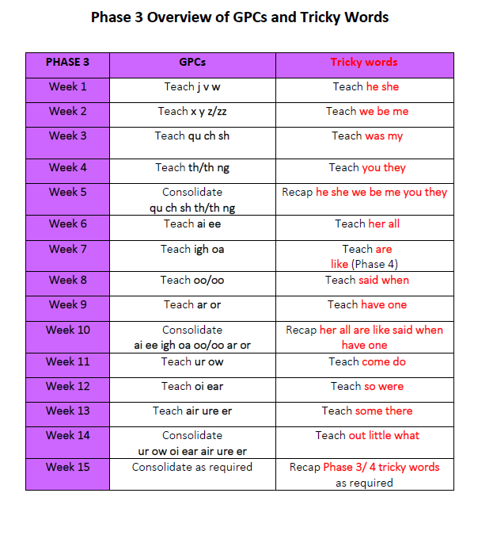
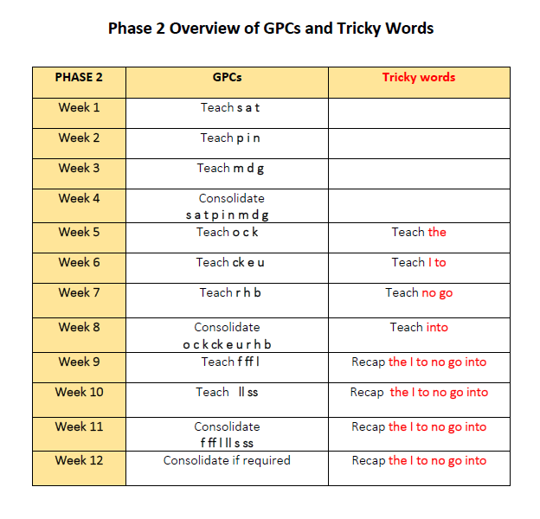
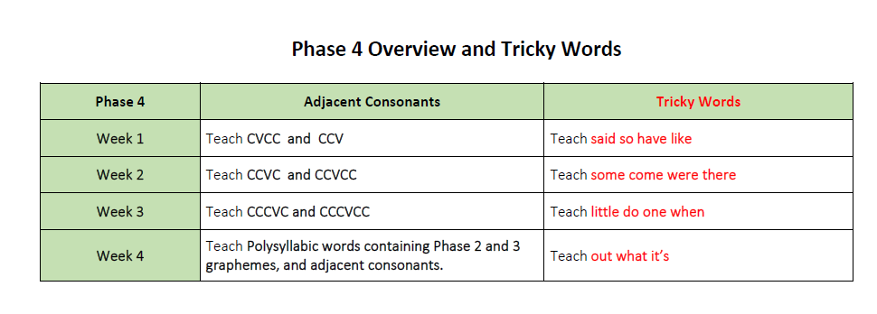
Overview of the year in Reception
Spring
Autumn
Summer
YouTube - Sounds of the English Phonic Code -Synthetic Phonics.wmv - https://www.youtube.com/watch?v=IwJx1NSineE
This link will help you to learn how to pronounce all the sounds correctly.
Jolly Phonics Songs
https://www.youtube.com/watch?v=Nv28ddzc9Oc

Slide 7
Lets have a go…
d

Slide 8




Lets have a go…
d

Slide 9
Blending
dog

Slide 10
Segmenting

Slide 11
Tricky Word
the

Slide 12
Games to practise
Spin to the bottle
Musical bumps/statues
Corners
Popcorn Pop

Slide 13
Apply into a sentence
The dog is hot.
Superhero
Head teacher ringing
Silly Voices
Find the words to make the sentences

