Slide 1
You can choose the world you want
FAIRTRADE FORTNIGHT
22 FEBRUARY – 8 MARCH 2021

Slide 2
Many of our choices will have an effect on other people.
Sometimes they will have a big effect.

Slide 3
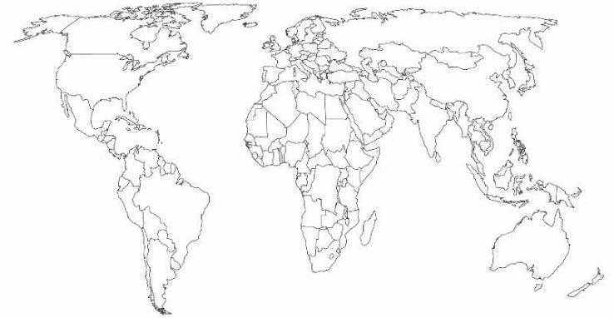
Where does it come from?
We are here!
Tropic of Cancer
Panama
Tropic of Capricorn
Kenya
Côte d'Ivoire

Slide 4
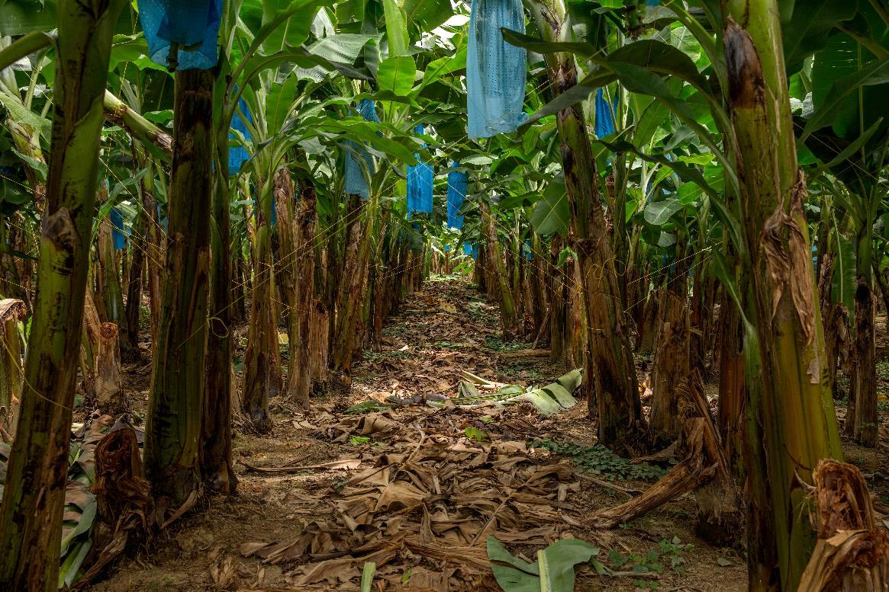
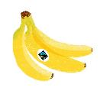
Where does it come from?

Slide 5
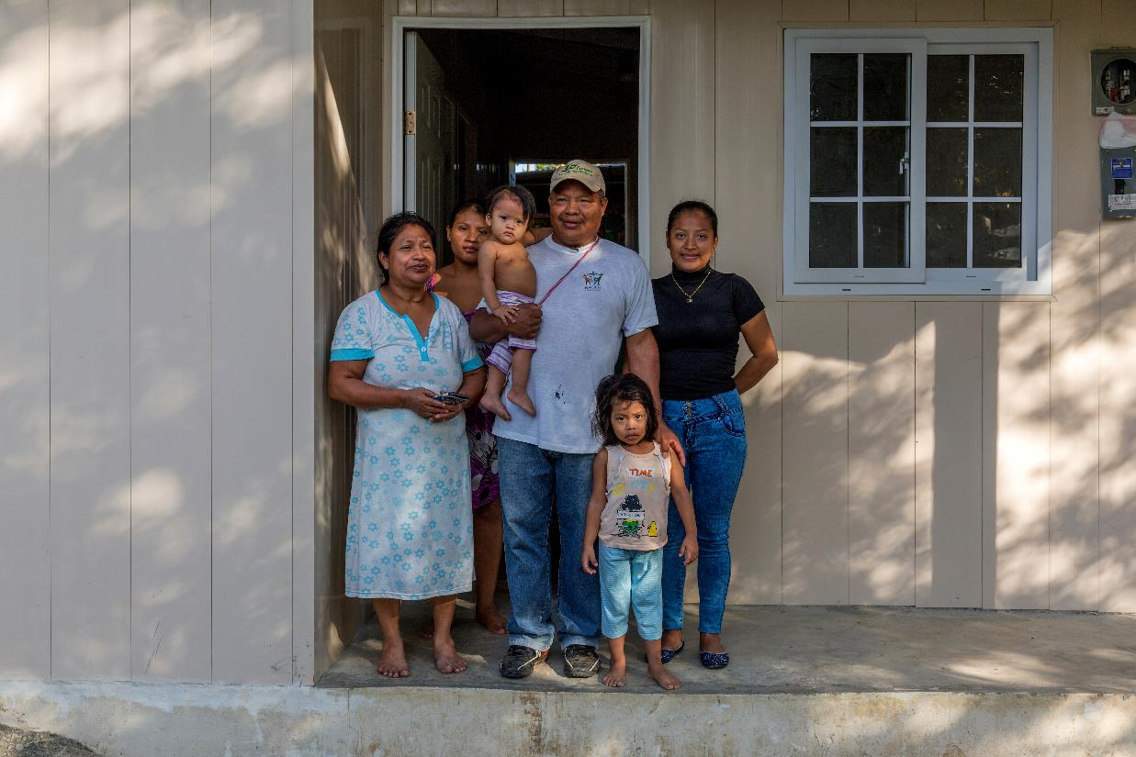
Where does it come from?
Notes:
I think the title of this needs to be more about incomes – maybe something like 'the reality of farmer poverty' or similar.. I like the layout here.

Slide 6
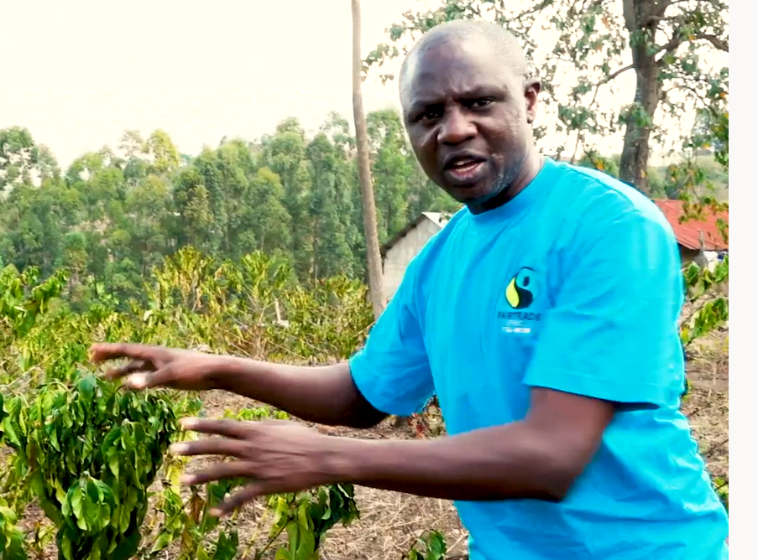

Where does it come from?

Slide 7
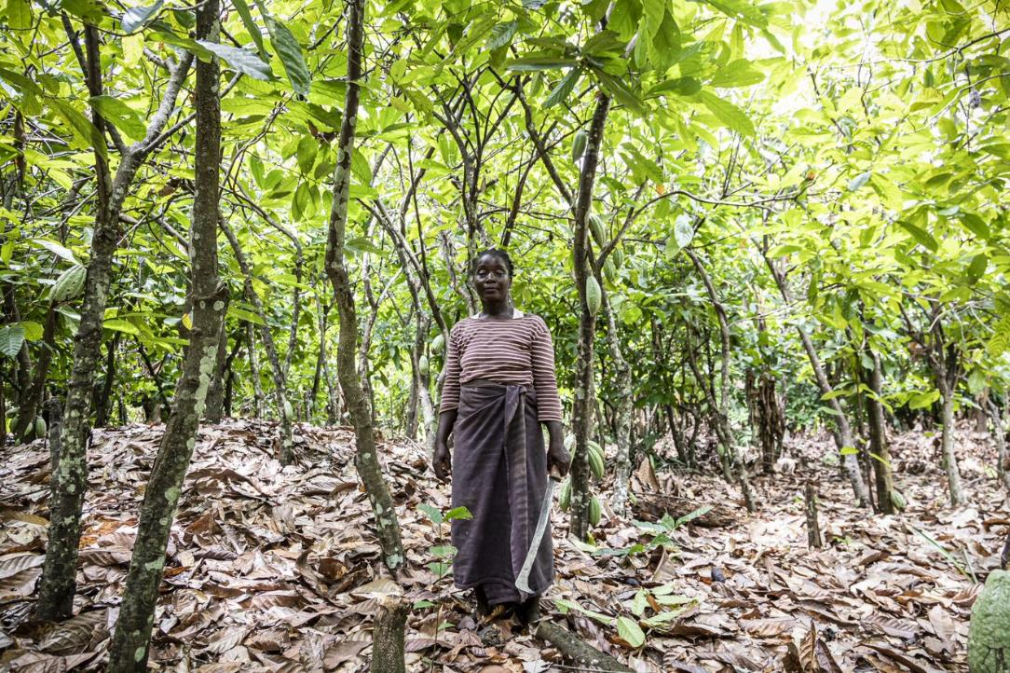

Where does it come from?

Slide 8
Your choices make a difference

Slide 9
CHOOSE THE WORLD YOU WANT
This Fairtrade Fortnight our school is sharing our vision
Learning about Fairtrade
Sharing our vision of the world we want for farmers and workers
Joining the Choose the World you want festival
Watching Change the world through your choices

