Slide 1
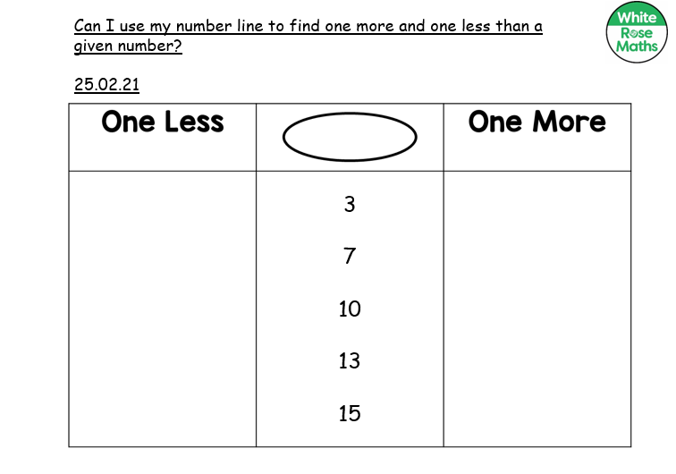

Slide 2
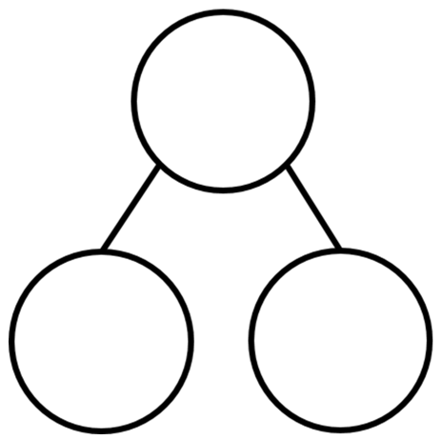
Can I find different ways to make the given numbers? 25.02.21
4
6
6
4
6

