Slide 1
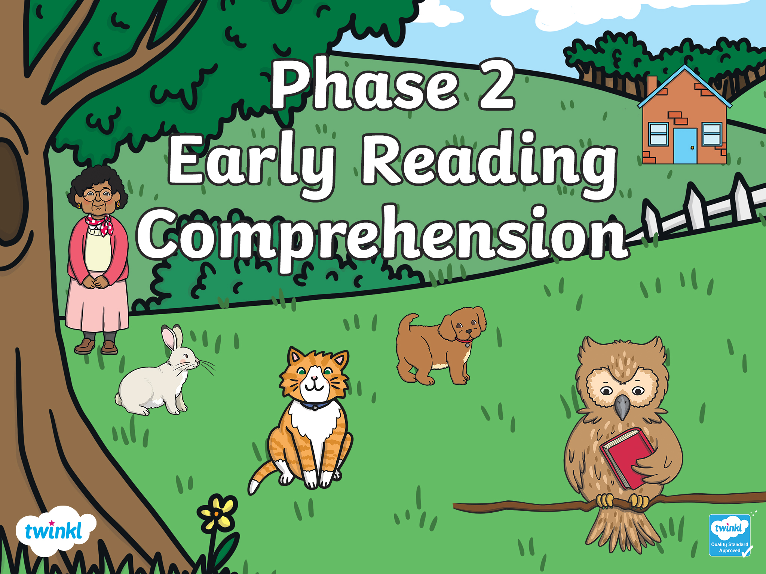

Slide 2
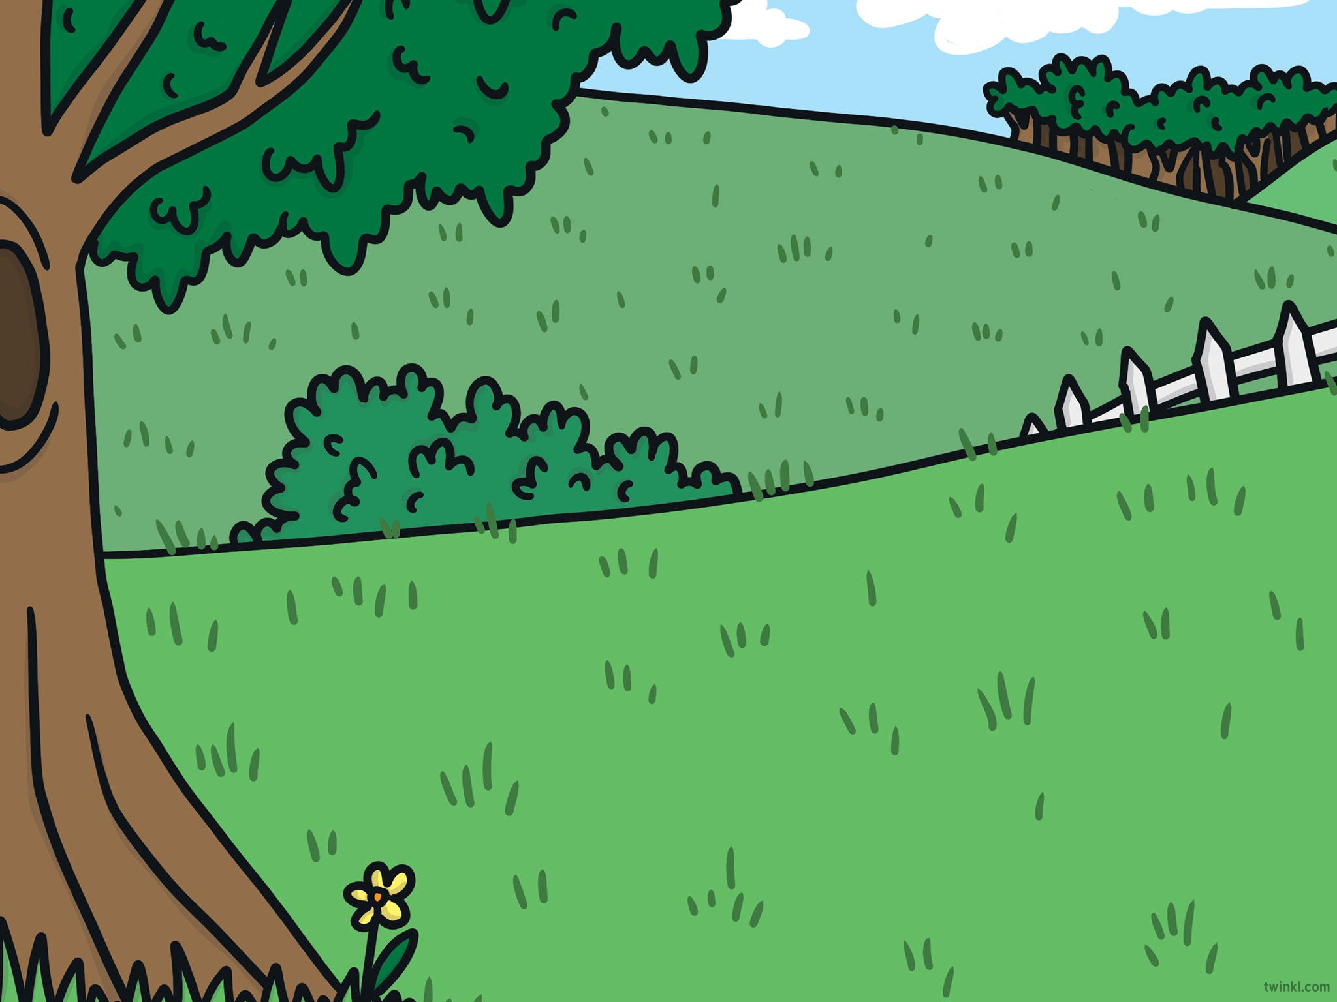
Can you read the sentences and choose the matching picture?
Which option would you like?
Read the sentence. Then,
click on the matching picture.
with sound buttons
without sound buttons

Slide 3
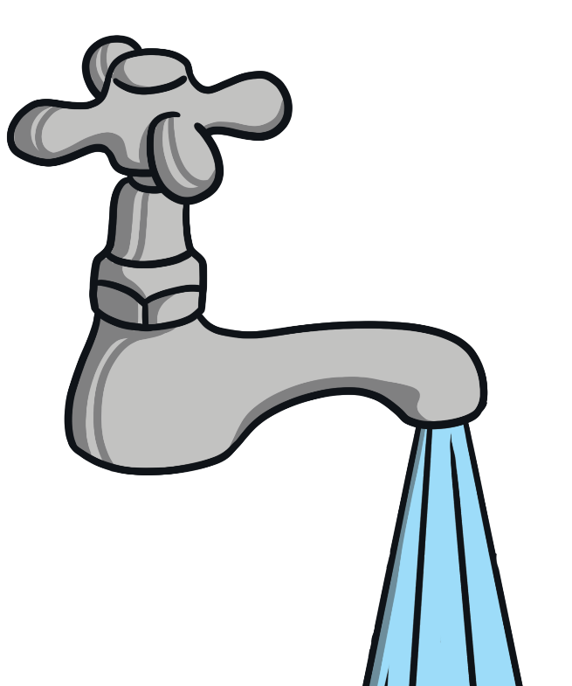

The tap is on.

Slide 4
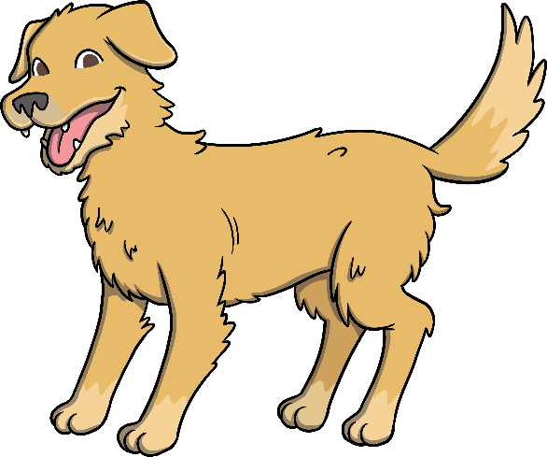

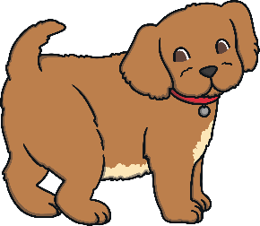
The dog has a pup.

Slide 5

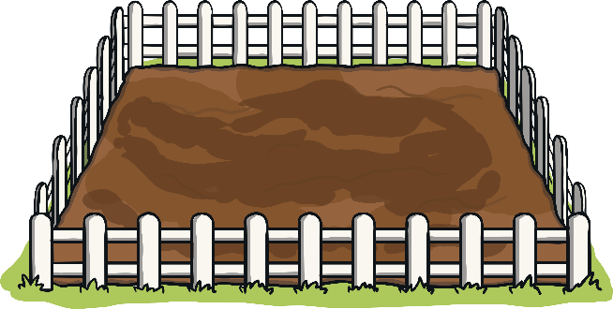
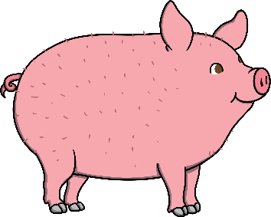

The pig can go in the pen.

Slide 6
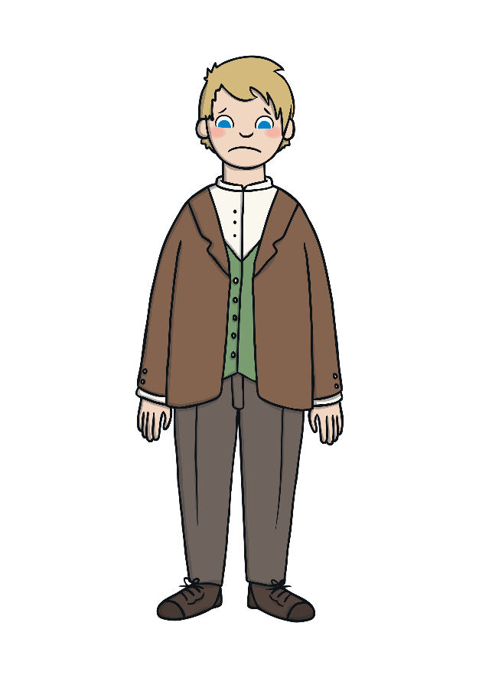
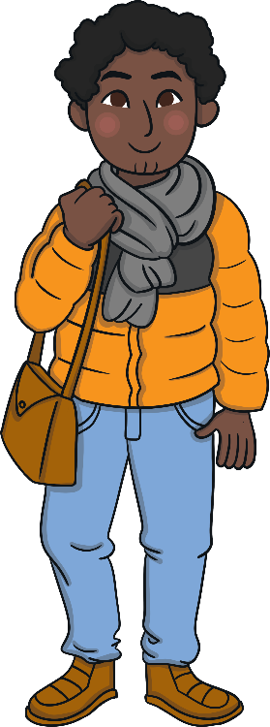
The man is sad.

Slide 7
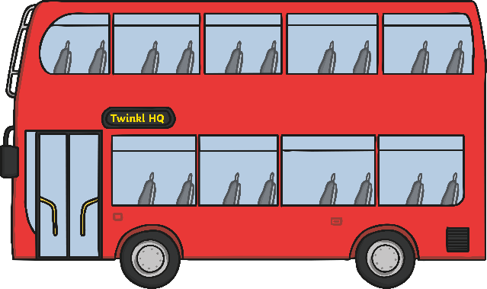
Nan is on the bus.

Slide 8
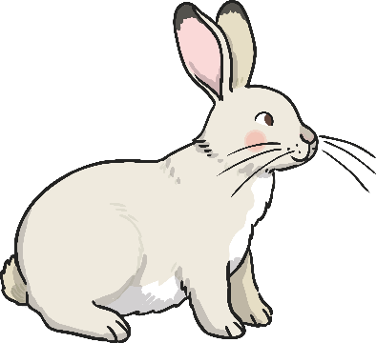


The rabbit is on the hill.

Slide 9

The cat has a big bell.

