Slide 1
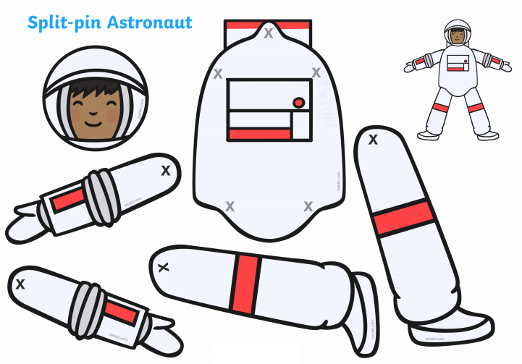
Can I cut out my astronaut and label him?
spacesuit
backpack
helmet
gloves
boots

