Slide 1
Craters
The next slide shows pictures of craters on the moon and of craters on Mars. The photos of Mars are the ones taken by Perseverance Rover.
Have a look at the pictures.
Either think about or talk about:
How do you think the craters were formed?
What is the same about the craters on the moon and on Mars?
What is different about the craters on the moon and on Mars?

Slide 2
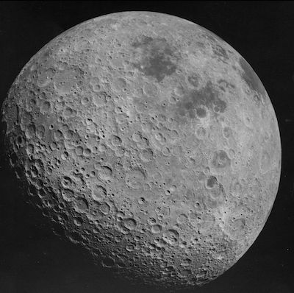
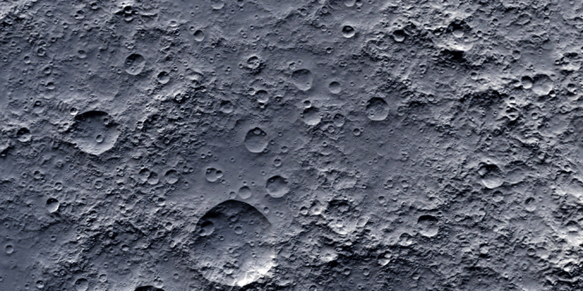
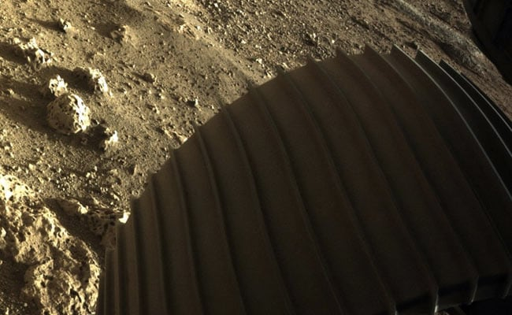
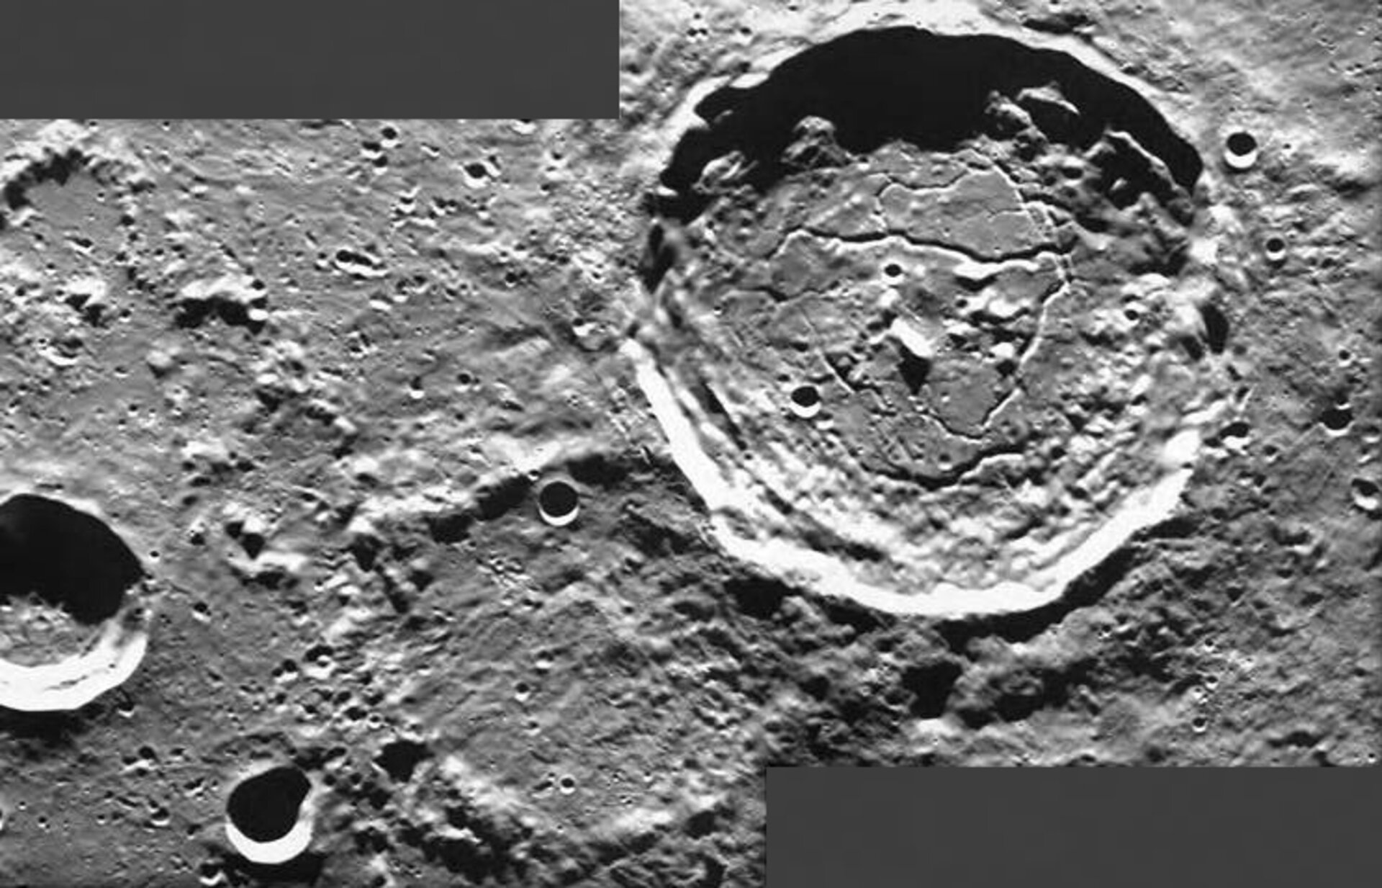
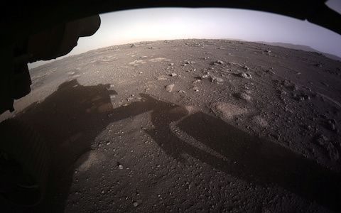
Mars
The moon

Slide 3
Craters are formed by large objects hitting the planets or moons.
You are going to do an investigation to try to answer the following question:
What affects the size of the crater?
You will be investigating whether the size of the crater is affected by:
The size of the object that hits it (meteorite).
The shape of the meteorite.
The distance that the meteorite comes from.
Or the angle that the meteorite hits the moon or planet.

Slide 4
Get a baking tray.
Cover it with around 1cm of flour.
Sprinkle cocoa powder on top.
Drop meteorites onto the baking tray.
Different sizes e.g. marble, tennis ball, etc.
Different shapes but a similar size e.g. stones.
From different heights.
At different angles e.g. tilt your hand sideways before you drop the meteorite.
Think about or talk about what you think affected the size of the crater the most.

Slide 5
Write the long date and title in your book:
Tuesday 23rd February 2021
Can I investigate what affects the size of a crater?
Either stick a photo or draw a picture of your craters in your book.
Copy and complete these sentences.
I have created a model of the surface of Mars, I did it by …
I think it worked well because…
I could make it more realistic by …
I think craters are biggest when the meteorite …

Slide 6
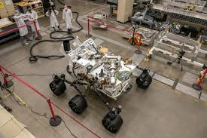
You have acted like a true scientist today.
Scientists have to model things on earth just like you have done today. The Perseverance Rover was tested on a fake surface of Mars before it was sent to Mars to see if it could do its job.

Slide 7
Optional extra:
Take lots of photos of your craters in black and white.
Draw round something circle on some paper.
Print your photos off and create a collage on the circle.
It should hopefully look like the surface of the moon or Mars.
Don’t worry if you don’t have a printer, you could always draw what your craters look like.

