Slide 1
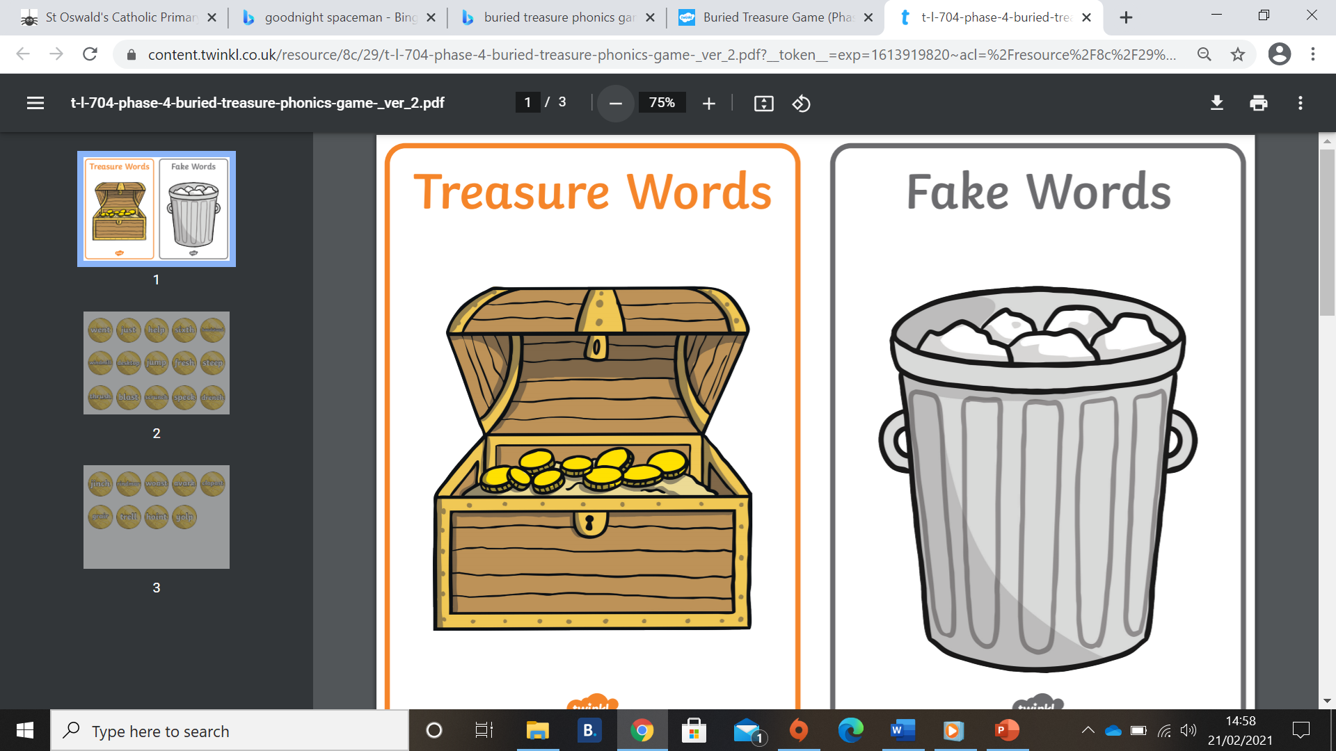
Can I read and sort the ‘ar’ words into real and silly words?

Slide 2
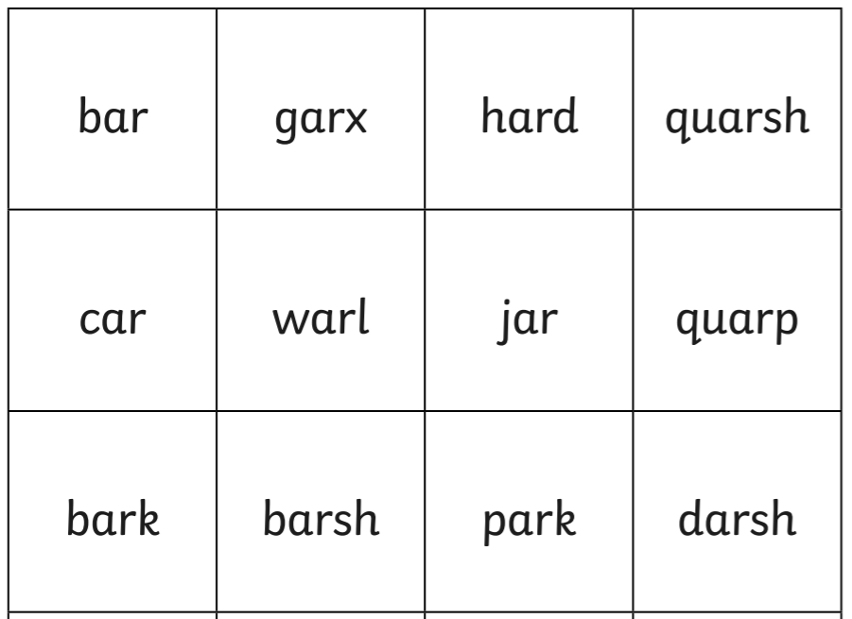

Slide 3
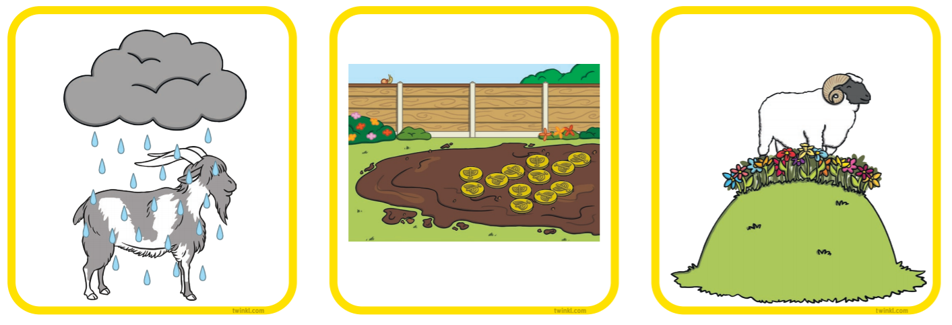
Can I write a sentence for one of these pictures?

