Slide 1
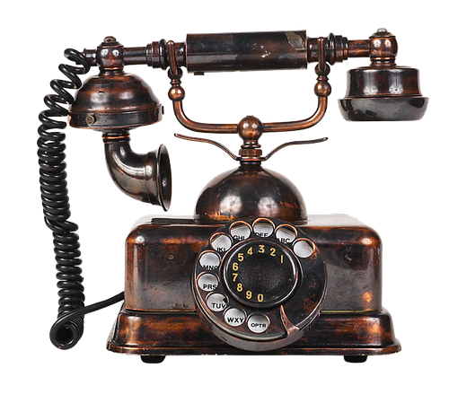
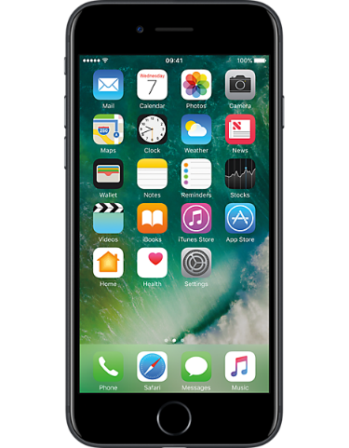
Instructions & Explanations
Changing Technology
Unit 3
Y5: Autumn Term

Slide 2
Parenthesis
This is when you add extra information to a sentence.
The extra information could be a word, phrase or clause.
The sentence would still make sense without it.
You can set up your own profile on twitter, similar to Facebook.
Tweets (up to 280 characters long) can be seen by anyone following you.
Join in conversations - via tweets - about your interests or chat with friends.
Try saying the sentences with and without the parenthesis. The meaning does not change.
We separate this extra information using commas, brackets or dashes.

Slide 3
Parenthesis – Punctuated by Brackets
Brackets are good for clarifying.
They can be used in non-fiction for adding technical details.
They stand out more than commas but are more formal than dashes.
Brackets always work in pairs
An iPad is operated by touching the screen (touchscreen).
The are many apps (140,000) available to download and use.
Rival tablet computers (Kindle Fire, Samsung Galaxy Tab, Asus ZenPad, for example) vary hugely in price.
Brackets draw attention to the information inside them.
They are useful for adding extra information in a clear way which stands out.
Some writers think that they are not suitable for formal writing.
They interrupt the flow more than commas.
Notes:
Round brackets are also called ‘parentheses’. It is not necessary for KS2 chn to know this.

Slide 4
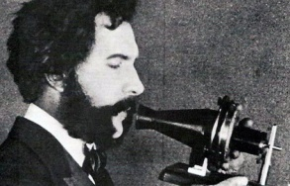
Spotting Parenthesis (Extra Information)
Alexander Graham Bell born in 1847 was an influential scientist, engineer and inventor.
He was given his middle name for his eleventh birthday by his father.
He is widely credited although not by everyone with the invention of the telephone.
In 1876 Bell and an American electrical engineer named Elisha Gray both filed patents with the U.S. Patent Office.
Which parts of each sentence are extra (the meaning would not change if you removed them)?
ANSWERS

Slide 5
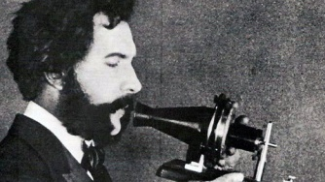
Spotting Parenthesis (Extra Information)
Alexander Graham Bell born in 1847 was an influential scientist, engineer and inventor.
He was given his middle name for his eleventh birthday by his father.
He is widely credited although not by everyone with the invention of the telephone.
In 1876 Bell and an American electrical engineer named Elisha Gray both filed patents with the U.S. Patent Office.
Which parts of each sentence are extra (the meaning would not change if you removed them)?
ANSWERS

Slide 6
Spotting Parenthesis (Extra Information)
Alexander Graham Bell (born in 1847) was an influential scientist, engineer and inventor.
He was given his middle name for his eleventh birthday (by his father).
He is widely credited (although not by everyone) with the invention of the telephone.
(In 1876) Bell and an American electrical engineer named Elisha Gray both filed patents with the U.S. Patent Office.
Which parts of each sentence are extra (the meaning would not change if you removed them)?
Here the parenthesis has been punctuated by brackets. They add extra, clarifying information.
ANSWERS

Slide 7
What do you remember about Parenthesis?
extra information
a word, phrase or clause.
the sentence will make sense without it
marked with commas, brackets or dashes
Snapchat allows users to share images, similar to Instagram.
Facebook has an age restriction (13 years) but this is hard to enforce.
Identifying a number as unwelcome- blocking it -can stop unwelcome calls or texts.

Slide 8
HINT
Parenthesis – How to choose the best punctuation
ANSWERS
The motorised picnic table is popular with families and campers. However there have been issues with motion-sickness.
Technology Review
Brackets draw attention to the information inside them.
They are useful for adding extra information.
The doggie umbrella has changed my life! My little Boris a Yorkshire terrier no longer hates to walk in the rain. Thank you! Comment on shopping site
Commas draw less attention.
They are used in more formal writing.
The squabble shield a transparent barrier which can be placed between passengers was invented to protect drivers from backseat distractions. Safety Manual
Dashes draw attention to the added information.
They are used in informal writing.
How would you punctuate each piece of extra information?
PLENARY

Slide 9
Parenthesis – How to choose the best punctuation
ANSWERS
The motorised picnic table is popular with families and campers. However, there have been issues with motion-sickness.
Technology Review
Brackets draw attention to the information inside them.
They are useful for adding extra information.
The doggie umbrella has changed my life! My little Boris - a Yorkshire terrier - no longer hates to walk in the rain. Thank you! Comment on shopping site
Commas draw less attention.
They are used in more formal writing.
The squabble shield (a transparent barrier which can be placed between passengers) was invented to protect drivers from backseat distractions. Safety Manual
Dashes draw attention to the added information.
They are used in informal writing.
How would you punctuate each piece of extra information?
PLENARY

