Slide 1

Starter Activity
How do we measure time?
What helps us to measure time?
Think about the smallest and largest units of measure we use…
Mind map or list all the different ways we measure time and the tools that we use.

Slide 2
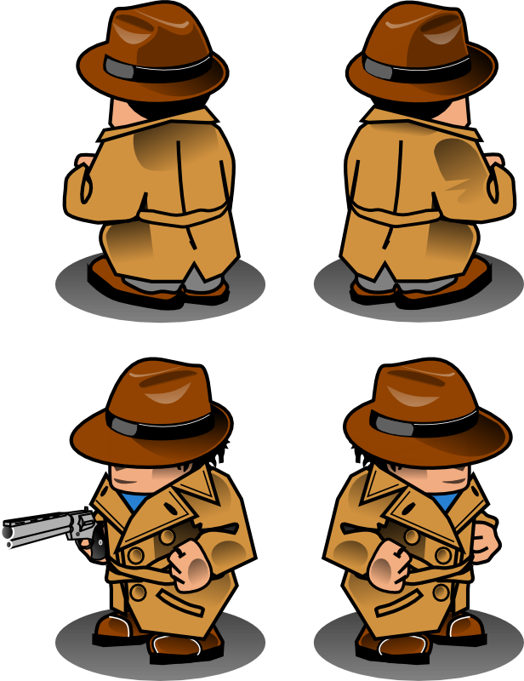
My name is Agent Chronology. I am the leader of the Time Detectives. We need more new recruits for our detective agency. Are you ready for a challenge?

Slide 3
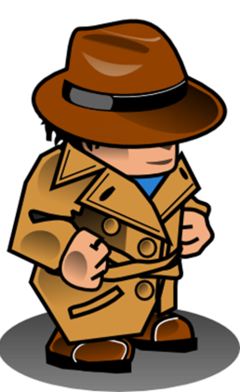
In this lesson you will be learning how the Mayans understood and measured time.
In doing so you will also understand more about their:
Beliefs
Achievements
Technology and
How different they were to us

Slide 4
Learning Objective
To understand the Mayan Calendar and the way that the Mayans thought about time.
You will also be researching effectively, taking notes and producing writing explaining your findings.

Slide 5
Mission Details
Use your detective skills to research the Mayan Calendar.
Use the internet, books and any other sources you have.
Mind map or take notes on your findings.
Create amazing writing.

Slide 6
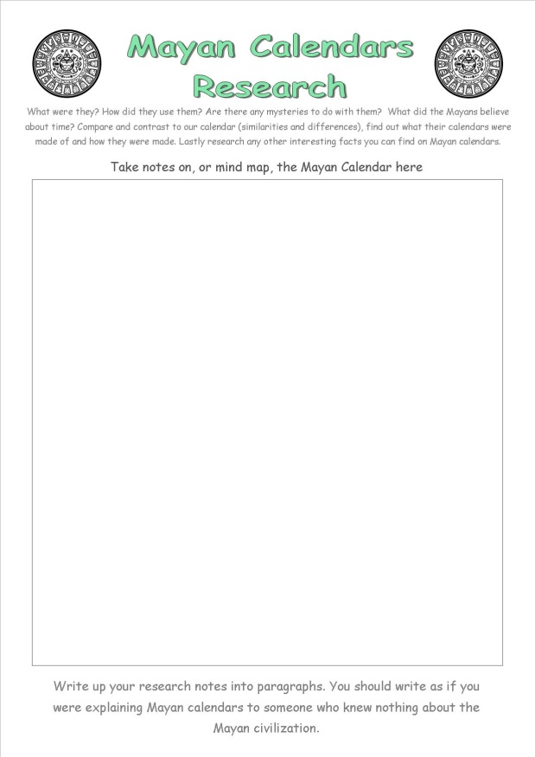
You will be given this sheet.
This part tells you WHAT to research. READ it carefully!
Take LOTS of notes here.

Slide 7
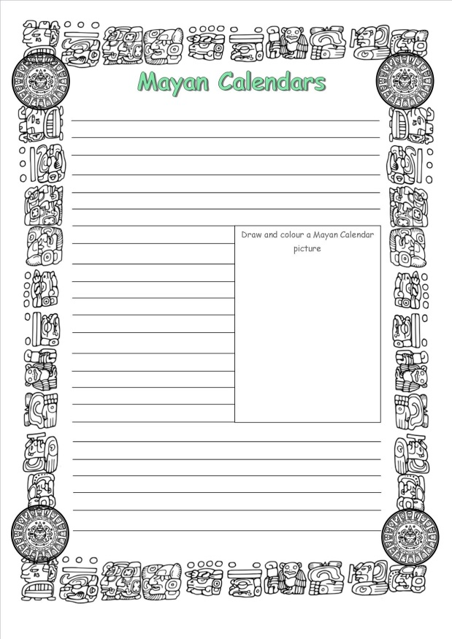
Afterwards you will write your notes up in neat. So make sure you are thorough.
This is the sheet. There is space for a picture. You have all been great in writing reports so simply do the same.

