Slide 1

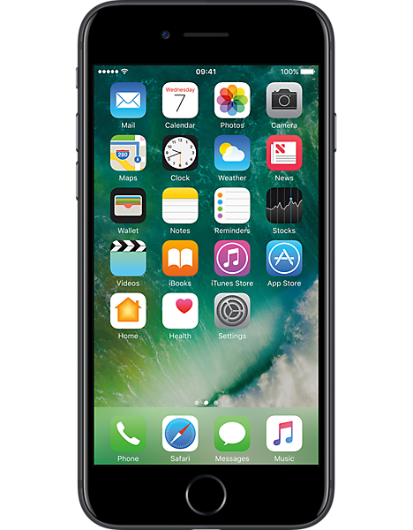
Instructions & Explanations
Changing Technology
Unit 1
Y5: Autumn Term

Slide 2
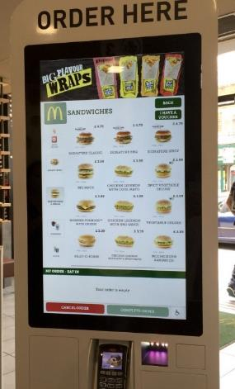
How to use a Self-service Kiosk
First, select from these two options: ‘eat in’ or ‘takeaway’. Make your choices by touching the screen.
Next, make your food and drink selections, again by tapping the screen images and swiping to move the screen up or down.
Now, you will be offered an opportunity to customise your meal. This may include removing certain ingredients (gherkins, for example) or making the portions bigger. Tap to choose.
Finally, check your order is correct on the ‘confirmation screen’ and pay. This must be done by card. Afterwards, you will receive a receipt with an order number.
Can you spot the imperative verbs?
Can you spot the time adverbs?
ANSWERS

Slide 3
How to use a Self-service Kiosk
First, select from these two options: ‘eat in’ or ‘takeaway’. Make your choices by touching the screen.
Next, make your food and drink selections, again by tapping the screen images and swiping to move the screen up or down.
Now, you will be offered an opportunity to customise your meal. This may include removing certain ingredients (gherkins, for example) or making the portions bigger. Tap to choose.
Finally, check your order is correct on the ‘confirmation screen’ and pay. This must be done by card. Afterwards, you will receive a receipt with an order number.
Can you spot the imperative verbs?
Can you spot the time adverbs?
ANSWERS

Slide 4
Adverbs link ideas in a paragraph
Adverbs link sentences – they do not join them.
Adverbs explain how words relate to each other.
They can give meaning to the links, to do with…
Time/Order
then
soon
yesterday
now
first
next
finally
Lists/Adding
firstly
secondly
furthermore
also
finally
Causes
therefore
consequently
as a result
thus
Contrasts
however
meanwhile
nevertheless
instead
Manner
fast
surprisingly
luckily
eventually

Slide 5
Adverbs link ideas in a paragraph
Time/Order
then
soon
yesterday
now
first
next
finally
Lists/Adding
firstly
secondly
furthermore
also
finally
Causes
therefore
thus
consequently
as a result
Contrasts
however
meanwhile
nevertheless
instead
Adverbs link sentences – they do not join them.
First, deal five cards to each player.
Manner
fast
surprisingly
luckily
eventually
Secondly, place the pile face down.
Now, take turns to choose a card from the pile.
Finally, count the cards to see who has won.
These adverbs help to show the order of the instructions.
They link them as a series of steps to follow.
When opening with an adverb, punctuate with a comma.
Which types of adverbs will be most useful in instruction writing?

Slide 6
Punctuating Adverbs
Adverbs for cohesion mostly appear at the beginning or end of a sentence.
Firstly, place your hand on the handrail.
Then, stand with your feet together on the step.
Furthermore, keep feet away from the edge.
Serious accidents are preventable quite often.
Therefore, wear comfortable shoes.
Flipflops, however, are not recommended
When opening with an adverb, punctuate with a comma.
Adverbs placed at the end do not usually need a comma.
An adverb in the middle is separated by a pair of commas.

