Slide 1


Slide 2

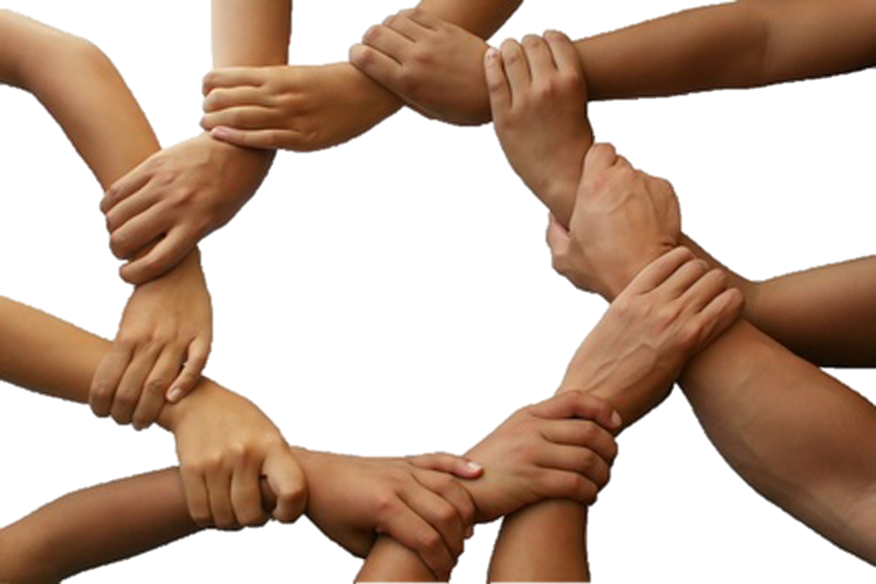
Keep them safe by the power of your name, the name you gave me, so that they may be one just as you and I are one.
Father! May they be in us, just as you are in me and I am in you.
I pray not only for them, but also for those who believe in me because of their message. I pray that they may all be one.
May they be one, so that the world will believe that you sent me

Slide 3
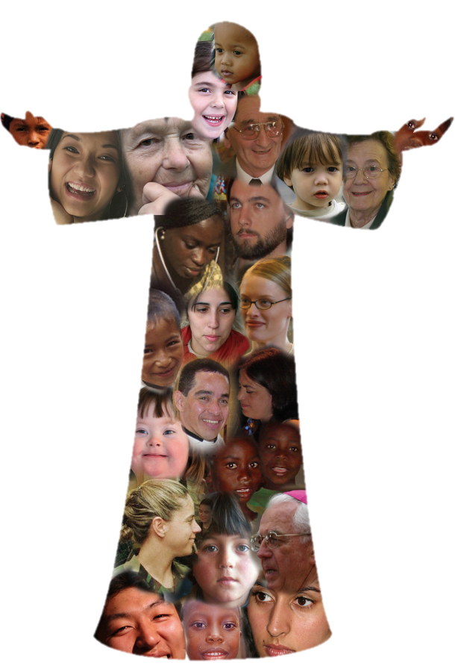
I gave them the same glory you gave me, so that they may be one, just as you and I are one I in them and you in me, so that they may be completely one, in order that the world may know that you sent me and that you love them as you love me.
Based on John 17: 11, 20-23
(Come and See)

Slide 4


