Slide 1
Wednesday Text
How to Train Your Dragon
Chapter 11 – to page 147.

Slide 2
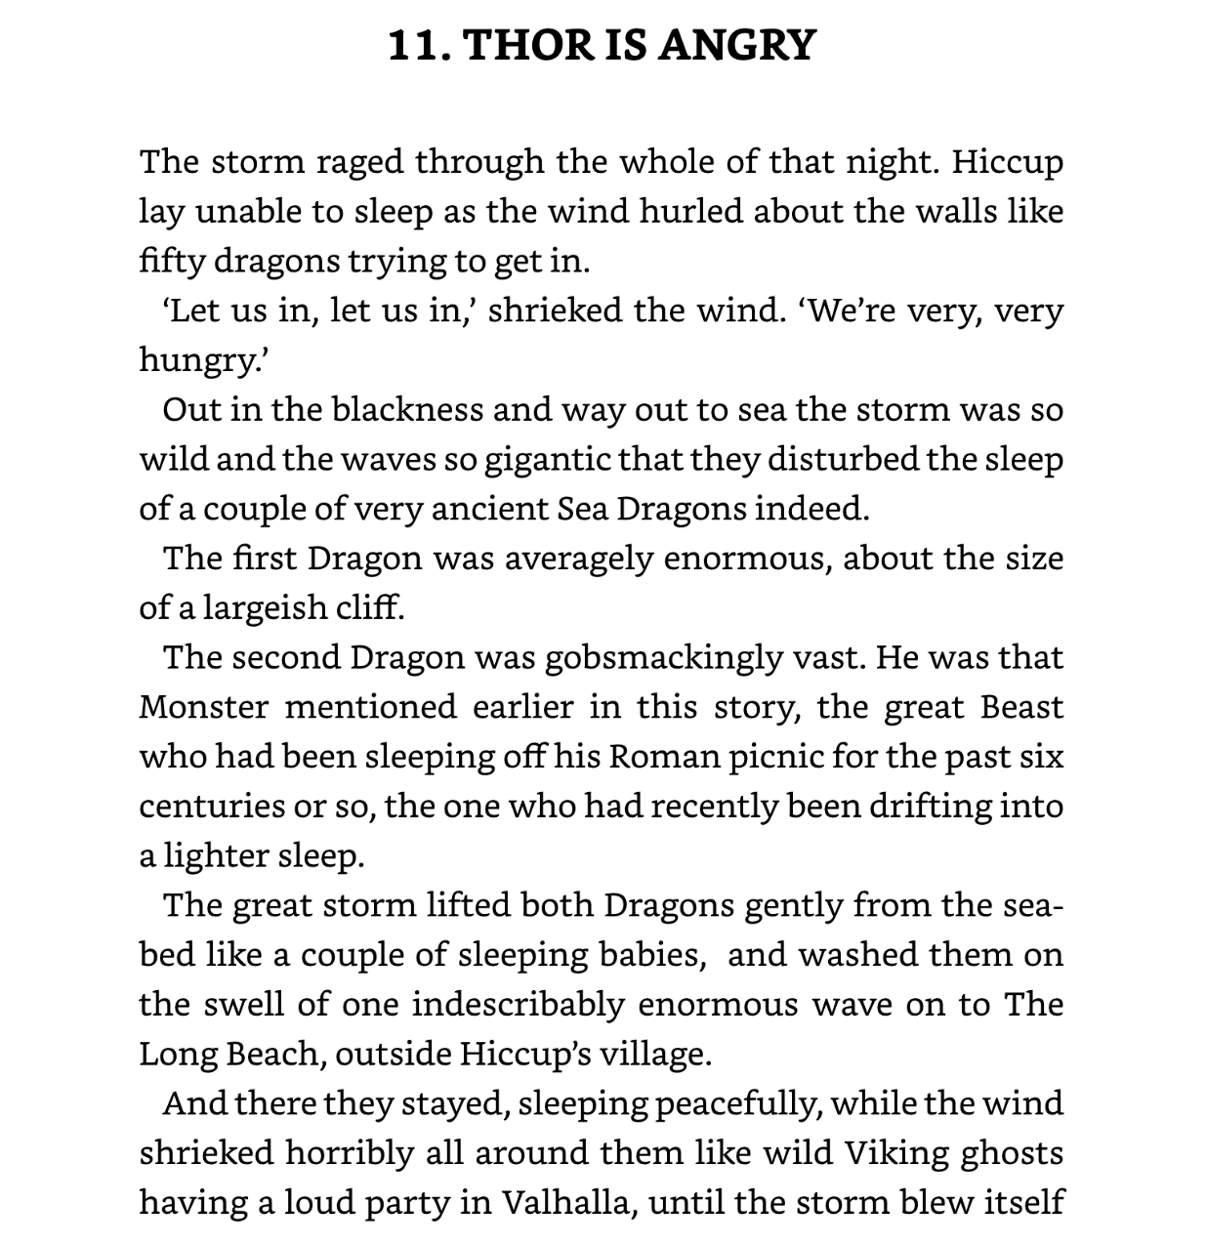

Slide 3
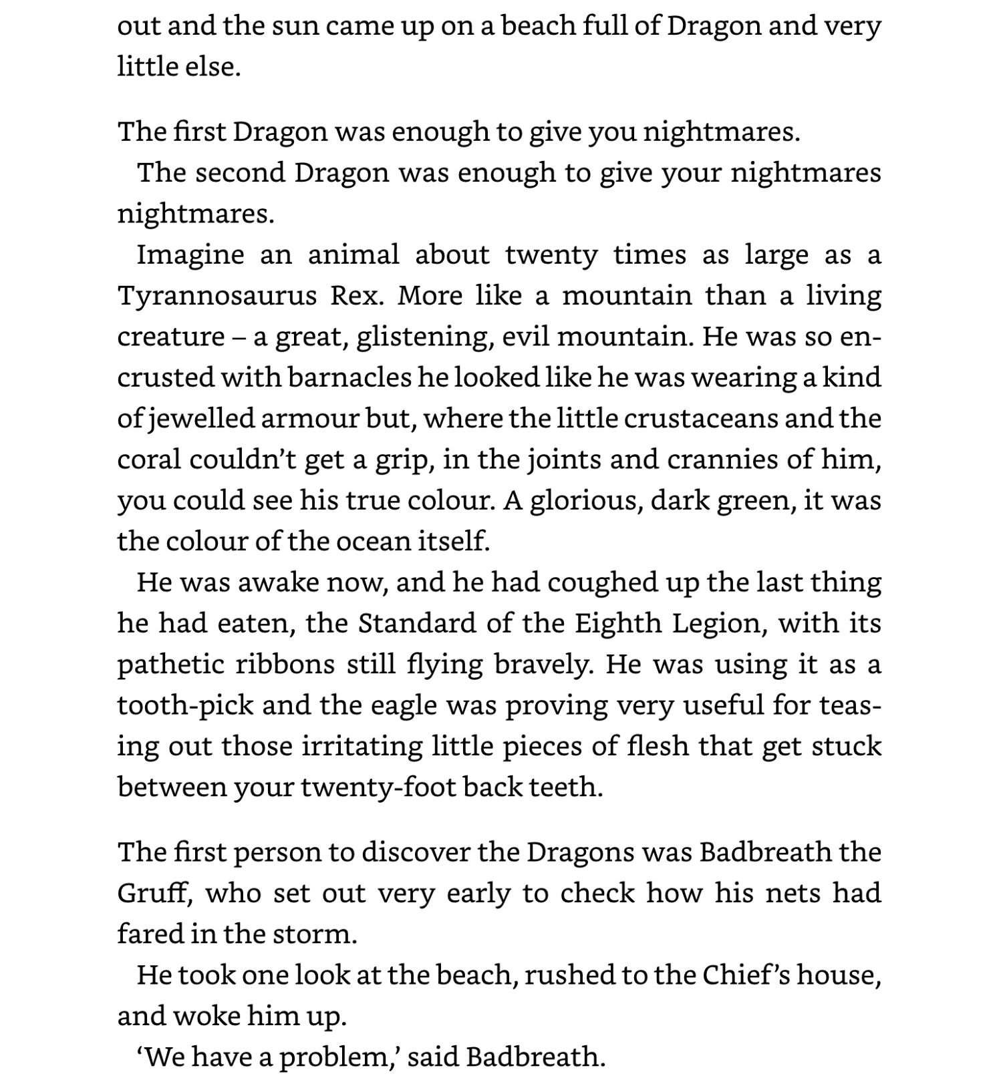

Slide 4
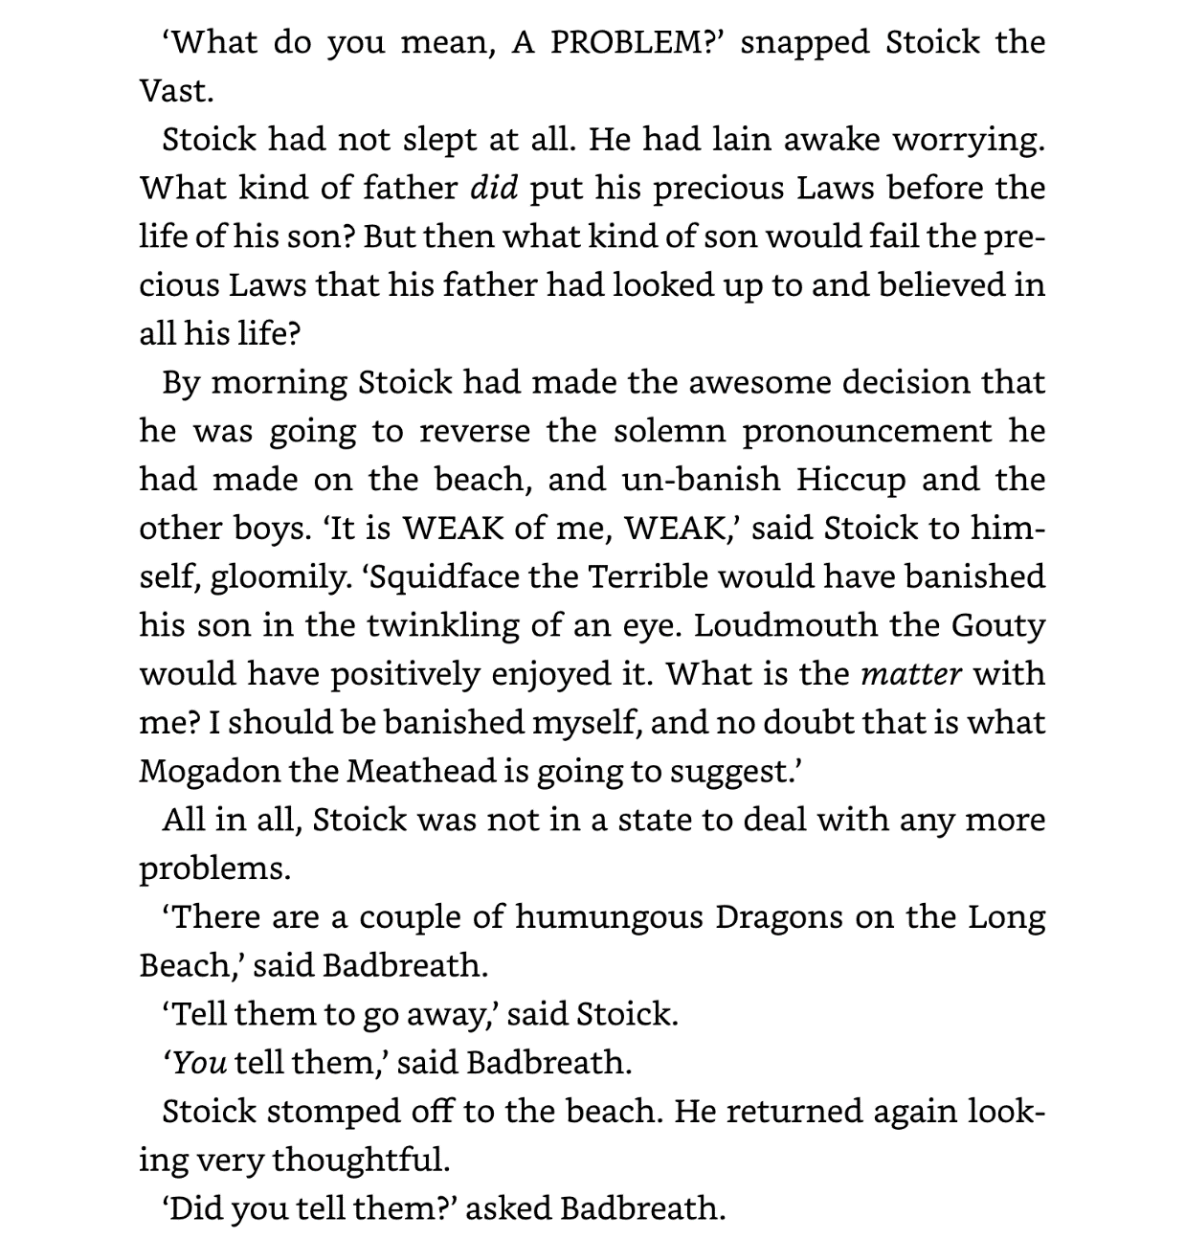

Slide 5
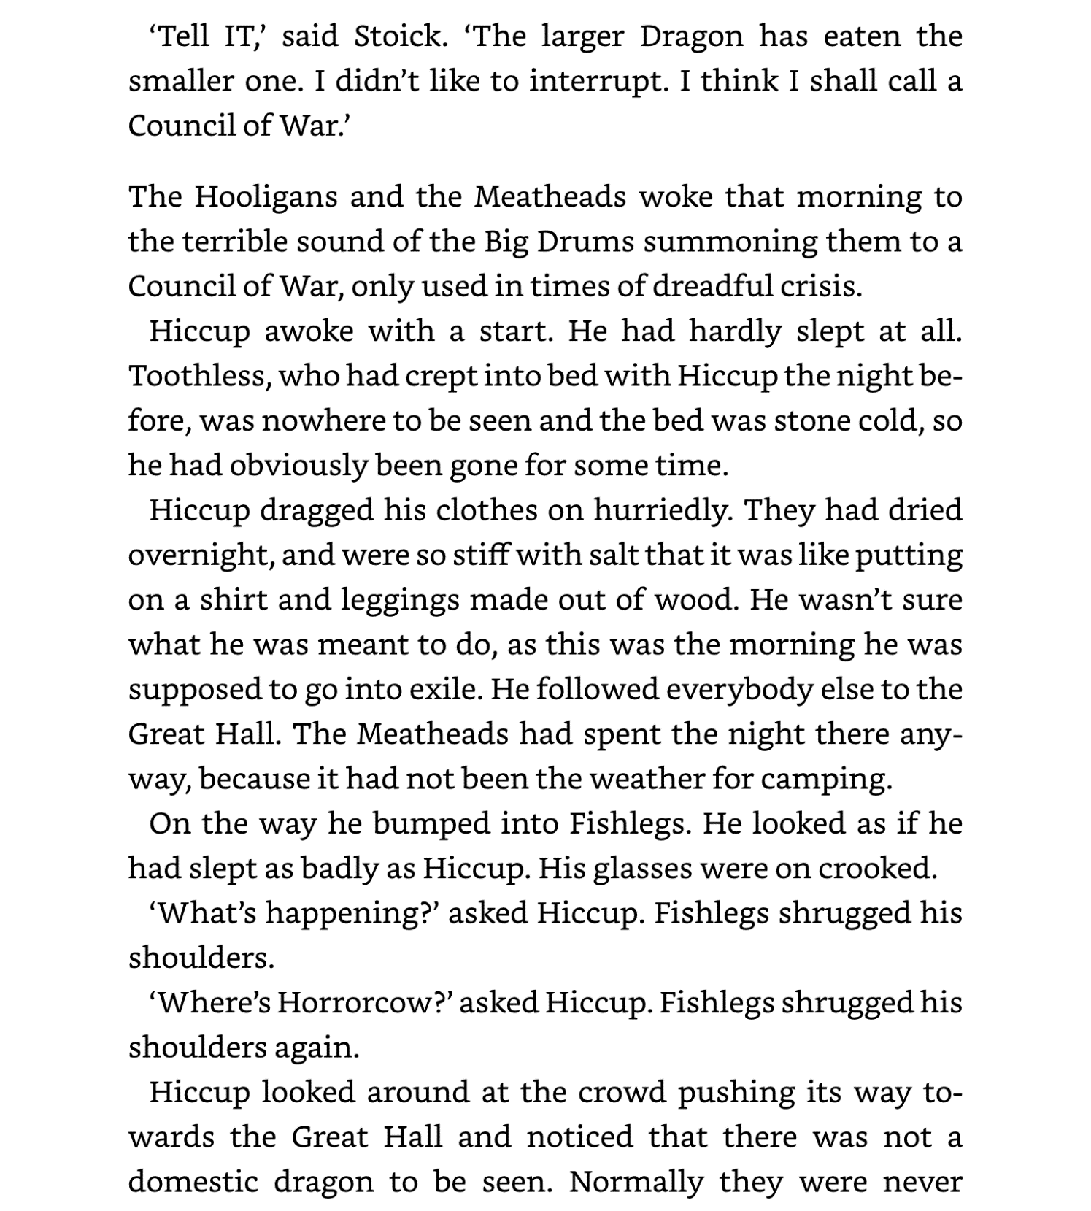

Slide 6
