Slide 1

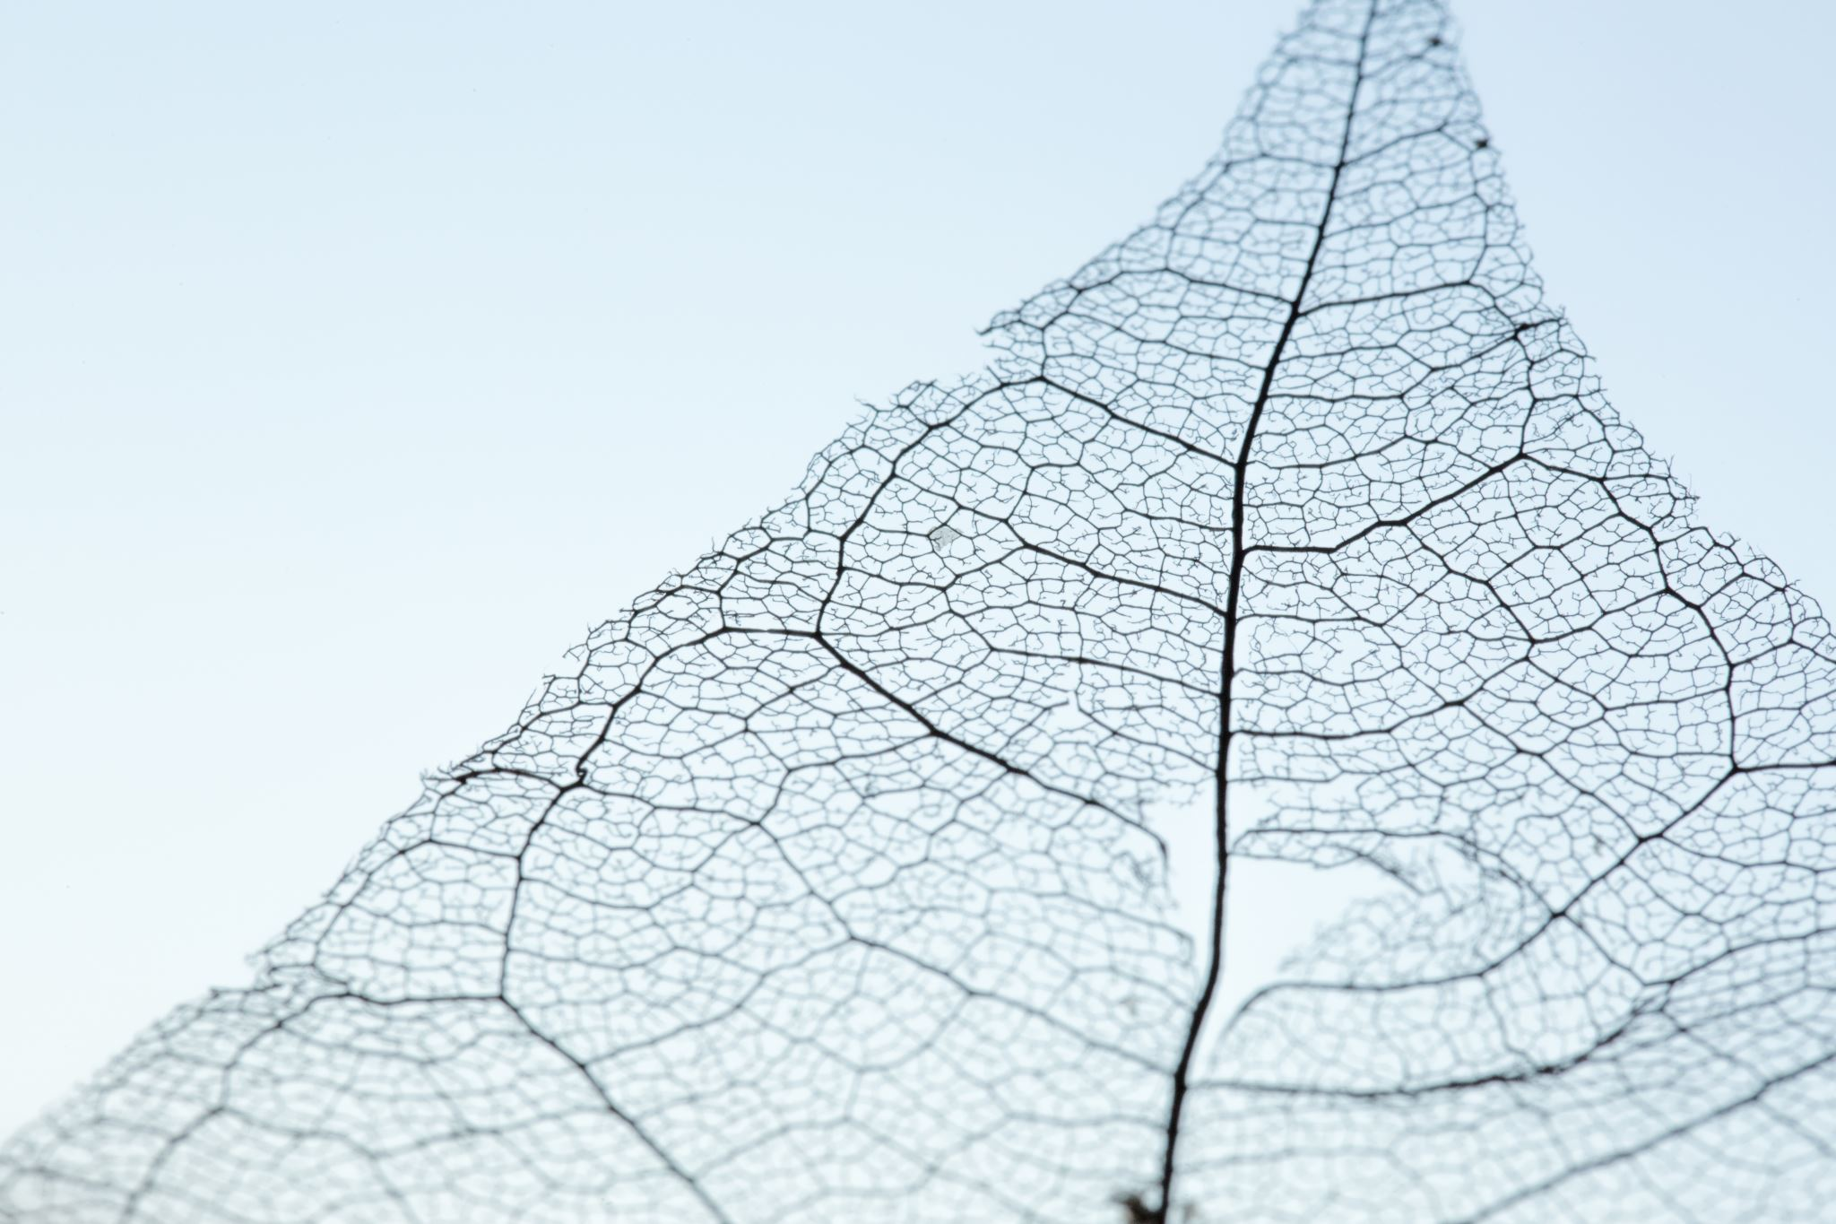


Light
For parents and carers
Thank you for supporting your child’s learning in science.
Before the session:
Please read slide 2 so you know what your child learning and what you need to get ready.
As an alternative to lined paper, slide 5 may be printed for your child to record on.
During the session:
Share the learning intentions on slide 2.
Support your child with the main activities on slides 3 & 4, as needed.
Slide 6 is a further, optional activity.
Slide 7 has a glossary of key terms.
Reviewing with your child:
Slide 8 gives an idea of what your child may produce.
Identify opaque, translucent and
transparent materials
Year 3 / Key Stage 2
Age 7-8

Slide 2


Light
Logo for section to sit inside roundel
Identify opaque, translucent and transparent materials
Key Learning
Shadows are formed on a surface when an opaque or translucent object is between a light source and the surface and blocks some of the light.
Activities (pages 3-5): approx. 30-40 mins
Use lined paper, ruler and pencil.
Alternatively, print page 5 as a worksheet.
Find out more… (page 6): approx. 10 mins
I can…
identify materials that are opaque, translucent or transparent.
2

Slide 3
Explore, review, think, talk….
Logo for section to sit inside roundel
What do you already know about properties of materials?
(10 minutes)
Collect a range of different objects from around your home.
How can you sort them? Can you think of at least 4 different ways to sort them?
You could sort them by:
colour
material used
size
weight
shiny/dull
waterproof
Are there any materials/objects that could be in more than one group?
3

Slide 4
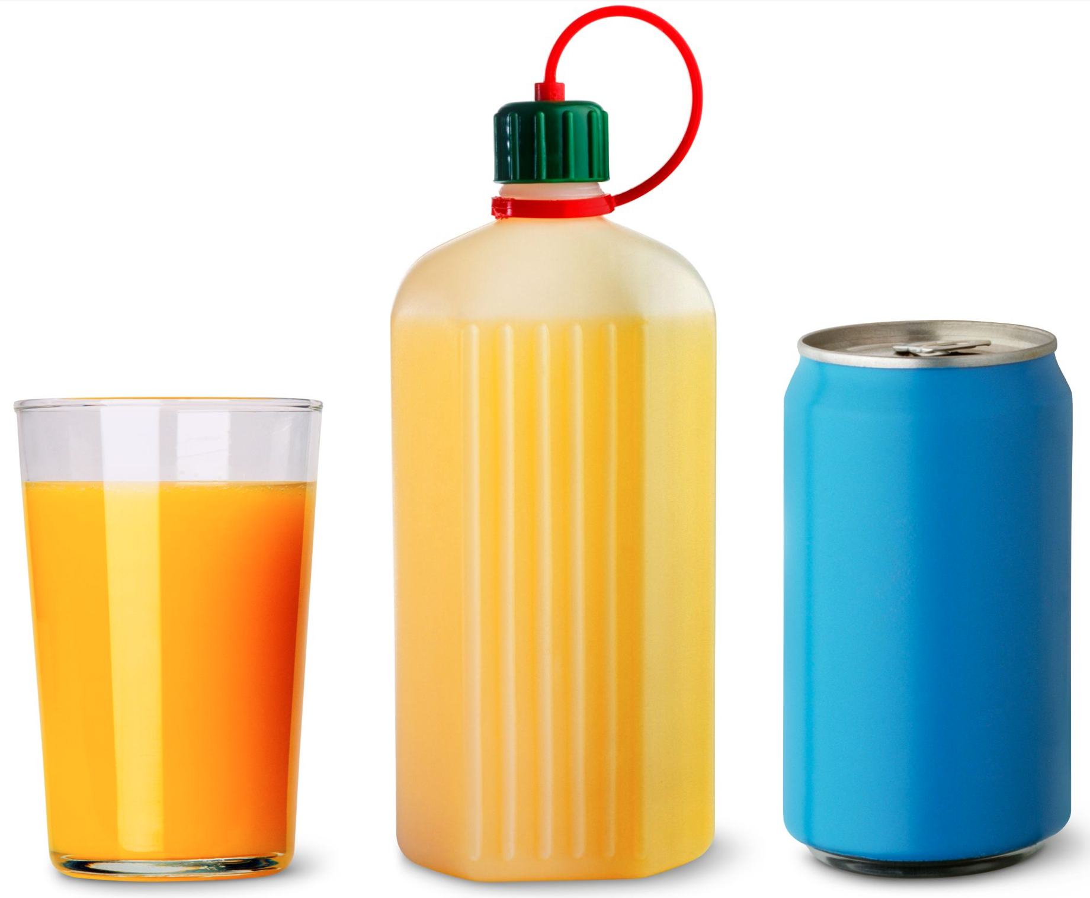
Watch, read, listen…
Logo for section to sit inside roundel
Identifying opaque, translucent and transparent materials
(10 minutes)
Read this article from DK:
https://www.dkfindout.com/uk/science/light/transparent-and-opaque-objects/
Transparent objects, such as glass, allow light to pass through.
Translucent objects, such as a plastic bottle, allow some light to pass through, but not clearly.
Opaque objects, such as a metal can, allow no light to pass through. It is impossible to see what is inside without opening it.
4

Slide 5
Instructions for Activity Ask children to find objects around the home and record whether they are opaque, translucent or transparent.
Learning outcome: I can identify materials that are opaque, translucent or transparent.
Opaque | Translucent | Transparent
5

Slide 6
Find out more…
Logo for section to sit inside roundel
Going further with translucent materials
(10 minutes)
Can you rank them?
Using the translucent materials your found in the activity, which ones are easier to see through?
Now decide on which material is the most translucent and rank all of the materials based on how translucent they are.
Why do you think some materials are more, or less, translucent?
What do you notice when you look through each material?
6

Slide 7
Glossary of terms
bright: If an object is bright it gives out or reflects much light.
dark (scientific): Dark is the absence of light.
dark (everyday): very little amount of light.
dull: If an object is dull it is not shiny or bright.
light: Light is the form of energy that makes it possible for eyes to see.
material: Anything used for building or making something else.
shiny: Reflecting or glowing with light.
surface: The outside limit or top layer of something.
7

Slide 8
Possible learning outcome for reviewing your work: I can explore the need for light to see things
Opaque | Translucent | Transparent
Harry Potter book My desk chair The wall curtains My slippers | Water bottle Ruler Plastic cup Light bulb | Window (glass part) My glasses
8

