Slide 1
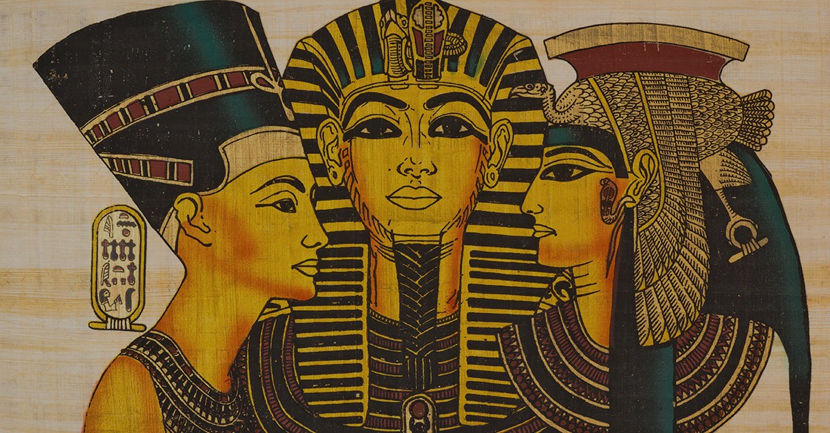
What did the Ancient Egyptians achieve?

Slide 2
What does the word ‘Achievement’ mean?
What were their achievements?
Did they have any impact on today?

Slide 3
Buildings
Built amazing structures like the pyramids without modern technology.
Paper
One of the first civilisations to make paper to write on.
Maths
Developed a system of maths that helped them measure accurately.

Slide 4
Medicine
They knew to keep healthy and learnt lots about the body from dissecting dead bodies.
Calendar
They invented a 365 day calendar system based on when the Nile flooded, giving them seasons.
Writing
One of the first civilisations to have a form of writing, called hieroglyphics. Allowed them to communicate.

Slide 5
Farming
Great at farming which kept the population well fed. Used the River Nile.
Language
Created a language that they could understand and communicate with.
Mummification
Knew how to preserve bodies so that they didn’t decay quickly. Means we know more about them today.

Slide 6
Write the long date: Monday 8th February 2021
Write the title: Can I understand some of the achievements of Ancient Egyptians?
Choose which of the achievements you think is the most important. There is no right or wrong answer, it is what YOU think.
Write it down and say why you think this is the most important.
Draw a picture.
Farming
Great at farming which kept the population well fed. Used the River Nile.
Language
Created a language that they could understand and communicate with.
Mummification
Knew how to preserve bodies so that they didn’t decay quickly. Means we know more about them today.
Writing
One of the first civilisations to have a form of writing, called hieroglyphics. Allowed them to communicate.
Calendar
They invented a 365 day calendar system based on when the Nile flooded, giving them seasons.
Buildings
Built amazing structures like the pyramids without modern technology.
Paper
One of the first civilisations to make paper to write on.
Maths
Developed a system of maths that helped them measure accurately.
Medicine
They knew to keep healthy and learnt lots about the body from dissecting dead bodies.

