Slide 1

Monday 8th February 2021
Can I use exciting vocabulary?
Capital letters and full stops
Perfect spelling (use yellow dictionary)
Beautiful handwriting
Make it even better by:
Adding a simile
Adding a question
Adding an exclamation mark
Adding extra information in brackets

Slide 2
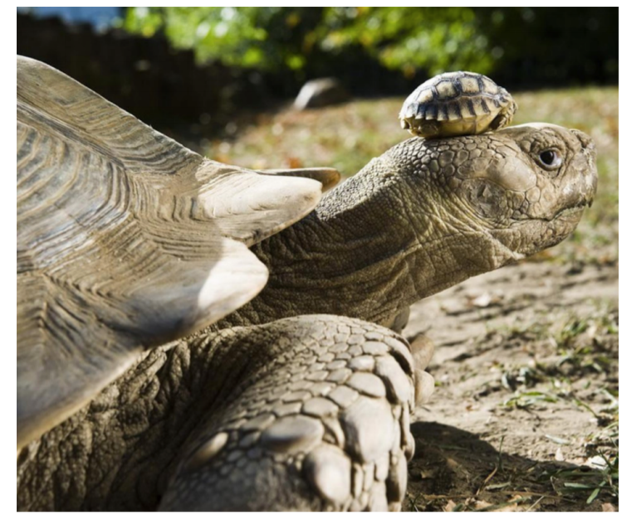
The world is a scary place when you’re a five day old turtle. Staying still, frozen like a statue on top of his mother’s head seemed like the best option. Terry had watched his brothers and sisters wander bravely (but slowly) into the distance. He hadn’t seen them come back. Why on earth would he want to venture out on his own? He was sure that if he perched silently on the top of his mother’s head, she wouldn’t even remember he was there. Terry’s mother had other ideas…

Slide 3
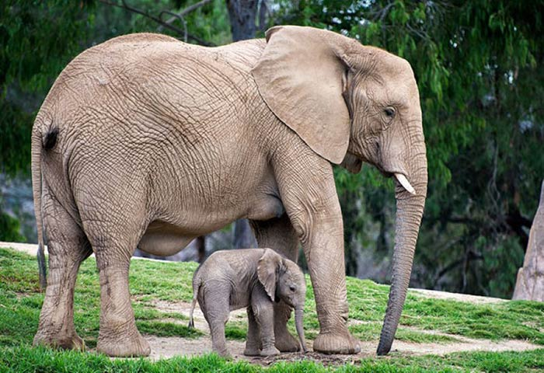
Concealed
(synonym for hidden)
plod
huge
noisily
as big as a double decker bus
clumsily
giant feet
march
Camouflaged
(synonym for hidden)
trumpet trunk
ears flapping

Slide 4
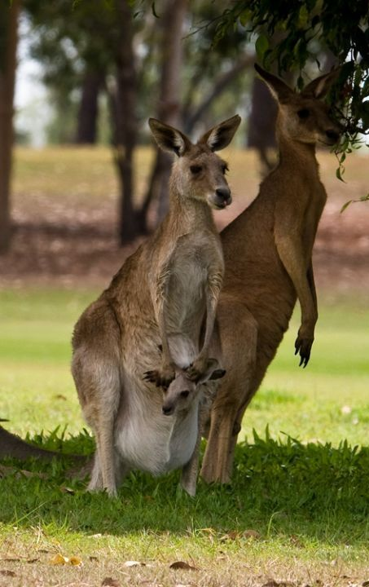
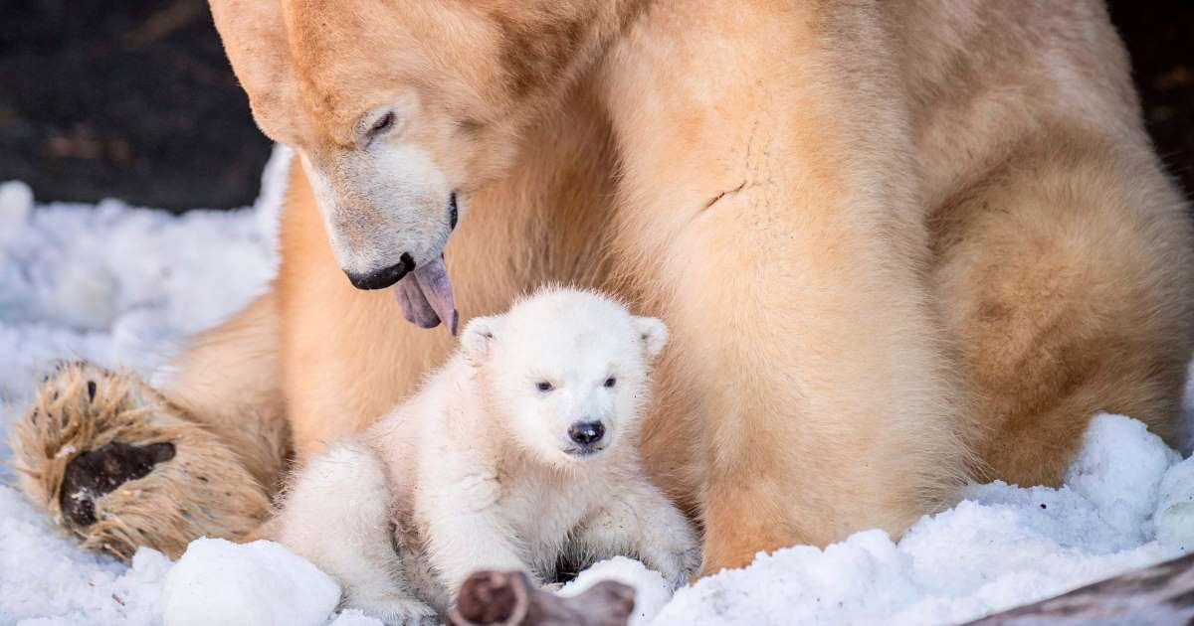
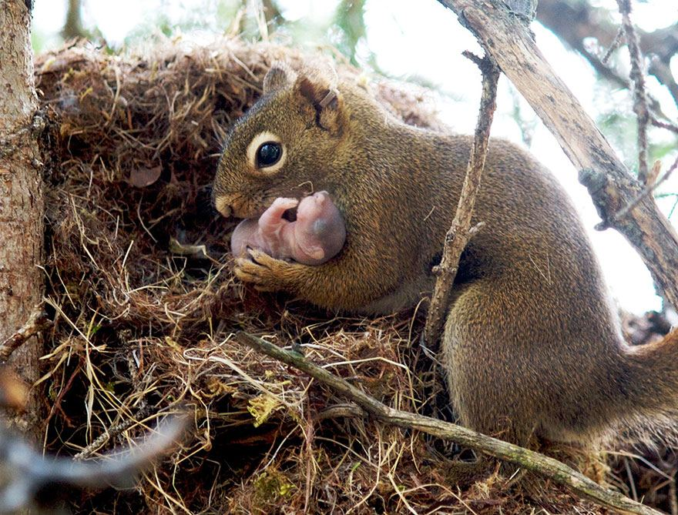
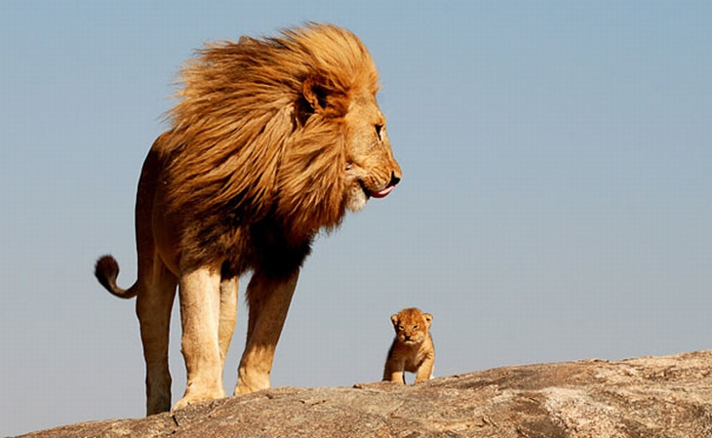
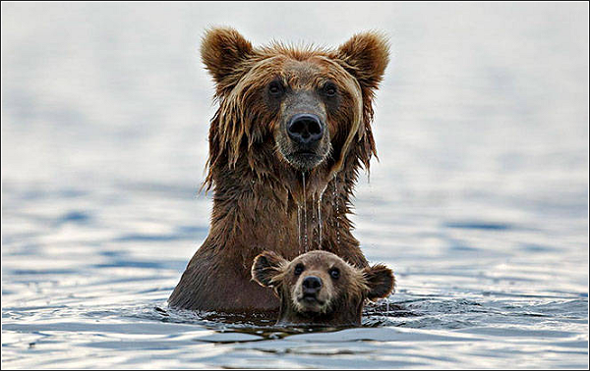
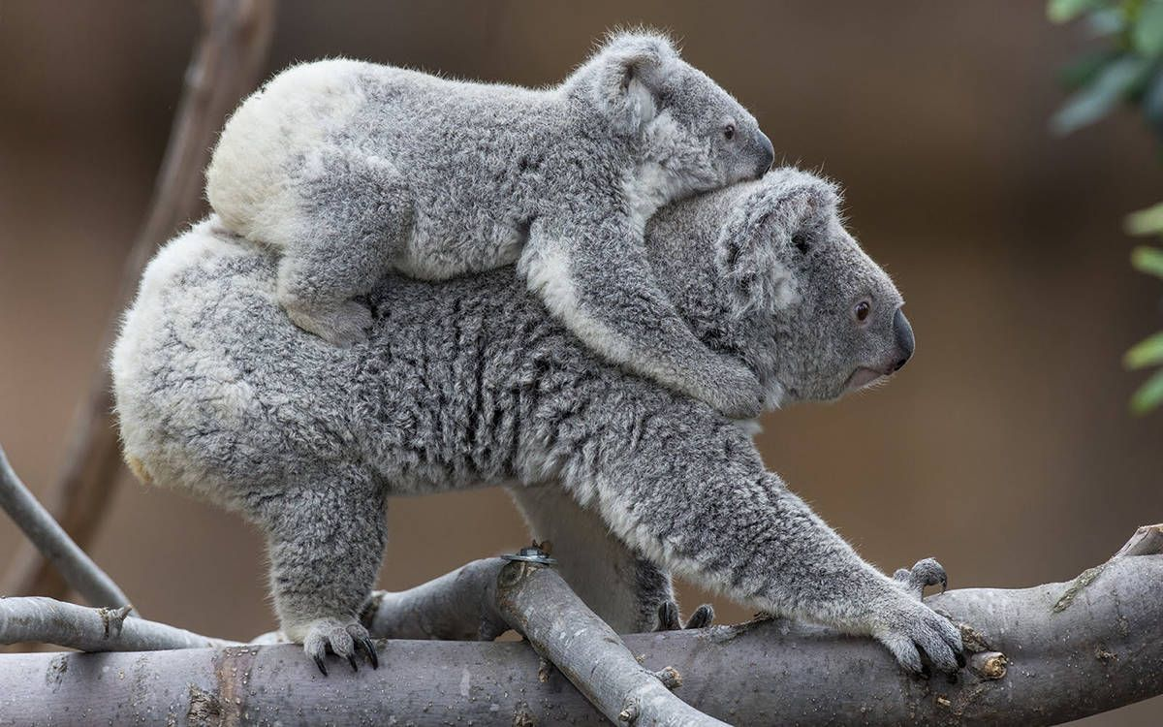
The world is a scary place when you’re a five day old turtle. Staying still, frozen like a statue on top of his mother’s head seemed like the best option.

Slide 5
Terry had watched his brothers and sisters wander bravely (but slowly) into the distance. He hadn’t seen them come back.

Slide 6
Why on earth would he want to venture out on his own?

Slide 7
He was sure that if he perched silently on the top of his mother’s head, she wouldn’t even remember he was there. Terry’s mother had other ideas…

