Slide 1
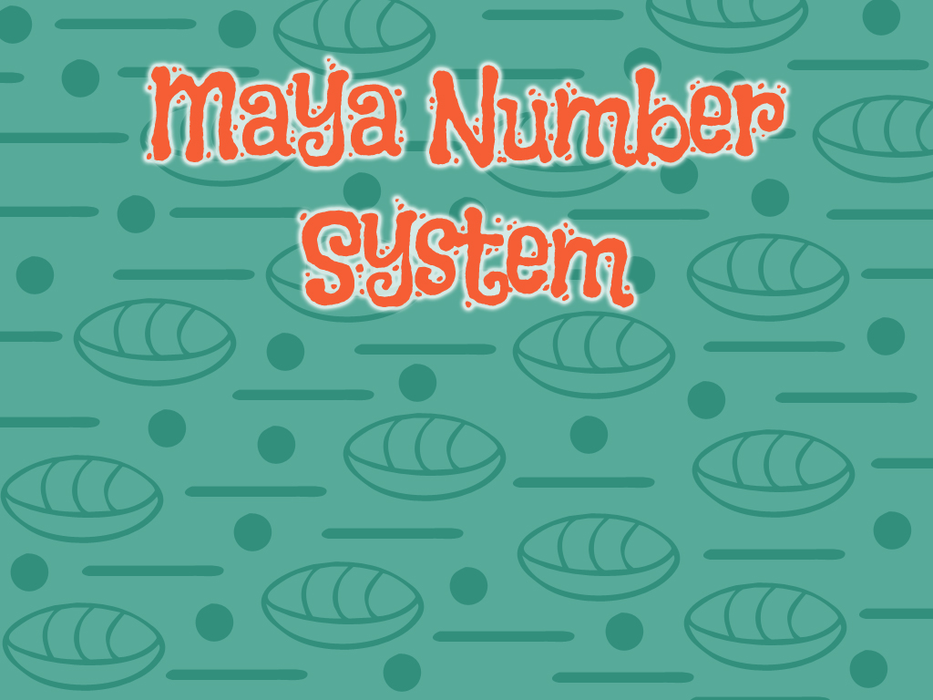
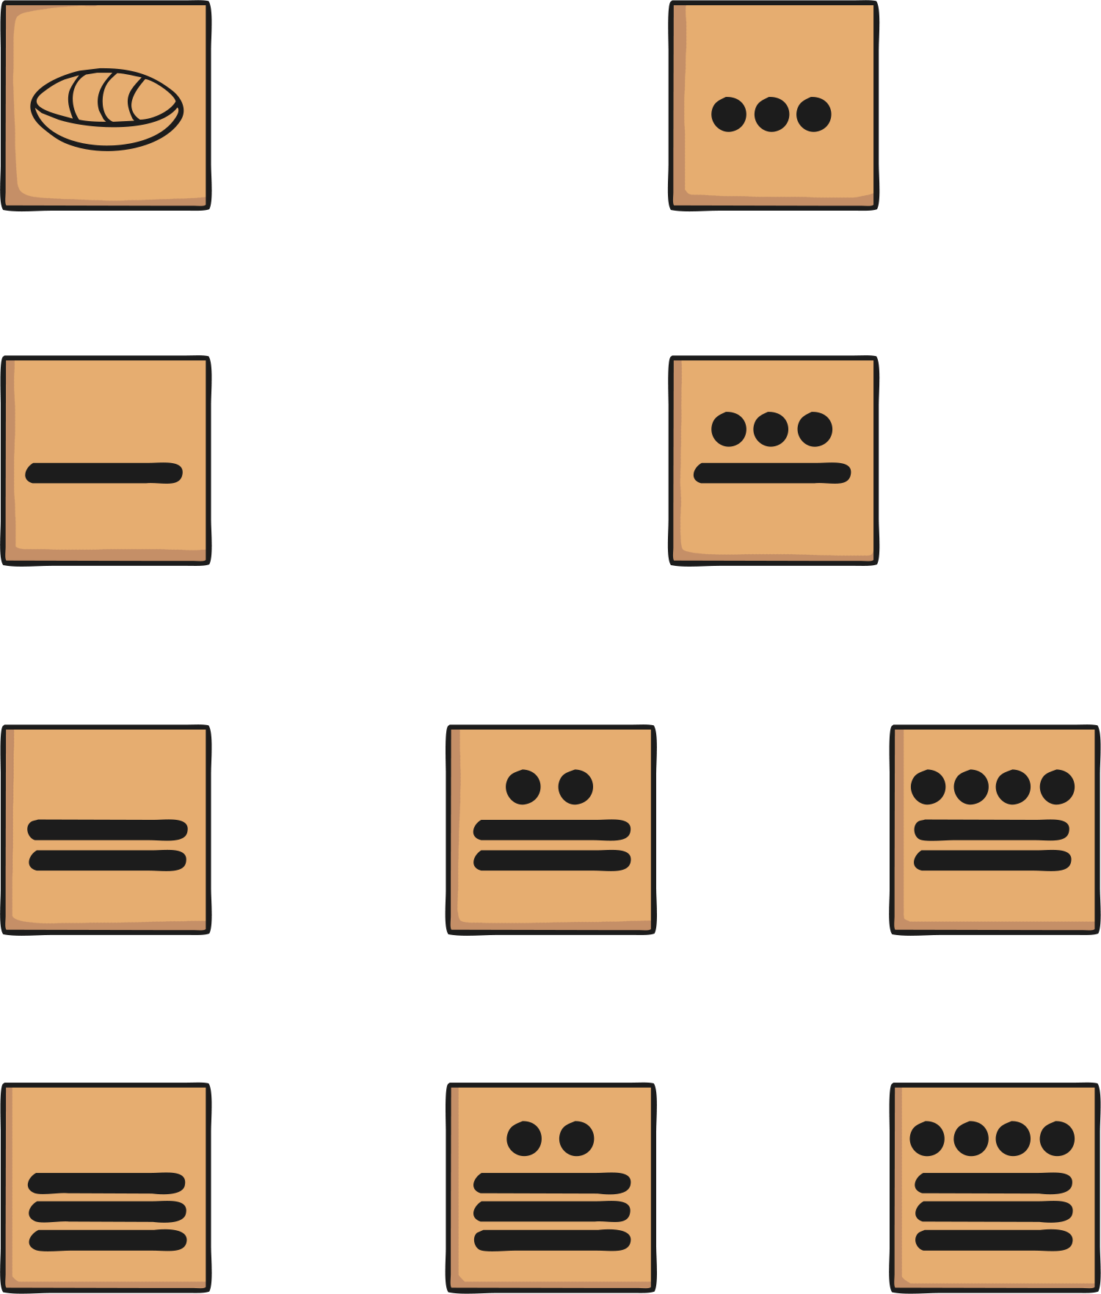


Slide 2
The Maya and Numbers
The Maya had a good understanding of numbers and they developed a complex number and counting system which was advanced for their time.
They were one of only two cultures in the world to develop the concept of zero and this allowed them to develop a place value system where a zero could act as a place holder in large numbers. This enabled the Maya people to distinguish between numbers like 23 and 203, where the placement of the zero determines the value of the digit 2 as 200. This is a very important concept which many civilisations did not understand until much later than the Maya.
The Maya people used symbols to represent their numbers. Let’s have a look at how it worked.

Slide 3

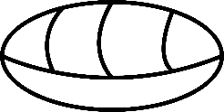
Number Symbols
The Maya people used just three symbols in their number system. These are thought to represent items that the Maya people might have first used to count with such as pebbles, sticks and shells.
With anyone in your house or by yourself, look at the following Maya numbers. Can you work out what numbers the symbols represent and how the system works?
= 7
= 18
= 11
= 20

Slide 4
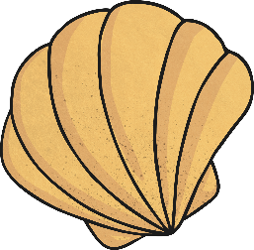
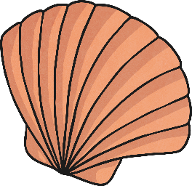
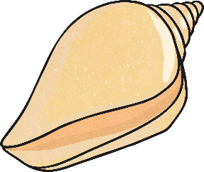
Shells, Sticks and Pebbles
Questions
Did you figure it out?
What have you learnt about the way the numbers are written?
What other Maya numbers can you write?
How is the Maya number system similar and different to our own?
= 0
= 1
= 5

Slide 5
Maya Numbers
1
2
3
4
5
6
7
8
9
10
11
12
13
14
15
16
17
18
19

Slide 6
Maya Numbers
20
21
22
23
24
25
26
27
28
29
30
31
32
33
34
35
36
37
38
39
The Maya people used a base 20 number system, so after number 19 multiples of 20 were written above the bottom number. This is called a vigesimal positional number system.

Slide 7
Working it Out
Here are a couple of examples of how the system works.
= 2 x 20
40 + 8 = 48
= 8
Number of 20s |  | 8 x 20 = 160 | 167
Number of 1s and 5s |  | = 7

Slide 8
Larger Numbers
Using the information you have learnt, can you work out what these larger numbers are?
40
18
200
18
= 58
= 218
320
18
= 338

Slide 9

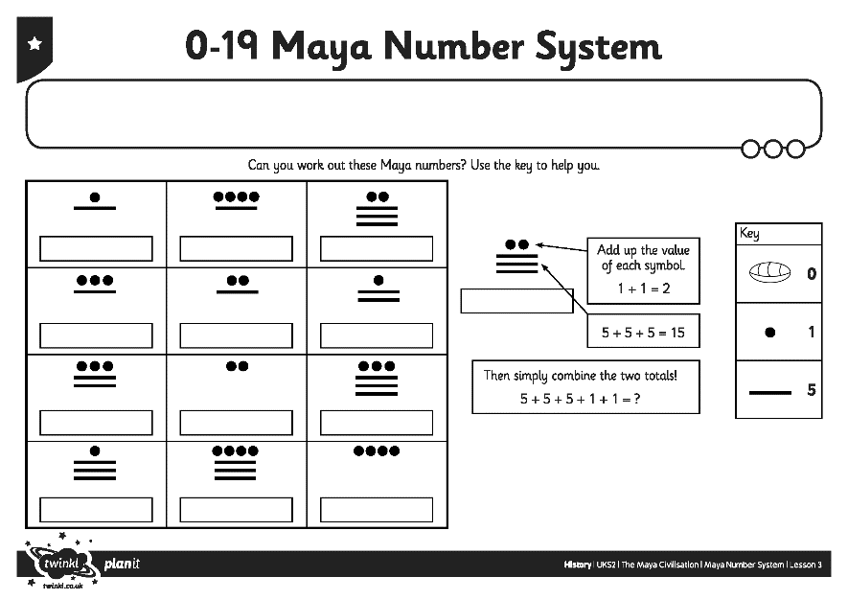
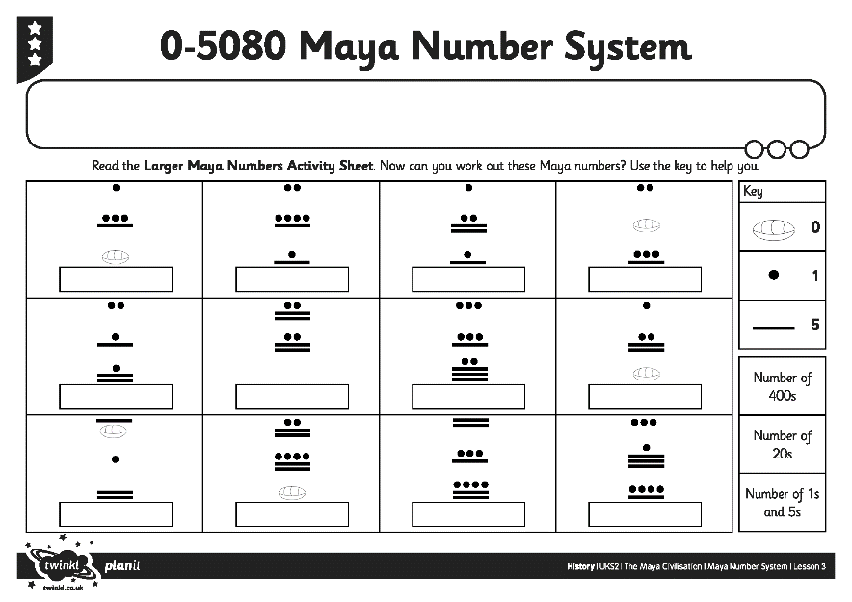
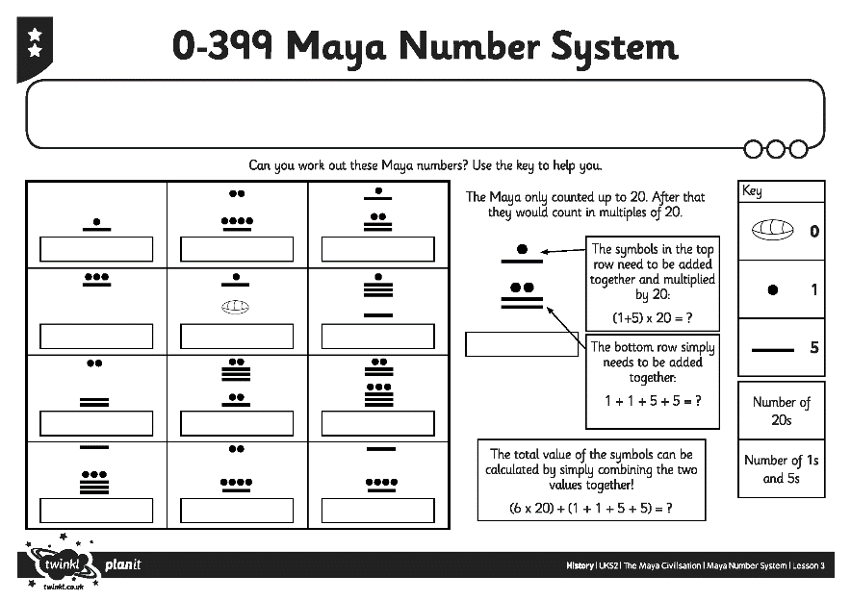
Maya Number System
Activity Sheets
Use the information you have learnt about the Maya number system to help you work out the numbers on the Maya Number System Activity Sheet.

Slide 10
Maya Calculations
Now you know all about Maya numbers are you able to solve this calculation?
Write down the answer and show me. Remember to use the Maya symbols!
+
=
24
Now write 3 calculations of your own and challenge your partner to solve them. The calculations can be addition, subtraction, or a mixture.
Use the numbers from your activity sheet to help you write the calculations then swap with your partner and work out each other’s calculations.
When you have finished, check the answers together.

